Slide 1
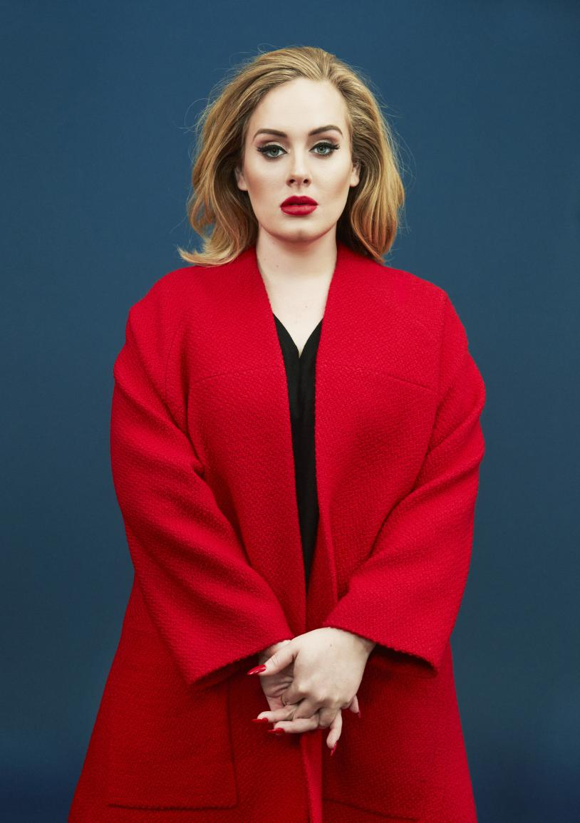
Adele Adkins
This is Adele
C’est Adele
She is 29 years old
Elle a 29 ans.

Slide 2
Adele
She is a singer
She lives in London
Elle habite à Londres.

Slide 3
Awards
She won Grammy Award for album of the year.
She won Grammy Award for song of the year.

Slide 4
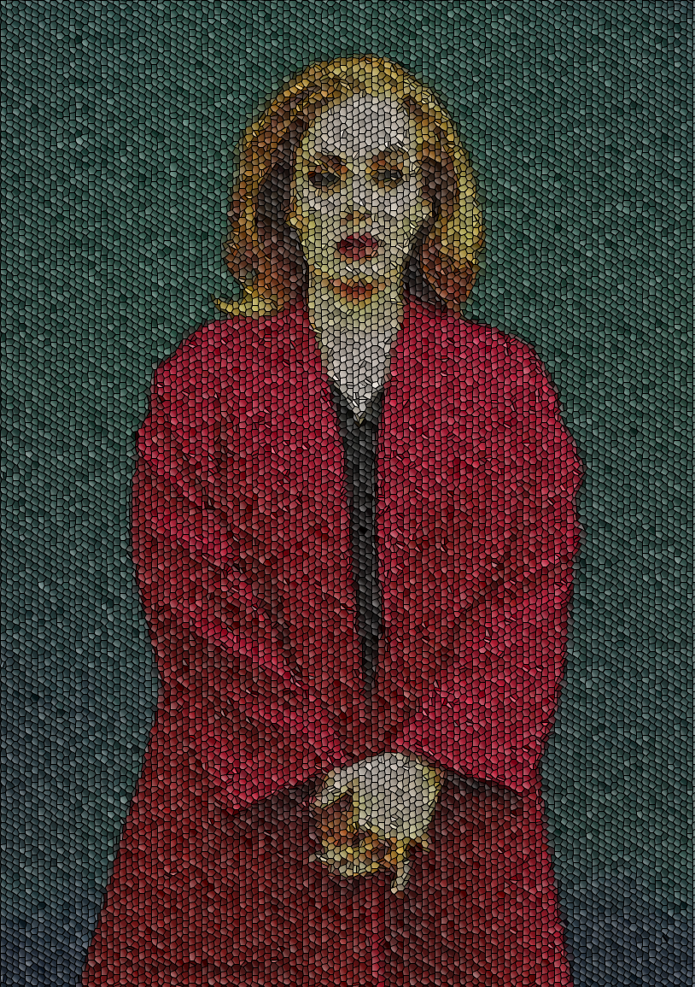
Family
Angelo Adkins (Son)
Penny Adkins (Mum)
Mark Evans (dad)

