Slide 1
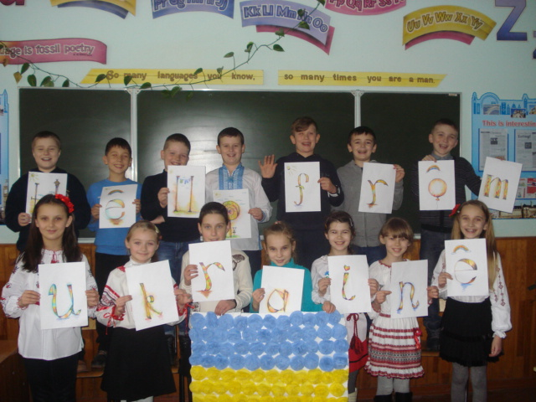
Our Likes
and dislikes

Slide 2
Our favourite subjects
Math
English
Reading
Sport
Art

Slide 3
Boys like Sports

Slide 4
Girls like Sports too

Slide 5
We love animals

Slide 6
We like
Painting
Playing the bandura
Acting
Embroidering
Playing games
Reading

Slide 7
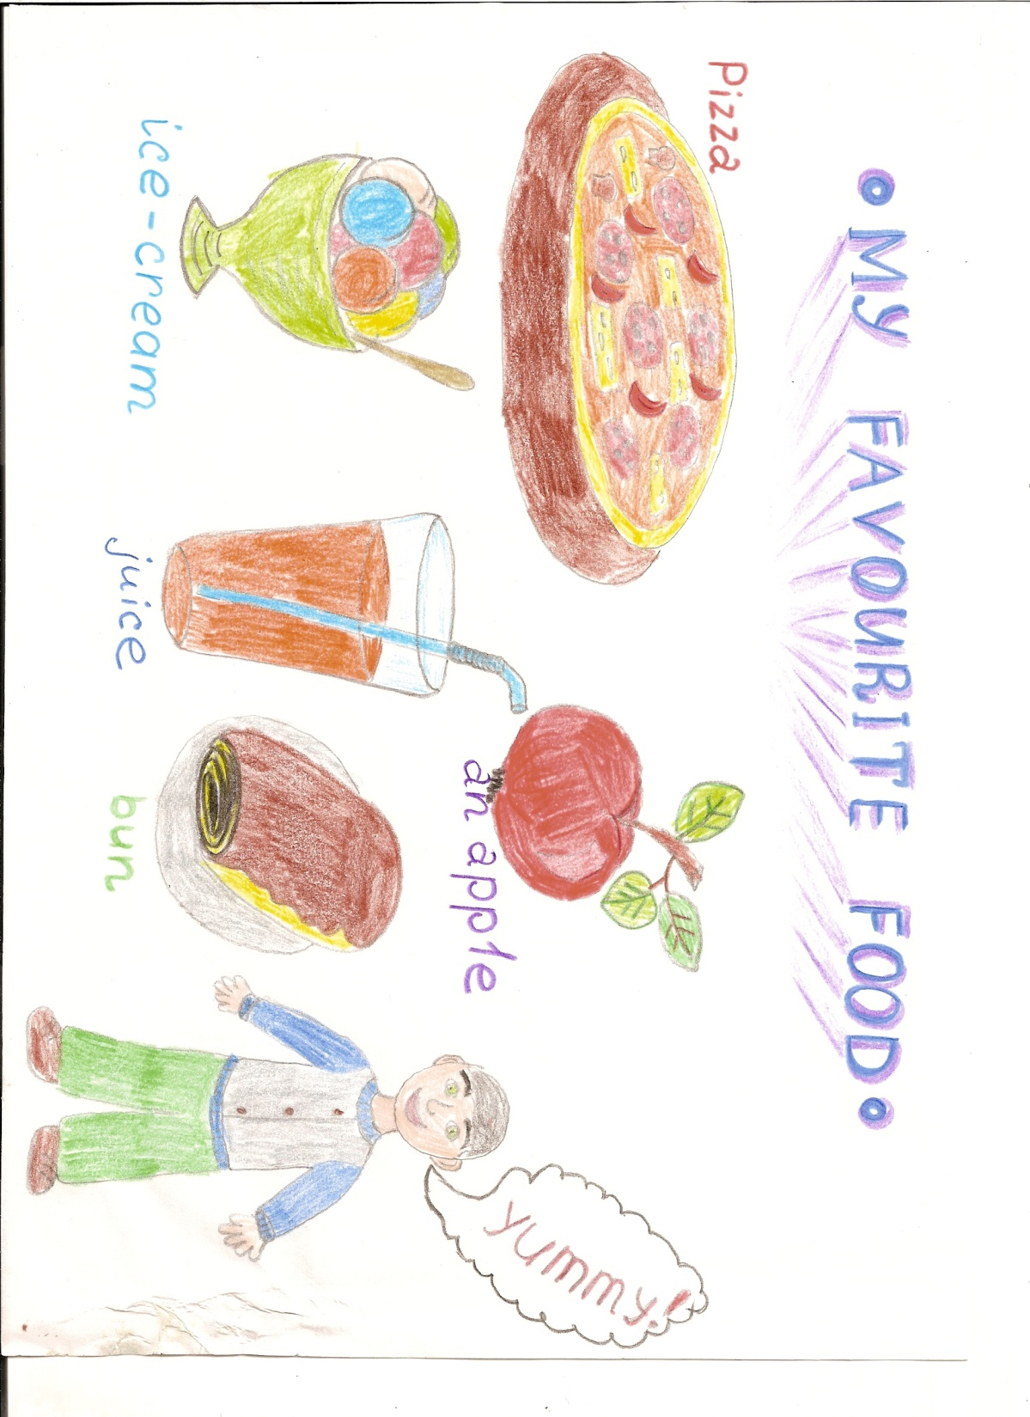
Our favourite food

Slide 8
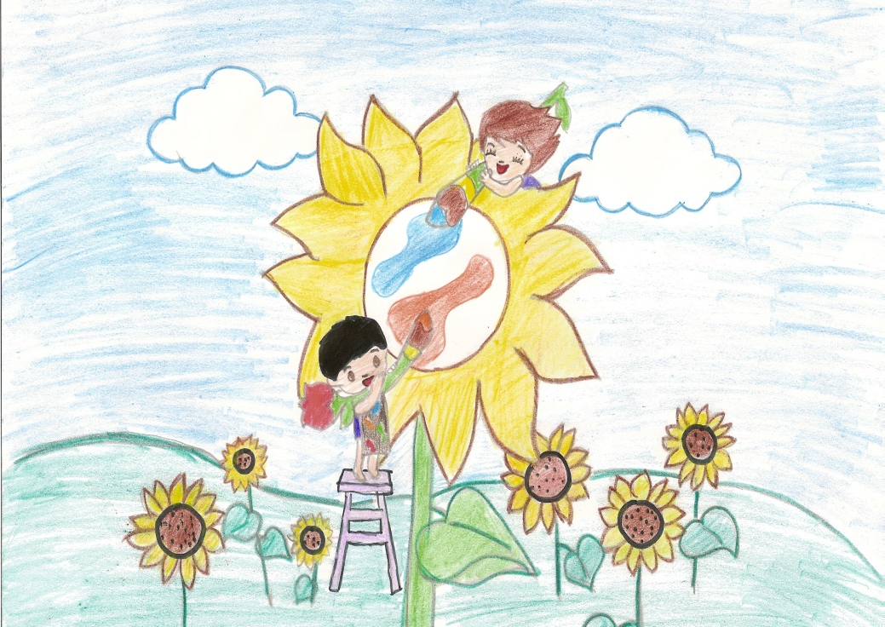
Favourite seasons

Slide 9
We don’t like to… be ill and angry

Slide 10
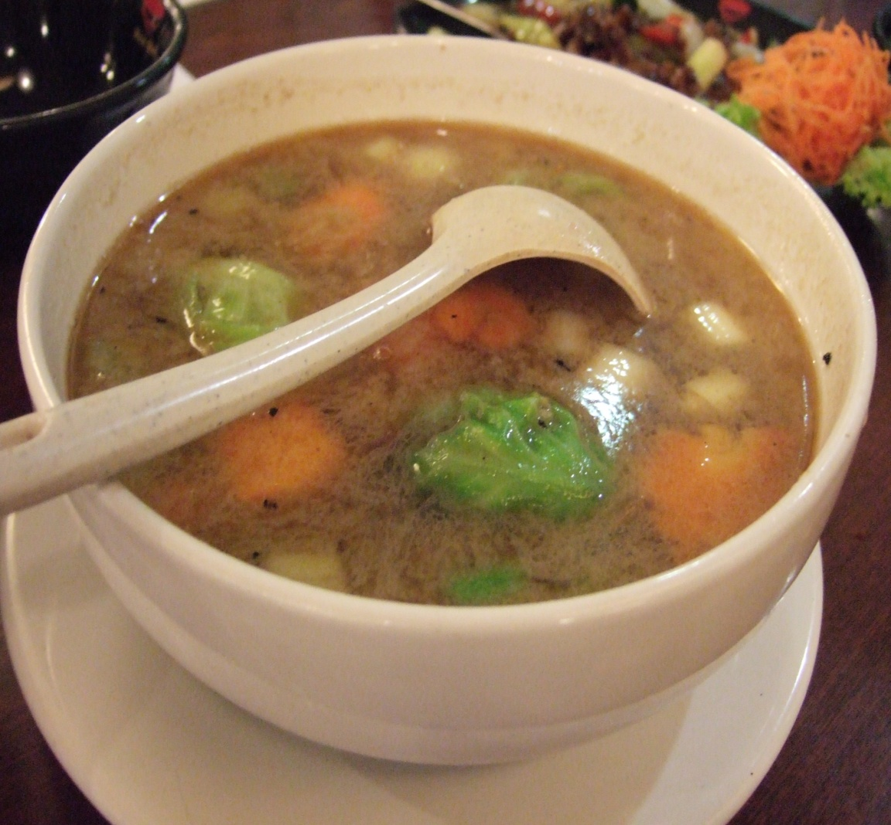
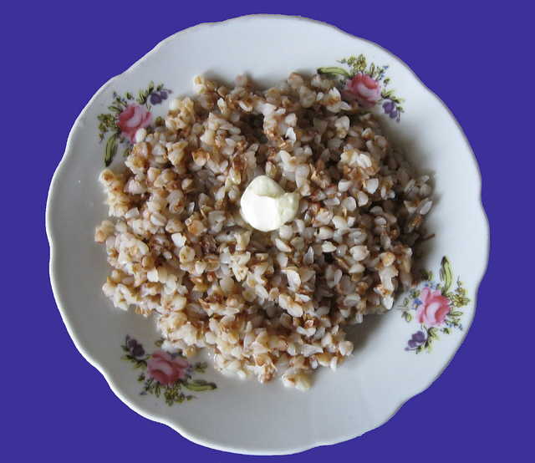
to eat soup and
porridge

Slide 11
EFL friends project

