Slide 1
To know each other
School:
Scoala Gimnaziala Mihai Eminescu
Powered by team
Şcoala Gimnazială Mihai Eminescu Săliştea de Sus

Slide 2
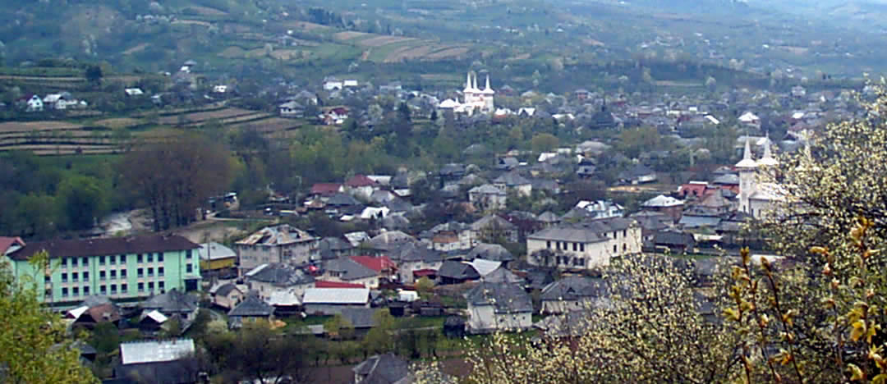
Scoala Gimnaziala Mihai Eminescu
B
A

Slide 3
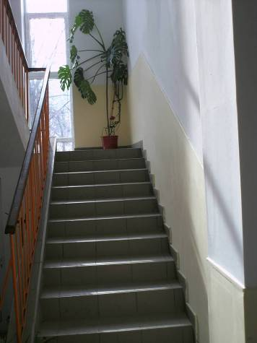
Documentary attestation
The first mention of a local school of 4 noiembrie 1787 have a information for GeorgeBishop Andrew Bacinschi Tokody, senior director of District studies Oradea, which showsthat the county of Maramures "worked well" several schools, including and the UpperSalistea.

Slide 4
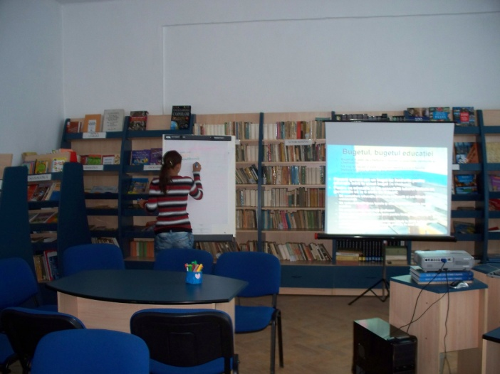
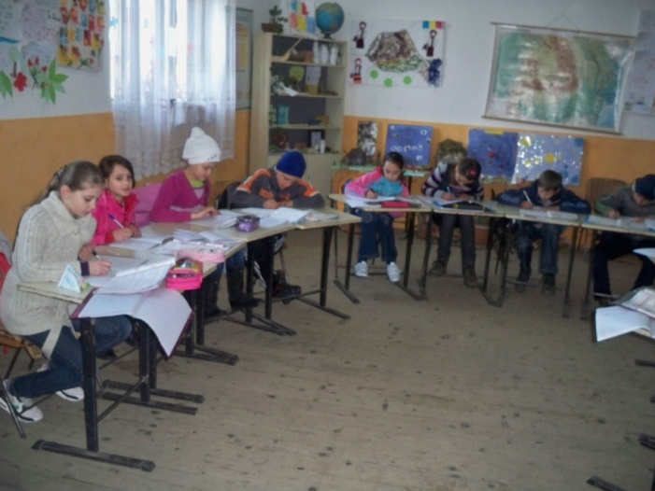
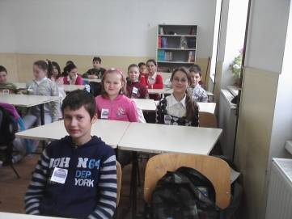
At present
Preschool - 7 groups: 138 children
Elementary school - 10 classes: 195 pupils
Secondary school-9 classes: 209 pupils
Technical high schools - 3 classes: 76 students
There are 37 teachers employed in our school.

Slide 5
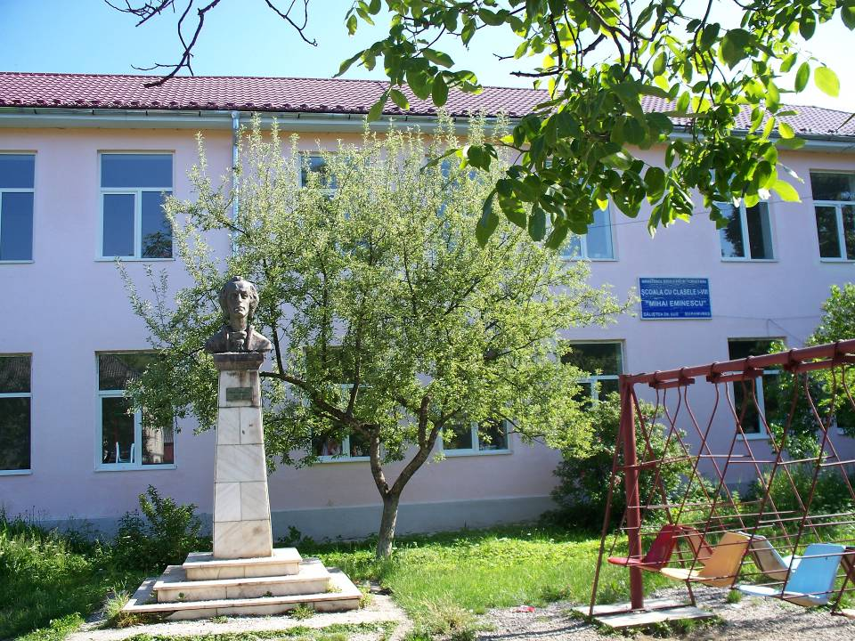
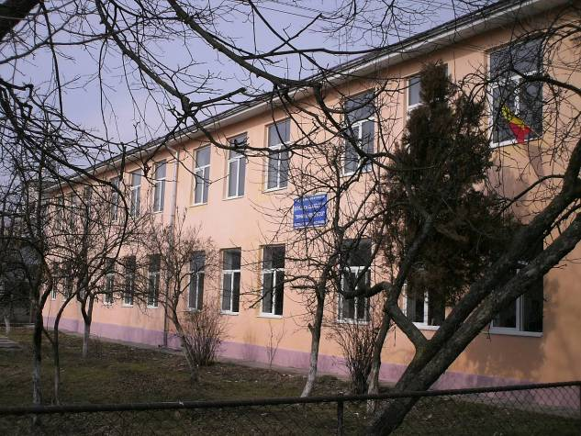
Building A
Spring-Summer-Autumn
Autumn -> Winter

Slide 6
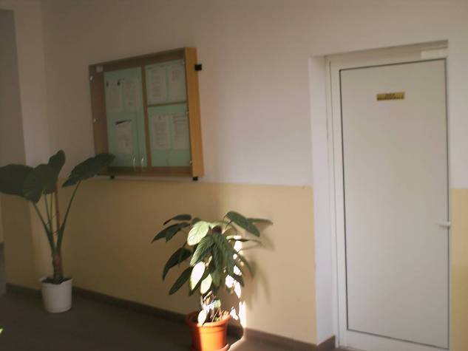
Aspects

Slide 7
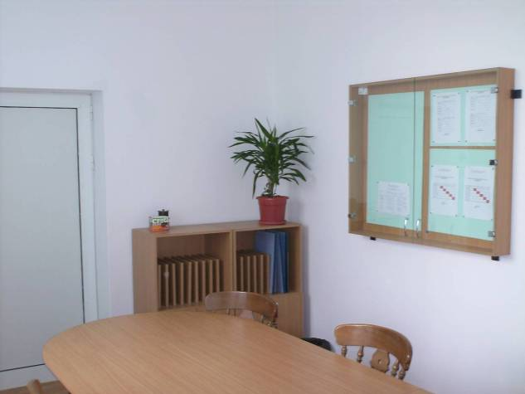

Slide 8
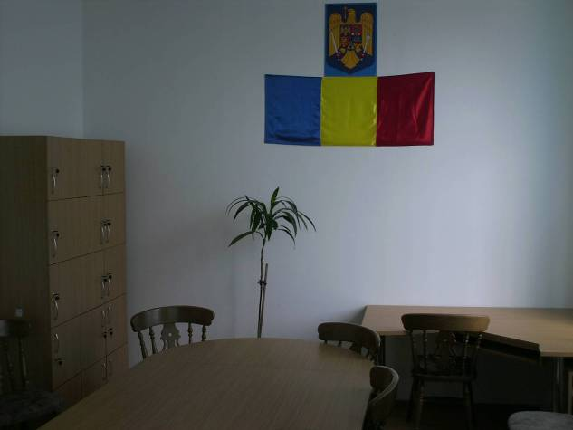

Slide 9
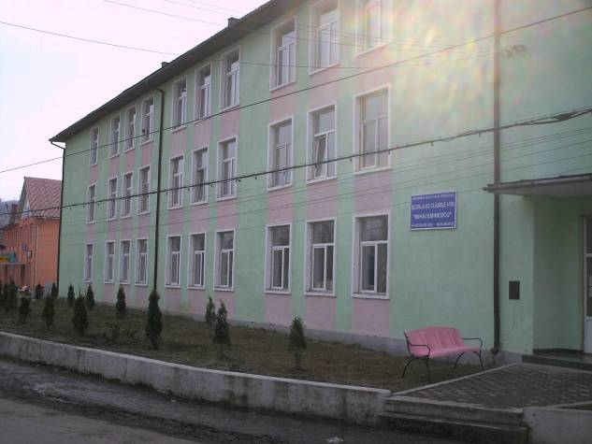
Building B

Slide 10
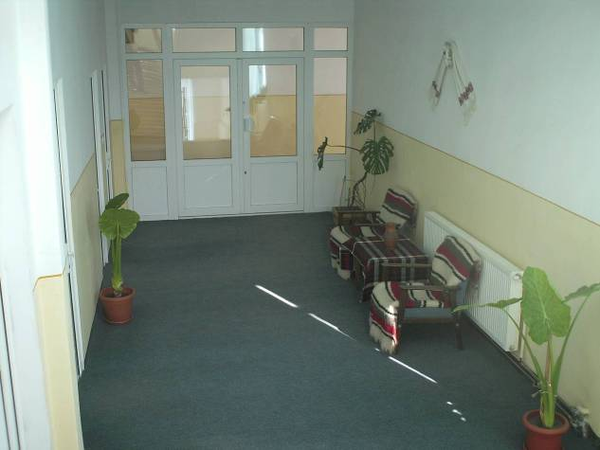
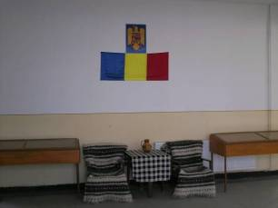

Slide 11
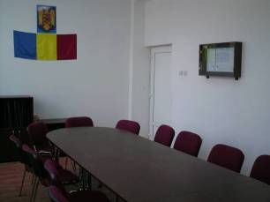
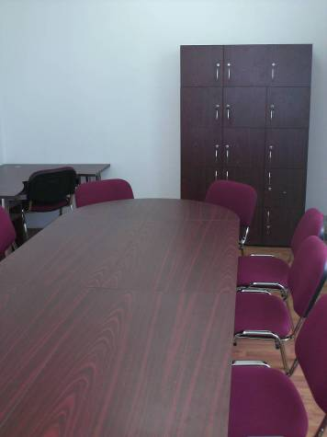
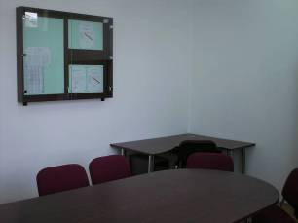

Slide 12
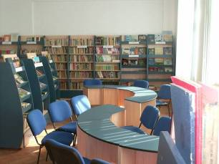
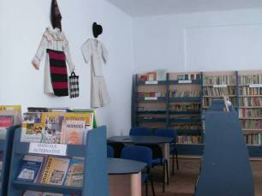
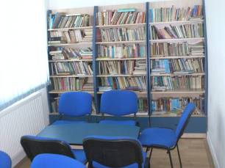
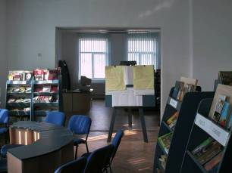
School has an Information and Documentation Centre (Library)

