Slide 1
To know each other
Country: Romania
Powered by team
Şcoala Gimnazială Mihai Eminescu Săliştea de Sus

Slide 2
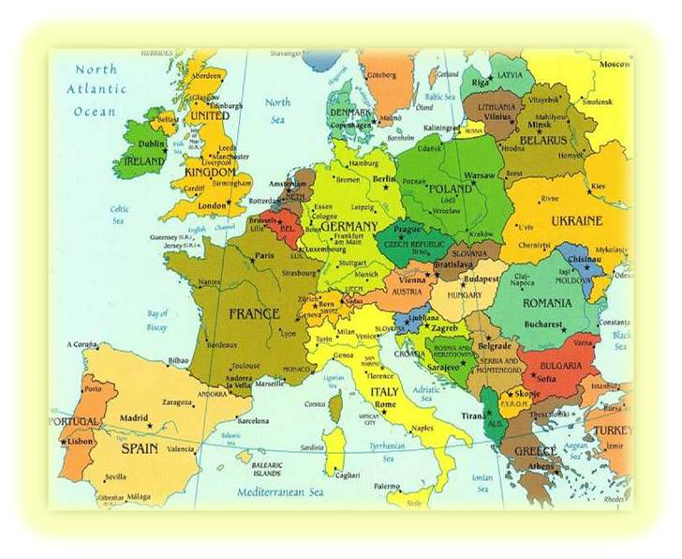
România - europa

Slide 3
Romania - 1
Official name: ROMANIA
Form of government: Republic
LOCATION: State located in southern Europe, north of the Balkan Peninsula, in the lower Danube, bordering the Black Sea, the? `` Carpathian Mountains Backbone `` (South East Carpathians);
Area: 238,391 sq km (11 in Europe and 79 worldwide)
Borders: 3175.1 km, including 1036.7 2138.4 km and km of river and sea land. Romania is bordered by Ukraine and Moldova to the north and east, the Black Sea SE, S Bulgaria, Yugoslavia and Hungary at the V & SV NV.
Population: 22,607,620 inhabitants (the July 1, 1996).
Administrative divisions: 41 counties , 262 cities, 2,686 towns, 13,285 villages.
The share capital of Bucharest.
Official language: Romanian (mother tongue >89% of the population)

Slide 4
Presentation Romania - 2
National Day: December 1
National anthem: Awake Roman
National Flag: three equal bands, vertically arranged red, yellow and blue
Official time: Eastern European Time (GMT + 2:00)
Currency: 1 leu (plural lei) = 100 bani
Denominations: Orthodox: 86.6%, Roman Catholic 5%, 3.5% Reformed, Greek Catholics 1%, Pentecostal 1%, 0.5% Baptist, others are Muslims, Jews, etc.
Nature: Romania is a country of the Carpathians and the Danube, bordering the Black Sea. With a varied and harmoniously distributed landscape (31% mountains, hills and plateaus 33%, 36% plains).
Climate: temperate - continental, with external influences (Ocean, Baltic Sea, the Black Sea, etc.)
Wildlife: It is rich and varied, exciting hunting by deer, bears, foxes, wild boars, rare species: pelicans, otters, chamois, lynx, grouse, are put under the protection of the law.

Slide 5
Tourism:
Romania has all the natural conditions to become one of the most important tourist destinations in Europe. The areas are the most sought Black Sea, Bucharest, Prahova Valley (Sinaia, Busteni, Azuga Predeal) Monasteries of Moldavia, wooden churches of Maramures, Danube Delta, medieval towns, spas, etc. numerous caves.

Slide 6
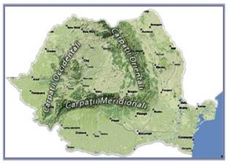
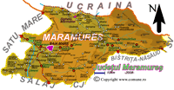
Maramureş

