Slide 2
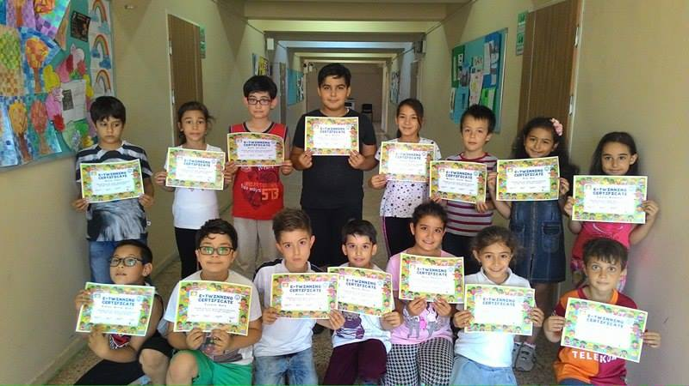
THE STUDENTS THAT TOOK PART IN THE ETWINNING PROJECT WERE GIVEN CERTIFICATES FOR PARTICIPATION IN THE PROJECT

Slide 3
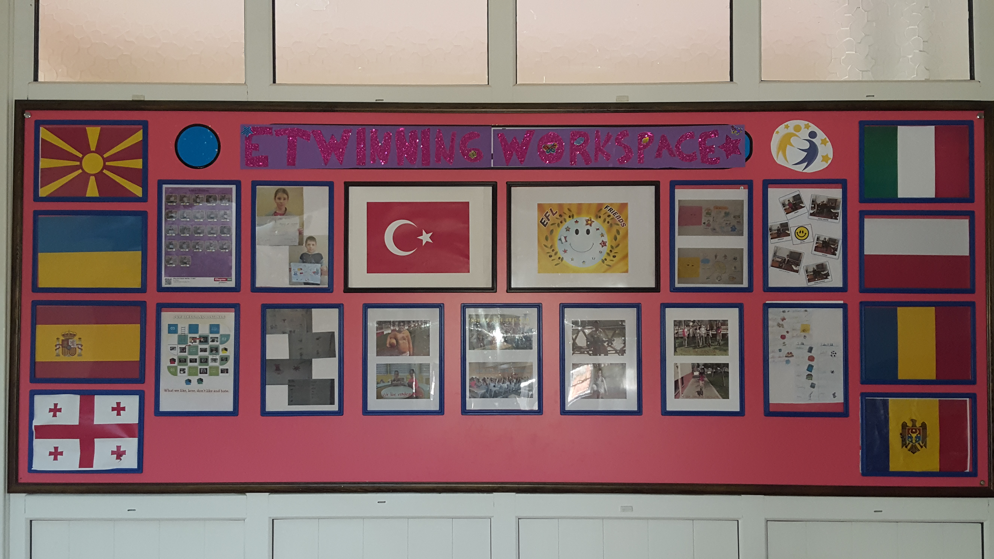

Slide 4
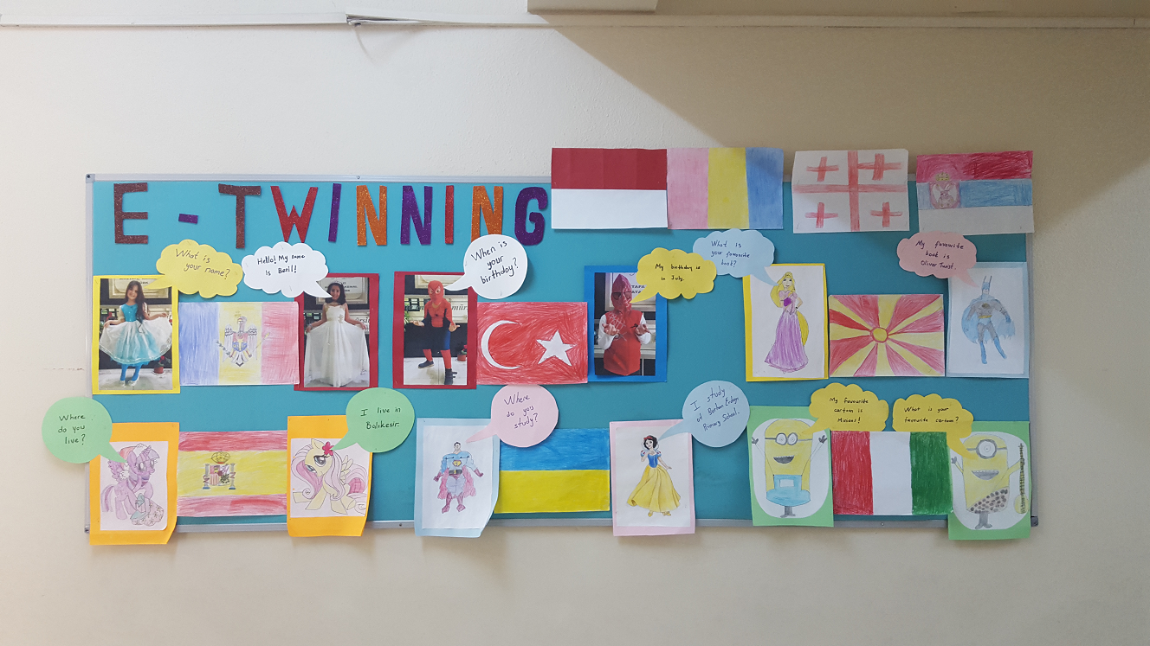

Slide 5
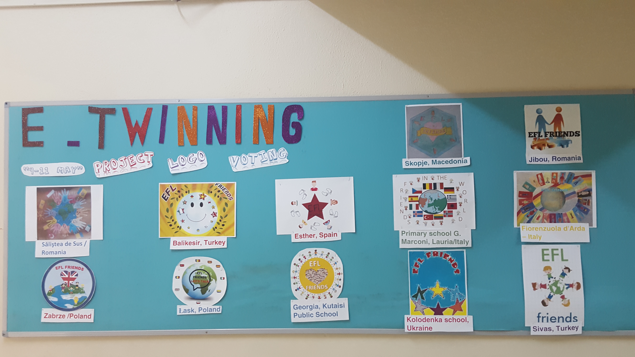

Slide 6
