Slide 1
Financial Skills for an Active Citizenship
Prilep,
16-20 October, 2019
Hungarian Evaluation

Slide 2
DU 1&2

Slide 3
DU 1&2 Number of students: 34(3 groups) Age: 13,14, 15

Slide 4
Levels OECD PISA | Score range | Number of students(Diósd) | Percentage(Diósd) | Total number of students taking part
1 | 0-6 | 1 | 3% | 34
2 | 7-8 | 2 | 6%
3 | 9-10 | 6 | 18%
4 | 11-12 | 6 | 18%
5 | 13-17 | 19 | 55%

Slide 5
Level 1 3% of the students (0-6 points, 1 student)
Students can identify common financial products and terms and interpret information relating to basic financial concepts. They can recognise the difference between needs and wants and can make simple decisions on everyday spending. They can recognise the purpose of everyday financial documents such as an invoice and apply single and basic numerical operations (addition, subtraction or multiplication) in financial contexts that they are likely to have experienced personally.

Slide 6
Level 2 6% of our students (7-8 points, 2 students)
Students begin to apply their knowledge of common financial products and commonly used financial terms and concepts. They can use given information to make financial decisions in contexts that are immediately relevant to them. They can recognise the value of a simple budget and can interpret prominent features of everyday financial documents. They can apply single basic numerical operations, including division, to answer financial questions. They show an understanding of the relationships between different financial elements, such as the amount of use and the costs incurred.

Slide 7
Level 3 18% of our students (9-10 points, 6 students)
Students can apply their understanding of commonly used financial concepts, terms and products to situations that are relevant to them. They begin to consider the consequences of financial decisions and they can make simple financial plans in familiar contexts. They can make straightforward interpretations of a range of financial documents and can apply a range of basic numerical operations, including calculating percentages. They can choose the numerical operations needed to solve routine problems in relatively common financial literacy contexts, such as budget calculations

Slide 8
Level 4 18% of our students (11-12 points, 6 students)
Students can apply their understanding of less common financial concepts and terms to contexts that will be relevant to them as they move towards adulthood, such as bank account management and compound interest in saving products. They can interpret and evaluate a range of detailed financial documents, such as bank statements, and explain the functions of less commonly used financial products. They can make financial decisions taking into account longer-term consequences, such as understanding the overall cost implication of paying back a loan over a longer period, and they can solve routine problems in less common financial contexts.

Slide 9
Level 5 55% of our students (13-17 points, 19 students)
Students can apply their understanding of a wide range of financial terms and concepts to contexts that may only become relevant to their lives in the long term. They can analyse complex financial products and can take into account features of financial documents that are significant but unstated or not immediately evident, such as transaction costs. They can work with a high level of accuracy and solve non-routine financial problems, and they can describe the potential outcomes of financial decisions, showing an understanding of the wider financial landscape, such as income tax.

Slide 10
Levels and indicators
1 st DU | LEVEL 1 |  | LEVEL 2 |  | LEVEL 3 |  | LEVEL 4 |  |  |  | LEVEL 5
 | Q 1 | Q 2 | Q 3 | Q 4 | Q 5a | Q 5b |  |  |  |  | Q 6
correct answers/Sts | 34 | 28 | 32 | 27 | 32 | 30 |  |  |  |  | 20
2 nd DU | Q 1 |  | Q 2 |  | Q 3 | Q 4 | Q 5 | Q 6 | Q 7 | Q 8 | Q 9 | Q 10
correct answers/Sts | 27 |  | 24 |  | 32 | 24 | 15 | 29 | 30 | 24 | 29 | 26
 | COMMENT |  | COMMENT |  | COMMENT |  | COMMENT |  |  |  | COMMENT
 | Indicators for Questions (from Level 1) Students can: - apply single and basic numerical operations in financial contexts - identify a common financial products, terms, concepts |  | Indicators for Questions (from Level 2) Students can: -apply single and basic numerical operations in financial contexts - recognise and interpret prominent features of everyday financial documents |  | Indicators for Questions (from Level 3) Students can: - make straight forward interpretation of a range of financial documents - apply a range of basic numerical operations - recognize some information relating to biz document such as a job offer |  | Indicators for Questions (from Level 4) Students can: - recognize some information relating to biz document such as a job offer |  |  |  | Indicators for Questions (from Level 5) Students can: -use given information to make simple financial decisions - can recognize information useful to choose competences relevant for them as they move towards work life

Slide 11
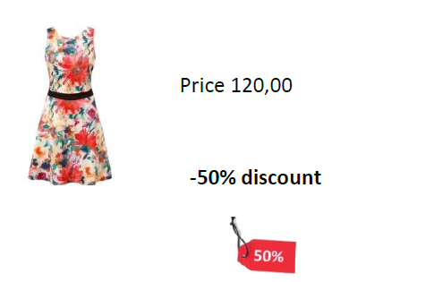
How much is this dress with 50% discount? The best, 100%

Slide 12
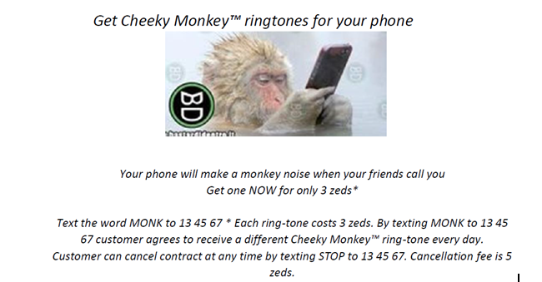
One of the hardest questions: Colin has 30 zeds credit on his phone. He texts the word MONK to 13 45 67. Colin does not use his phone again to make calls or send texts. He does not add any more credit. How much credit will Colin have on his phone exactly one week later?

Slide 13
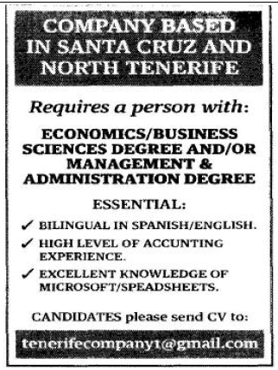
Another hard question: Does the offer indicate which company is it?

Slide 14
The most confusing: What training should the interested party have?

Slide 15
DU 3 & 4

Slide 16
DU 3&4 Number of students: 66(3 age groups) Age: 13,14, 15

Slide 17
Levels OECD PISA | Score range | Number of students(Diósd) | Percentage(Diósd) | Total number of students taking part
1 | 0-12 | 22 | 34% | 66
2 | 13-15 | 8 | 12%
3 | 16-18 | 7 | 11%
4 | 19-21 | 12 | 19%
5 | 22-28 | 16 | 24%

Slide 18
Other facts
Only one 28/28 answer! (66 students)
Many unknown terms, reading and understanding problems
To fill in it needed 2 lessons with a financial expert from a bank before
Too many students to evaluate, so we chose 20 students, from each age level 6+6+8(13, 14, 15 years old)

Slide 19
Suppose you owe $ 1.000,00 on a loan and the interest rate you are charged is 20% per year compounded annually. If you didn't pay anything off, at this interest rate, how many years would it take for the amount you owe to double?

Slide 20
Topics
At different levels, students had to interpret an invoice, the terms: tax, including and excluding tax, the similarity between postage and delivery and identify a delivery cost in an invoice for clothing. It asks a specific question, and the relevant information is explicitly stated. To answer this question correctly, students need to identify the relevant information, understanding that postage refers to the delivery charge. While calculations are not required, students are required to identify numerical information: the cost of postage.
They also interpreted graphs and calculated shares.
Pay slip- net and gross salary- Identify financial information on a pay slip. Students need to understand the difference between gross and net pay, that is, the difference between pay before and after any deductions have been made (such as deductions for health care or tax).
How to secure the account data- evaluate financial issues about the financial landscape by focusing on potential fraud. Students should demonstrate that they know how to take appropriate precautions by recognizing what can be considered good advice in case they receive a financial scam e-mail message. Numeric operations are not required.
To interpret a car insurance policy and which are the factors that influence the insurance which has to be paid, understand that the higher their risk exposure is with regards to measurable criteria, the more it will cost them to buy appropriate insurance. This question falls under the content area of risk and reward. Students need to be able to identify factors likely to affect the cost of motorbike insurance under given circumstances

Slide 21
Other topics to be discussed
• Calculations with interest rate
• Inflation
• Mortgage and loan
• Terms to be identified: IBAN, red number and interest
• Virtual currency
• To get to know about pension plans
• What is to invest in shares
• Different types of insurance: credit, liability, accident, and health
• Stock market

Slide 22
3rd DU | LEVEL 1 |  | LEVEL 2 |  |  |  | LEVEL 3 |  |  |  |  | LEVEL 4 |  |  |  | LEVEL 5
 | Q 1A | Q 1 B | Q 2A | Q 2B | Q 3 |  | Q 4 A | Q 4 B | Q 4 C | Q 5 | Q 6 | Q 7 |  |  |  | Q 8 | Q 9
correct answers/Sts | 7 | 15 | 12 | 14 | 10 |  | 11 | 14 | 6 | 10 | 8 | 13 |  |  |  | 9 | 4
4th DU | Q 10 | Q 11 | Q12A | Q12B | Q12C | Q 13 | Q 14 |  |  |  |  | Q 15 A | Q 15B | Q 15 C | Q 15 D | Q 16 | Q 17
correct answers/Sts | 9 | 9 | 5 | 12 | 7 | 16 | 12 |  |  |  |  | 6 | 9 | 10 | 7 | 5 | 9
 | COMMENT |  | COMMENT Indicators for Questions (from Level 2) Students can: - use given information to make simple financial decisions - recognise and interpret prominent features of everyday financial documents - begin to apply their knowledge of common financial products, terms and concepts |  |  |  | COMMENT Indicators for Questions (from Level 3) Students can: -choose the operations needed to solve routine problems in relatively common financial contexts - choose the numerical operations needed to solve routine problems in relatively common financial literacy contexts, such as interest calculations - make simple plans taking into account the consequences of financial decisions in familiar contexts - apply their understanding of commonly used financial products to situations that are relevant to them |  |  |  |  | COMMENT |  |  |  | COMMENT
Hungary, Diósd | Indicators for Questions (from Level 1) Students can: - can recognise the purpose of everyday financial documents such as an invoice - interpret information relating to basic financial concepts |  |  |  |  |  |  |  |  |  |  | Indicators for Questions (from Level 4) Students can: - apply their understanding of less common financial products to contexts that will be relevant to them as they move towards adulthood, - make financial decisions taking into account longer-term consequences |  |  |  | Indicators for Questions (from Level 5) Students can: - apply their understanding of a wide range of financial terms and concepts to contexts that may only become relevant to their lives -analyse complex financial products -

Slide 23
Activities with students and Dissemination
We introduced the project to our new colleagues and emphasized the importance of taking part in such events.
The 8th grade students took part at a job fair, where secondary education schools introduced themselves and their range of instruction. Our students heard presentations on jobs, skills and form of education.
Students were taught the new terms that they needed to deal with the questionnaries of DU 3-4.
Students learnt how to do an online questionnaire and how to submit their answers.
Based on their difficulties on the questionnaire, an extra lesson was held to explain the correct results of the most difficult and misunderstood questions.
Special need students took part in the first question naire (Du1-2) as it was easier and more adequate to their level.
A bank expert from OTP Bank came to give a presentation and do a workshop with our students, who took part in the DU3&4 questionnaire, as it was very hard for them.
The presentation of the project and the first year results was made in the local council, too.
A webinar was performed with our partner school in Germany about the EU. The main topics of the project were discussed with the participating teachers and German students.

Slide 24
Thank you for watching

