Slide 1
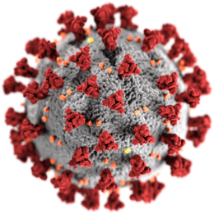
Covid Stories
Positive experiences during Covid-19 period

Slide 2
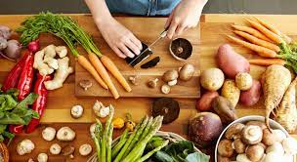
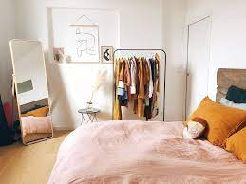
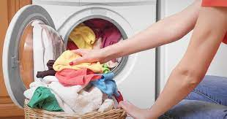
Housekeeping: very hard work!
During the period of Covid-19, due to the absence of my parents and grandparents at home, I have learnt to cook, to do the washing machine and to tidy up my clothes.

Slide 3
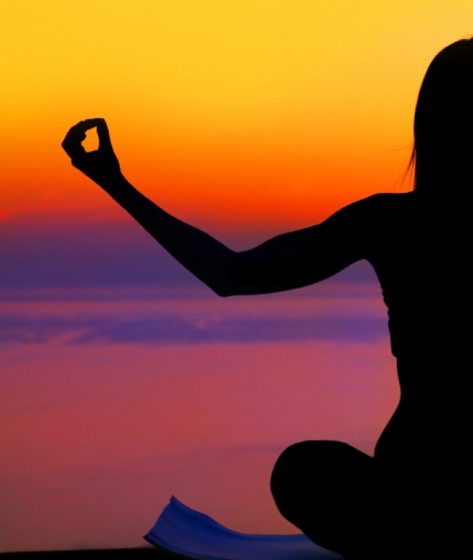
Why not yoga?
I learned to do sport.
In this period I started practicing yoga.

Slide 4
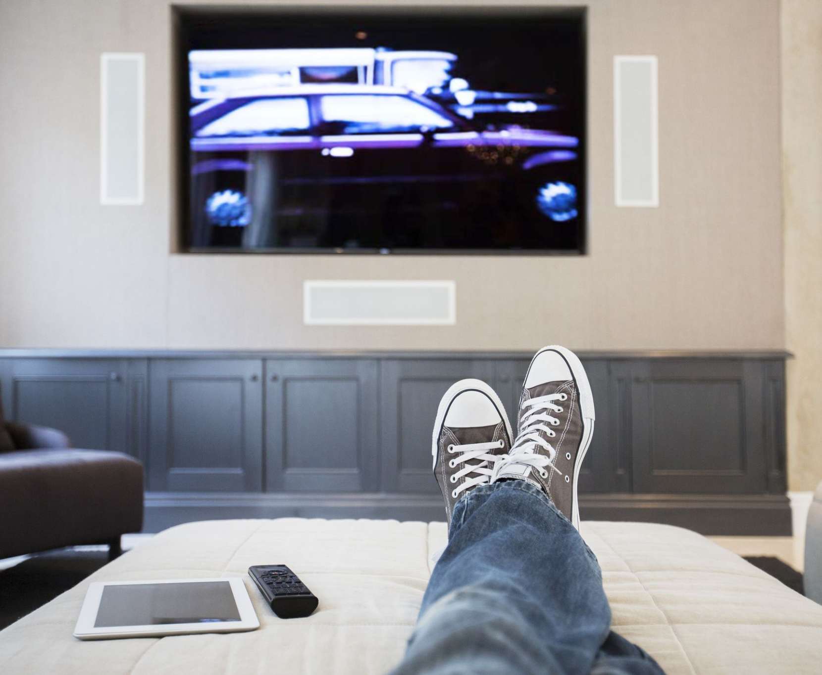
It’s movie time !
During the period of Covid-19, I learned how to the use PC, and I spent more with my family and I had more time to devote myself to my passions.

Slide 5
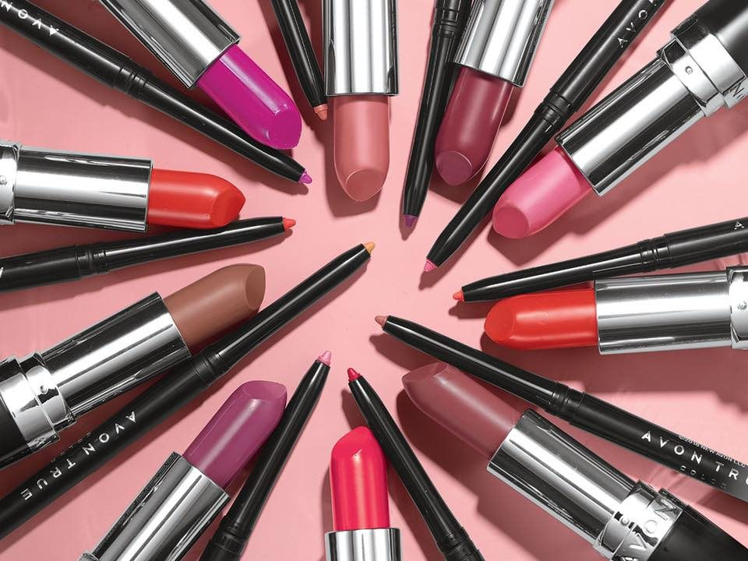
Let’s go working...
I had the opportunity to start a Beauty Consulting Activity through the company :
“Avon Cosmetics”
Now I have the chance to apply, what I have learnt at school in the real world.
COSMETICS

Slide 6
Learning by doing...
During the lockdown period I was part of an engaging entrepreneurial project.

Slide 7
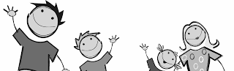
My family: what else?
During this lockdown I rediscovered the joy of being with my family

Slide 8
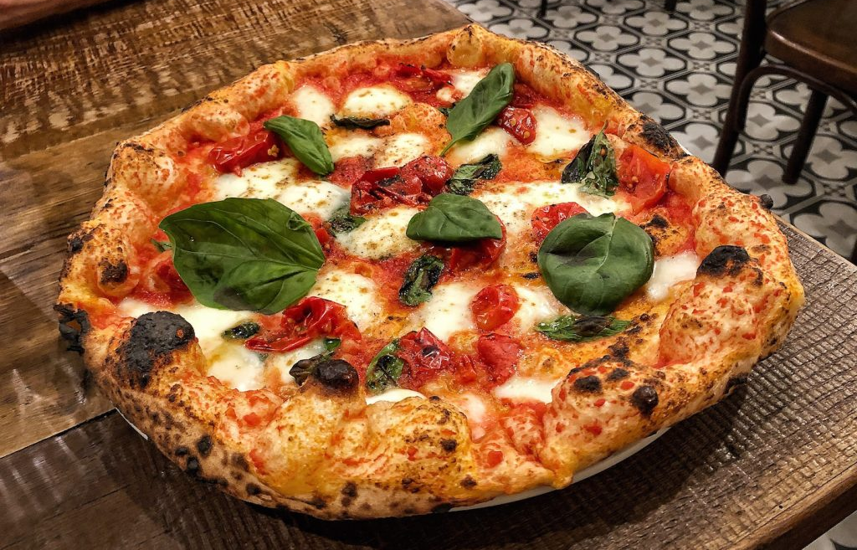
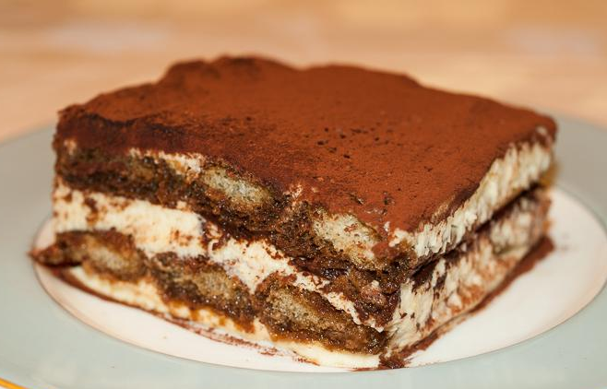
The pleasures of the table!
During the covid-19 period, I started to cook pizza and prepare desserts

Slide 9
and…
what about you?

