Slide 1
BEHAVIOUR DURING COVID-19 PANDEMIC (Responses from Macedonian students)

Slide 2
Hello, my name is Anamarija Neshkoska, im 16 y.o. and I live in North Macedonia.
My family is made up of 6 members: my father, mother, grandfather, grandmother me and my older sister, she is 2 years and a half older than me.
I spend a lot of time with my family, but I don’t go shopping with them, expect if it is something for me like clothes accesories and other, most of the time when I’m outside I’m with my bestfriends and I have a really good time with them, and also sometimes when I’m out only with my female friends we go shopping togeher because it is realy fun and we enjoy it.

Slide 3
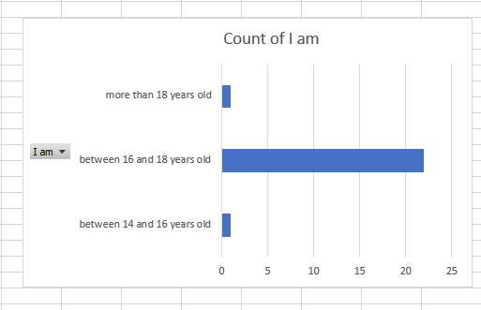
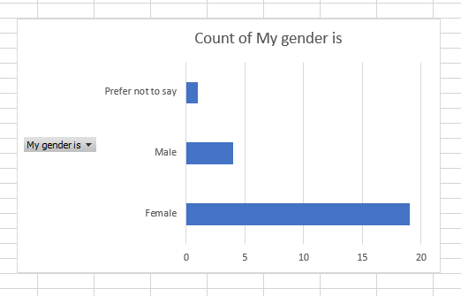
Most of the people that answered were between the age of 16 and 18.
_____________________________________________________
Most of them were also female.

Slide 4
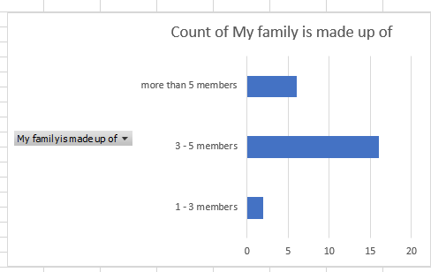
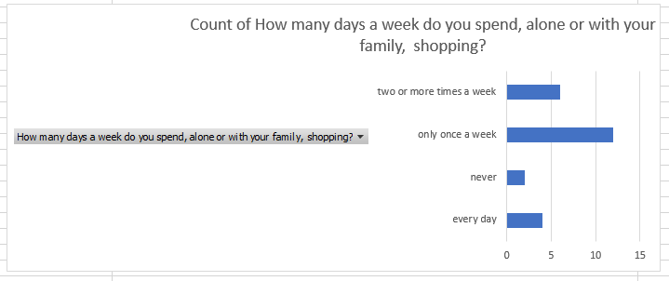
Most families consisted of 3 to 5 members.
_____________________________________________________
Most people go shopping only once a week.

Slide 5
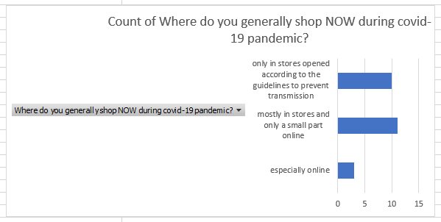
Because of the pandemic most of the pеople shop in a stores and small part online.

Slide 6
How did your purchases generally happen before the pandemic?
The covid-19 pandemic has forever changed the shopping experience for me, before the pandemic I loved to shop in stores.
This chart below shows the number of people and their shopping habits before the pandemic, 12 people said that they used to purchase only in stores and also 12 people said that they mostly used to purchase in stores and only a small part online.

Slide 7
How were your food purchases generally made before the pandemic?
My food purchases before the pandemic were made mostly in stores and only a small part online, but now my purchase habits are completely changed.
This chart below shows the number of people and their food purchase habits before the pandemic, 20 of the people we questioned said that they used to purchase only in stores and, 3 people said that they mostly used to purchase in stores and only a small part online, and 1 man or women said that he/she used to purchase exclusively online.

Slide 8
How safe do you feel to shop online?
Online shopping is convenient, easy and quick. We can shop when we want, compare prices and have our purchases delivered to our front doors. But because of daily stories of online fraudsters and hackers I don’t feel very safe to shop online.
This chart below shows the number of people and how safe they feel to shop online, 8 of the people we questioned said that they feel a little safe to shop online, 3 people said that they feel not safe at all, only 2 people said that they feel perfectly safe to shop online and 11 people said that they feel quite safe to shop online.

Slide 9
What do you buy most online?
Online I buy all kinds of things, but mostly I tend to buy clothing and personal care products.
This chart below shows the number of people and what they usually buy online. The most of the people we asked said they quite frequently shopped online before the pandemic.

Slide 10
Were online purchases (related to the previous point) frequent even before the pandemic?
Before the pandemic my online purchases happened quite frequently.
This chart below shows the number of people and how frequent their online purchases were before the pandemic. The most of the people we asked said they quite frequently shopped online before the pandemic.

Slide 11
Q11: Compared to the pre-pandemic period, do you now pay more attention to advertising and promotional emails? - There isn't any difference in my attention for advertising and promotional emails since Covid, but I think in the future I might just pay little more attention to stuff like the promotional emails and advertisements.

Slide 12
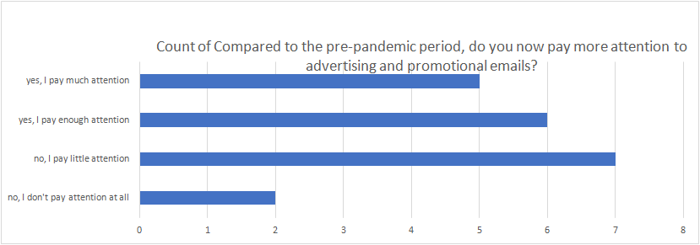
The following chart is telling us that five people pay much attention to promotional emails and adverts, six people pay enough attention to it, seven people pay just a little bit of attention and two people don't pay any attention to them.

Slide 13
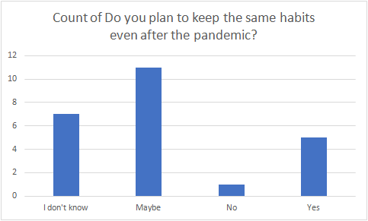
In this graph below we can see that five people said yes to keeping their same habits even after the pandemic, one person answered with no, eleven people answered with maybe and seven people answered with "I don't know"

Slide 14
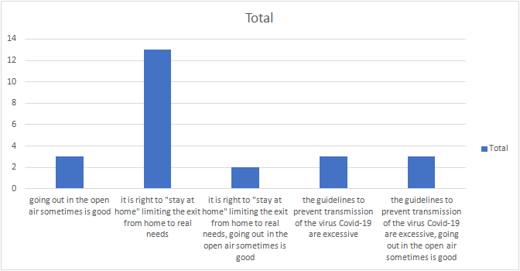
In this graph we can see that three people answered that sometimes going out in the open air is good, thirteen people answered that limiting the exit from home is right, two people answered with limiting exit from home to real needs, going out in open air sometimes is good, three people aswered that the Covid-19 guide lines are excessive and three people answered that the guide lines are excessive, but going in the open air sometimes is good.

Slide 15
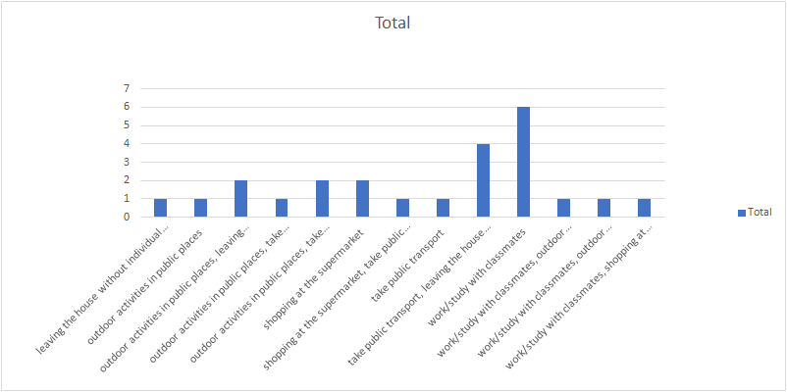
In the next graph we have the answers for the question "Considering the current pandemic situation of Covid-19, how risky do you think the following activities are for your health" and we have one person that answered for leaving the house without individual protection, one person for outdoor activities in public places, two people for outdoor activities in public places without individual protection, one person for outdoor activities in public places taking public transport, two people for outdoor activities in public places, taking public transport and not having individual protection, two people for shopping at the supermarket, one person for shopping at the supermarket whilst taking public transport..

Slide 16
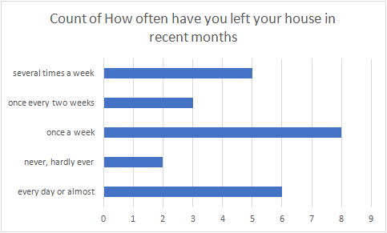
In this graph we can see that five people have left their homes several times a week, three people have left their homes once in every two weeks, eight people have only left their homes once a week, two people have never or hardly ever left their homes, and six people have left their house almost everyday.

Slide 17
During the lockdown many people were kept constantly updated on what was happening through media. How much time did you spend on isolation days to keep yourself informed?
During the lockdown period I spent some time in front of the TV watching and listening to the news only briefly just to see what was going on in my country.
From this chart it can be seen that during the quarantine most students spent less than 30 minutes on the media to be informed about what was happening in the world.

Slide 18
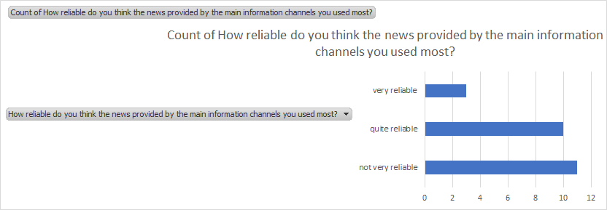
How reliable do you think the news provided by the main information channels you used the most?
When we were isolated for months, we received information from the media, no one knew if that information came from real channels, but everyone sat in front of the TVs and on the Internet watching and hoping that we would receive news to improve the situation.
From this chart we can see that most students answered that they think that the different channels on which we follow the information are not reliable.

Slide 19
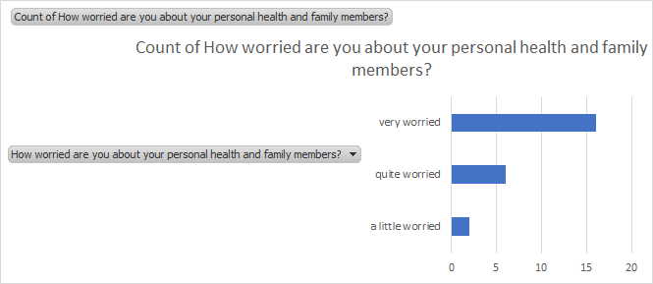
How worried are you about your personal health and family members?
As we face and we are still facing the virus that has ruled us for two years, many things in the lives of all people have changed. During the lockdown period we became more attached to our family, had more communication with our loved ones and spent more time with family than ever before, The feeling of fear for health prevailed in all of us, first of all for ourselfs and then for our loved ones.
From this chart we can notice that we all have been worried about our personal health and health for family members.

Slide 20
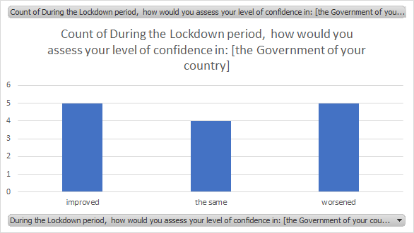
During the Lockdown period, how would you assess your level of confidence in: (The Government of your country)
When it comes to trust in the Government and the European Union regarding this situation, I have not taken a special position, I have no information, except those that come from the news. My confidence in the Government has improved, but my only complaint is that now that vaccines have been developed, It is not clear to me how our Government cannot find a way and provide enough vaccines for all, even though our country is too infected compared to other foreign countries.

Slide 21
During the Lockdown period, how would you assess your level of confidence in: [European Union]
My confidence in the EU during the lockdown period has improved because the number of infected people has been reduced in most EU nations.
This chart below shows the level of confidence in the European union in other people. For the majority of them it has remained the same.

Slide 22
During the Lockdown period, how would you assess your level of confidence in: [the Government of your country]
My level of confidence in the Government of my country has remained mostly the same, since the number of COVID cases has remained the same.
In this chart is shown the level of confidence of other people in the Government of our country. Of the people we asked, 5 of them said that they’re level of confidence has worsened, another 5 have also said that their level of confidence has improved and the other 4 have said that it had remained the same

Slide 23
During the Lockdown period, how would you assess your level of confidence in: [regional or local authorities]
My confidence in the local authorities has improved a bit because they have taken some actions to ensure our safety.
This chart below shows the level of confidence that people have in regional or local authoroities. And from the people we questioned, most of them said that they’re level of confidence has improved.

Slide 24
During the Lockdown period, how would you assess your level of confidence in: [police]
The level of confidence I have towards the police has for the most part, remained the same.
In the chart below is shown the level of confidence that people have in the police. Most of the people we questioned said that they’re confidence had also remained the same

Slide 25
During the Lockdown period, how would you assess your level of confidence in: [citizens]
My level of confidence towards my fellow citizens has worsened a bit since most of them don’t go by the protocols as much as they used to and that worries me.
This chart below shows the level of confidence that the citizens have amongst each other.

Slide 26
During the Lockdown period, how would you assess your level of confidence in: the European Union, the Government of your country, regional or local authorities, police, citizens, the health care system. This charter below shows what was the level of confidence in the past year and now. Out of a total 20 respondents, most answered that their trust has decreased in all these institutions except in the health care system, that shown resultats of a big improvement, and the level of confidence in the citizens that remained the same.
%
%
%
%
%
%
%
%
%

Slide 27
Which of the following interventions do you think is more important for the post-lockdown phase? Because the lockdown has a strategic aspect that is associated with delaying the peak of the epidemic, which is limiting the number of sick people at any one time. The best thing to do in this time from my look is to: encouraging smart working where possible and implementing distance learning. This charter below shows how 16 people responded on this. Seven of them think that is more important to encouraging smart working where possible, four of them think to encouraging domestic tourism, the same number goes to implementing distance learning and just one men thinks that is more important expanding public transportation.

Slide 28
In the months of the pandemic did you follow distance courses? As the school closures became inevitable, the Ministry of Education and Science came up with two workable solutions, the TV-Classroom and the E-Classroom. Beside the E-Classroom and studying from home due to the covid-19 situation I wasn’t following any other distance courses. This charter shows how 10 student responded on this question. Before the start of the pandemic 6 of them were following distance courses and 4 of them didn't, after the start the number increased by two.

Slide 29
Were you able to follow all the curricular lessons with distance learning? Our republic has improved access to education during this pandemic by involving as students to study by distance learning with the online platform Microsoft teams and with this platform I was able to follow all curricular lessons, but the quality of the platform and the lessons wasn't so good. From ten respondents just one wasn’t able to follow curricular lessons with distance learning, the reason is unknown. ,

Slide 30
How did the distance learning take place mostly? Well we would start at 07:30 am or 13:30 pm depending if we are first or second shift starting, and we would finish at 12:55 am or 18:55 pm depending how much lessons we have six, seven or eight. The duration of the lesson is 35 minutes with 5 minutes rest between every lesson and 15 minutes lunch rest that is placed between the second and the third lesson. And this it was synchronous distance learning with live communication between as students and the teacher. From 11 students 7 of them sad that the learning is different, 3 of them that is the same and 2 of them that is improved.

Slide 31
Looking ahead to the next school year 2021/2022, would you like distance learning to continue? Personally I would not like the distance learning to continue, because I think that the students are not getting enough knowledge, as they would with the physical presence in the schools where the teacher can see if the student really has learn the material or not. This charter below shows that out of 10 students eight responded that they want distance learning to stop, of which two sad they wanted to continue.

