Slide 1
IMAGINE THE FUTURE
ERASMUS+ PROJECT FESAC
ONLINE MEETING PROGRAMME
DARUVAR, June 7th - 11th 2021
INVESTING MONEY TO ENSURE ONE’S OWN FUTURE
Notes:
Greta

Slide 2
Tomorrow is less scary if we know how to design it!
Notes:
Greta

Slide 3
Taking out an insurance contract can be a very sensible investment to protect yourself against the eventuality of an accident: damage to things, people, animals, losses, fires to buildings, goods..
Notes:
Greta

Slide 4
A bit of history: how and when insurance is born
Insurance was born in Italy between the XIIIth and XIVth centuries
Maritime traffic increased and there was a need to insure goods and vessels from the dangers that could be encountered when sailing
The cities of Genoa, Florence and Pisa were the first to use an insurance system: the owners of the merchant ships established a common fund to compensate those who were affected by a negative event.
.
Notes:
Greta

Slide 5
At the end of the XVIIth century the system changed: special insurance companies were established with insurers specialized in the analysis and risk management of their customers
Notes:
Greta

Slide 6
financial risk
In the field of insurance, «risk» means the possibility of a future and uncertain event
RISK = PROBABILITIES X EXPECTED ECONOMIC DAMAGE
The possibility of a future and uncertain event occurring may cause damage to things and/or people.
Damage to property and / or people involves a financial loss (cost)
Consequently:
Financial loss can be sustainable or unsustainable by a family or a business
Notes:
Alessia

Slide 7
The main elements of the insurance
The risk
The possibility of a future event occurring can result in damage, if the event is unfavorable, or a gain if it concerns risks of a favorable nature
Car accident, injury, fire
PURE
Risk
DEMOGRAPHIC
death
SPECULATIVE
Financial transactions
Notes:
Andrea

Slide 8
The insurance contract in general terms
The insurance policy is a contract where the insurer agrees, in exchange of an initial payment known as premium, to refund the policyholder if a certain defined event occurs
Notes:
Pietro

Slide 9
The parties of an insurance policy are
Contractor
Policyholder
Beneficiary
the person who draws up the contract and must pay the premium
the person exposed to the risk that is insured
the person to whom the insurer must pay an amount of money or indemnity if a certain defined event happens
Usually the contractor is also the policyholder and beneficiary of the insurance policy but in some cases the policyholder and/or the beneficiary can be different people.
Notes:
Irene

Slide 10
Property insurance
Property insurance is a contract which refunds the policyholder, up to a certain extent of a damage caused by a certain defined event
Ex. A person wants to protect himself against the risk of fire of the Villa he owns. The value is equal to 1,000,000 euros
“In-house” risk management => “total cost” 1,000,000
Transfer of risk through insurance coverage:
The Company, with respect to this risk, has in its portfolio a cluster of 12,000 policyholders with homogeneous characteristics (property value, type of building, ...) and has observed an event frequency of 0.1%.
Damage to cover = 12.000 x 0,1% x 1.000.000 = 12.000.000
“partial cost” = 12.000.000 : 12.000 = 1.000
Notes:
Carlo

Slide 11
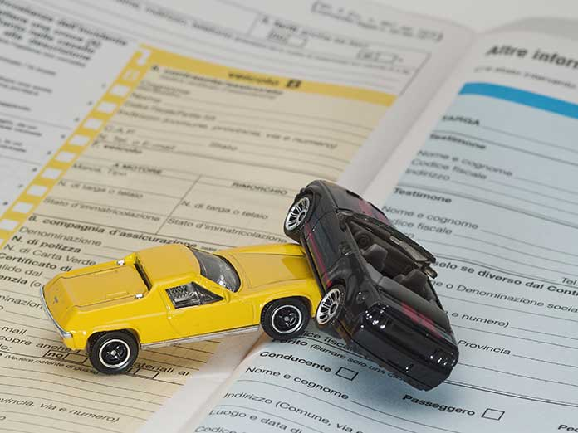
Liability insurance
Liability Insurance is the contract where the insurer AGREES, against payment of a premium, to refund the policy-holder of what HE OWES to a third party for a DEFINED EVENT depending on the liability invoked in the contract,
Notes:
Benedetta

Slide 12
Life insurance
Life insurance is an insurance policy where the insurer, behind payment of a premium, agrees to pay a capital or rent on the occurence of a certain defined event related to human life.
There are three types of life insurance:
Insurance in case of death (the insurer agrees to pay, at the death of the policy-holder, a capital or rent to a third beneficiary).
Insurance in case of survival (the insurer agrees to pay a capital or rent to the policyholder or a third beneficiary if the insured survives to some extent).
Mixed insurance (The insurer agrees to pay capital or rent at the death of the policyholder if the policyholder survives for a certain period).
Notes:
benedetta

Slide 13
Why ensure your future?
Investing money to ensure one’s own future
Because the end of work activity means "retirement" which is a source of great uncertainty in today's society both for today's adults and, above all, for tomorrow's adults.
Notes:
syria

Slide 14
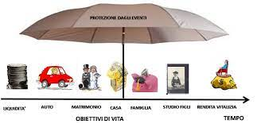
Investing money to ensure one’s own future
How to ensure your future at the end of work?
Planning is important
Notes:
syria

Slide 15
Investing money to ensure one’s own future
Do some counts - Will your savings last?
Life expectancy is getting longer - so savings need to last longer too.
What are your plans for your new life? Holidays, travels, a new hobby?
Expenses can change - for example by paying off your mortgage, but your bills can increase if you spend more time at home.
Will your savings be able to overcome inflation? A solution is offered by the distribution of savings over different types of investments, including shares.
How much to withdraw from your savings? Taking too much too quickly can erode your savings.
Notes:
syria

Slide 16
Investing money to ensure one’s own future
Investment options
If you have planned your retirement, you already know how long your current savings can finance your lifestyle.
You also know that by changing your investment style you can help your savings last as long as you want and protect your assets.
It is always advisable to distribute your money on different investments.
Investing in stocks can protect against the impact of inflation, allowing continued capital growth.
Notes:
Rosa

Slide 17
A possible choice for the worker SUPPLEMENTARY PENSION SCHEME IN THE PAY SLIP
Investing money to ensure one’s own future
Definition
By supplementary pension scheme we mean saving money in order to build a future pension
Notes:
Omar

Slide 18
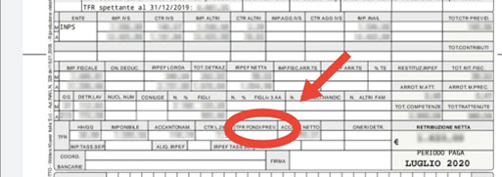
HOW SUPPLEMENTARY PENSION SCHEME WORKS
Within 6 months of hiring, the worker who adheres to this investment mode, allows every month his employer withdraws a monthly premium directly in the pay slip (agreed sum) to allocate it to the pension fund
At the end of the employment relationship, from the date on which you become eligible for pension benefits, you will receive a supplementary pension in the form of a periodic pension.
Notes:
Emilio

Slide 19
Notes:
Greta

