Slide 1
Covid Questionnaire
Evaluation for Diósd-Hungary

Slide 2
The age of our Hungarian respondents

Slide 3
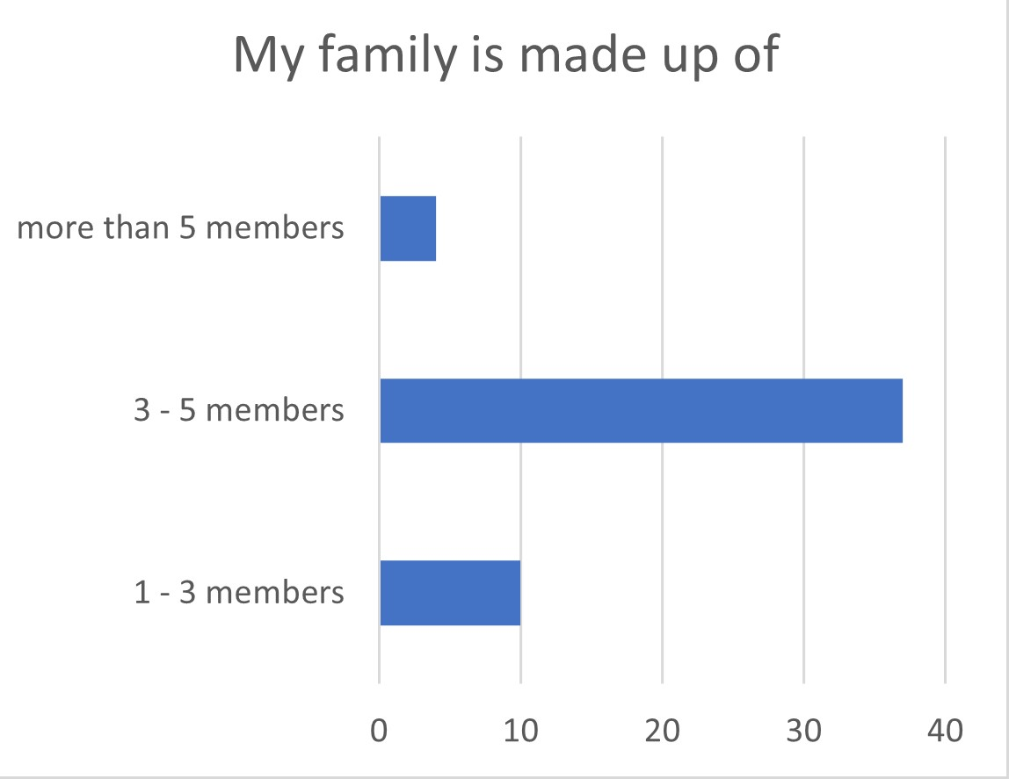
The size of their families

Slide 4
Shopping-number of days

Slide 5
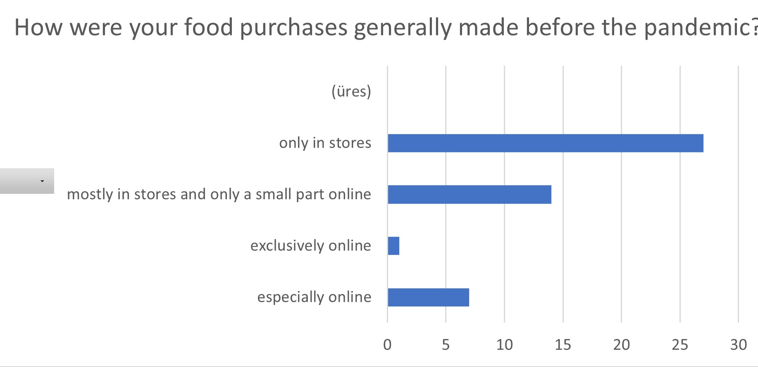
Before the pandemic-food purchases

Slide 6
Online shopping-safety

Slide 7
Before pandemic-online shopping

Slide 8
Advertising/promotion

Slide 10
Staying home or going out?

Slide 11
Media-keep informed

Slide 12
Media-news channels-reliability

Slide 13
Personal health

Slide 14
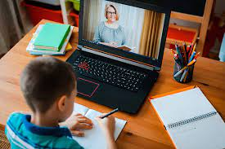
Distance learning-concerns

Slide 15
To continue distance learning?

Slide 16
Conclusions
Most of our students live in families 3-5 people
They go once or two times a week shopping
Before the pandemic, they mostly bought food in stores, some families used online webshops, too
However, the feel quite safe with online shopping
The question related to: online shopping frequency- they answered in about 1: 1 proportion yes/no, so the answers are not relevant here(misunderstood?)
The students don’t pay more attention to promotions/advertising than before pandemic

Slide 17
Conclusions
The students are not sure about keeping these shopping habits after pandemia
They mostly left their houses in the pandemic period more times a week or every day
The students were spending about half an hour to keep updated with the latest news in the isolation period
The Hungarian students think that our news channels give the news in a quite reliable form
They are quite worried about their and their families’ personal health
Most of them answered that they could follow the online lessons during distance learning
The Hungarian students said in a big proportion that they do not want to continue distance learning

