Slide 1
Known alternative payment instruments for cash,credit and debit cards,online purchases

Slide 2
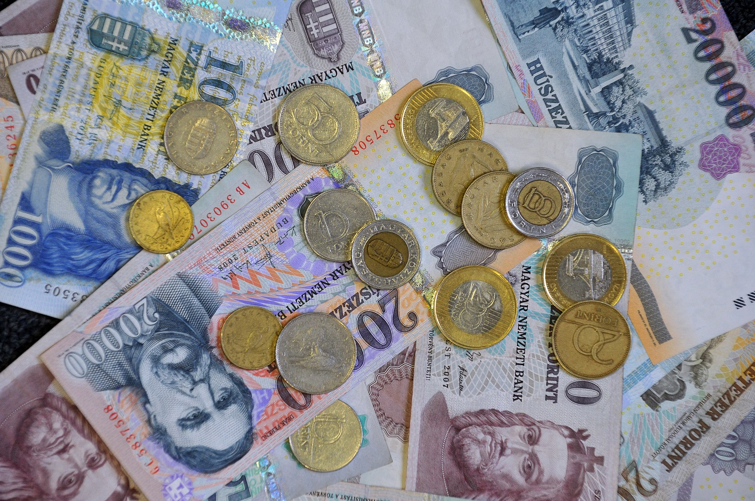
Cash in Hungary
Younger people use cash
Money at hand for emergencies as well
Some people like cash instead of debit card
Hungarian currency is Forint(HUF)

Slide 3
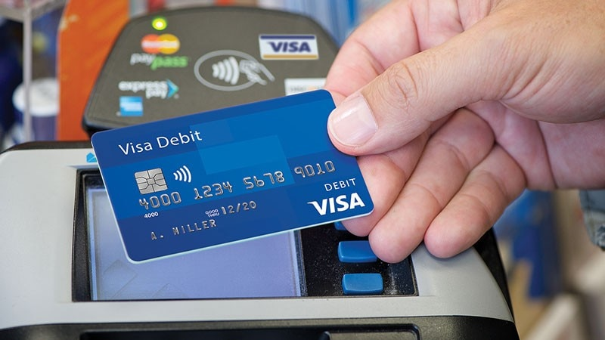
Debit card
Adults use Debit card
Most commonly used payment instrument in many places
When you get your salary you can claim it on your bank account instead of getting it in cash
Used for online payment as well
Takes off money from bank account when you pay

Slide 4
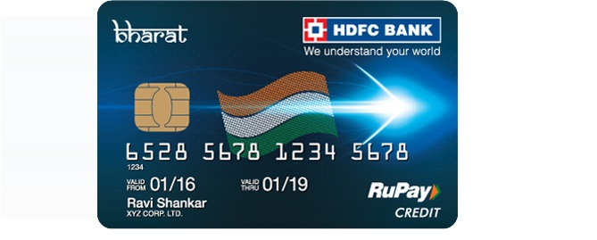
Credit card
Adults use this payment instrument
You pay with the bank’s money, and you take credit
Also you need to pay the money back in 2-3 weeks
If you are late the money that you need to give back will increase
Use it carefully!

Slide 5
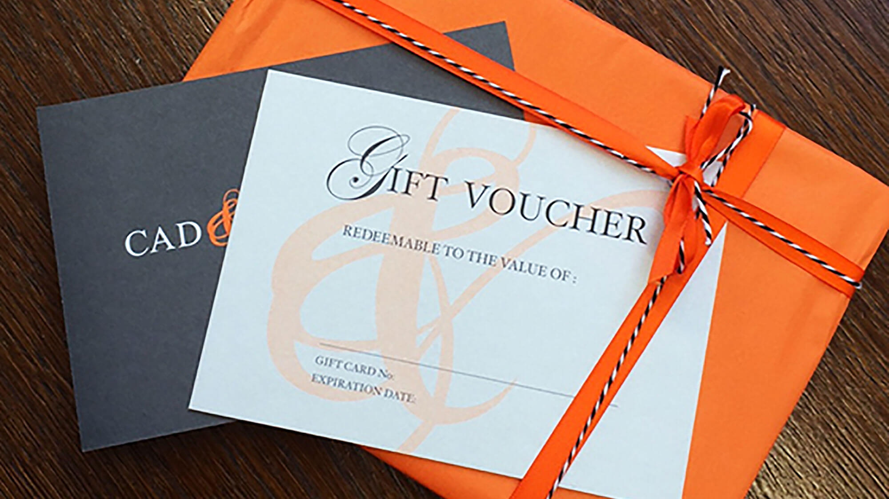
Vouchers and Coupons
There are many types of vouchers,like gift voucher
By collecting coupons from shops, you can get a discount or get a free item
Banks and shops can give you vouchers

Slide 6
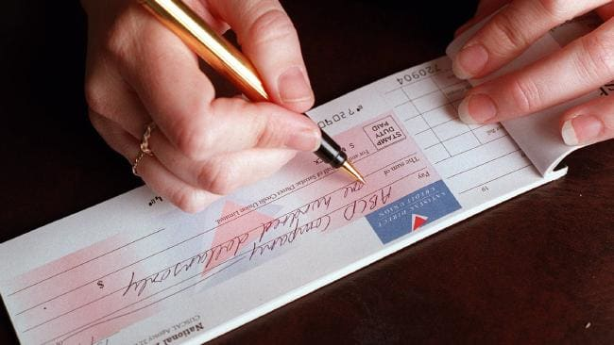
Cheque
We don’t have cheques in Hungary
Cash substitute
You can redeem it in a bank
Companies use this payment instrument for money exchange

Slide 7
Cryptocurrency (bit coin,ethereum)
In Hungary it’s rarely used
Digital payment instrument
Exchange tool
You need to convert it to a bank account to pay with it

Slide 8
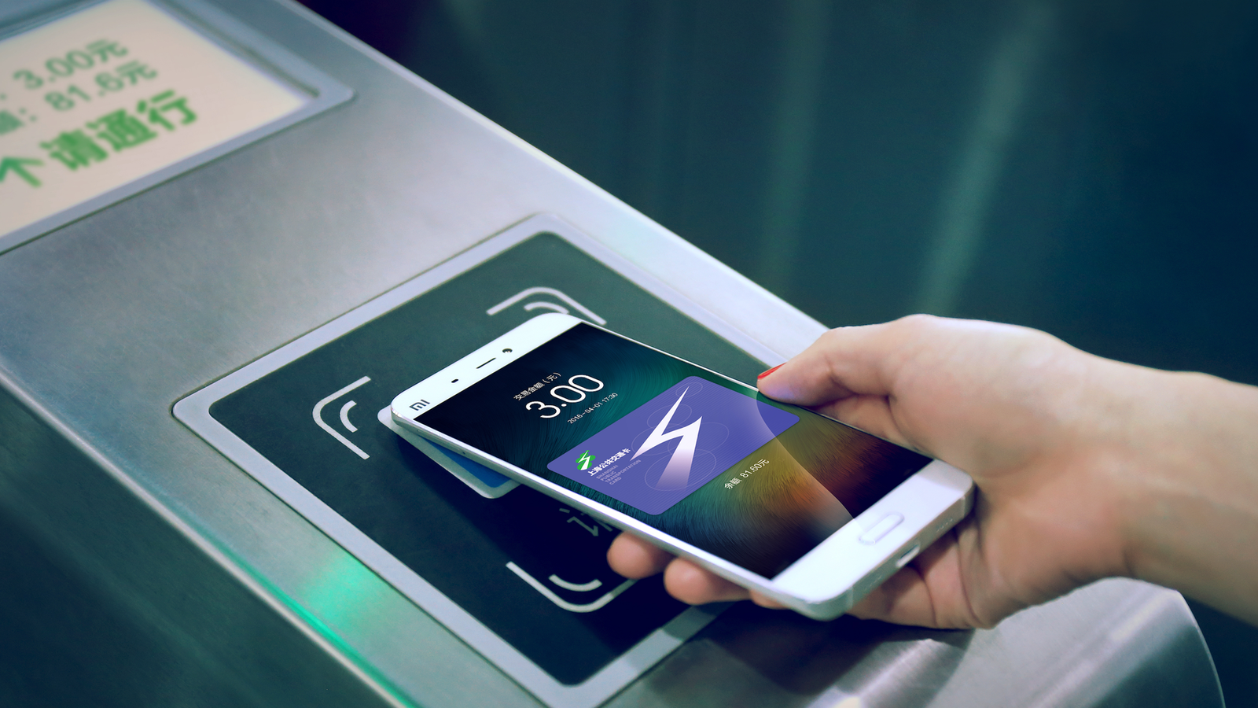
Phone payment
Connect your bank account to your telephone for easy payment instead of using a debit card
This method is very rarely used in Hungary
It’s like a debit card on your phone

Slide 9
Summary
Cash
Debit card
Credit card
Vouchers and coupons
Cheque
Cryptocurrency
Phone payment

Slide 10
Thank you for listening and watching our presentation
Made by:
Nandor Hock
Adam Dozet

