Slide 1
2020 GLOBE Virtual Regional Meeting for Europe and Euroasia
October 26 - 29, 2020

Slide 2
LET’S DO IT!
Ivica Štrbac, prof.
Tamara Banović, prof.
Elementary School Josip Pupačić Omiš, Croatia

Slide 3
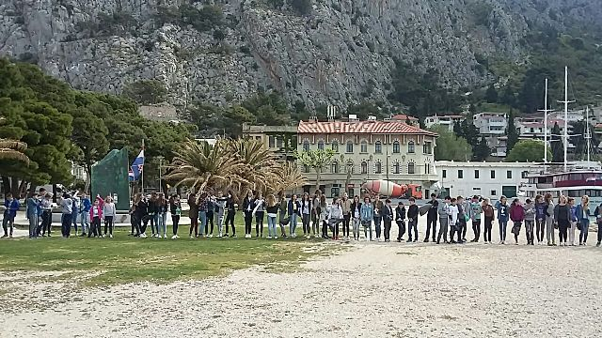
2014.-2019.
The green and blue clean up

Slide 4
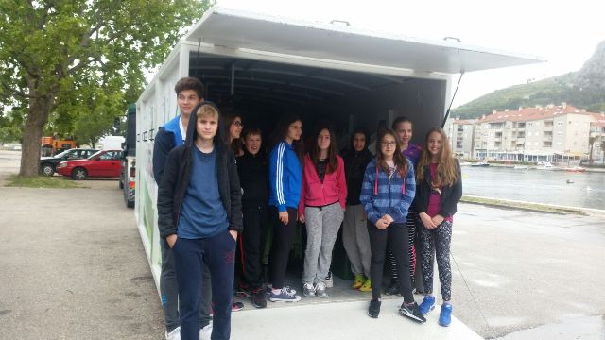
”Tree for Tree”
LET’s PROTECT THE ENVIRONMENT

Slide 5
ASSESSMENT OF SANITARY PROPERTY OF SEA WATER AND SHELLFISH IN OMIS CITY PORT
Research project of GLOBE group students

Slide 6
RESEARCH QUESTIONS
Can we swim carefree in the harbor?
What is the quality of mussels living in the sea in the study area and can we use them in our diet?
What is the sanitary level of the sea water in the city port of OmiŠ?

Slide 7
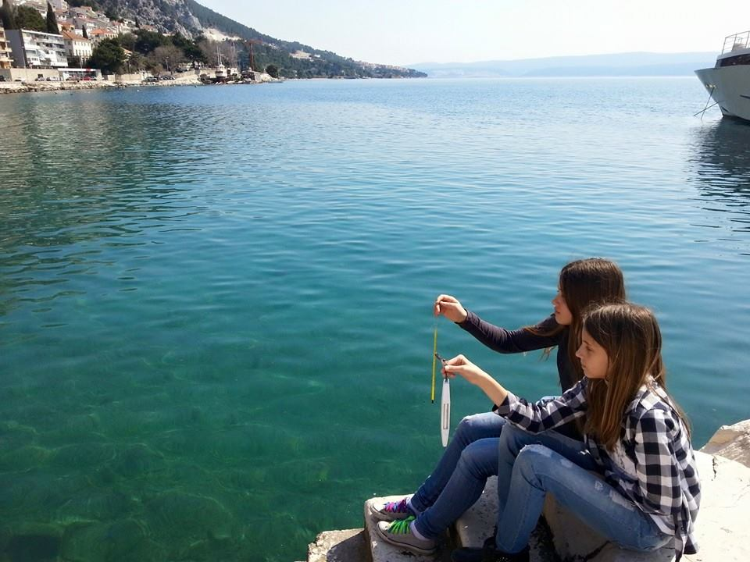
Research methods
Research area: GLOBE station in the city port of Omiš
Research time: from March 2, 2018 to March 1, 2019

Slide 8
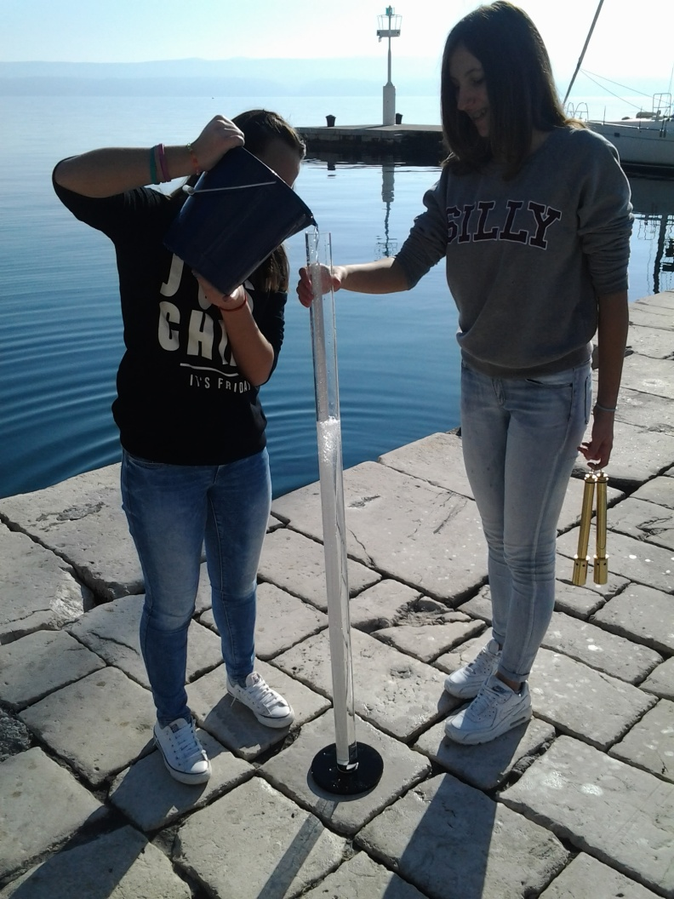
PHYSICO-CHEMICAL PROPERTIES OF WATER ACCORDING TO GLOBE PROTOCOLS
water temperature
pH value of water
salinity
transparency
alkalinity
dissolved oxygen
nitrates
nitrites

Slide 9
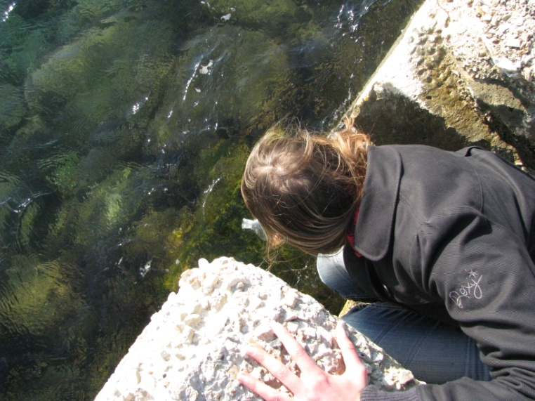
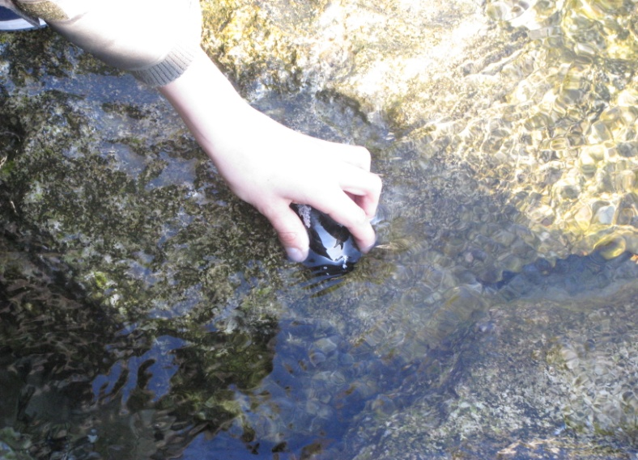
MICROBiological analysis of seawater and shellfish
1. Collection of samples

Slide 10
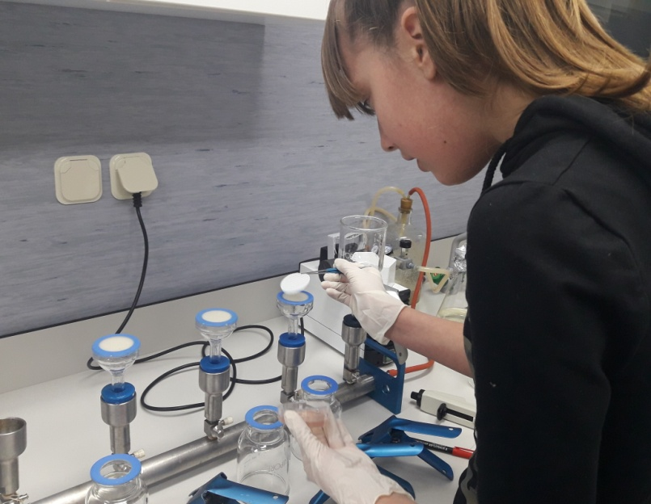
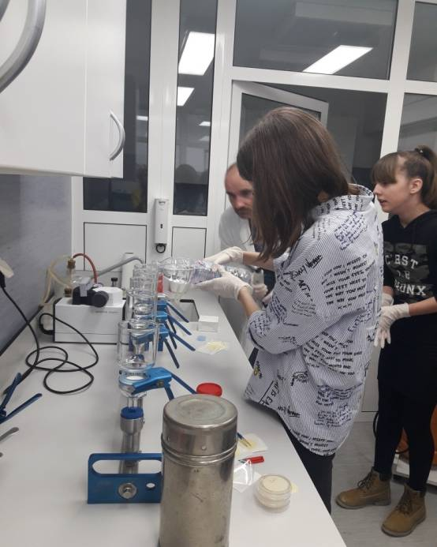
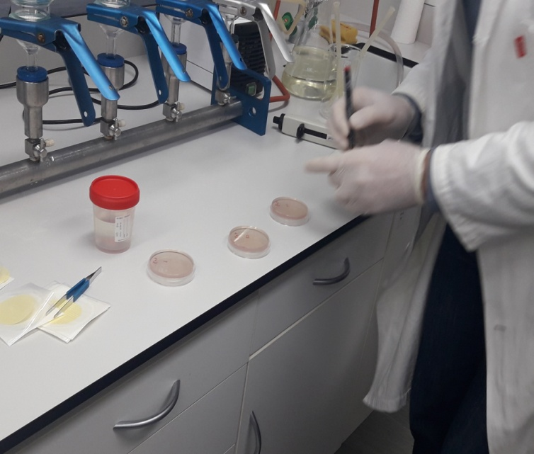
2. Sample Processing – Institute of Oceanography and Fisheries in Split
Sea Analysis: Membrane Filtration Method

Slide 11
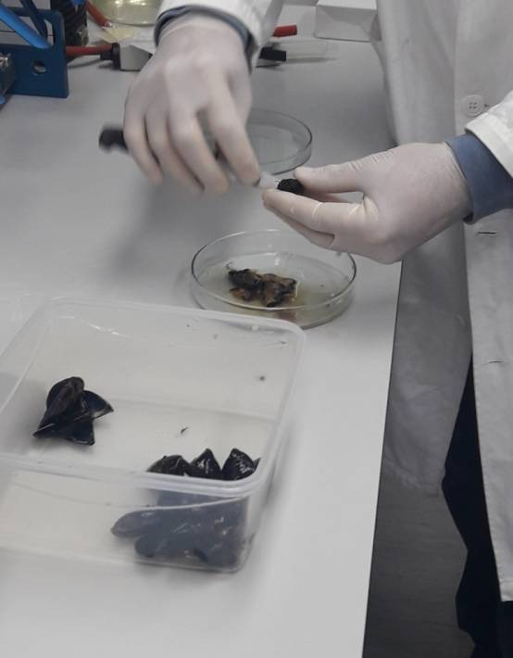
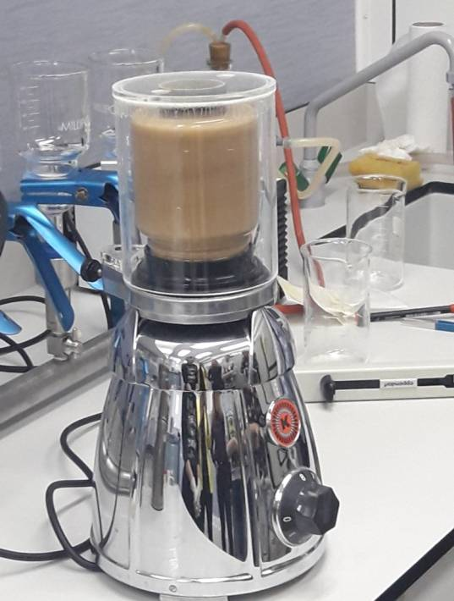
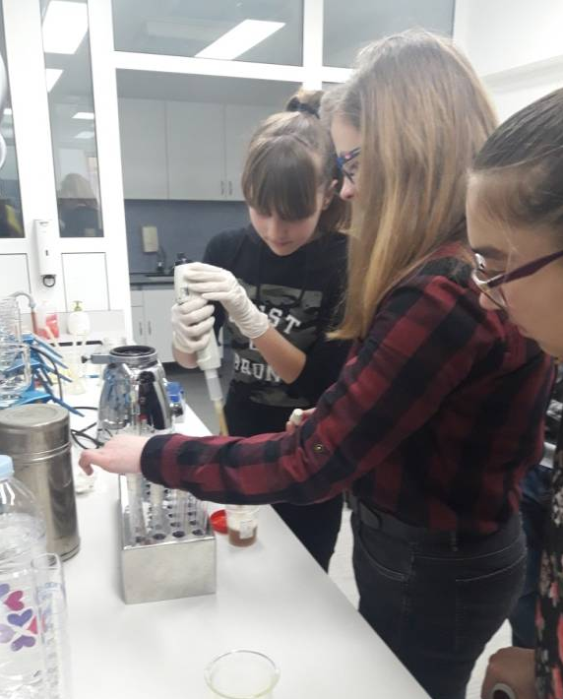
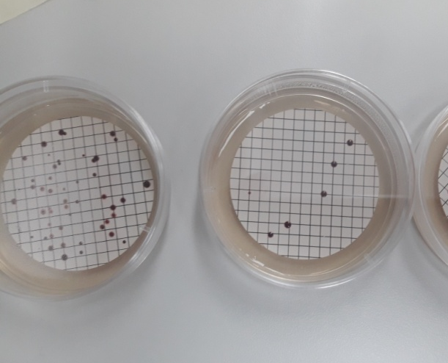
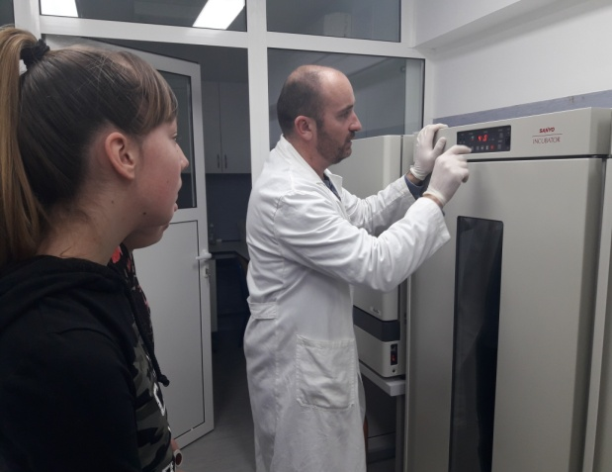
Shellfish analysis: THE MOST PROBABLE NUMBER METHOD

Slide 12
RESULTS OF THE ANALYSIS OF PHYSICOCHEMICAL PROPERTIES OF WATER ACCORDING TO GLOBE PROTOCOLS
Average monthly values of temperature, salinity, and dissolved oxygen in sea water

Slide 13
Average monthly values of alkalinity and pH value

Slide 14
Results of microbiological analysis of sea water on indicators of fecal pollution
Uzorak | Datum | CFU(FE)/ 100 ml vode | CFU(E.coli)/ 100 ml vode | Temperatura °C | Salinitet ‰ | mg(O₂)/l | pH | Alkalitet mg(CaCO₃)/l
1. | 12.10.2018. | 26 | 11 | 20 | 38.2 | 7.6 | 7.64 | 402
2. | 10.2. 2019. | 24 | 14 | 12 | 38.6 | 9.6 | 7.74 | 400
3. | 1.3. 2019. | 26 | 11 | 14.5 | 38.6 | 9.4 | 7.74 | 396
 | Kakvoća morske vode
Indikator | Izvrsna | Dobra | Zadovoljavajuća
Enterokoki (CFU/100ml) | ˂60 | 61 - 100 | 101 - 200
E. coli (CFU/100ml) | ˂100 | 101 - 200 | 201 - 300
Standards for the assessment of bathing sea quality according to the Bathing Sea Quality Regulation(NN 73/2008)

Slide 15
Results of microbiological analysis of mussels on indicators of fecal contamination
Uzorak | Datum | CFU(E.coli) /100 g mesa i međuljušturne tekućine | Temperatura/°C | Salinitet ‰ | mg(O₂)/l | pH | Alkalitet mg(CaCO₃)/l
1. | 12.10. 2018. | 40 | 20 | 38.2 | 7.6 | 7.64 | 402
2. | 10.2. 2018. | 42 | 12 | 38.6 | 9.6 | 7.74 | 400
3. | 1.3. 2019. | 38 | 14.5 | 38.6 | 9.4 | 7.74 | 396
Područje kakvoće mora | Fekalni koliformi | Escherichia coli
I | ˂300 CFU u 100g mesa i međuljušturne tekućine | ˂100 CFU u 100g mesa i međuljušturne tekućine
II | ˂6000 CFU u 100g mesa i međuljušturne tekućine u 90% uzoraka | ˂4600 CFU u 100g mesa i međuljušturne tekućine u 90% uzoraka
III | ˂6000 CFU u 100g mesa i međuljušturne tekućine
Standards for the assessment of the quality of bivalve molluscs according to the Ordinance on the hygiene of food of animal origin (NN 99/2007) and Ordinance on official controls on food of animal origin(NN 99/2007)

Slide 16
The ratio of the number of e-coli colonies isolated in sea water and in mussels

Slide 17
INFLUENCE OF TEMPERATURE ON E.COLI ACCUMULATION IN MUSSELS
Uzorak | Datum | CFU(E.coli)/ 100 ml vode | CFU(E.coli)/ 100 g školjkaša | Temperatura °C
1. | 12.10.2018. | 11 | 40 | 20
2. | 10.2.2019. | 14 | 42 | 12
3. | 1.3.2019. | 11 | 38 | 14.5

Slide 18
Conclusions
Sea water transparency is high, there are no nitrates and nitrites, the amount of dissolved oxygen and the pH value of sea water is in line with the values ​​for sea water
Salinity values ​​are variable, and possible reasons for variability are: evaporation of water, precipitation, winds, electricity, inflow of the Cetina from the mouth of the river
Temperature values ​​are variable and dependent on the season.
The amount of dissolved oxygen is temperature dependent, at lower seawater temperature, the amount of dissolved oxygen is higher and vice versa.
Alkalinity values ​​were uniform throughout the study and consistent with sea water values.

Slide 19
Concentration indicators of fecal pollution are very low, indicating excellent purity of sea bathing water
The concentration of indicators in mussels is very low and its value indicates that the tested shellfish belong to the highest category of sanitary levels and can be used in the diet.
The number of bacteria is multiple in the body of shellfish compared to the sea.
Concentrations of microorganisms in shellfish are generally proportional to their concentrations in free sea water, but in this paper due to the small number of samples and the small number of indicators of fecal contamination isolated from the samples, we cannot say with certainty.

Slide 20
Temperature could be a factor influencing the concentration of indicator bacteria in shellfish tissue, because at higher temperatures a larger number of indicator bacteria is present in the shellfish sample. Before the final conclusion it would be important to examine the influence of other factors influencing sea water filtration and concentration of indicator bacteria in shellfish.
Systematic control of marine and marine pollution is important from an ecological and health point of view. In this context, this research is only a small contribution to the preservation and improvement of the marine environment.

