Slide 1
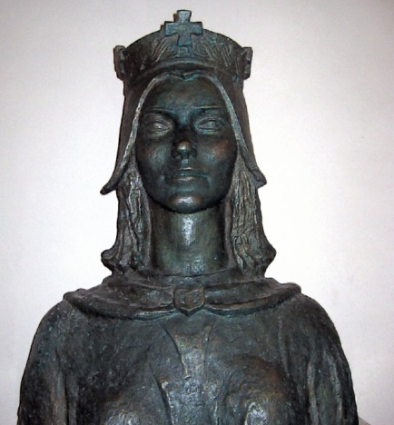
“KRALJICE JELENE” PRIMARY SCHOOL SOLIN - CROATIA

Slide 2
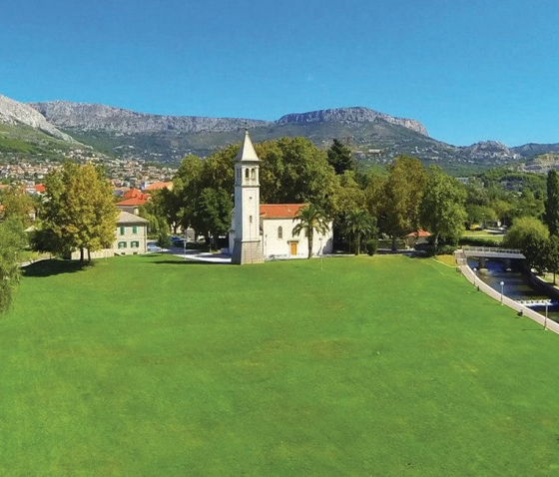
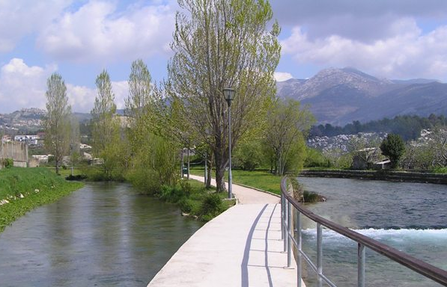
OSNOVNA ŠKOLA KRALJICE JELENE SOLIN - CROATIA
“Kraljice Jelene” primary school is situated in a small town Solin, located near the second largest Croatian city - Split.

Slide 3
OSNOVNA ŠKOLA KRALJICE JELENE SOLIN - CROATIA
Solin is a town with the youngest population in Croatia and number of its citizens is growing because it provides great social and cultural environment for young families and their children. It is child friendly town.

Slide 4
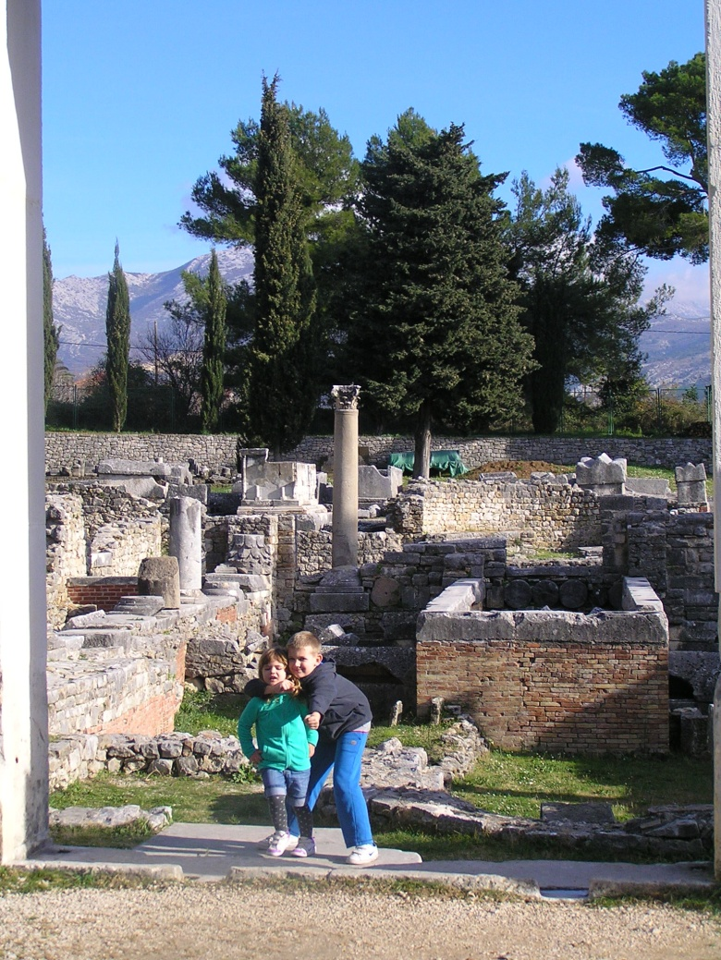
OSNOVNA ŠKOLA KRALJICE JELENE SOLIN - CROATIA
It is also a town with rich cultural and historical heritage. Ancient Salona is a significant archeological site over 2000 years old and it is closely related to the history of the city of Split and its founder, the emperor Diocletian.

Slide 5
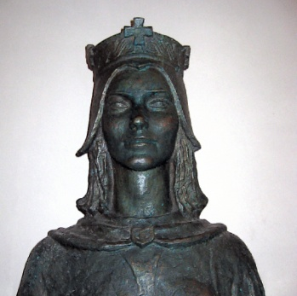
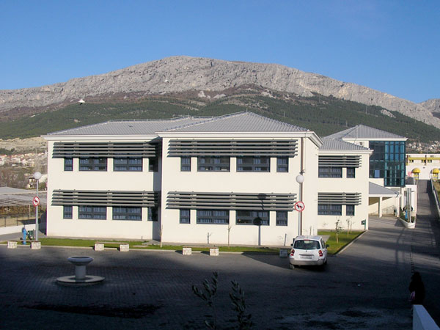
OSNOVNA ŠKOLA KRALJICE JELENE SOLIN - CROATIA
Our school has been named after the Croatian queen Jelena, king's Mihajlo Krešimir II wife, who lived in 10th century. She is known under the name of Jelena Famous because she was very popular in Croatia.

Slide 6
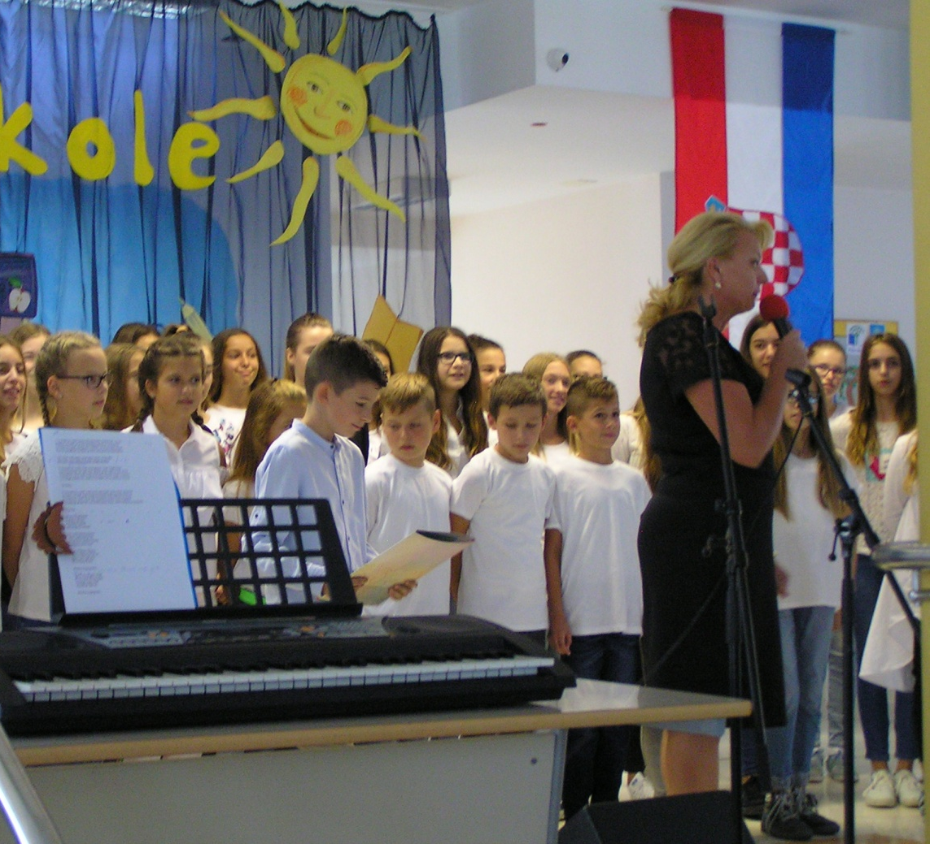
OSNOVNA ŠKOLA KRALJICE JELENE SOLIN - CROATIA
This year we celebrated the 11th birthday.
Our school is of recent construction and its attended by 1 001 students. We also have two small schools in Mravince and Kučine. Students attend these schools for 4 years after which they go to the central school, reaching it by school bus.

Slide 7
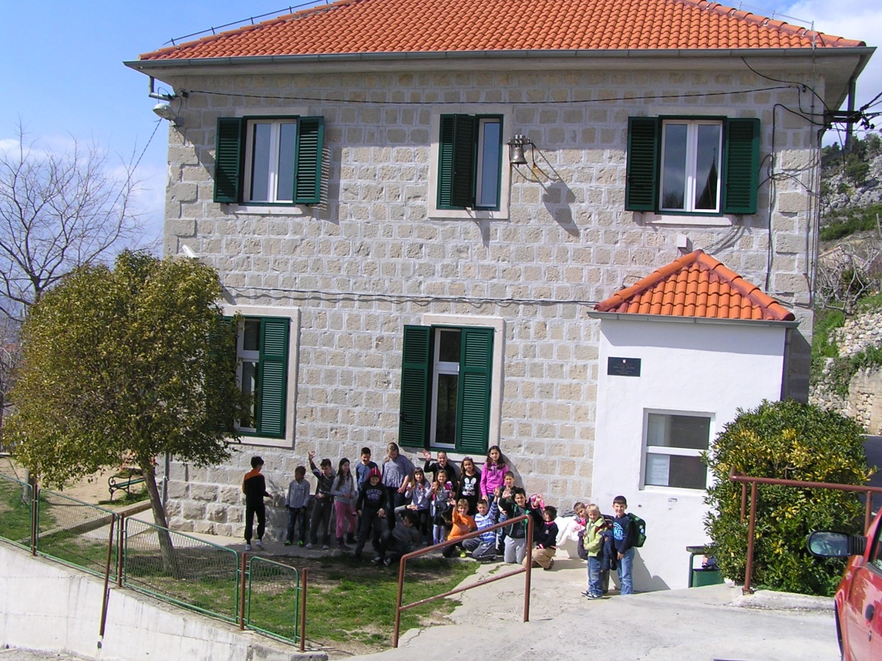
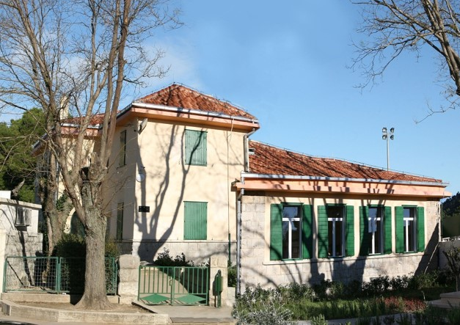
OSNOVNA ŠKOLA KRALJICE JELENE SOLIN - CROATIA
MRAVINCE -
SCHOOL
KUČINE -
SCHOOL

Slide 8
OSNOVNA ŠKOLA KRALJICE JELENE SOLIN - CROATIA
We are proud of our projects in which our school has been participating for several years.
UNICEF

Slide 9
OSNOVNA ŠKOLA KRALJICE JELENE SOLIN - CROATIA
We are especially proud of our humanitarion work with these associations:

Slide 10
OSNOVNA ŠKOLA KRALJICE JELENE SOLIN - CROATIA

