Slide 1
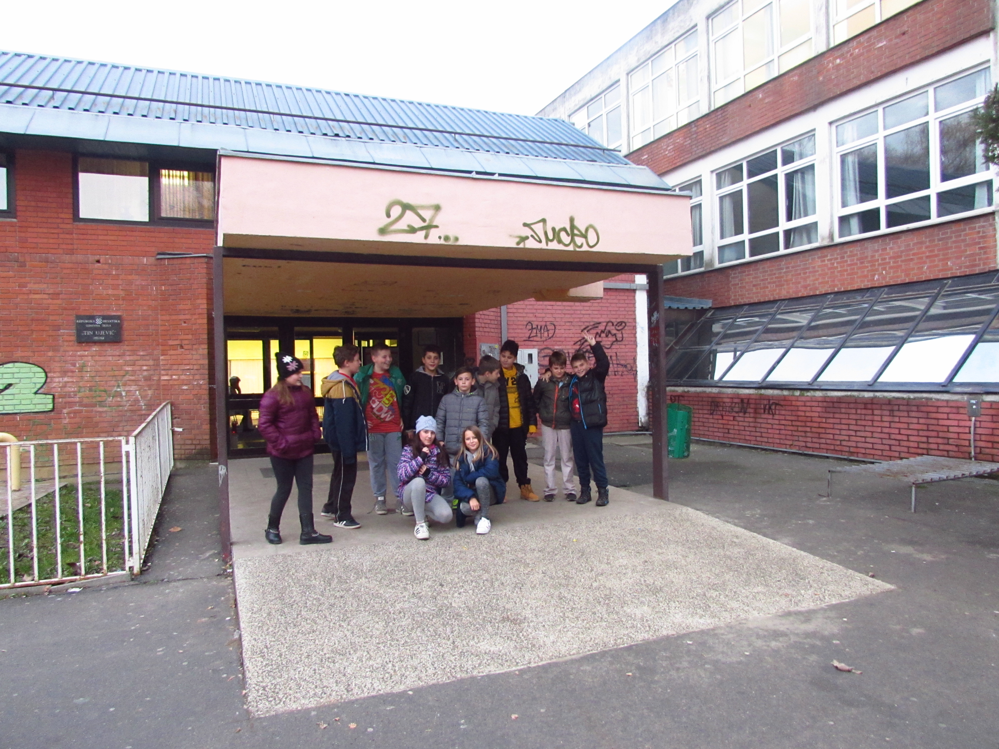
Primary school Tin Ujević Osijek, Croatia

Slide 2
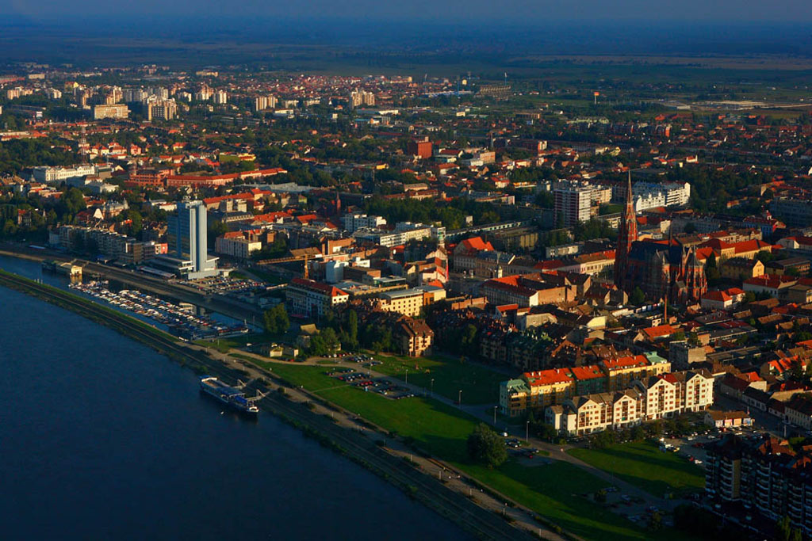
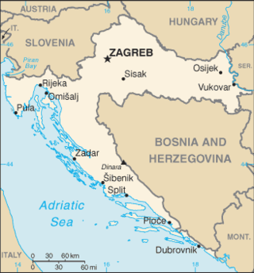
our school is situated in the part of Osijek called Jug II (South II).
Osijek is the largest city in eastern Croatia and it lies on the river Drava

Slide 3
Pupils and teachers
483 pupils in 24 classes, 40 teachers and other school staff in our school
our pupils go to school in shifts
School logo

Slide 4
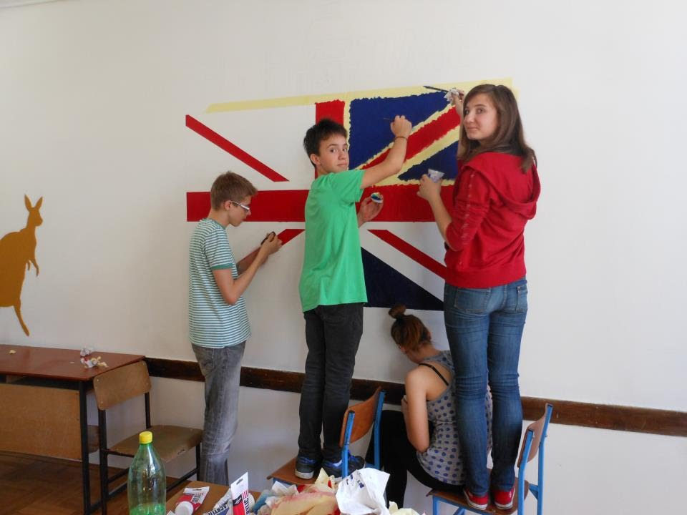
Our school
The school got its name after the famous Croatian poet Tin Ujević and it is 45 years old
there is a gym, a library, a computer lab, a big playground and a beautiful park around the school.
Most classrooms are painted by the pupils themselves so we enjoy spending our time there.

Slide 5
Subjects in Croatia
in Croatian schools children from the 5th to 8th grade have these subjects: Croatian, Art, Music, English, Maths, Science, History, Geography, Technical Education, Physical Education and Informatics (the 5th and 6th grade)
from the 1st to the 4th grade pupils do not learn Chemistry, Physics, Biology
in the 7th and 8th grade pupils learn Physics, Biology and Chemistry
Optional subjects that pupils can choose to attend are Religion and German from the 1st grade and Informatics from the 7th grade.

Slide 6
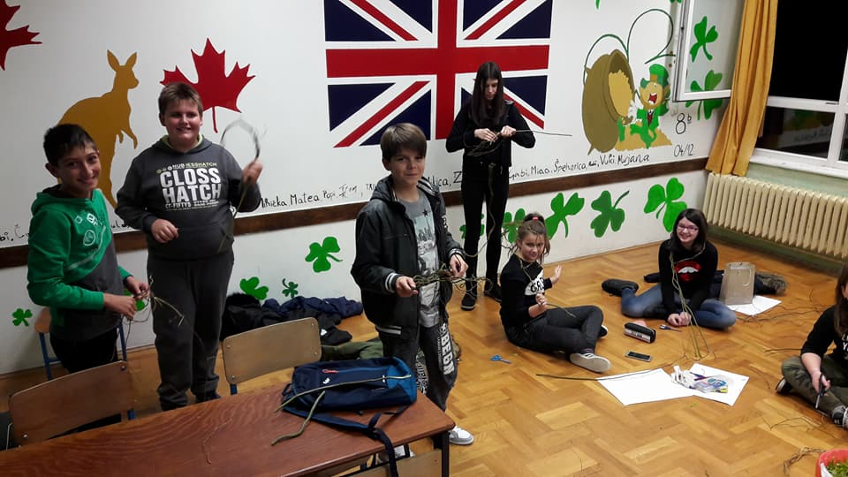

Slide 7
School library
Workout playground

Slide 8
In 1993, The International Commission for UNESCO visits the school and proposes it to be the school under its protection, the first in Croatia.
Since then we have been working on various projects related to the cultural heritage, promoting peace, nonviolence, tolerance and preserving the local customs

Slide 9
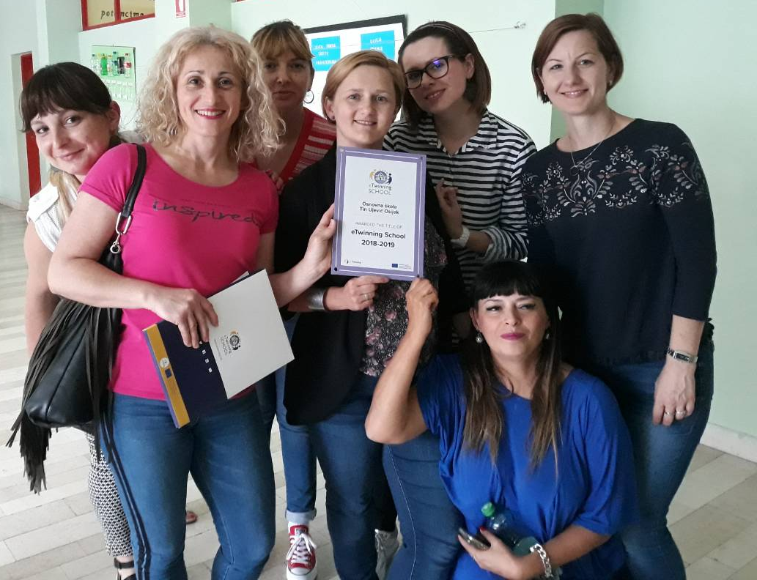
Last school year we were awarded eTwinning School Certificate

Slide 10
Our teaching goals and methods
we strive to provide education that will prepare our students to become skilled, tolerant and open-minded European citizens

Slide 11
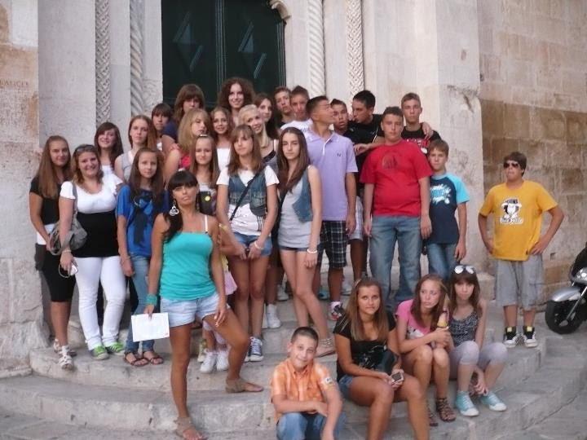
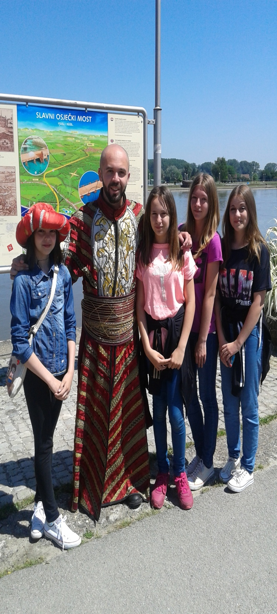
School and field trips, excursions...

Slide 12
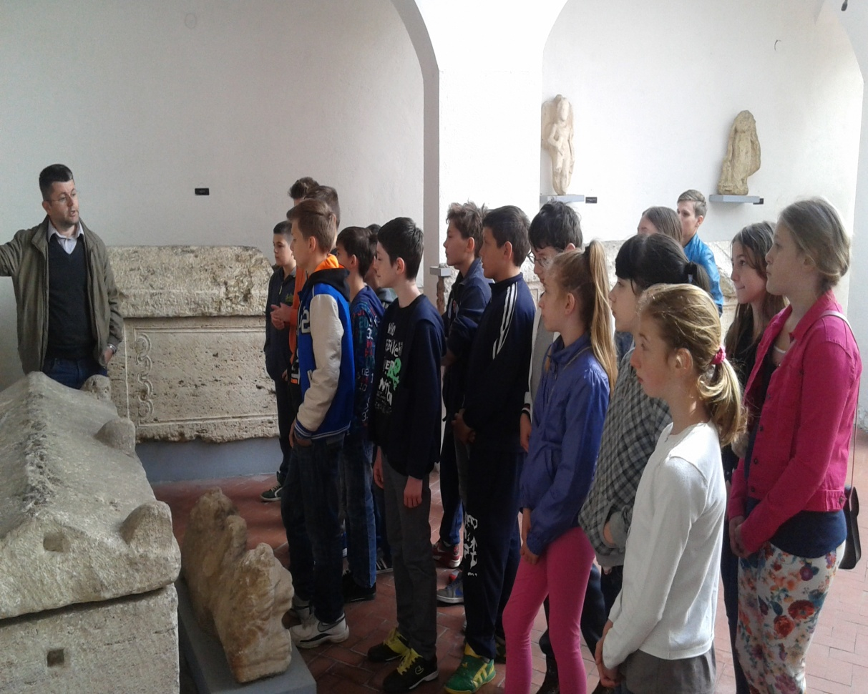
Visits to museums

Slide 13
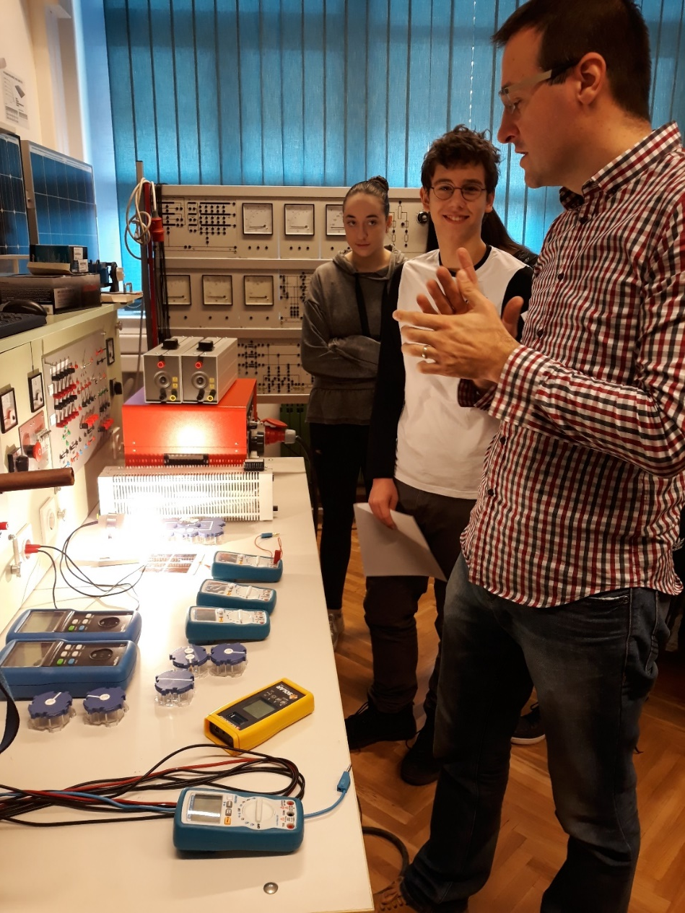
Attending The Festival of Science
hosting various guest lecturers

Slide 14
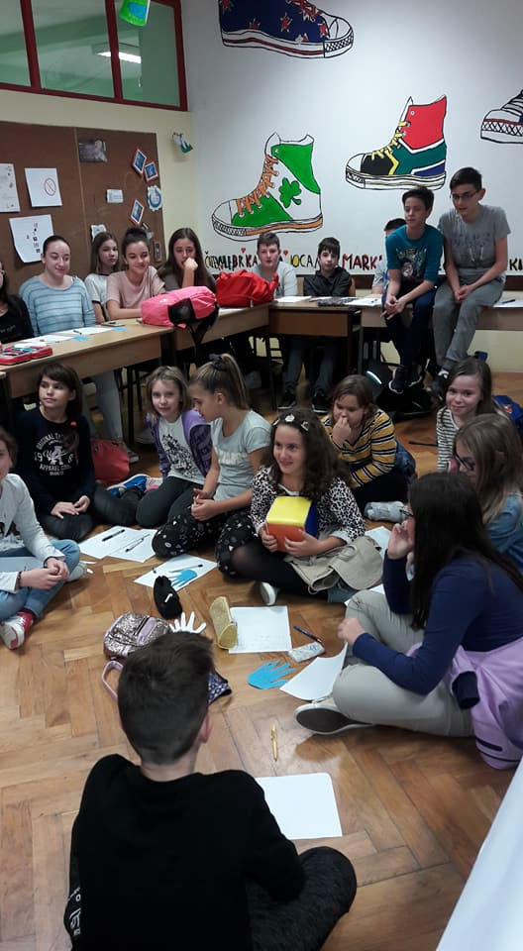
Research and project work

Slide 15
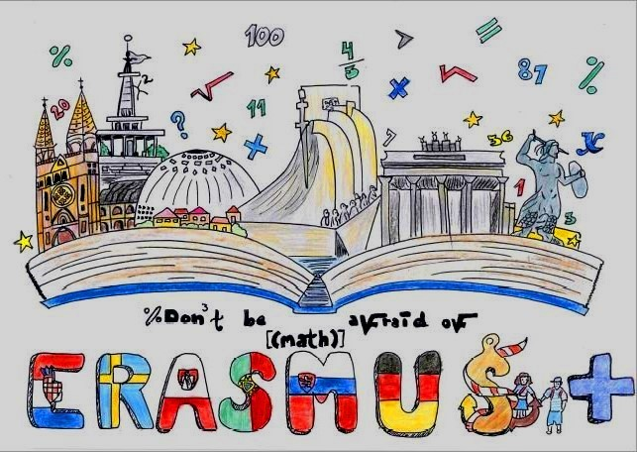
3 KA2 Erasmus+ projects “DON’T BE AFRAID OF MATH”

Slide 16
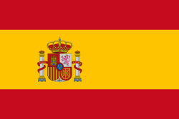
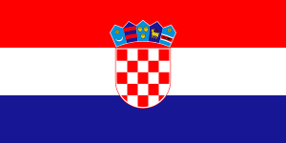
“DIMENSIONS OF EUROPEAN CULTURAL HERITAGE”

Slide 17
“CASTLES ON THE DANUBE – OUR LINKING HERITAGE”

Slide 18
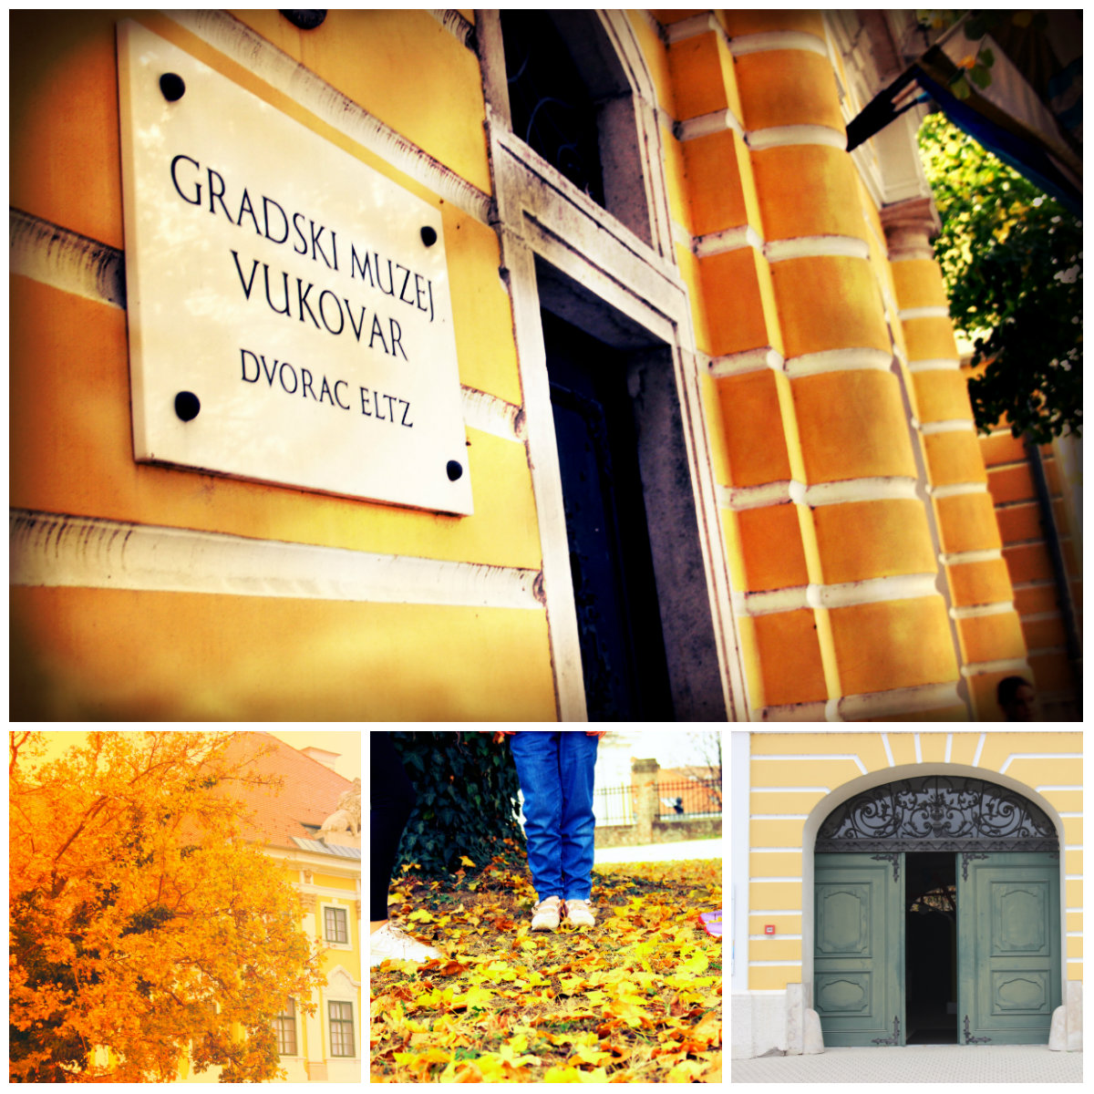
THE ELTZ CASTLE - VUKOVAR
The noble Eltz family built it in the 18th century
it was severely damaged during the Homeland War and today it is completely restored
The Eltz family gave the castle to the town of Vukovar

Slide 19
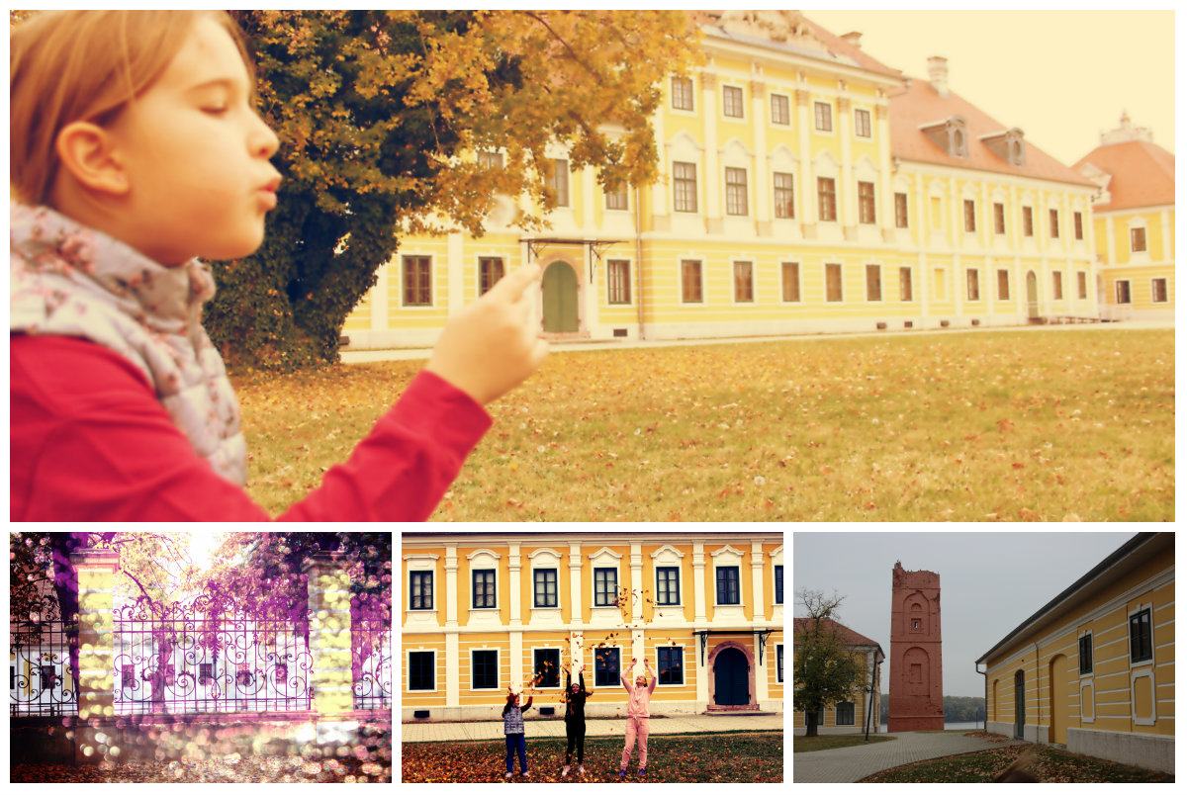

Slide 20
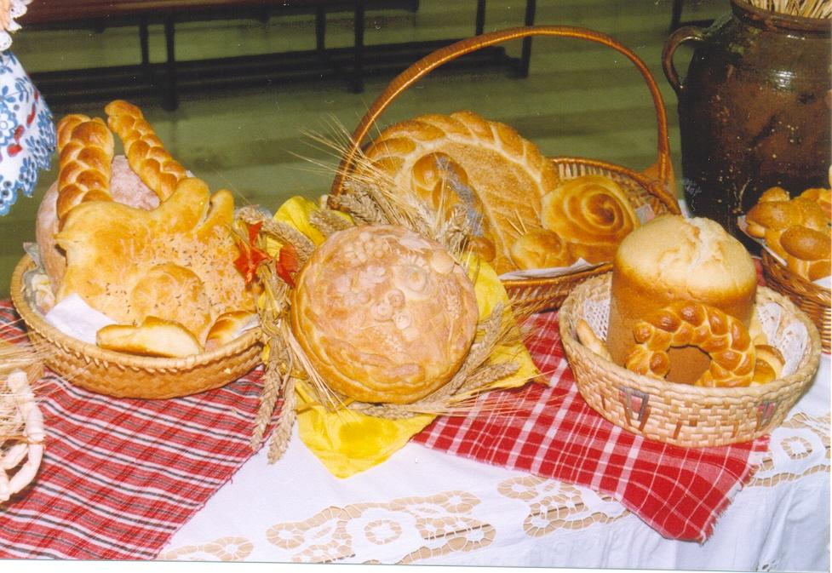
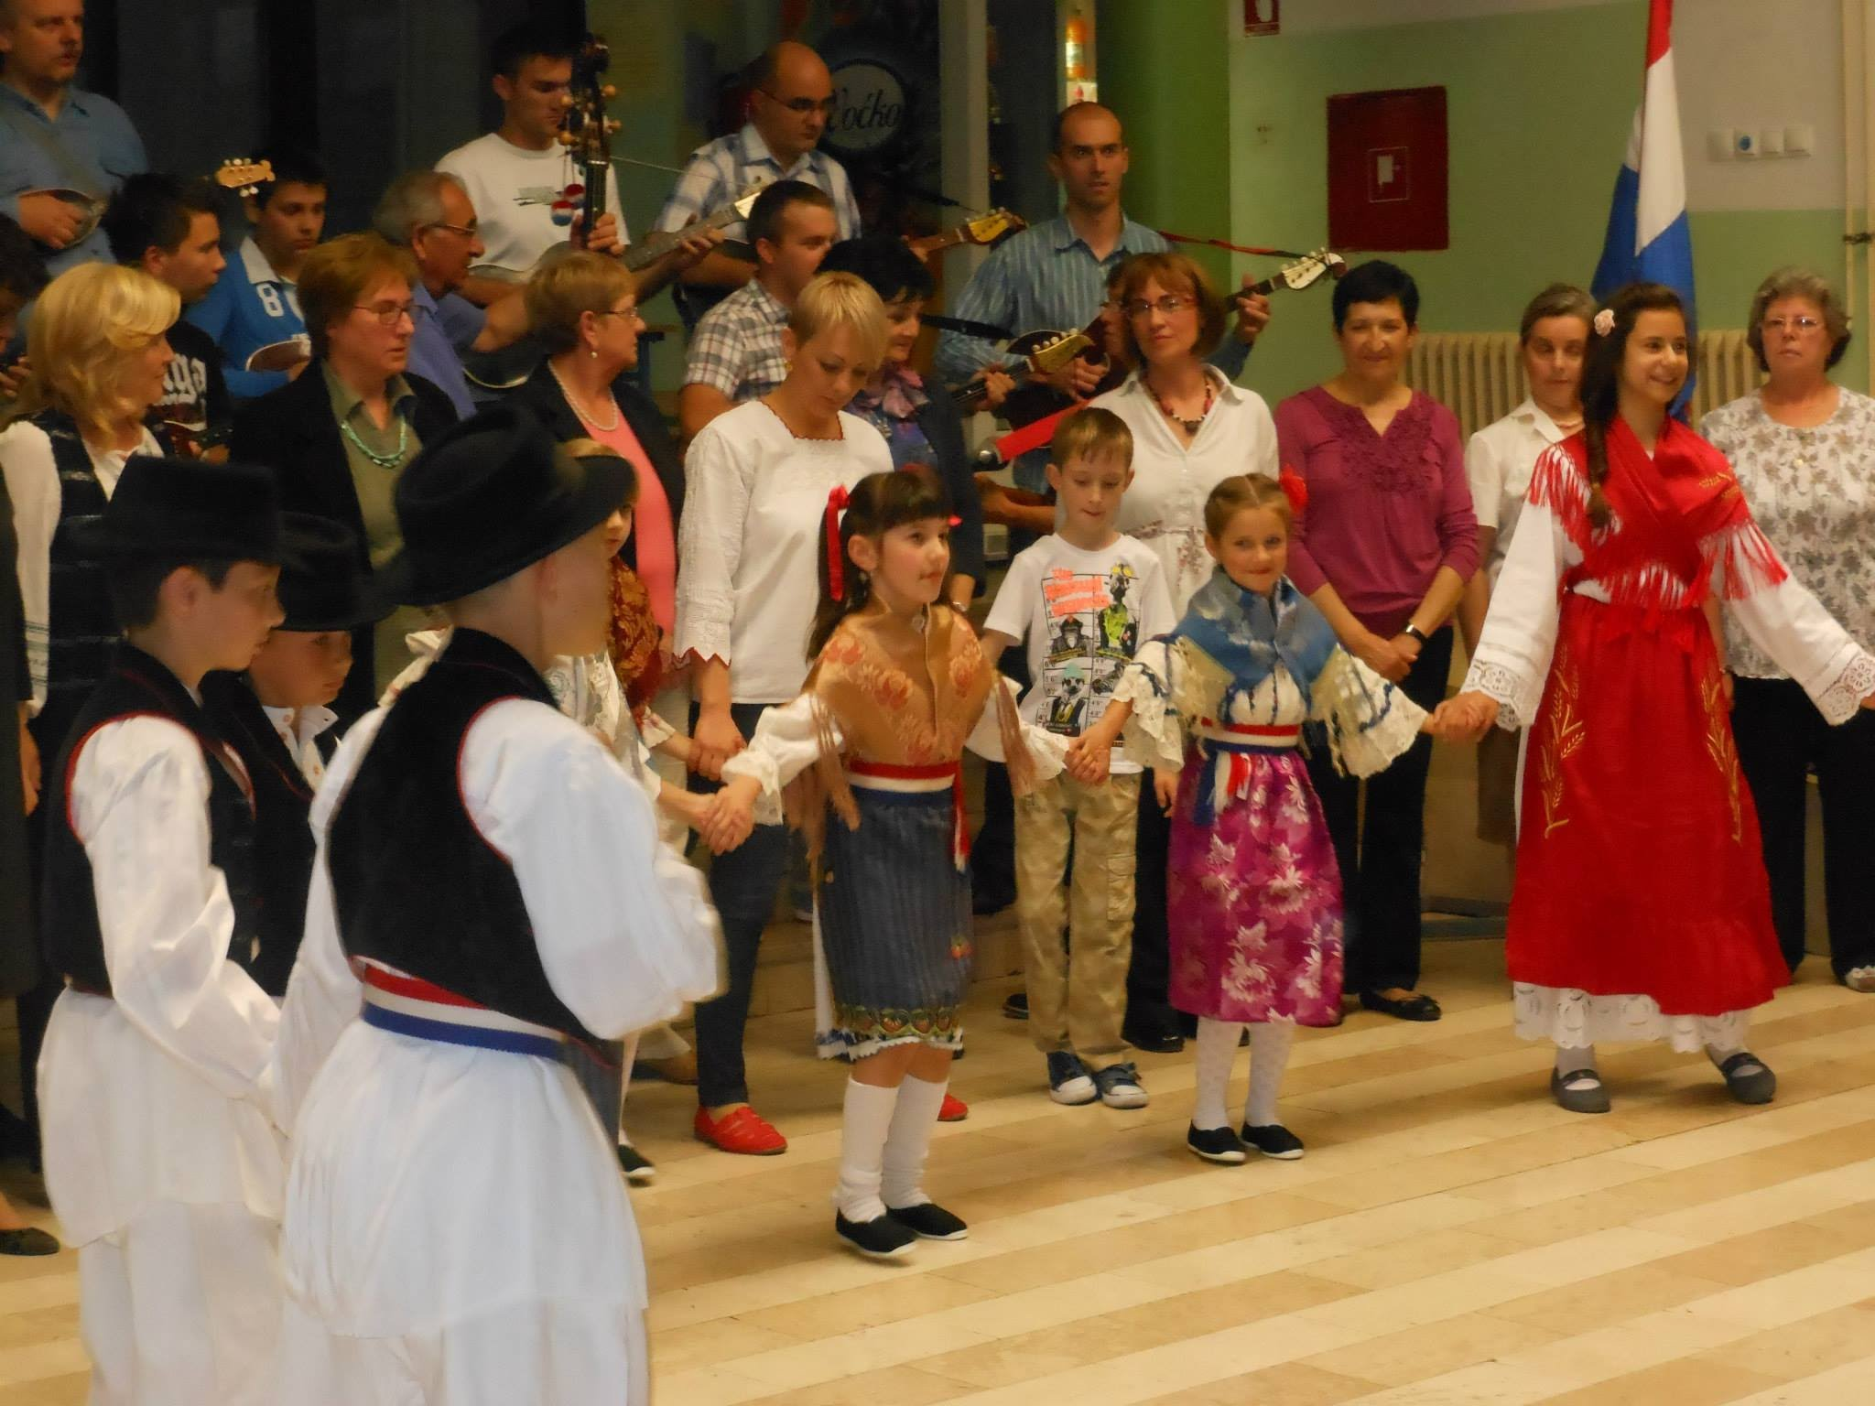
Days of bread...
Folk dances...

Slide 21
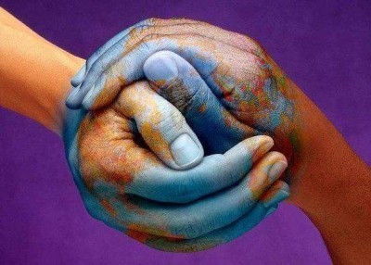
We enable our pupils numerous extracurricular activities which teach the young generation of different abilities.

Slide 22
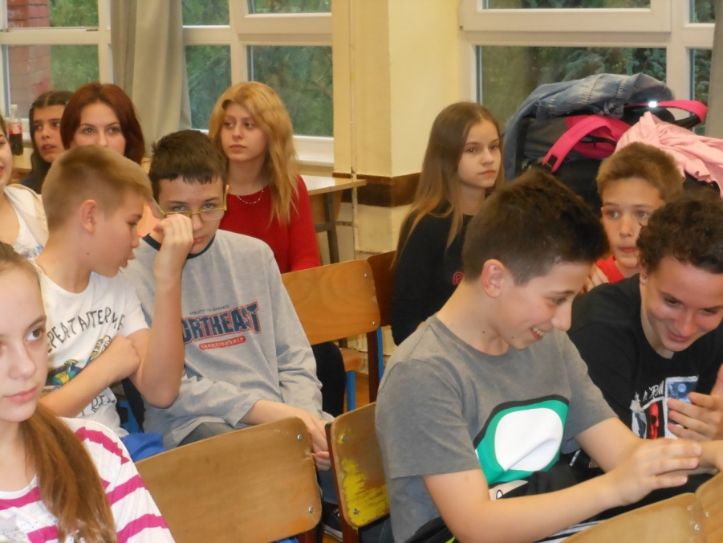
parties like Halloween Party, Valentine‘s Day Party, Carnival Party, Pink Shirt Day, eTwinning projects, Spelling Bee and creative workshops where children make various things which we sell on Christmas Fair and in Easter.
Spelling Bee Competition

Slide 23
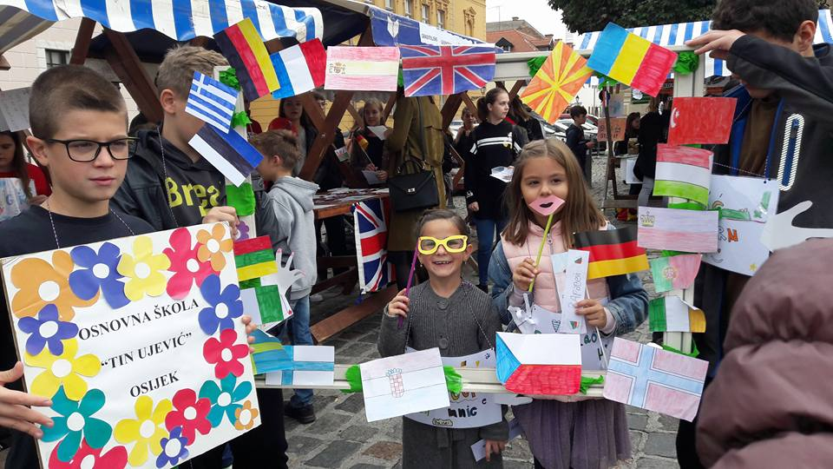
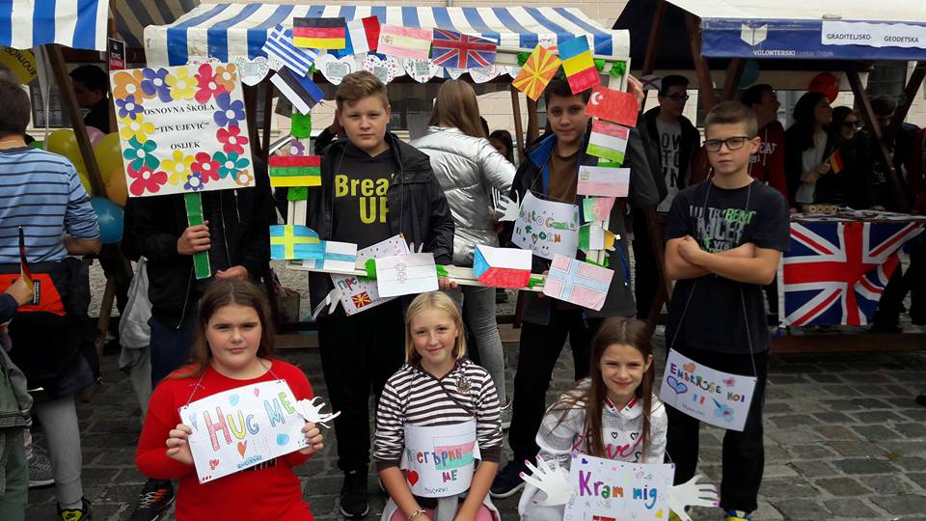
European Day of Languages

Slide 24
Eratosthenes experiment

Slide 25
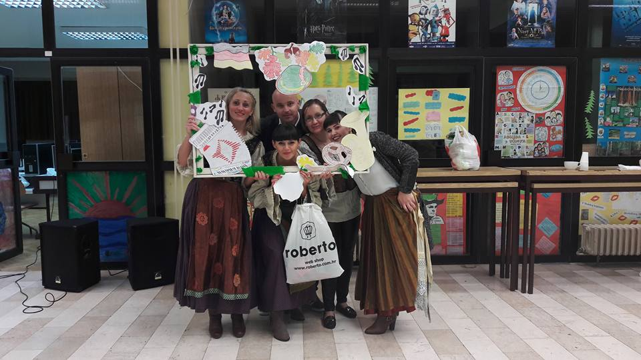
Bavarian Days

Slide 26
Sports
our students are excellent at various sports like: table tennis, football, basketball, volleyball, athletics, chess, judo and other sports

Slide 27
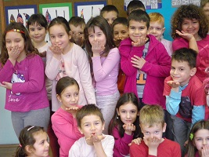
We hope you’ve enjoyed our little “trip” around our school ☺

