Slide 1
Subject. LET'S GET TO KNOW THE PARTS OF THE PLANTS THE PURPOSE of THE LESSON is to recognize parts of the plant, discuss their importance to the plant, and emphasize that all plants are equally significant and need to be protected. Aims: 1. to remember parts of plants, differences between trees, shrubs and grasses; 2. to learn to identify the age of the tree.

Slide 2
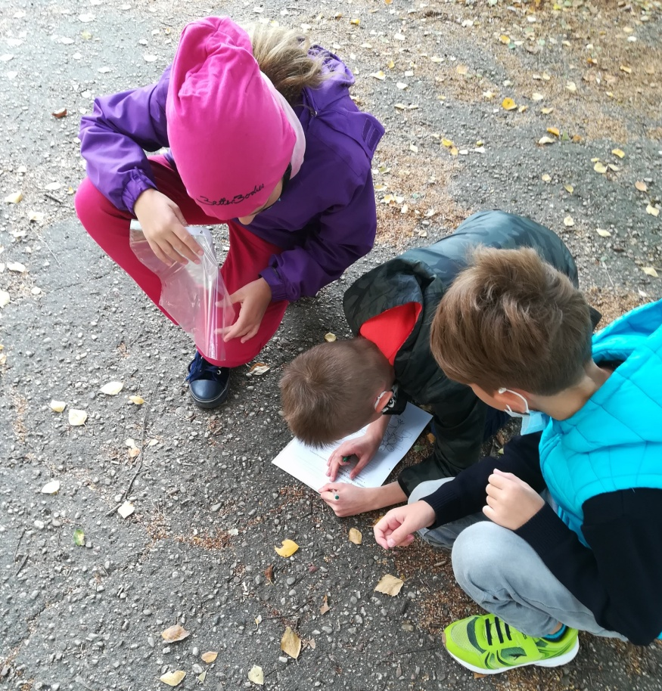
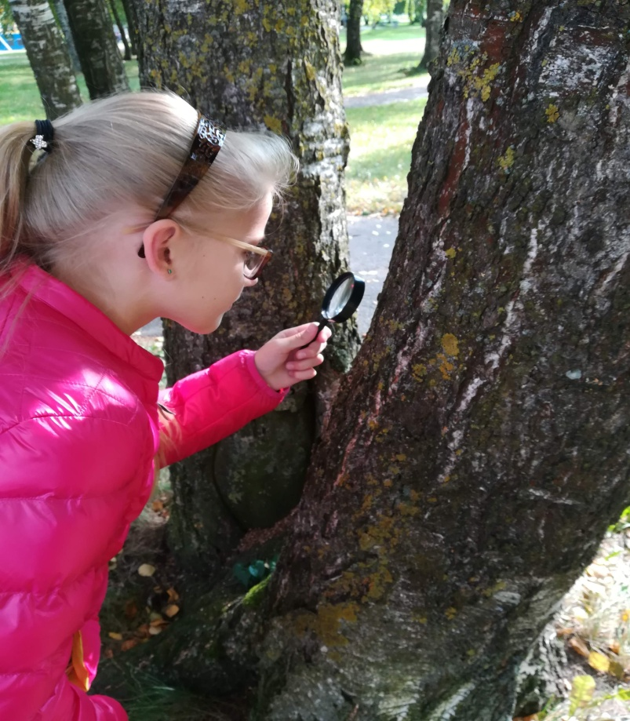
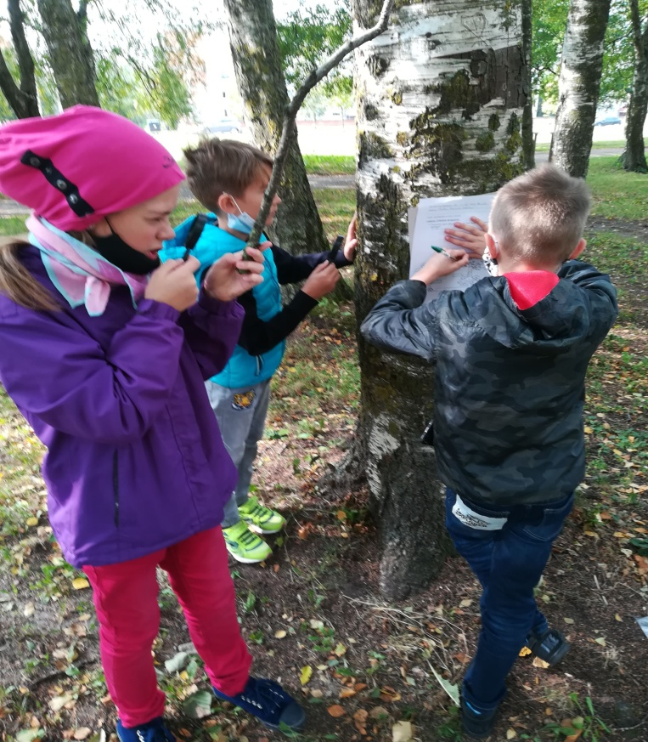
STUDENTS STUDY AND THINK: Students remembered parts of the plant, looked through the loupe. Then they discusssed what they saw and noticed in the groups of 4.

Slide 3
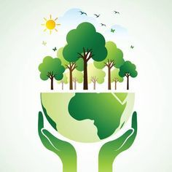
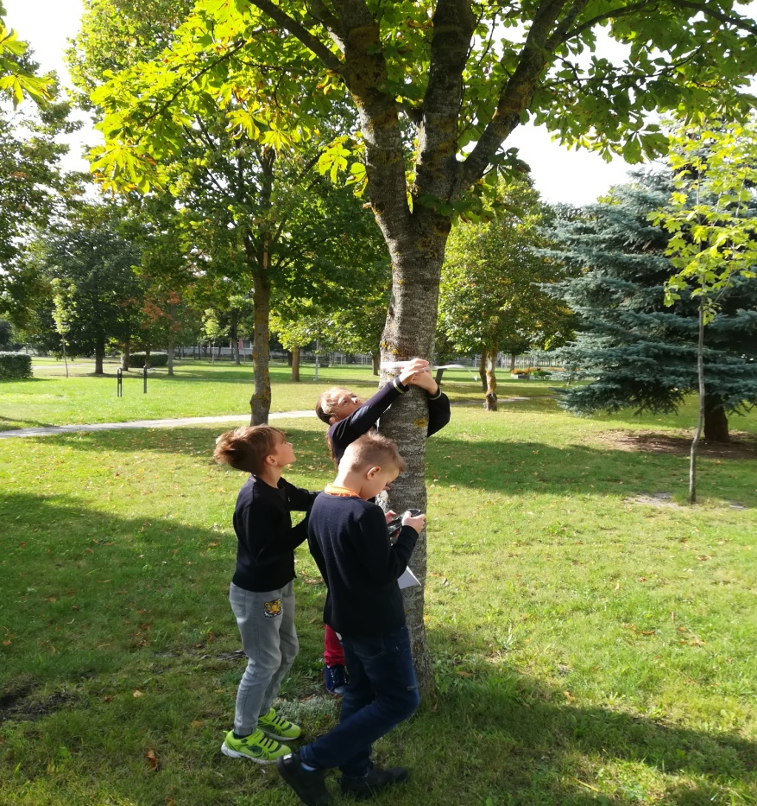
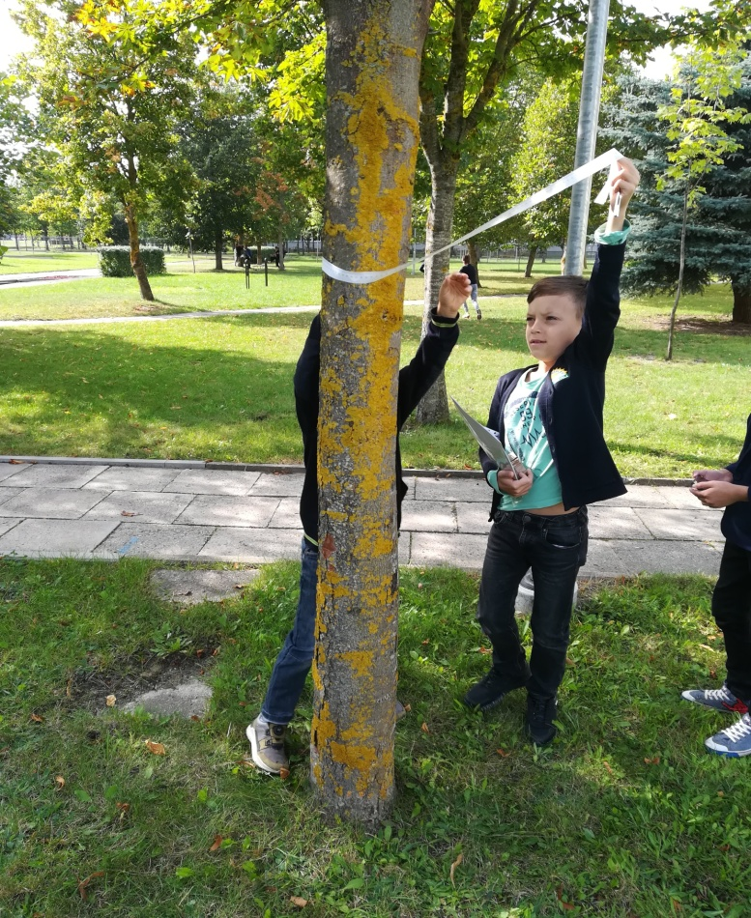
2. I am researching and thinking:How to predict the age of the tree? They chose three trees, guessed what was the scope of their trunks. Using the tape- measure, at the hight of their eyes, they measured the scopes of the trunks. Then they found out if their guesses had been confirmed.

Slide 4
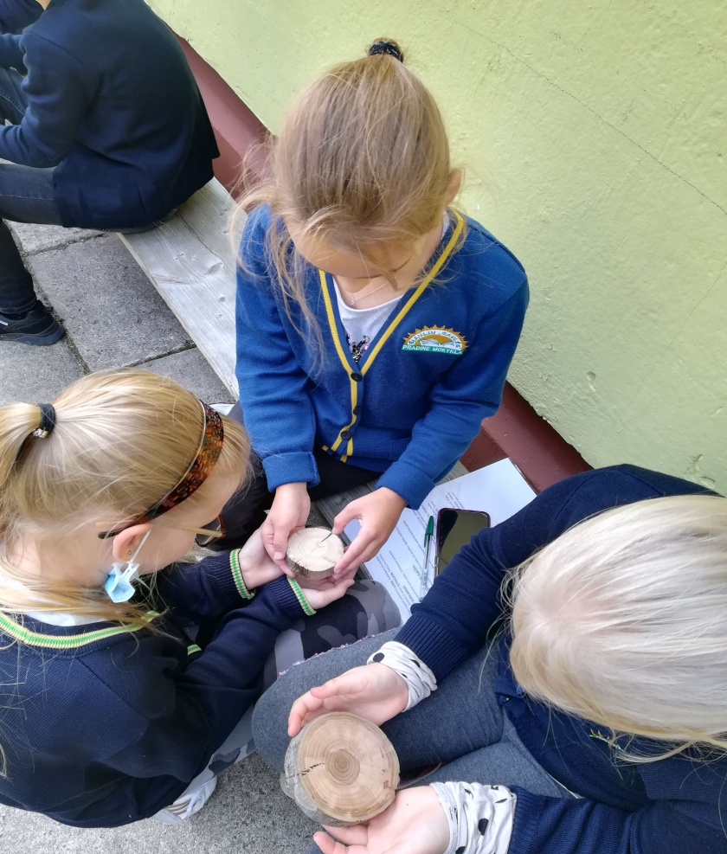
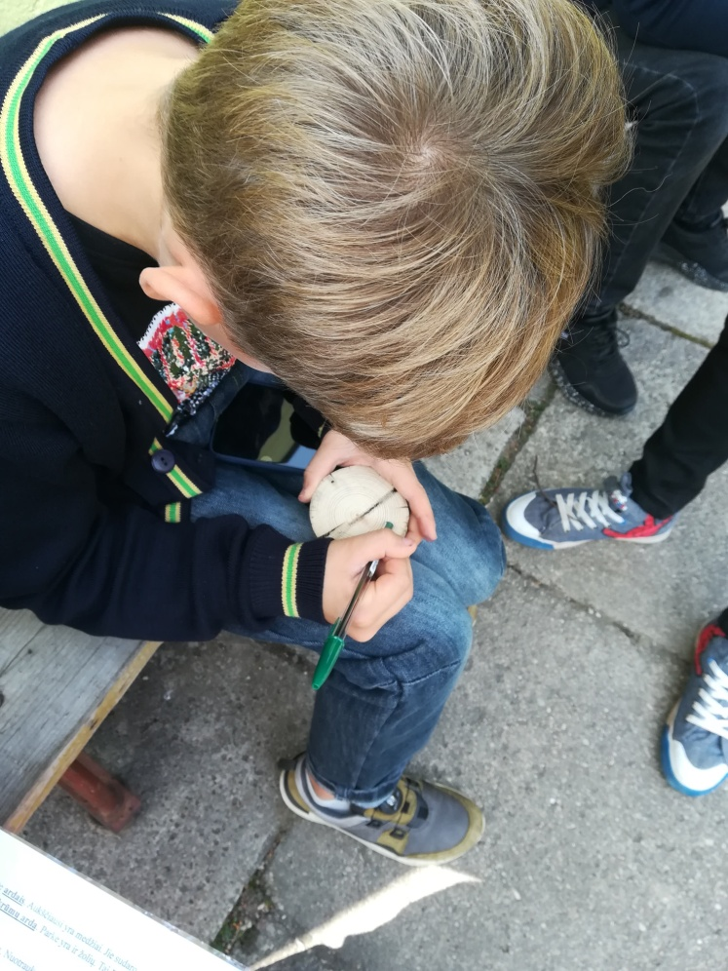
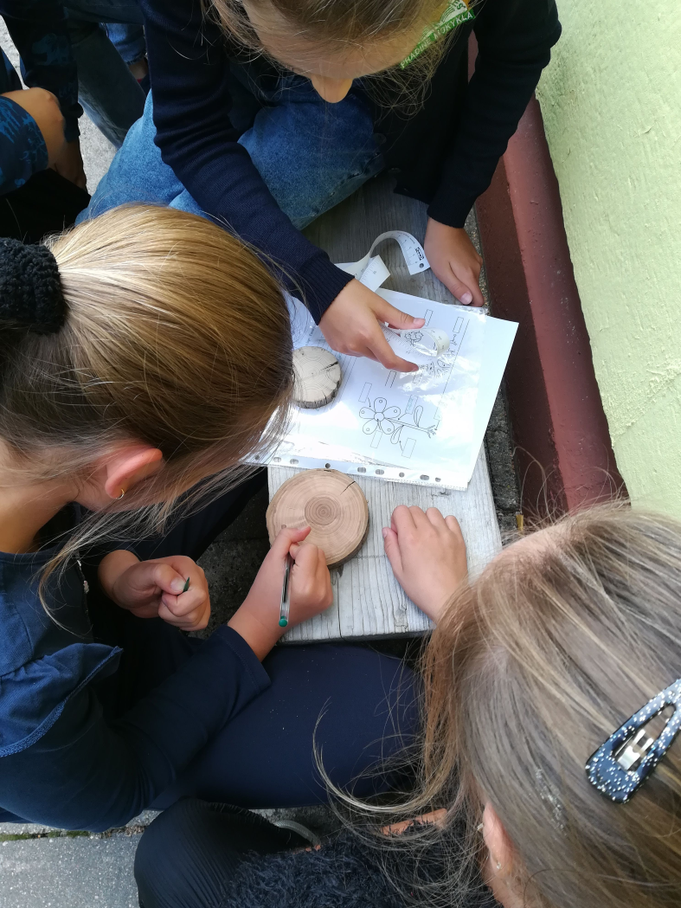
3. I‘M RESEARCHING AND THINKING: What‘s the age of the tree? They found the heart of the tree, a small circle in the middle. Then they began counting from a dark ring around its heart and continued counting untill reached the bark. The number of rings corresponds to the age of the tree.

Slide 5
FEEDBACK. STUDENTS‘ BRAINSTORM TREE- INEXHAUSTIBLE SOURCE OF ENERGY. TREE-THE OBJECT OF INFORMATION ABOUT ENVIRONMENT AROUND US. TREE- A SPREADER OF GOOD MOOD, COMFORTER. TREE- A MAGIC LABORATORY AND A BIG PRESENT TO ALL OF US. STUDENTS WILLINGLY TOUCHED AND WERE INTERESTED IN PLANTS AND THEIR SAVING.

