Slide 1
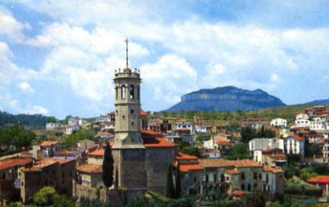
SANT FELIU DE CODINES
Our town
5th grade / Fedac Sant Feliu

Slide 2
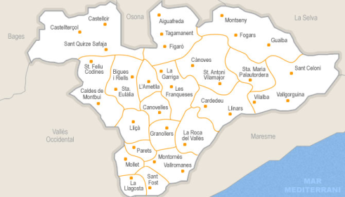
INTRODUCTION
Sant Feliu de Codines (our town) is in Barcelona in a region called Vallés Oriental. It is between Caldes de Montbui and Castellterçol
Here we are
There are approximately
6,000 inhabitants

Slide 3
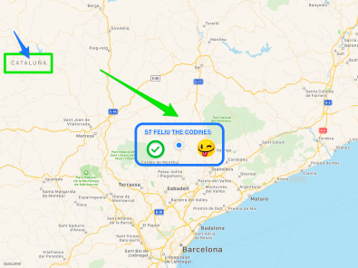
COAT OF ARMS MAP

Slide 4
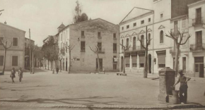
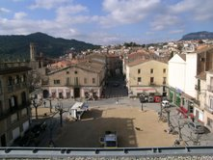
“LA PLAÇA”
The square of Sant Feliu De Codines is situated in the center of the town
There are two coffees, a stationary, two bakeries, some houses and a library around the square.
the old one on 1920
the new one on 2018

Slide 5
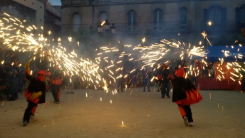
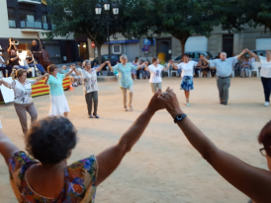
In the square people
Can have some drinks like: herbs, coffee, juices ...
In the square people can dance ”sardanas” (a typical Catalan dance), watch theatre, do crafts (for young children), different festivals like “correfoc”, a typical party with firecrackers.
CORREFOC (FIRECRACKERS)
SARDANA (TYPICAL CATALAN DANCE)

Slide 6
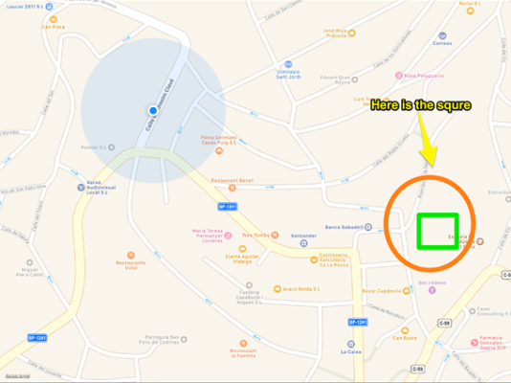
MAP

Slide 7
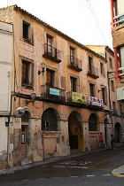
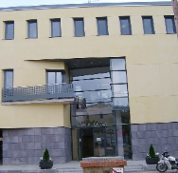
THE TOWN HALL
The new Town Hall of Sant Feliu de Codines is located in the center of the town, in the main square.
New Town Hall Old Town Hall

Slide 8
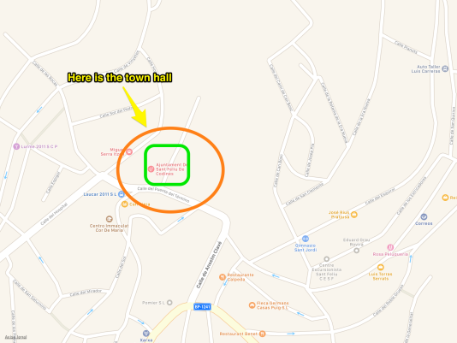
MAP

Slide 9
THE CHURCH
The church of Sant Feliu de Codines is on the old quarter.
It was rebuilt after the war of Spain in 1936.
All the old quarter is made of stone.
Martí is the priest´s name of Sant Feliu. He is friendly.
The priest participates in most of the activities of the town.

Slide 10
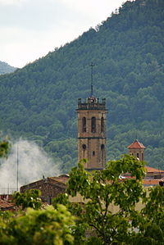
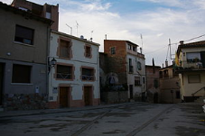
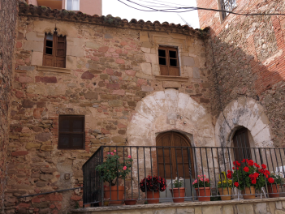
Photos of Sagrera neighbourhood

Slide 11
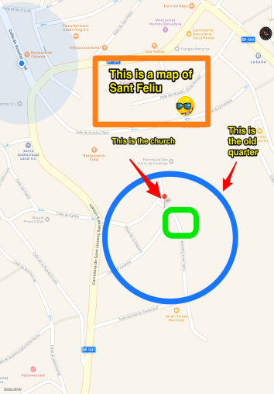
MAP

Slide 12
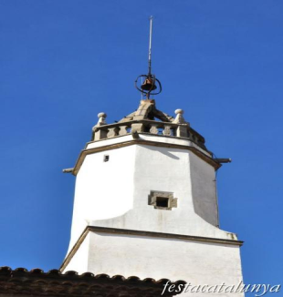
THE CLOCK TOWER
It is the oldest tower of the town.
It´s located in the center of the town .
We can hear the time each quarter of an hour.
Its was built at the end of the 18th century.

Slide 13
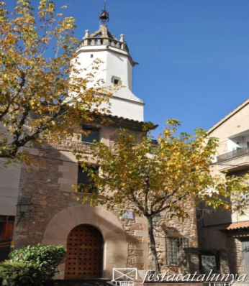
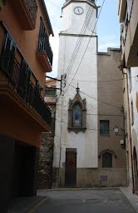
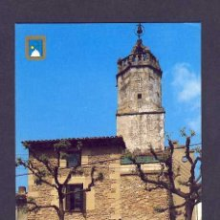
THE CLOCK TOWER

Slide 14
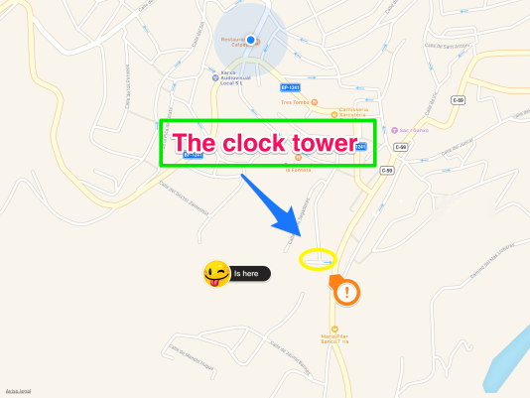
MAP

Slide 15
CIVIC CENTER
The Civic center is an old factory rebuilt to use to do different activities such as:
Cinema, dancing, roller skate, children club , theatre, computer courses, tournement of scalextric, tournament of PSP 4 and a service of bar and restaurant.

Slide 16
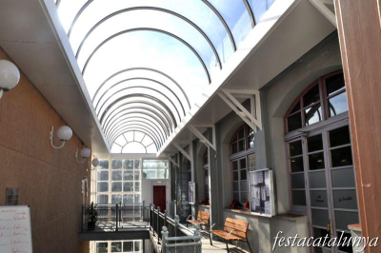
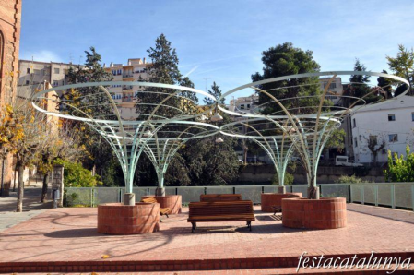
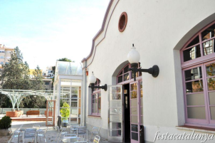

Slide 17
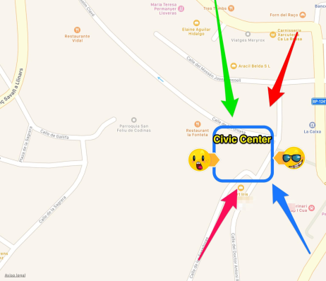
MAP

Slide 18
SCHOOLS
There are four schools in our town.
-FEDAC school: Primary and Secondary schools. It’s a semi private school.
-Jaume Balmes: Primary public school.
-Carrasco i Formiguera: Secondary public school
-Mestre Jané : Kindergarden school

Slide 19
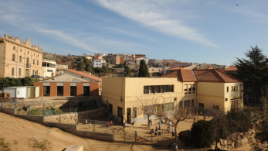
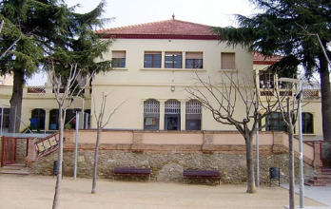
Fedac Sant Feliu
Information
In the school there are 340 students.
Fedac Sant Feliu has two buildings, one for primary and pre-primary
and the other for secondary.

Slide 20
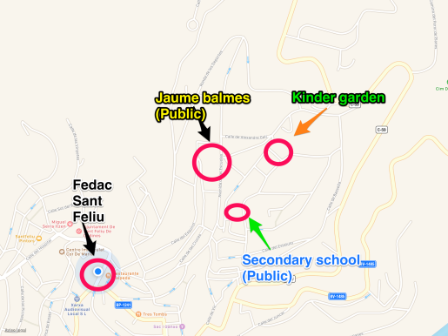
MAP

Slide 21
SPORTS CENTER
It’s an area, where we can play different sports. There are three different places to play them: the pavilion, the tennis court and the football court. In the pavilion, people practice hockey, basket, football and skating. Tennis is played in the tennis court, and you can play football and athletics in the football court.

Slide 22
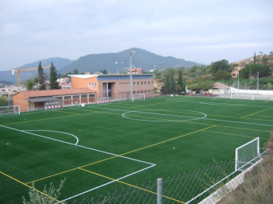
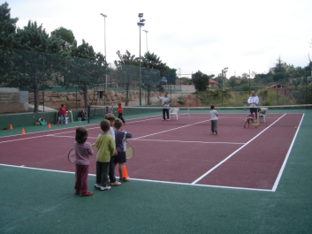
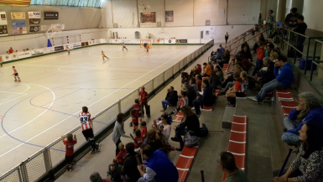

Slide 23
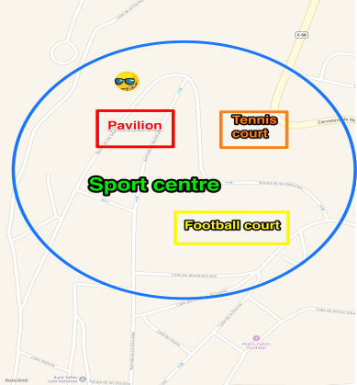
MAP

Slide 24
ALBERS PARK
The “ Albers Park” is a park next to the school.
In Albers park the are 2 parks, 1 zone is for young children to play
and the oher zone is for the adults to sit and relax.
It is very nice!!!

Slide 25
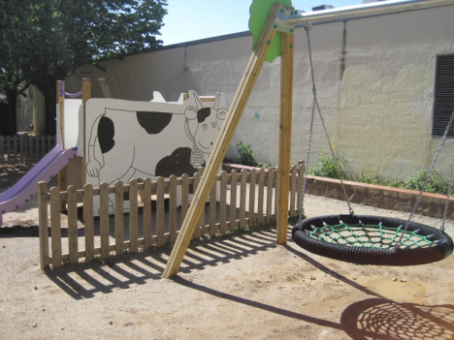
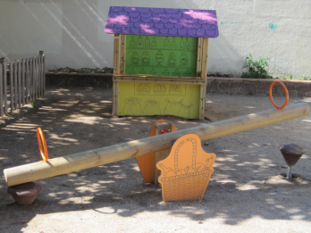
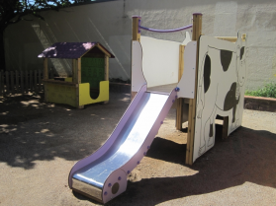

Slide 26
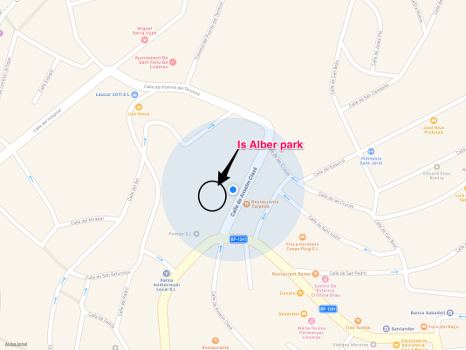
MAP

Slide 27
THE CLOCK MUSEUM
In Sant Feliu de Codines we have got the clock museum. This museum is downstairs of one theatre and there are lots of old clocks. Every year there is a big clock fair and people come from everywhere to visit and to buy old clocks.

Slide 28
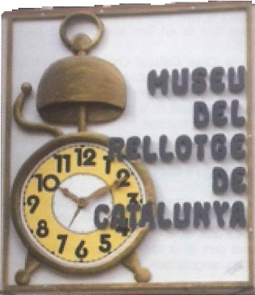
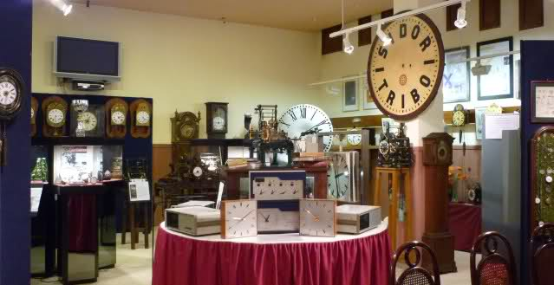

Slide 29
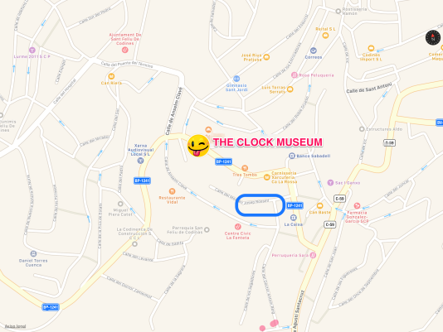
MAP

Slide 30
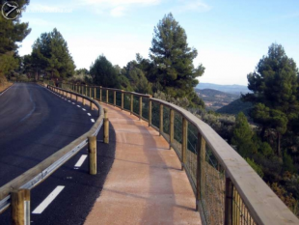
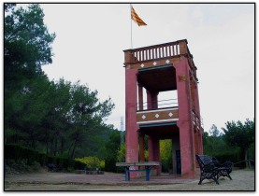
PARK USART
Park Usart has incredible views and you can see them from this tower.The park is near the town, and people usually go there by bike or walking.

Slide 31
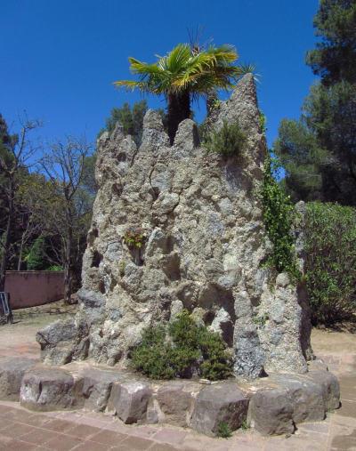
Next to the park Usart there is a path where you can go through the wood.

Slide 32
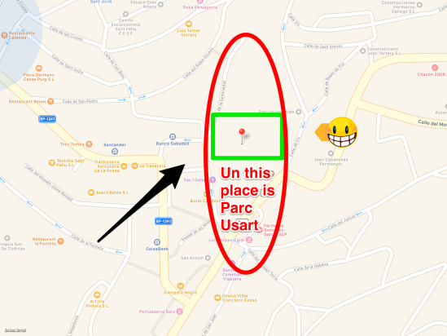
MAP

Slide 33
PARK XIFREDA
Can Xifreda is a nice park in the centre of Sant Feliu.
There are a lot of trees and very good landscapes.
There is a fountain to drink water and there are swings.

Slide 34
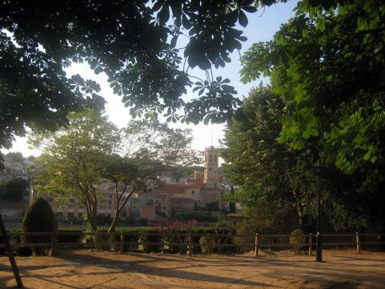
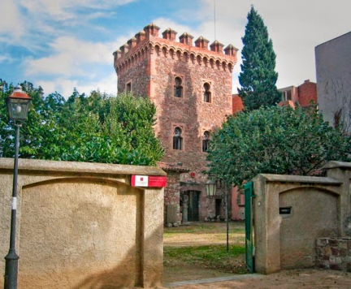

Slide 35
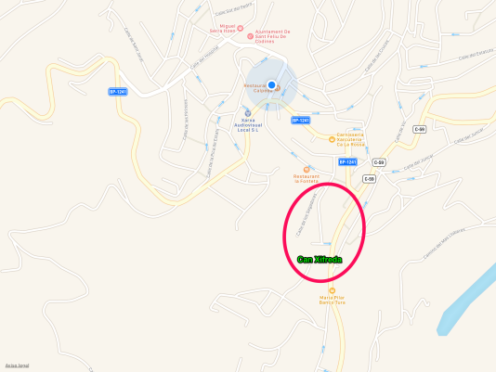
MAP

Slide 36
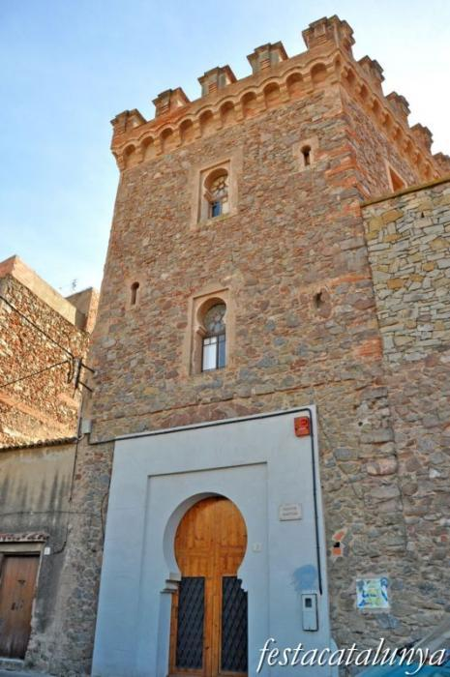
ARQUEOLOGICAL MUSEUM
The arquelogical museum is a prehistoric place where we can observe old things.
There are: old bones, old rocks, knives, arrows, fossils and a lot of more prehistoric things.

Slide 37
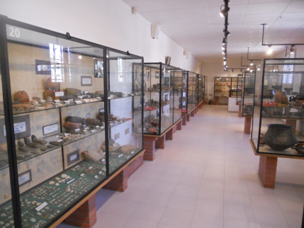
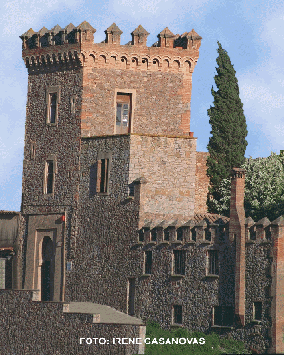

Slide 38
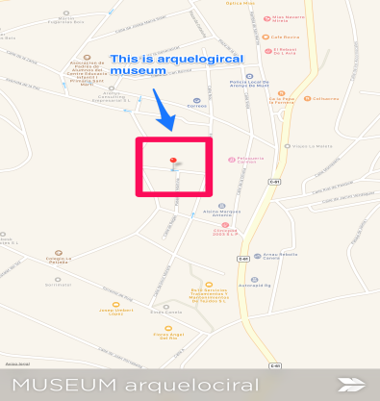
MAP

