Slide 1
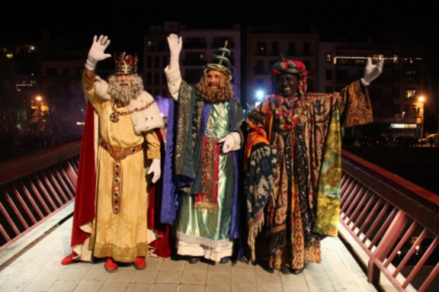
THE THREE KINGS
5th class
E-twining
Marc Tuneu and Roger Masiques

Slide 2
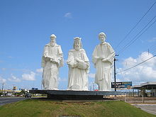
THE HISTORY OF THE THREE KINGS
The Kings of the East, according to the New Testament, were magicians who brought gifts to Jesus and were guided by a star. These gifts were gold, incense and myrrh.

Slide 3
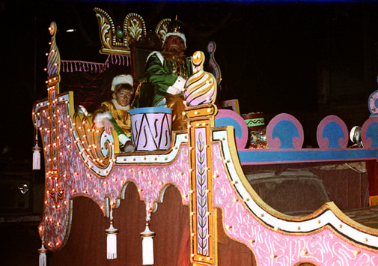
THE NIGHT OF THE KINGS
The Catholic Church in Spain, celebrates the Day of the Three Kings festival on January 6 th.
During the previous days, the children write a letter to Kings Melcior, Gaspar and Baltasar asking for what presents or toys they want, and they behave a little better than the previous days and prepare emotionally for the arrival of the Kings.

