Slide 1
‘Water unites us’ project is funded by European Comission in the framework of Erasmus+.
Cooperation and Innovation for Good Practices.
Water unites us
KA2 Erasmus+ Strategic Partneships School project
6y
Olaine Secondary School No 1
Transnational meeting in Latvia, November 2017

Slide 2
WETLANDS And swaps

Slide 3
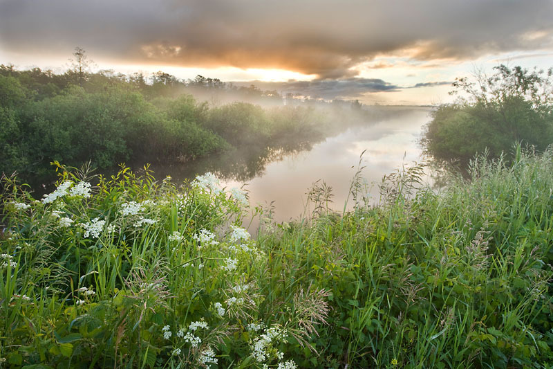
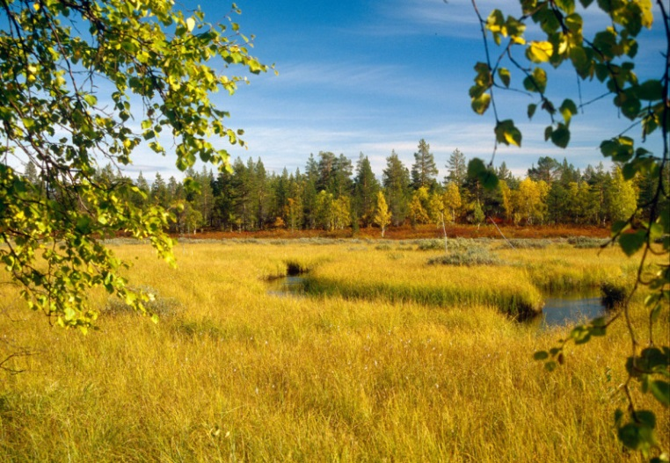
Wetlands
These are eco-systems which constantly or periodically collect water.
Wetland or mire is the territory or biome which is too humid or covered with a shallow water layer. Swamps, rivers, lakes, streams are considered wetlands

Slide 4
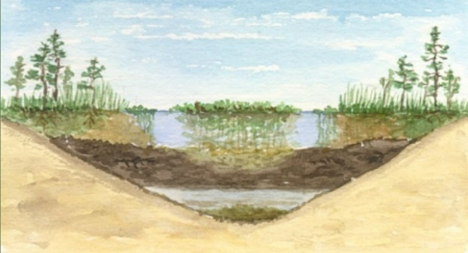
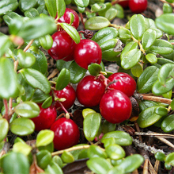
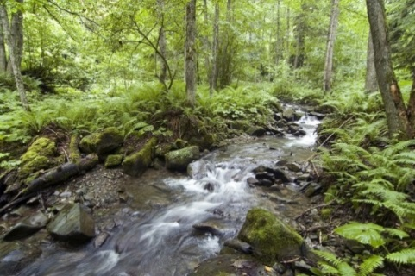
The Significance of Wetlands
Wetlands are marvellous and very valuable eco-systems –
they perform water treatment
supply the groundwater with water
helps to soften the climate changes
reduce the amount of flood
are used in the extraction of materials and food
are the habitat for a huge number of species of plants and animals

Slide 5
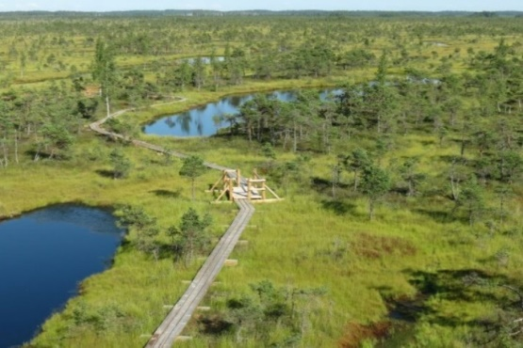
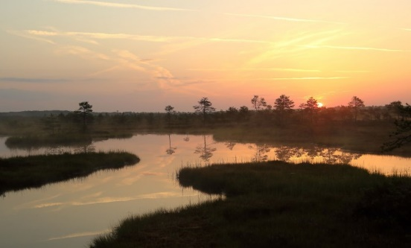
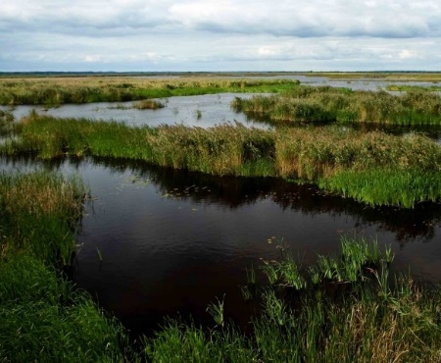
The Areas of Wetlands in Latvia
The most significant areas of wetlands in Latvia are formed by more than 12 400 rivers and 2256 lakes which are bigger than one hectare.

Slide 6
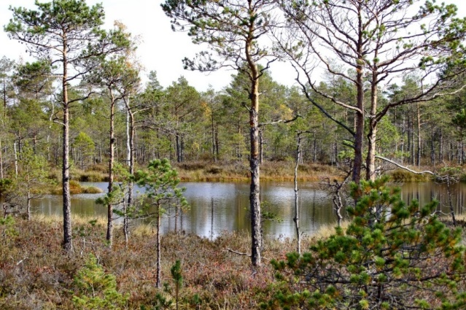
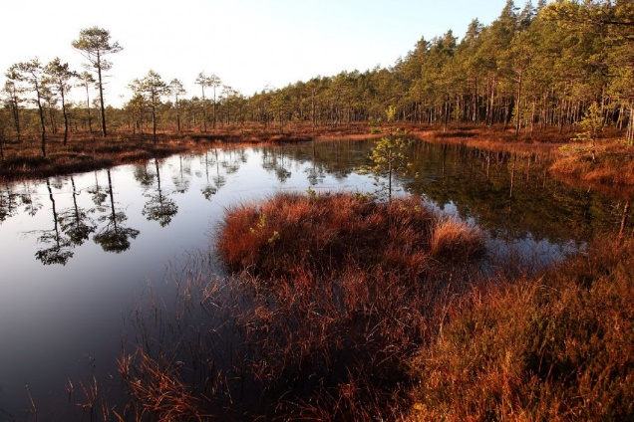
What is the swamp?
The swamp is the upper part or plot of the ground which has some typical features:
Constant or continuous periodical wetness;
Specific flora;
Accumulation of peat moss.
The swamp can be formed by the area that turns into the swamp or overgrowing the water body.

Slide 7
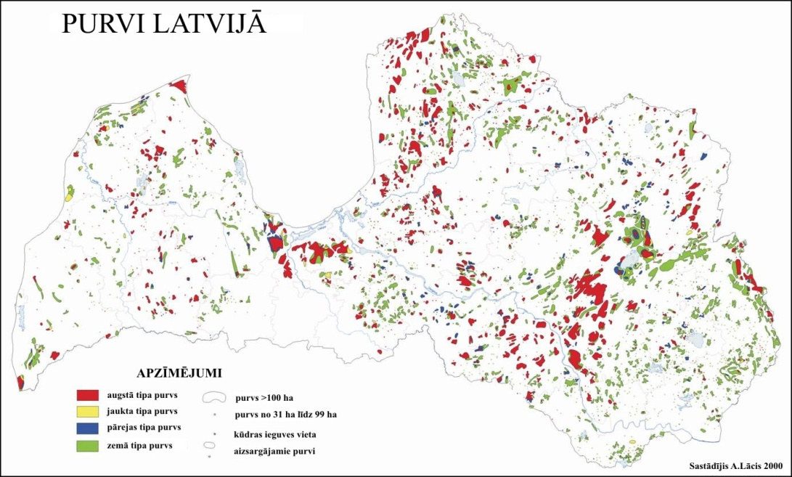
The Area of Swamps
Swamps occupy 10% of the territory of the country but only 4.9% are undamaged swamp areas.

Slide 8
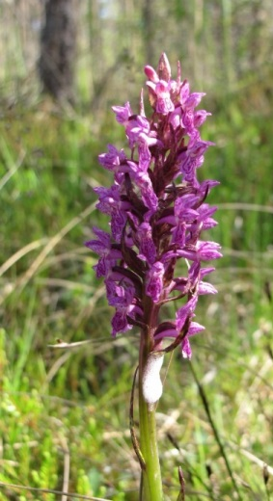
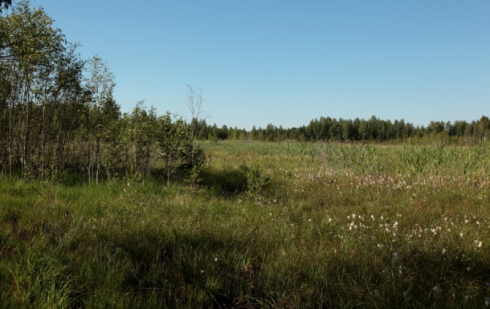
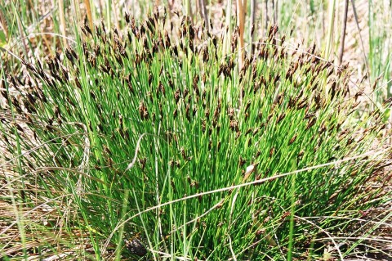
Classification of Swamps
Low or grass swamp – historically, it is the first stage of the development of swamps. Such a swamp is fed on ground waters which contain dissolved mineral substances that are needed for the plants.
brown Bog-rush
common Butterwort

Slide 9
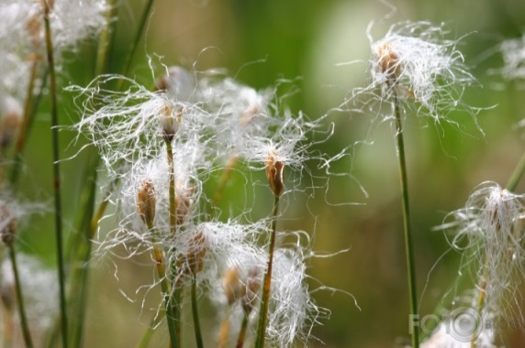
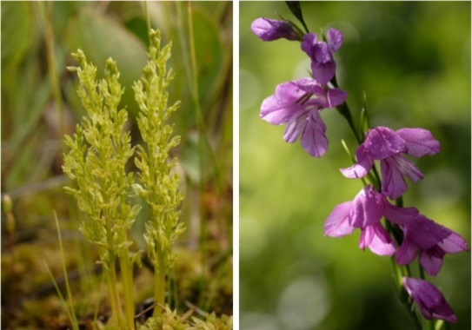
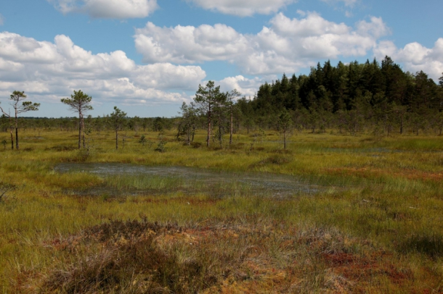
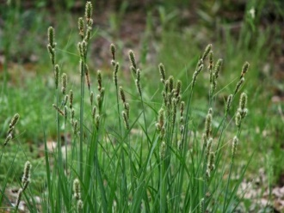
Transitive swamps – are developed from grass swamps, it is the inter-transitive stage between the high and low swamp; it contains the features of both types of swamps.
cotton Deergrass
bog Orchid
.
Hartmaņa Sedge

Slide 10
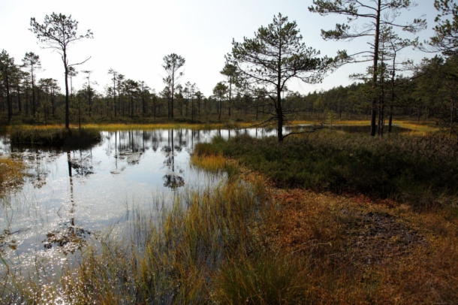
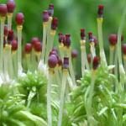
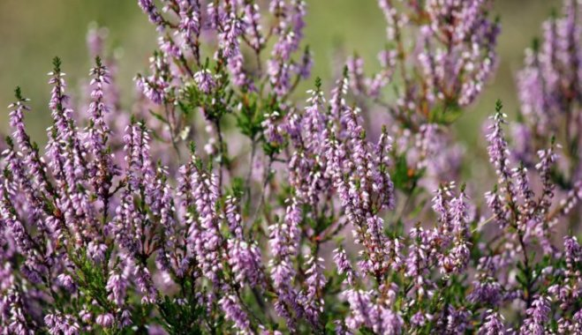
High of moss swamp – is developed from the transitive swamp and is the final degree of the swamp development. Such type of swamps obtains water and nutrients only from rainfall.
Sfagnum
Heather
Moss swamps are the poorest of all kinds of swamps in species. Only docile species of plants, which grow in nutrient poor environment, can survive there.

Slide 11
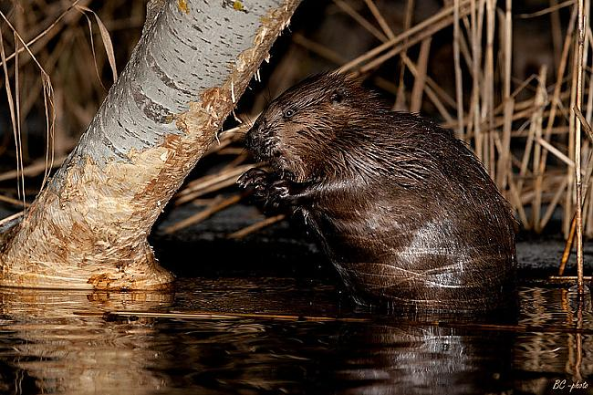
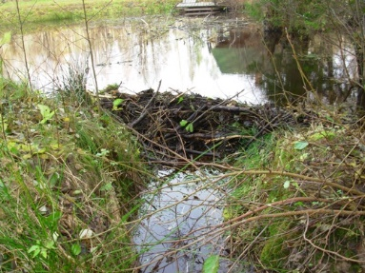
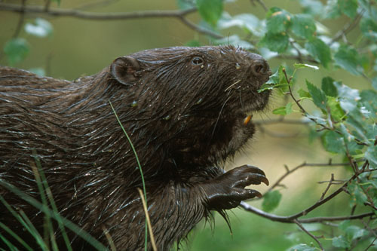
Influence of Beaver on ecosystems in Latvia
Beavers, building dams, flood large areas.

Slide 12
Thank you for attention!
Thank you for attention!

