Slide 1
‘Water unites us’ project is funded by European Comission in the framework of Erasmus+.
Cooperation and Innovation for Good Practices.
Water unites us
KA2 Erasmus+ Strategic Partneships School project
Olaine Secondary School No1
Transnational meeting in Latvia, November 2017

Slide 3
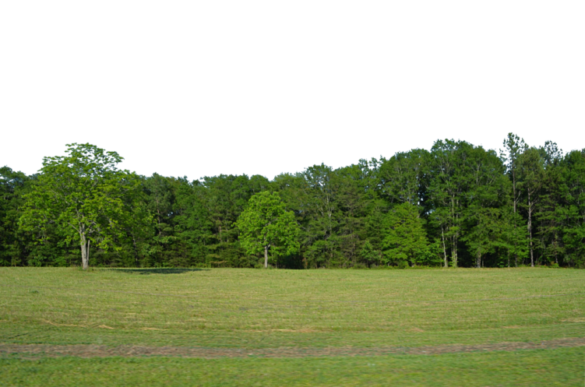

Slide 4
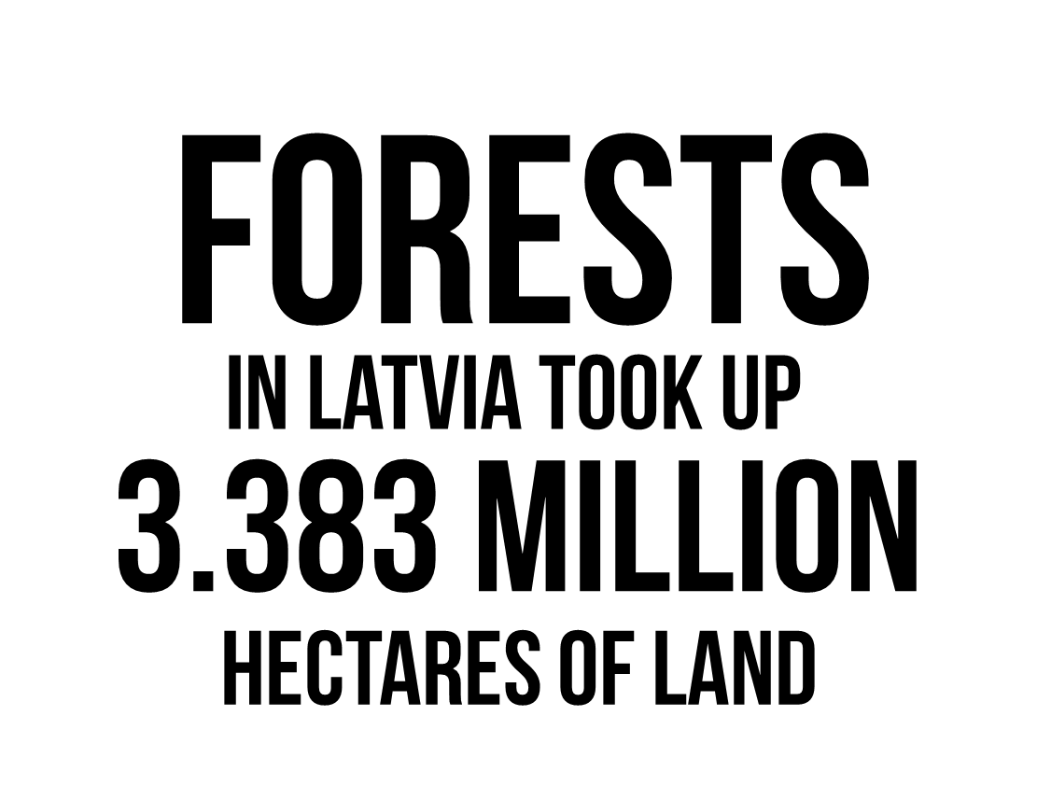

Slide 7
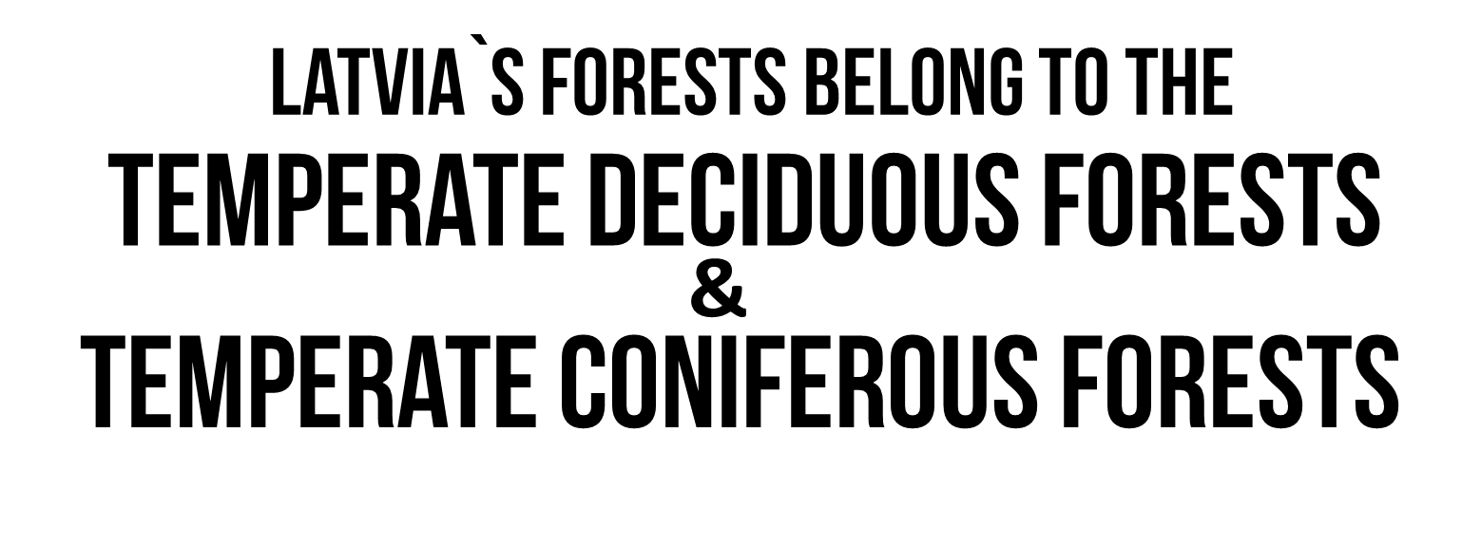
THE FOREST OF LATVIA
BELONG TO THE

Slide 8
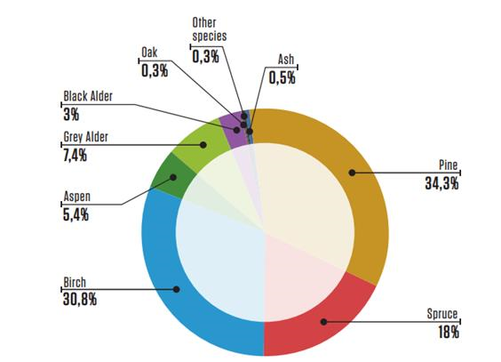
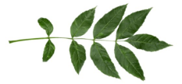
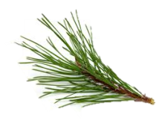
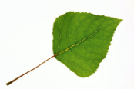
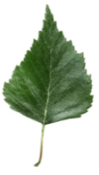

Slide 9
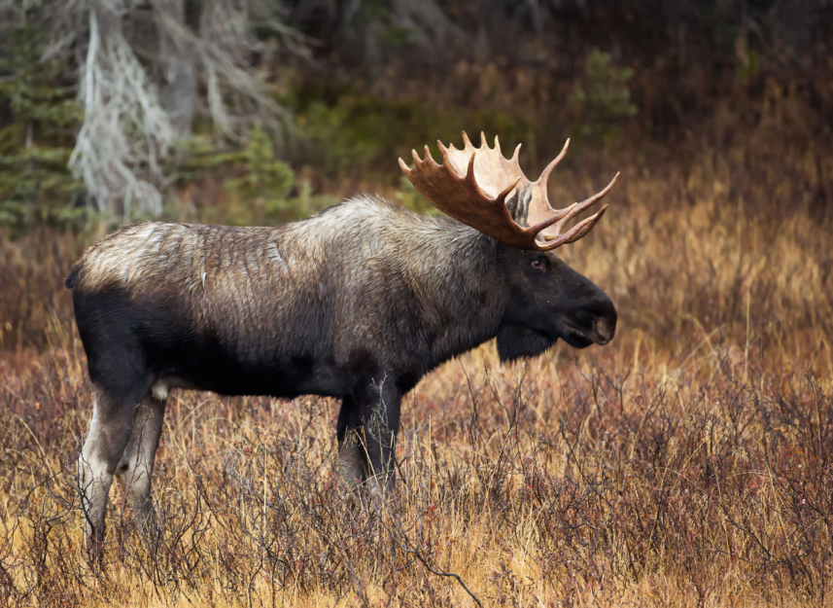
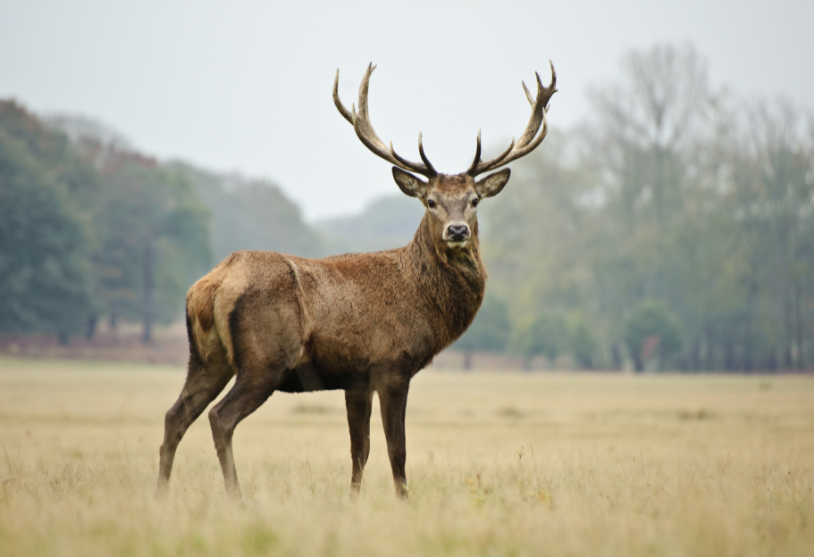
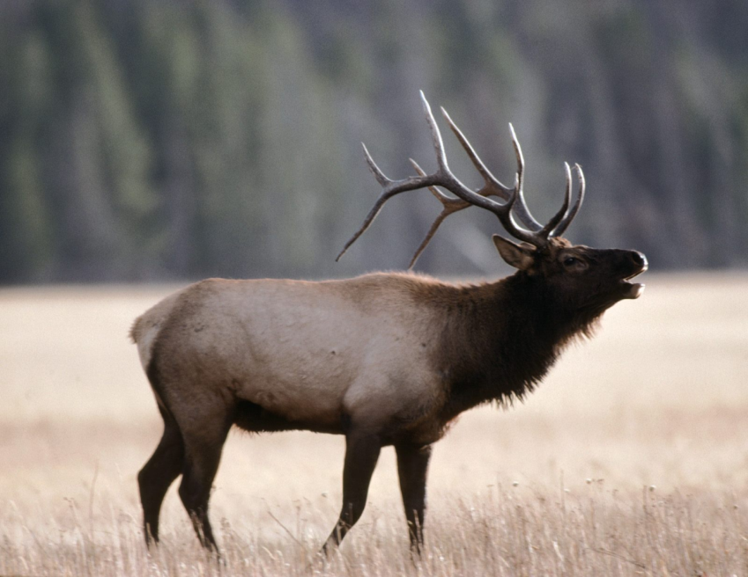
EXAMPLES OF ANIMALS THAT DOMINATE IN THE FOREST:

Slide 10
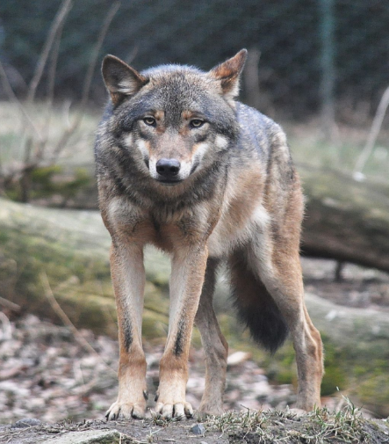
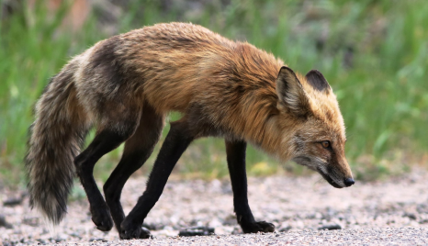
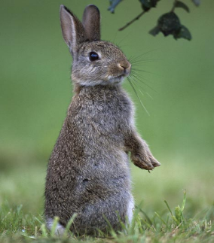
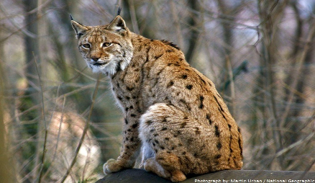
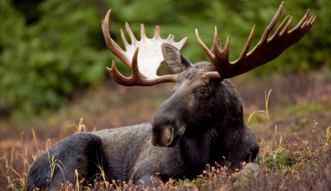
ANIMALS LIVING IN THE TEMPERATE DECIDUOUS FORESTS MUST BE ADAPTED TO COLD WINTERS.

Slide 11
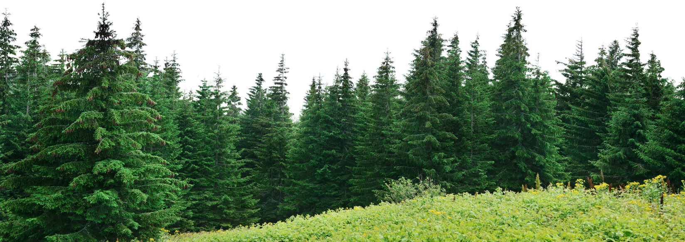
EVERGREEN CONIFERS DOMINATE IN THESE FORESTS.

Slide 12
Latvian meadows

Slide 13
Meadows
Meadows are one of Latvian ecosystems.
Meadow is formed as a result of harvesting and grazing.
Approximately 50% of the protected plant species are found in the meadows.

Slide 14
About meadows
They cover approximateley 1% of the territory of Latvia
There are different types of meadows in Latvia:
Dry meadows
Moderately humid meadows
Wet meadows

Slide 15
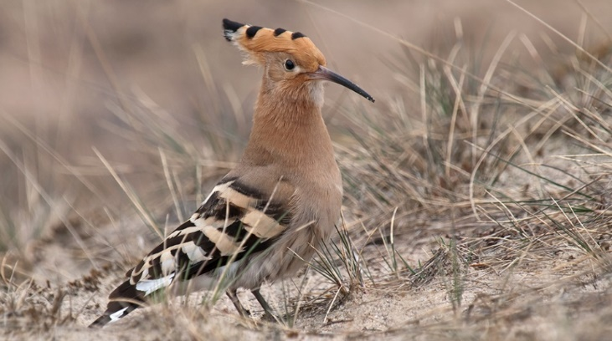
Dry meadows
Located in dry places - in the dunes, sands and cliffs.
Surface is covered with grasses.
Plants do not cover the whole soil.
Hoopoe (Upupa epops)

Slide 16
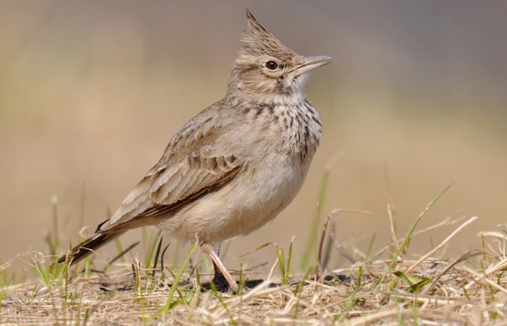
Moderately humid meadows
The most popular meadow type in Latvia.
The meadow is fertile.
It is seasonally wet.
Plants grow in different floors.
The high diversity of species.
Crested lark (Galerida cristata)

Slide 17
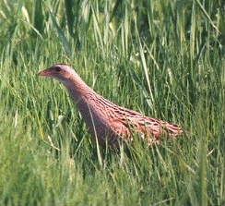
Wet meadows
They are located close to the lakes or rivers
Dominant plant - sedges
Almost all year water is above the soil
Birds can hide and get water supplies
It is the smallest by territory
Corn crake (Crex crex)

Slide 18
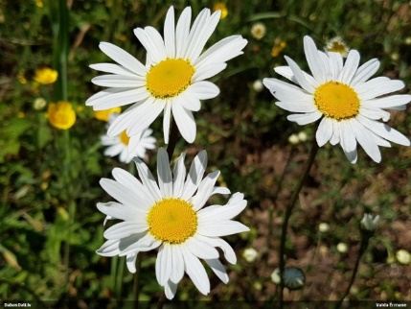
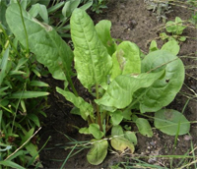
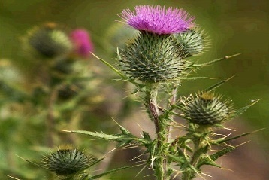
Types of plants which are in the meadows
Approximatley 1/3 of all Latvian plant types
Oxeye daisy
Red clover
Poppy
Burdock
Broad-leaved dock

Slide 19
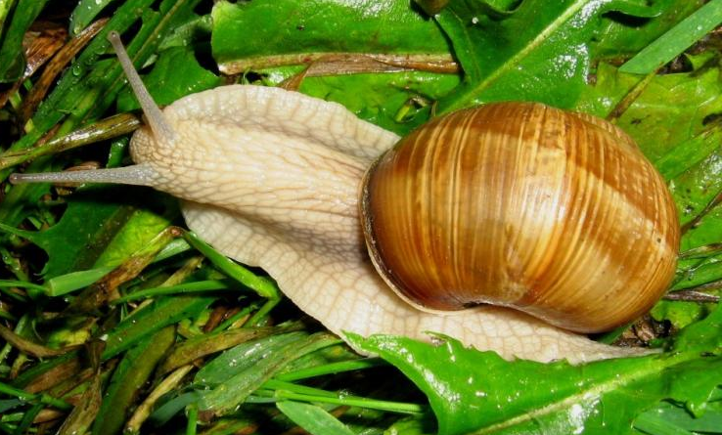
Animal types in the meadows
In the meadows there live two different animal types:
vertebrate animals
invertebrate animals

Slide 20
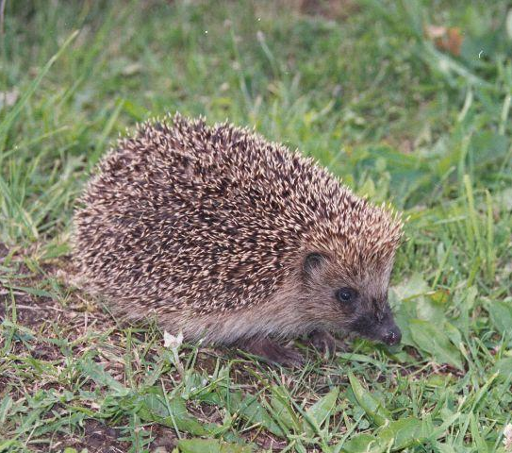
Vertebrate animals
Invertebrate animals

Slide 21
The protection of meadows
The meadows are the most protected biotope in Latvia
Meadows must be protected from fire
Meadows must be protected from overgrowing
The natural area of meadows is sharply reducing

