Slide 1
WATER SPORTS
We have a beautiful sea, where we can spend our time with friends and do all what we want: for example we have so much fun in doing thrilling WATER SPORTS!

Slide 2
Windsurfing

Slide 3
What is Windsurf?
Windsurf is a form of sailing, where a board
is powered across the water by the wind.
.

Slide 4
Unlike surfing, windsurfing uses
the wind to propel forward while
surfing uses the force of waves.

Slide 5
You can practice the sport anywhere
with a big body of water

Slide 6
…it can be enjoyed at any age

Slide 7
Windsurfing in Salento...

Slide 8
Where can we practice windsurfing in Salento?
Torre dell’Orso
Gallipoli
Torre Mozza
Porto Cesareo

Slide 9
Kitesurfing

Slide 10
Kitesurfing or kiteboarding
or more commonly "kite"

Slide 11
Invented in 1999

Slide 12
It is a variant of surfing and consists in being driven by a kite

Slide 13
It uses the wind as a propeller and a "control bar“
connected to the kite by thin cables called "lines"

Slide 14
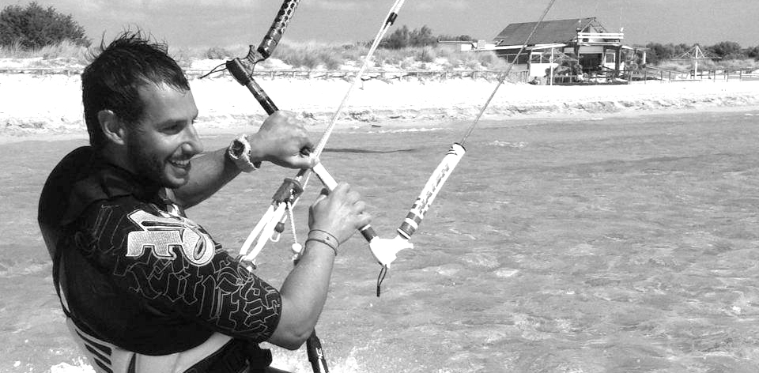
KITESURF’S SCHOOL IN SALENTO
Daniele De Nuzzo
masculine instructor IKO 2° level
masculine instructorI FIV 1° Level
The Salento Coast Ovest kitesurf school is the first school for kitersurfing on the Ionian coast and gives kitesurfing lessons in Gallipoli - Baia Verde and in the Natural Park of Lido Pizzo, Torre San Giovanni and Marina di Ugento.

Slide 15
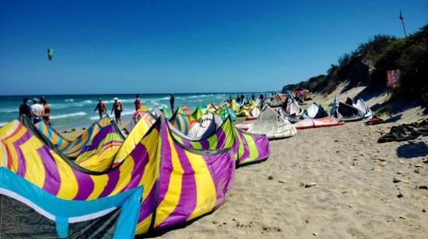
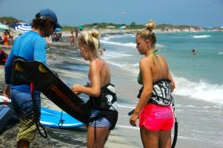
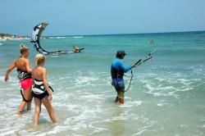
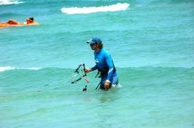
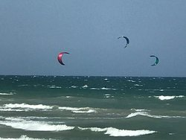
Kitesurfing in Salento
Torre Mozza
Torre dell’Orso
Porto Cesareo

Slide 16
Flyboarding

Slide 17
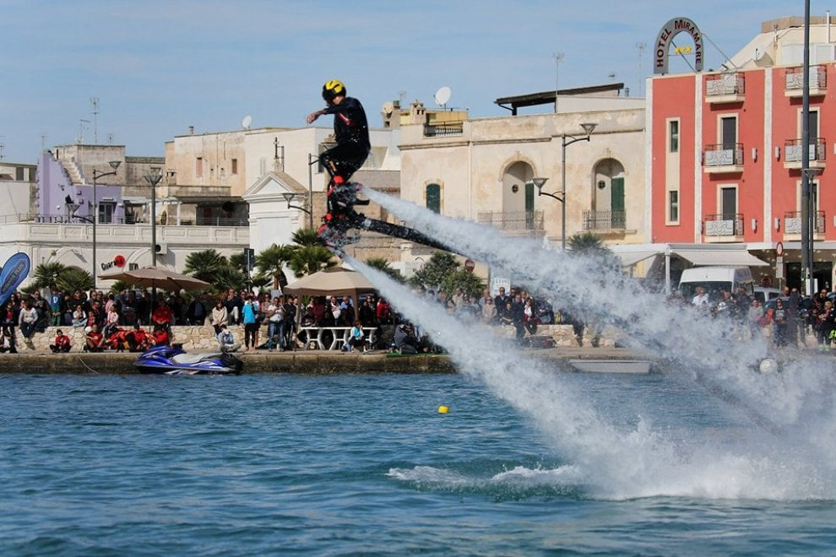
Flyboarding components
a Flyboard Board;
a pair of Wakeboard boots;
a rotation system, equipped with balls for plastic bearings (in order to avoid corrosion from water);
two hoses with handles (optional) to be inserted on the arms;
a pipe that supplies a jet of pressurized water, from the watercraft to the Flyboard;
a 180 ° recurve tube that serves to reverse the flow of water from the bike;
a conical outlet system for directing and accelerating the flow of water from the turbine.
Porto Cesareo

Slide 18
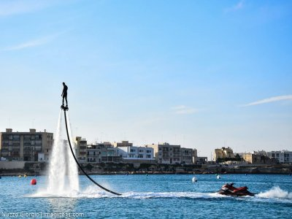
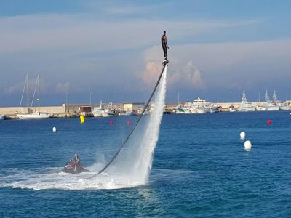
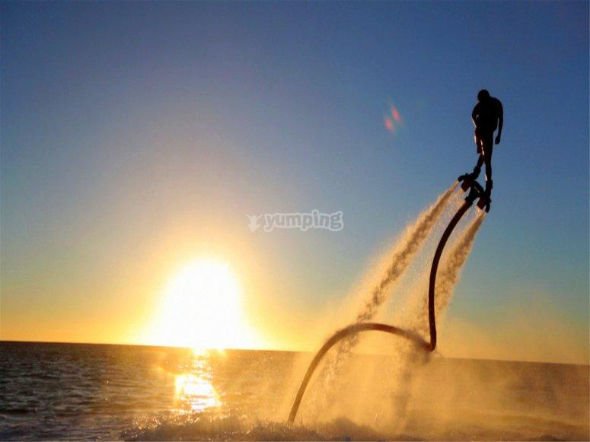
October 26, 2017 in Porto Cesareo province of Lecce was held the world championship flyboard having as a judge Simon Desira the champion of this sport.
The participating categories were: Junior (up to 17 years), Pro (up to 40 years), Veteran (over 40) and Ladies. The athletes come not only from all parts of Italy but also from Malta, England, Spain and France.

Slide 19
Diving

Slide 20
Diving is a sport in which the athletes, jumping from a trampoline or a platform placed at a certain height above a pool, they jump into the water performing a series of acrobatics.
diving is one of the most popular Olympic sports thanks to their spectacularity, attracting a large number of spectators.

Slide 21
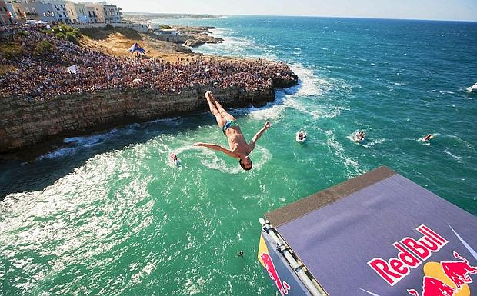
Tenth edition of the world tournament held in Polignano a Mare – Adriatic Coast of Apulia

Slide 22
Diving in the “Poesia” Cave

Slide 23
STAND UP PADDLE (SUP)

Slide 24
WHAT IS S.U.P. ?
Stand Up Paddle (also called in the acronym SUP) is a variant of the surf in which you are standing on a board similar to the surf but with greater volume to support the weight of the athlete, using a paddle suitable for propulsion.

Slide 25
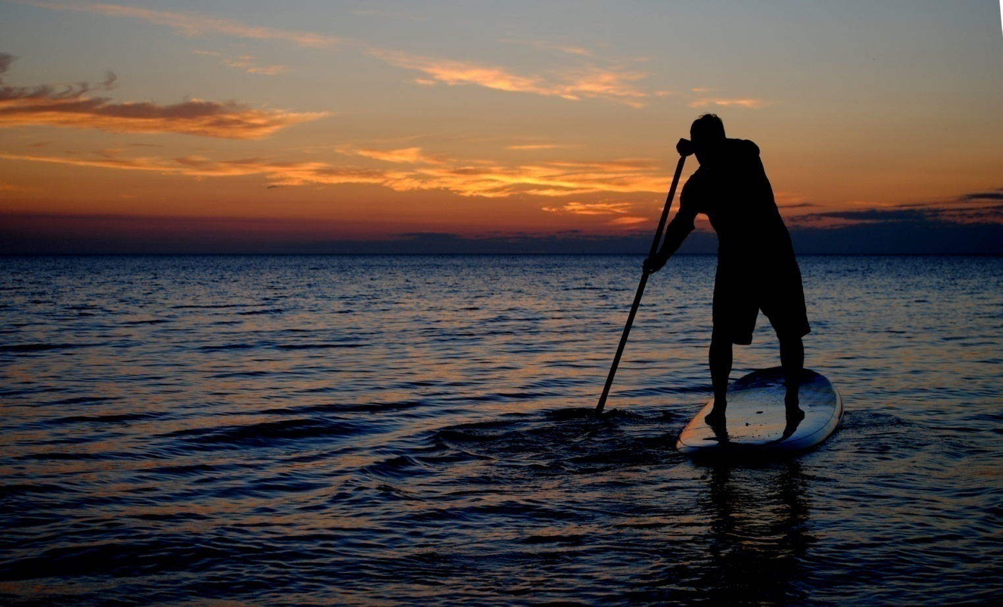
S.U.P. IN SALENTO
Local Salento propose SUP courses to teach you the basics of this sport, which is very easy to learn. After a lesson you can rent the paddle surf and keep practicing on your own!

Slide 26
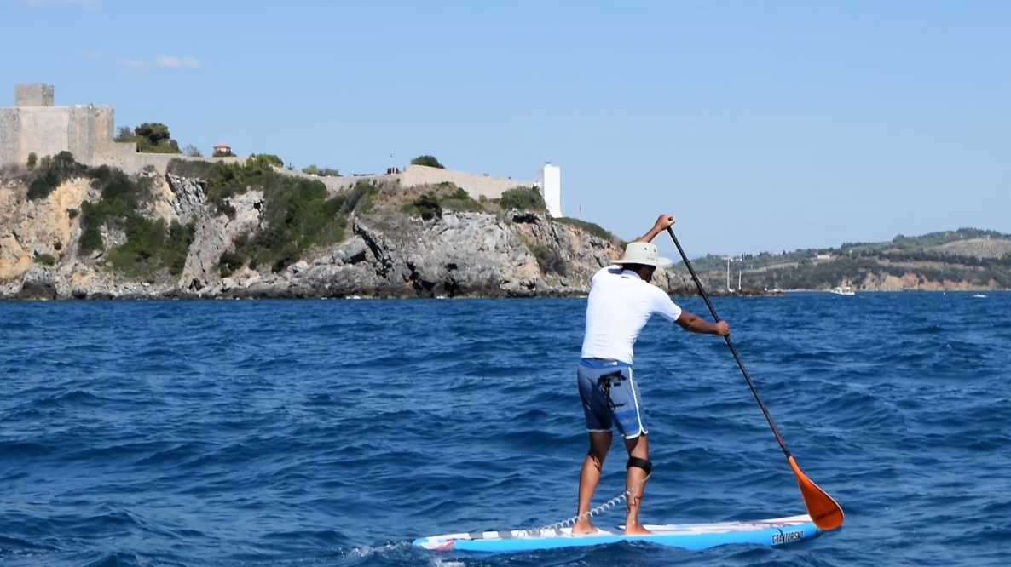
An additional benefit of SUP is the full body workout
wonderful sea of Salento

Slide 27
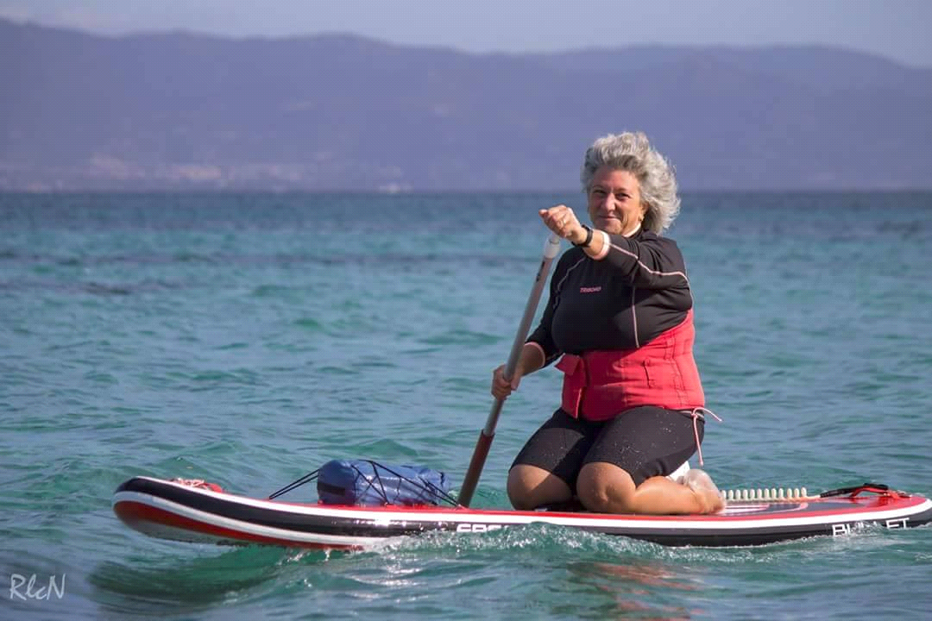
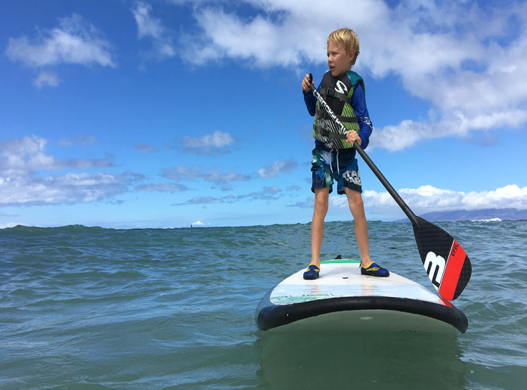
S.U.P. FOR EVERYONE
It’s a funny sport for all ages!

Slide 28
Fantastic time paddle boarding in our crystal clean waters!

Slide 29
Regatta

Slide 30
A regatta is a series of boat races

Slide 31
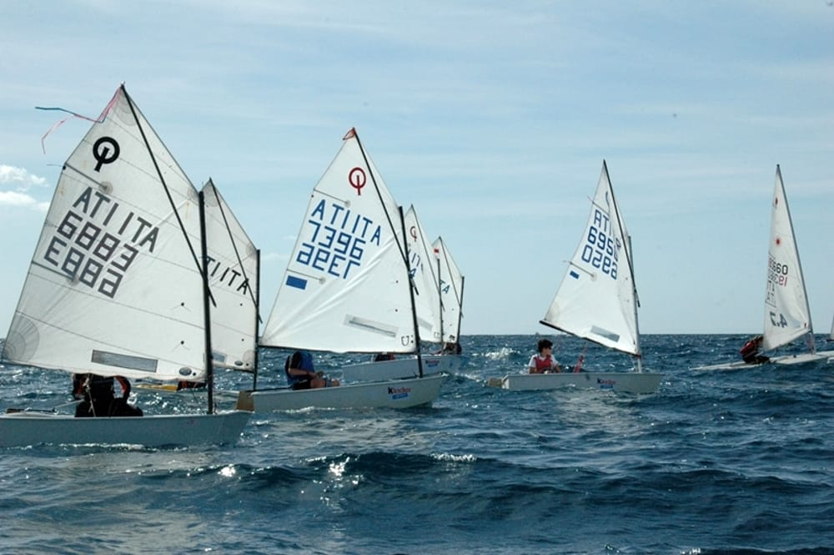
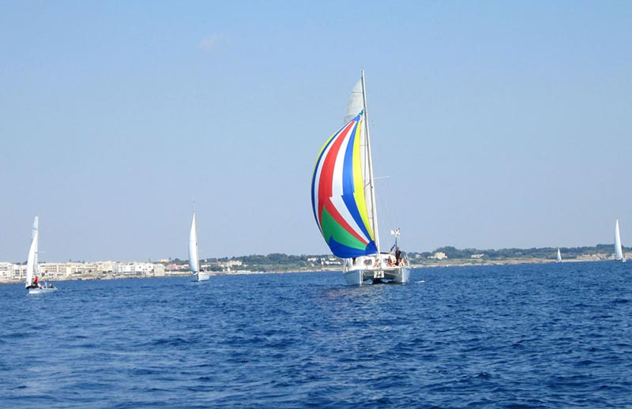
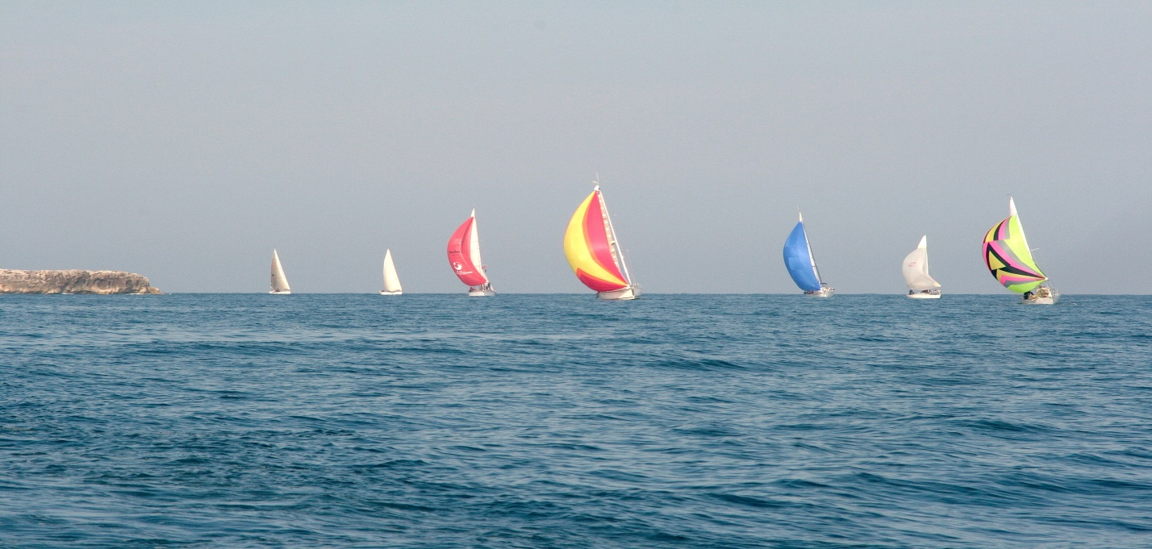
Where can we practice it in Salento?
Otranto
Porto Cesareo
Santa Maria di Leuca

