Slide 1
ERASMUS +
BRIDGE
Building Researching Improving Developing in General Ecology
“WATER UNITES US”

Slide 2
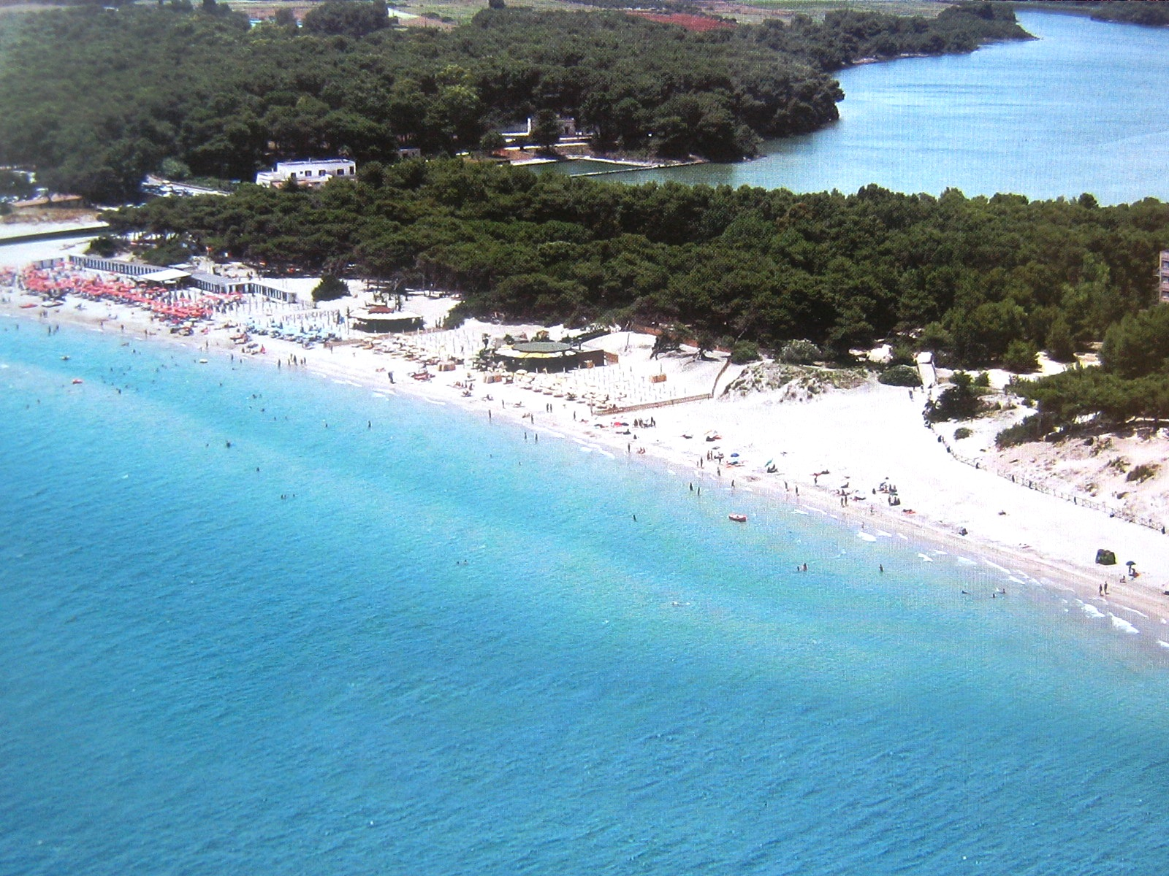
The content
Exploration of the biotic and abiotic parameters of aquatic ecosystems (AQUE) considering the geographical peculiarity of Salento (land between two seas and crossroads between the west and the east in the heart of the Mediterranean).

Slide 3
the following abiotic and biotic parameters will be considered:
main physical-chemical characteristics of water;
geomorphological characters;
present biodiversity level;
rare species;
transadriatic and transionic species;
alien species.

Slide 4
Eco Systems
Punta Palascia
The Italian nearest place to Greece!

Slide 5
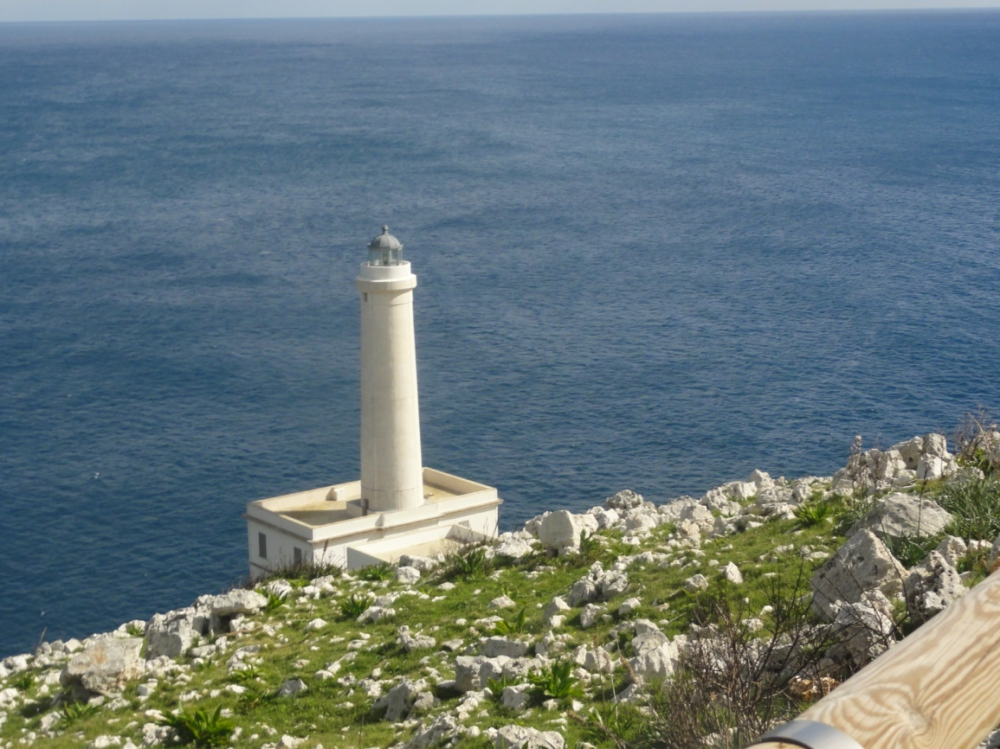
A Land of Great Inspiration…
Novelists drew inspiration from this place owing to its loneliness, salty wind, coastal towers and the close fortified manor farms and monasteries.

Slide 6
The Lighthouse
Reactivated some decades ago, the lighthouse can be visited by tourists .
The watchman doesn’t live in the lighthouse because nowadays it is automatic.

Slide 7
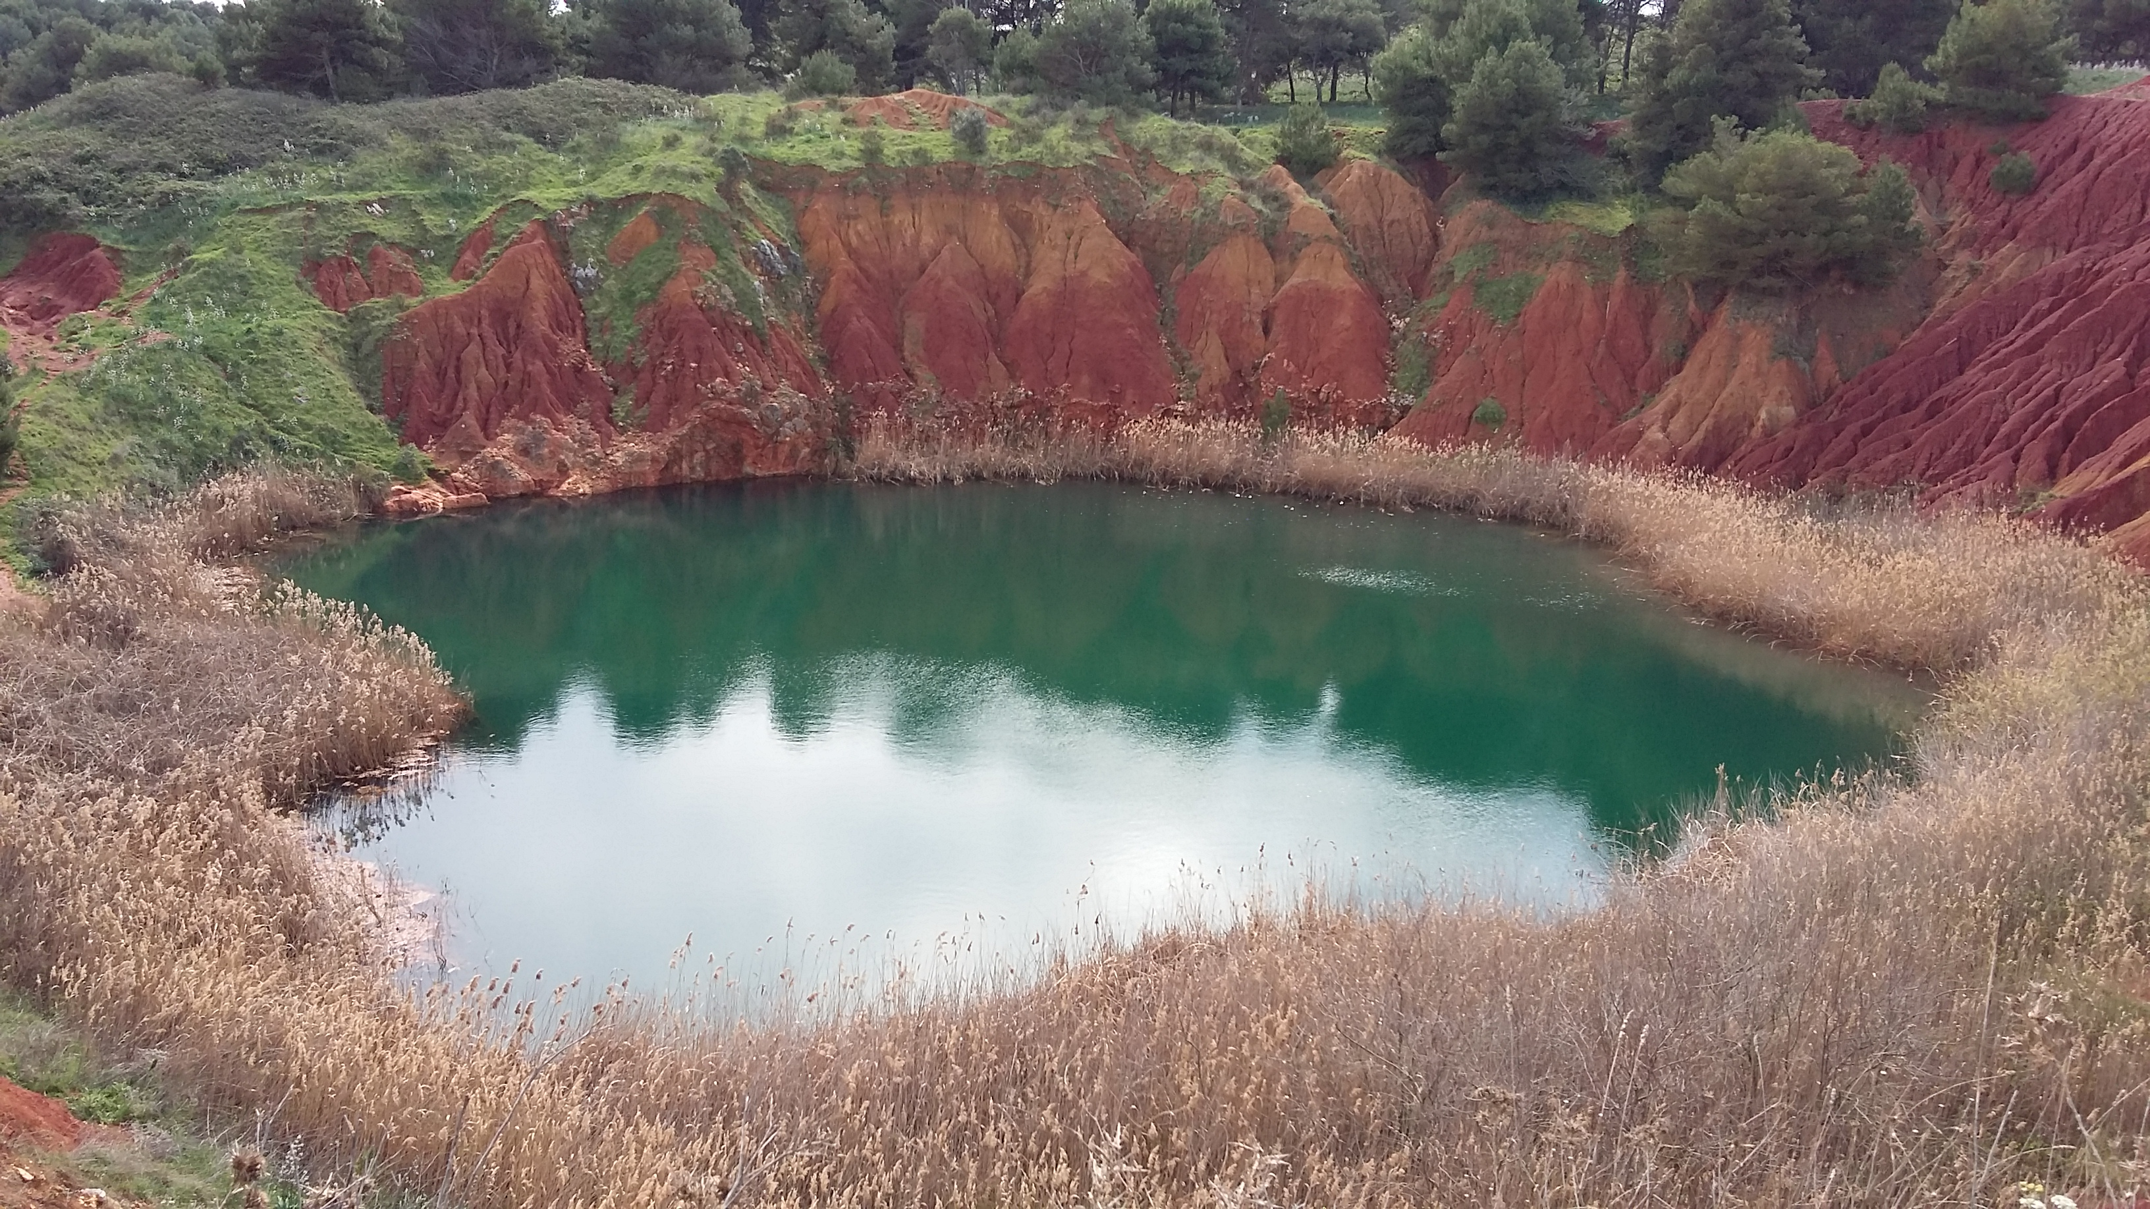
The Bauxite Quarry
HOT SPOT of Salento Geological Landscape

Slide 8
Bauxite mining in Salento
The Bauxite quarry is an example of industrial archeology with an ongoing process of naturalization.
Bauxite mining started in the 60s and went on for a decade in other parts of the area too.

Slide 9
This site is interesting for its landscape, history and naturalistic relevance.
It si a significant example of spontaneous
ri-naturalization of an anthropological environment.

Slide 10
The lake water is surprisingly very clear and seaweedless despite it is a strongly eutrophic
eco-system.
The presence of aluminium and iron released by
the bauxite prevent the seaweed proliferation.

Slide 11
Geological, botanical and fauna aspects are relevant.

Slide 12
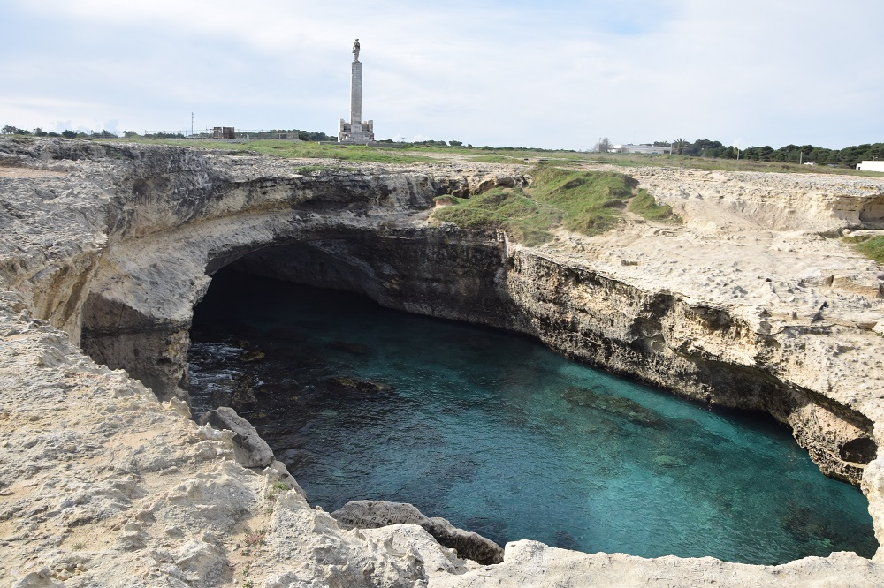
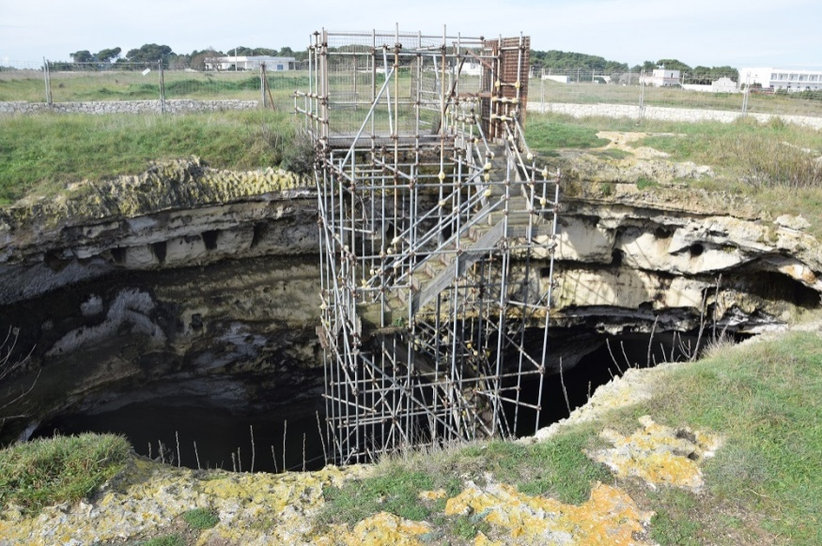
THE “POESIA” CAVES
The “POESIA” BIG CAVE, in the archeological park of Ancient Roca, is considered one of the most beautiful natural pools of the world.
The “POESIA” SMALL CAVE is considered a Time Shrine, a place of worship for the Messapians who worsipped the God Tator.

Slide 13
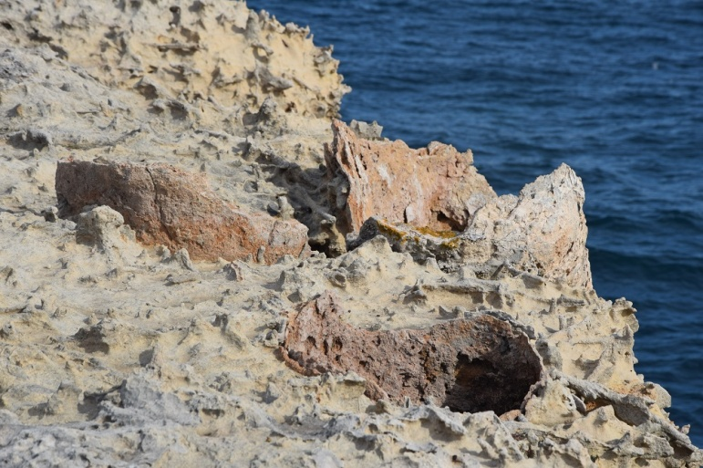
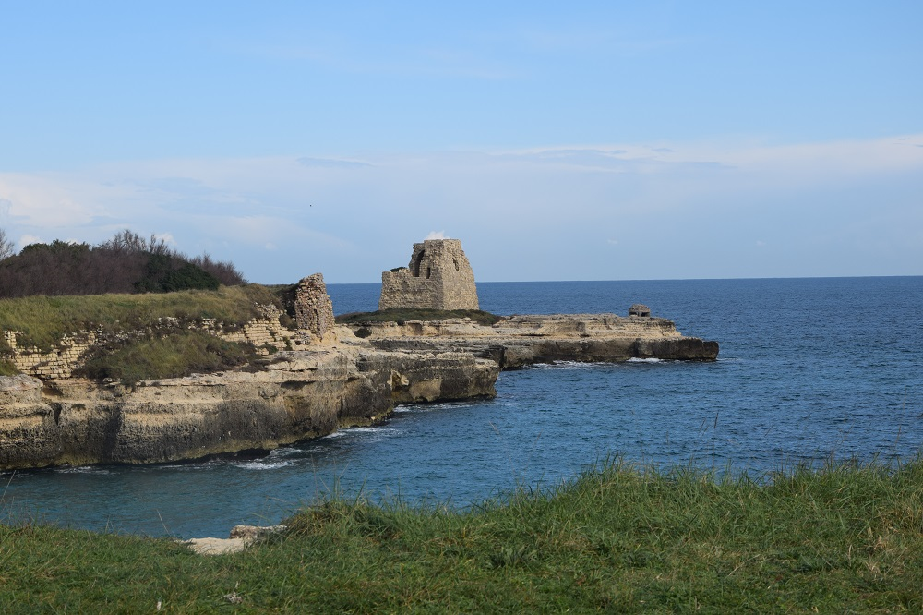
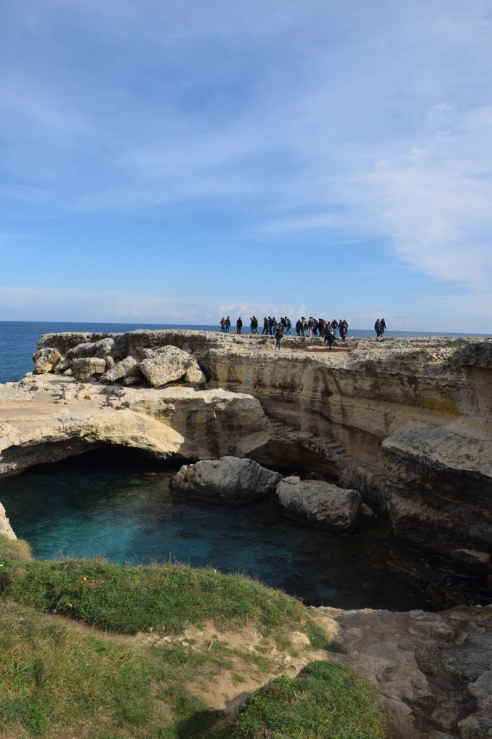
Natural beauty, Particular Erosion phenomena , Archeological Sites and the Water and Beauty Myth.
“ POESIA” a Greek word for water spring.

Slide 14
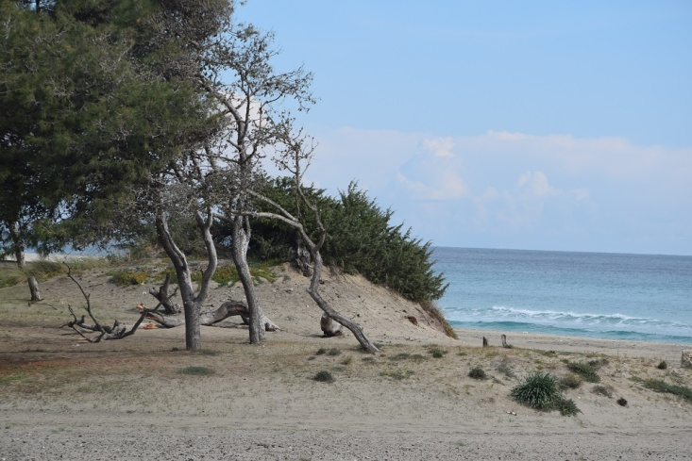
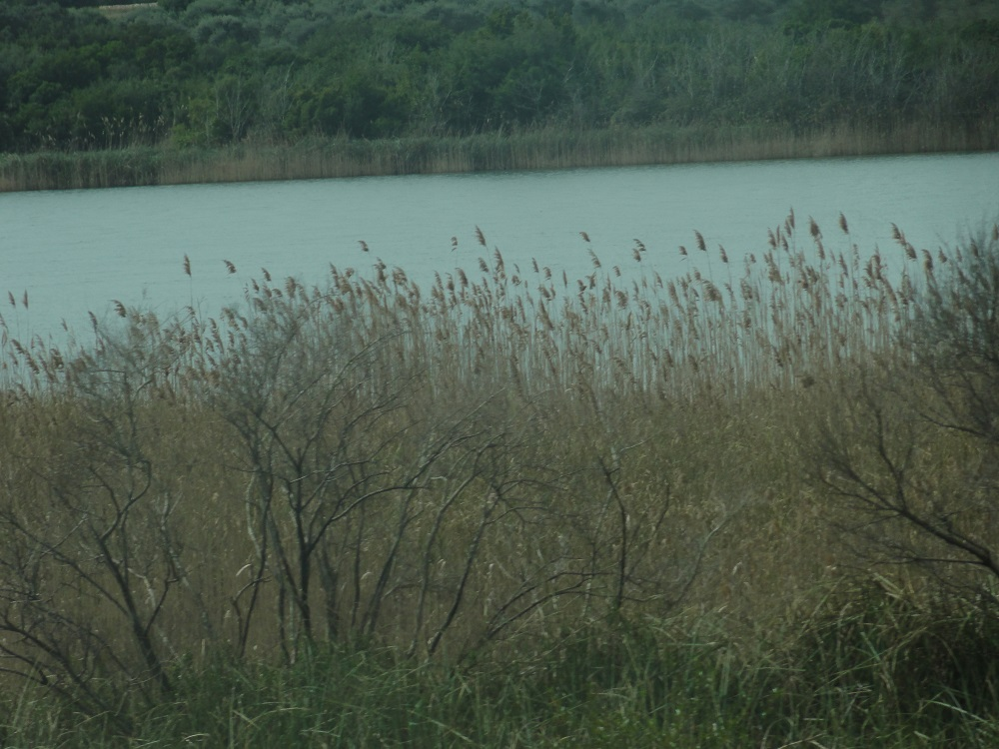
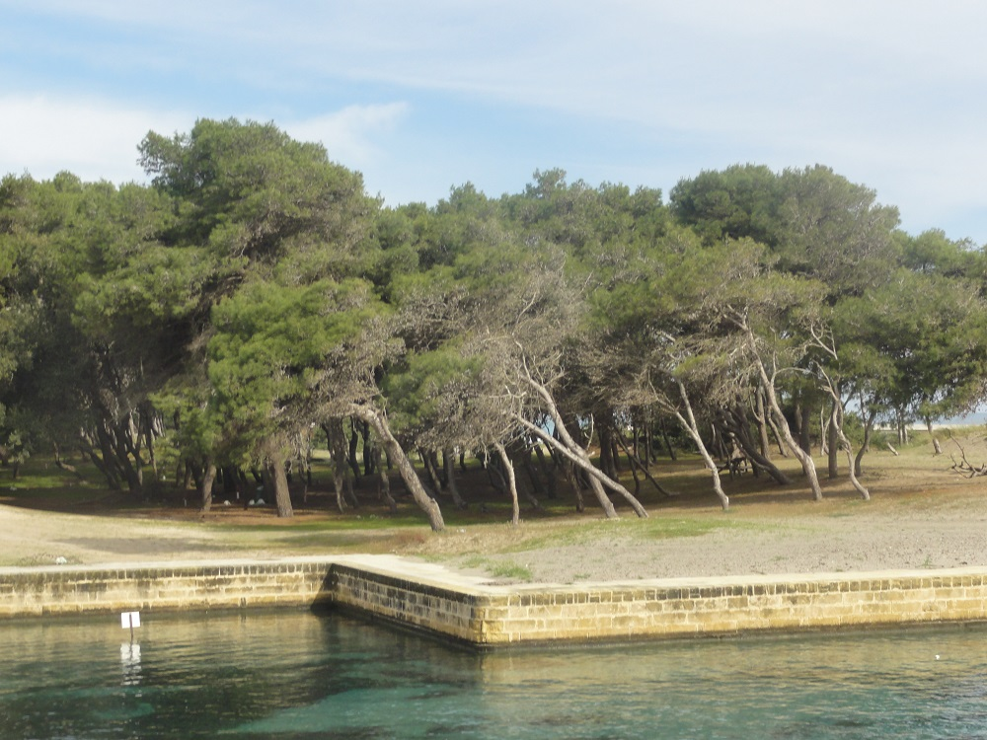
Alimini Lakes
Between the dune and coastal lagoons there are two Lakes:
Big Alimini and Fontanelle.
A landscape rich in biodiversity and history too.
Big Alimini is a salty lake, Fontanelle is a fresh water lake.

Slide 15
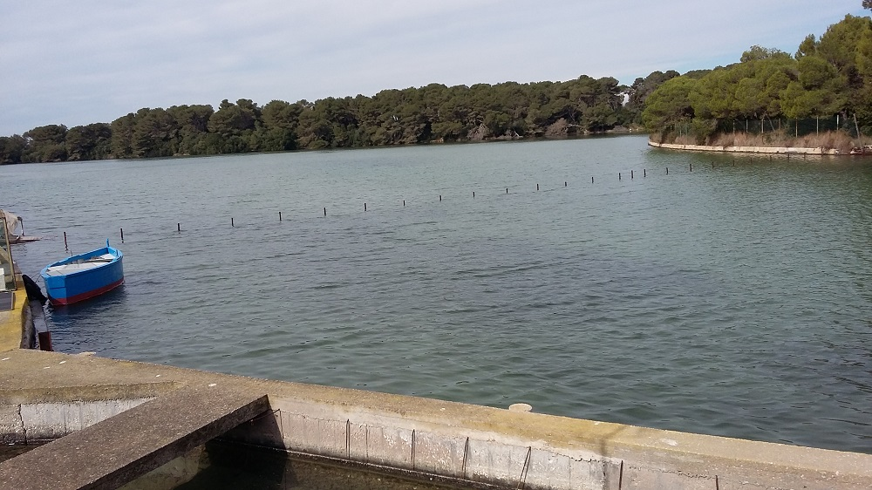
The present Alimini district relates about a past of great landscape transformations: from swampland to farmed land, from juniper dunes to pineforest near the sea.

Slide 16
Etwinning project in 2015 Italy - Greece

Slide 17
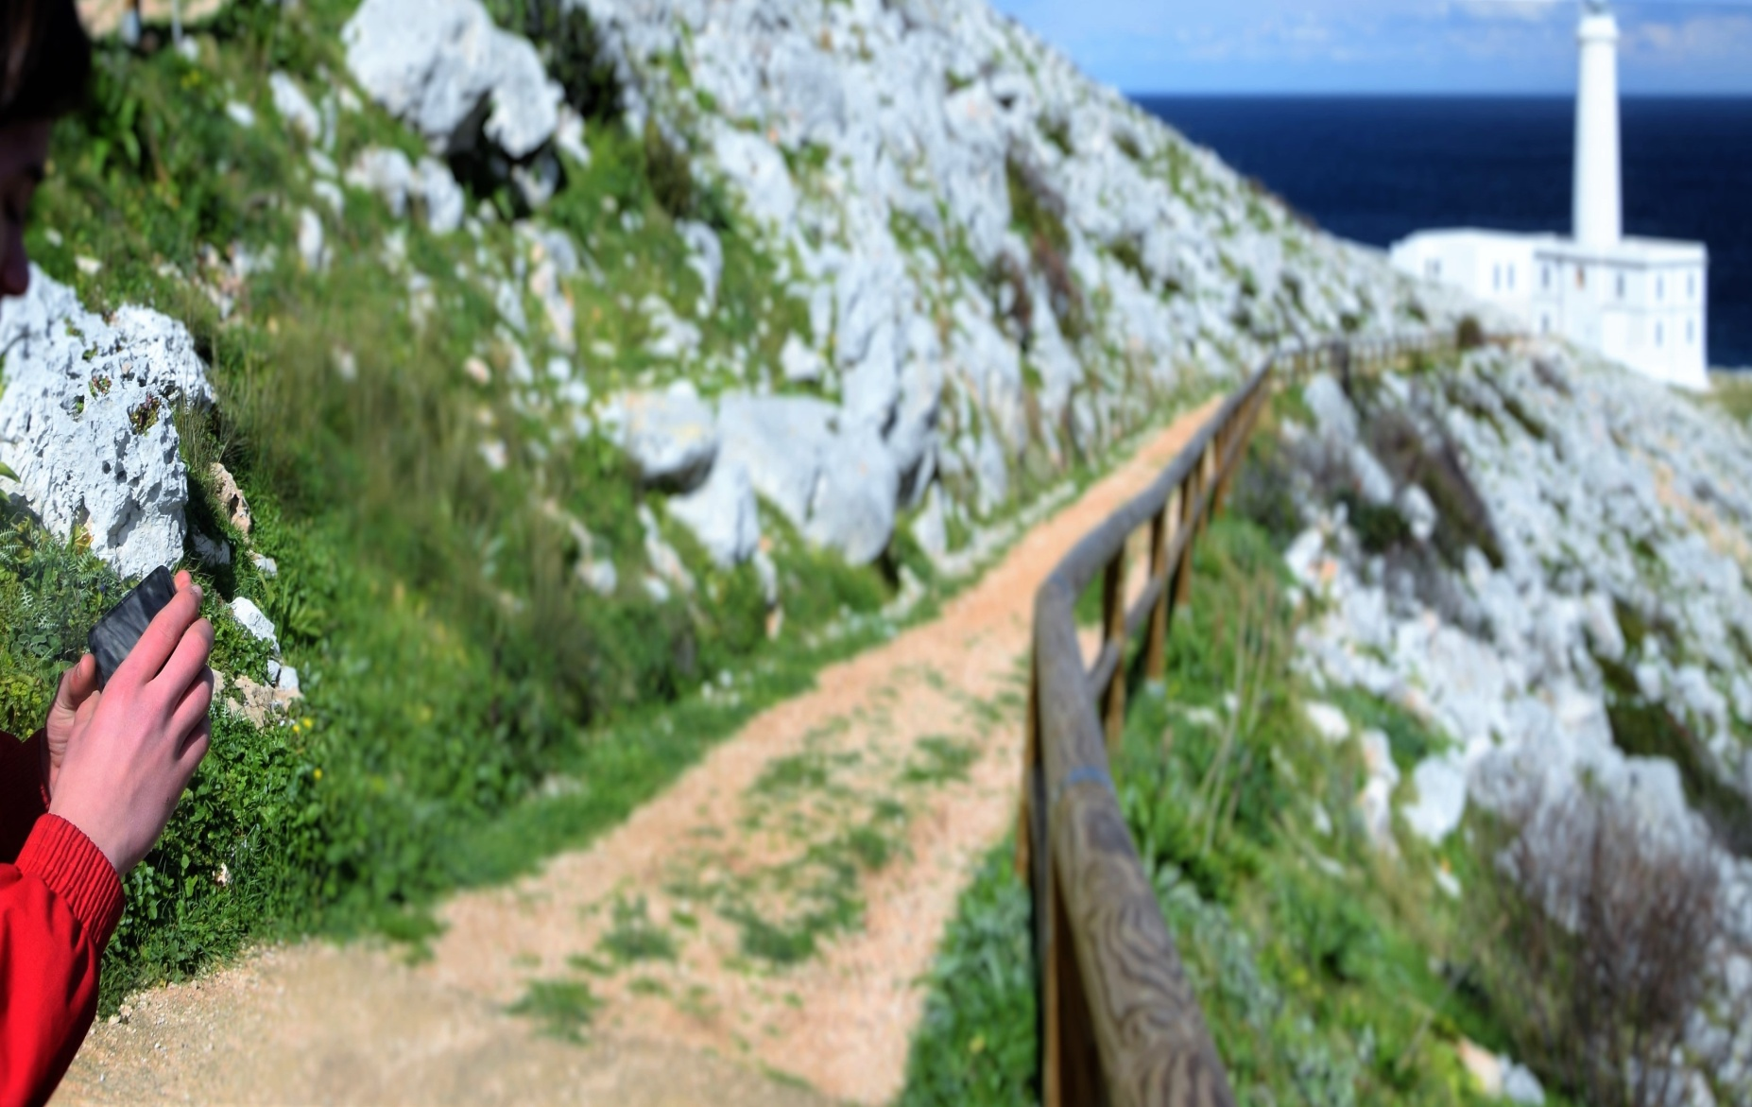
Welcome to Greece

Slide 18
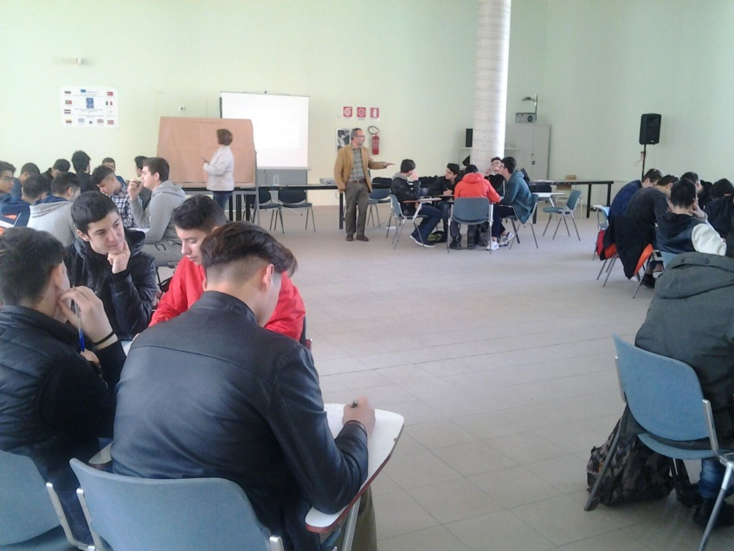
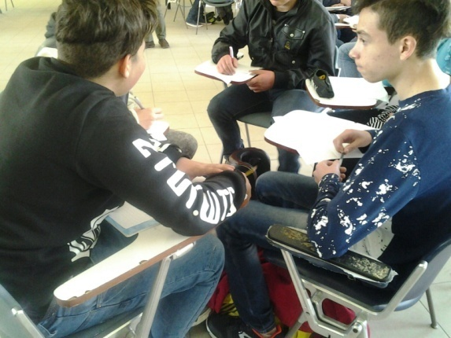
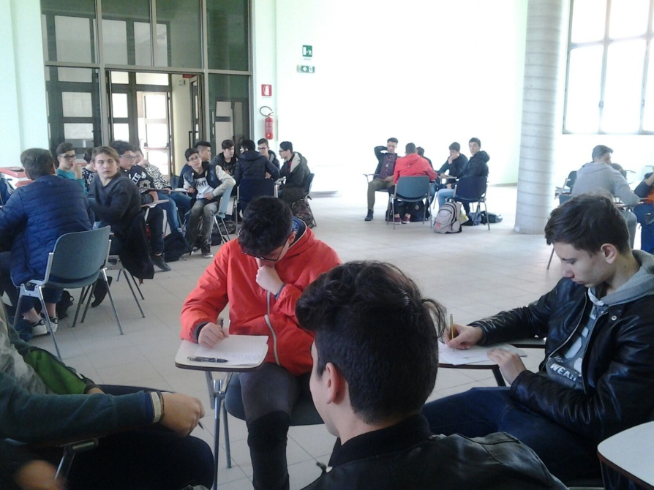
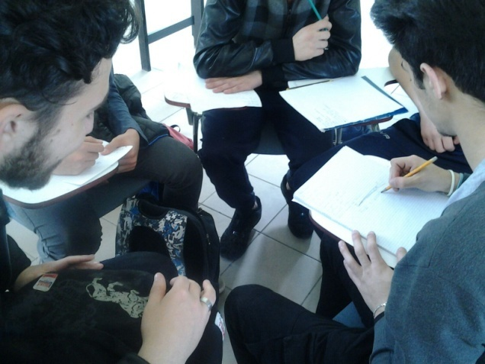
Activities and methods
Classroom lessons with -cooperative learning modes
-Naturalistic laboratories
-Physico-chemical analysis
-Excursions and field analysis

Slide 19
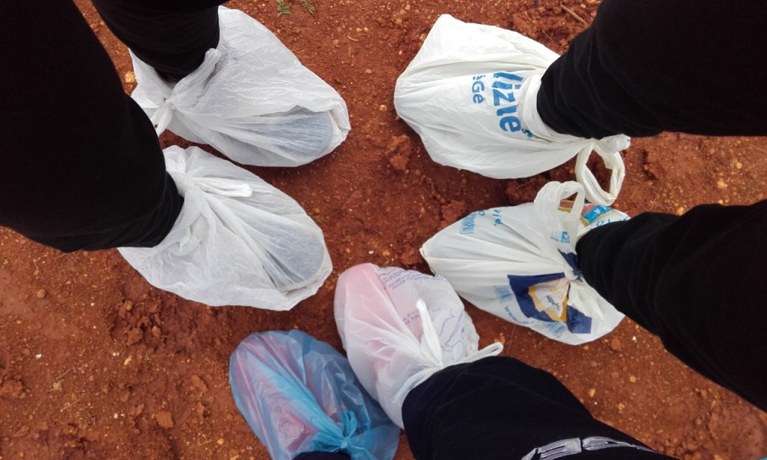
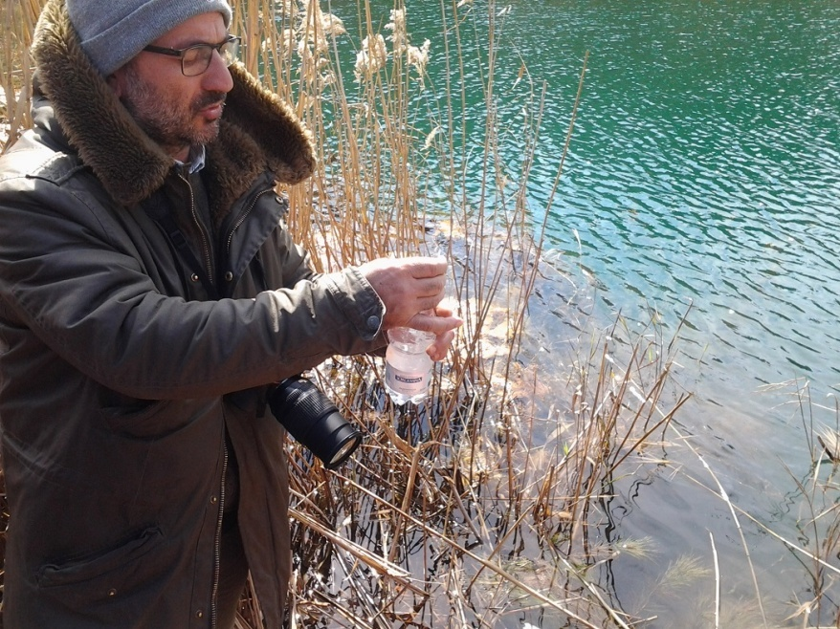
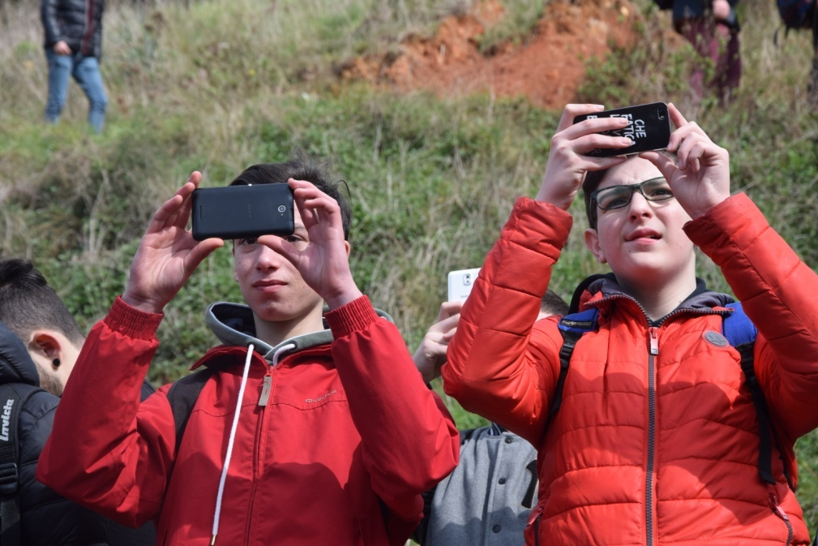
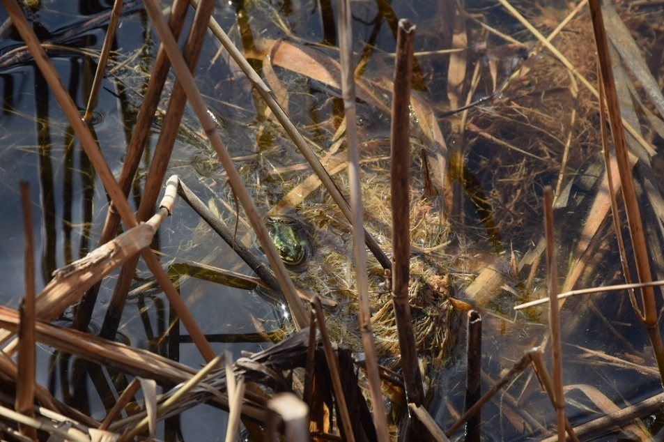
Excursions and analysis

Slide 20
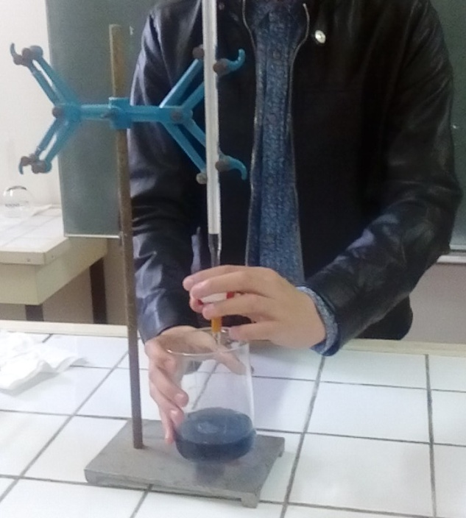
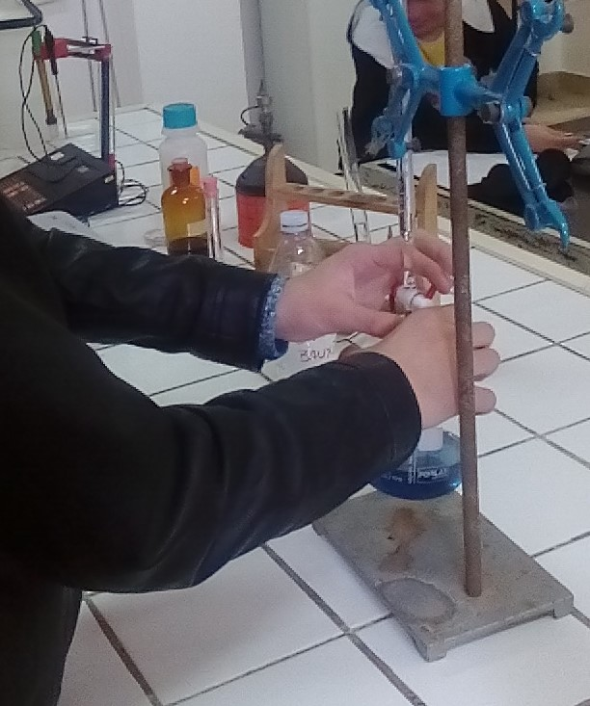
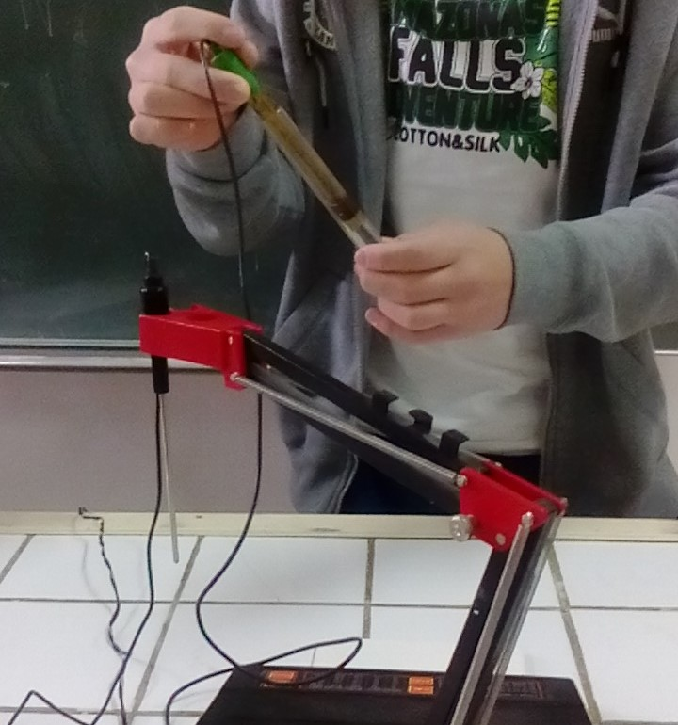
Water hardness
Temperature measurement
Chemical and physical analysis of the water sample
pH measurement

Slide 21
Naturalistic laboratories at The Sea Outpost
The marine biology outpost studies the biodiversity of the coastal marine environment.
Biologists and ecologists from all over Europe carry out surveys and research in this marine biology lab.

Slide 22
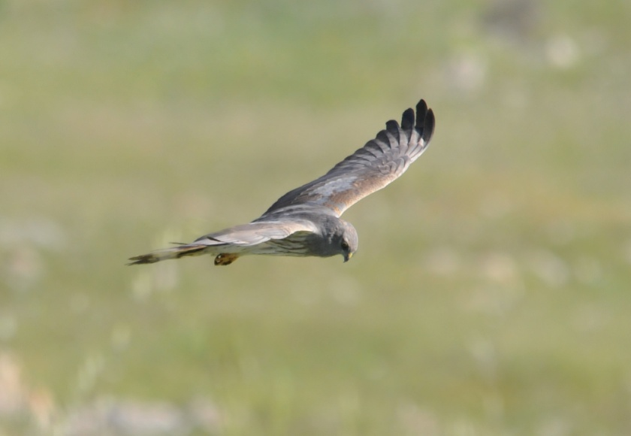
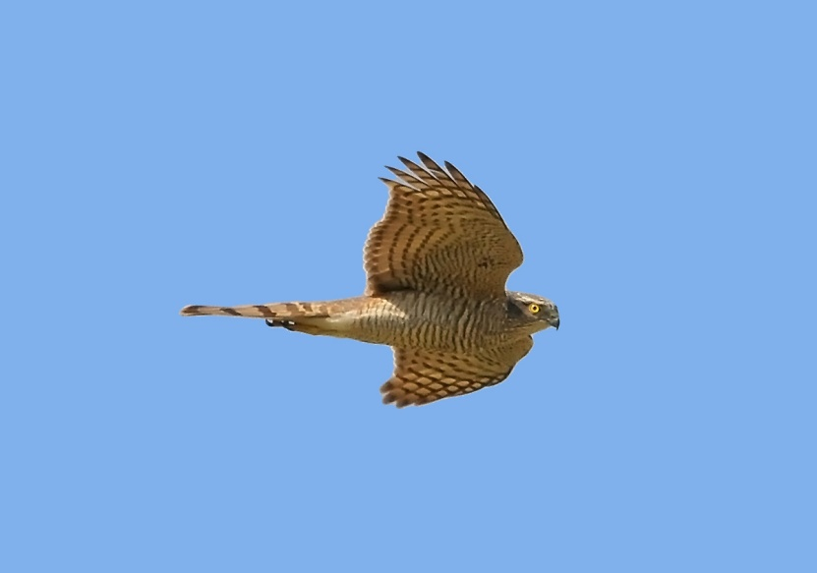
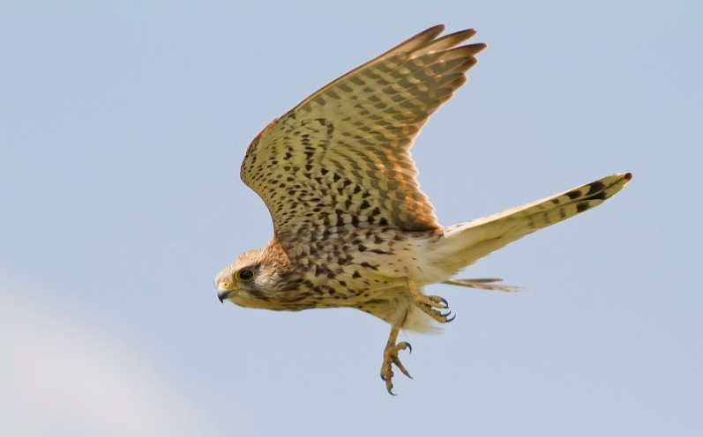
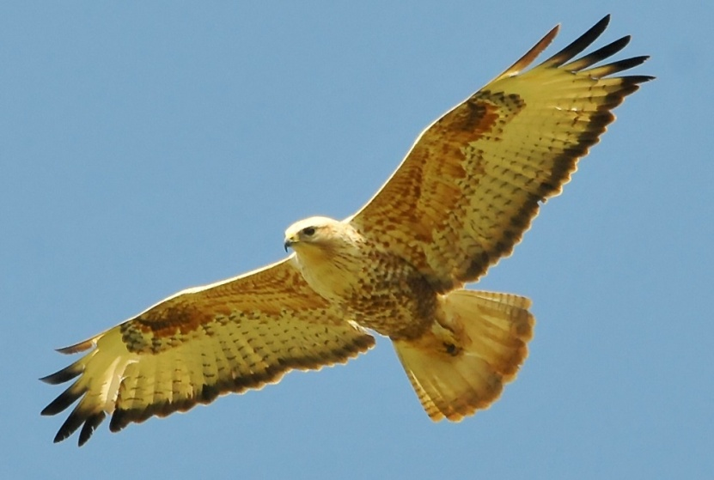
An Immigration Land
In Spring, in Punta Palascia, the birds of pray compete with the seagulls to get the area.
It’s one of the most important sites for bird watching.

Slide 23
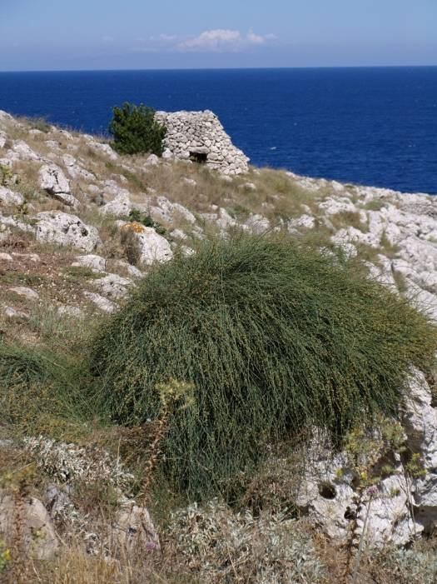
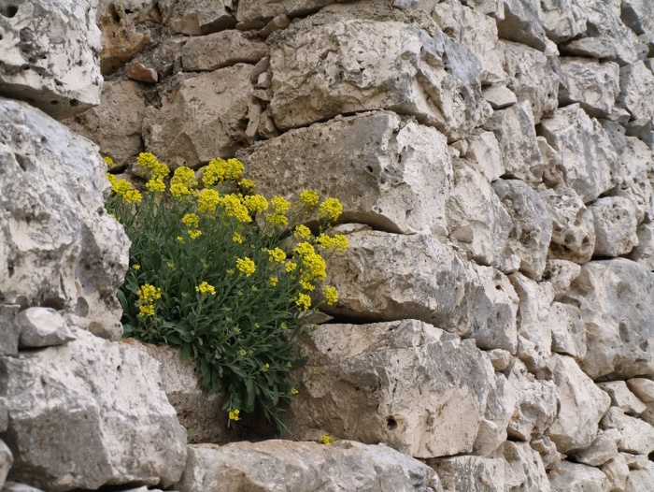
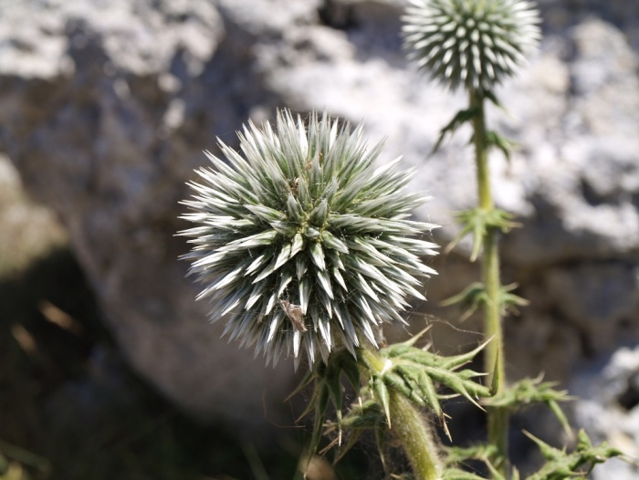
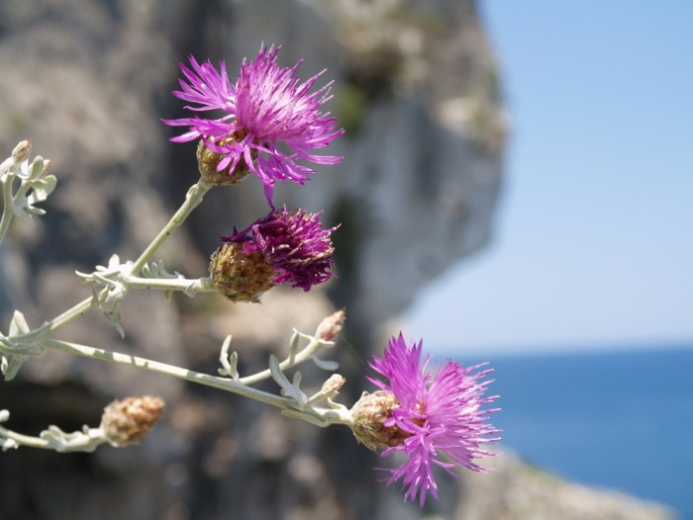
Transadriatic and rare Flora
Ephedra campilopoda
(National Red List)
Aurinia leucadea
(National Red List)
Echinops spinossimus
(National Red List)
Centaurea nobilis
(National Red List)

Slide 24
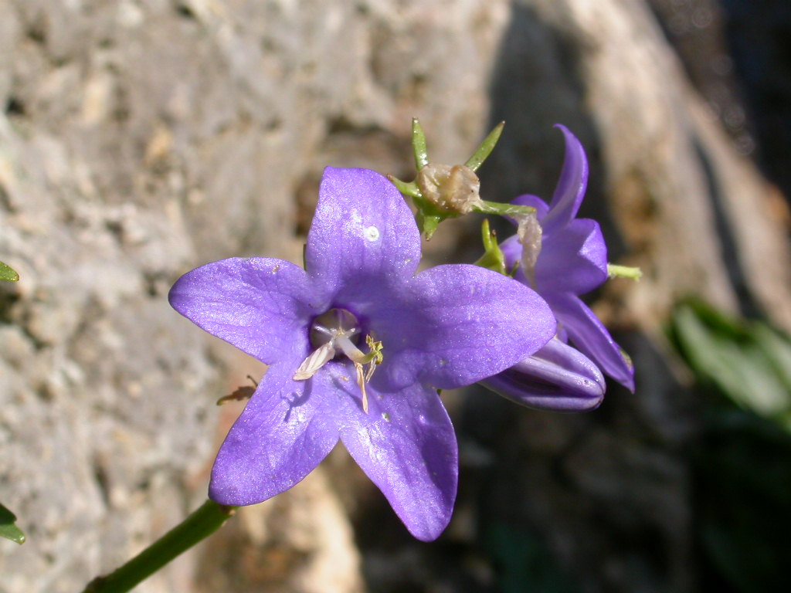
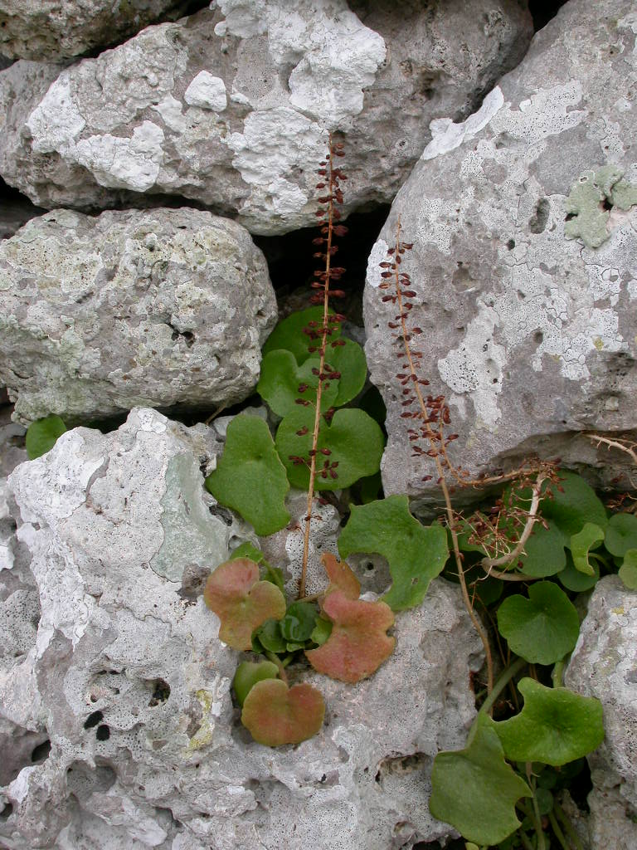
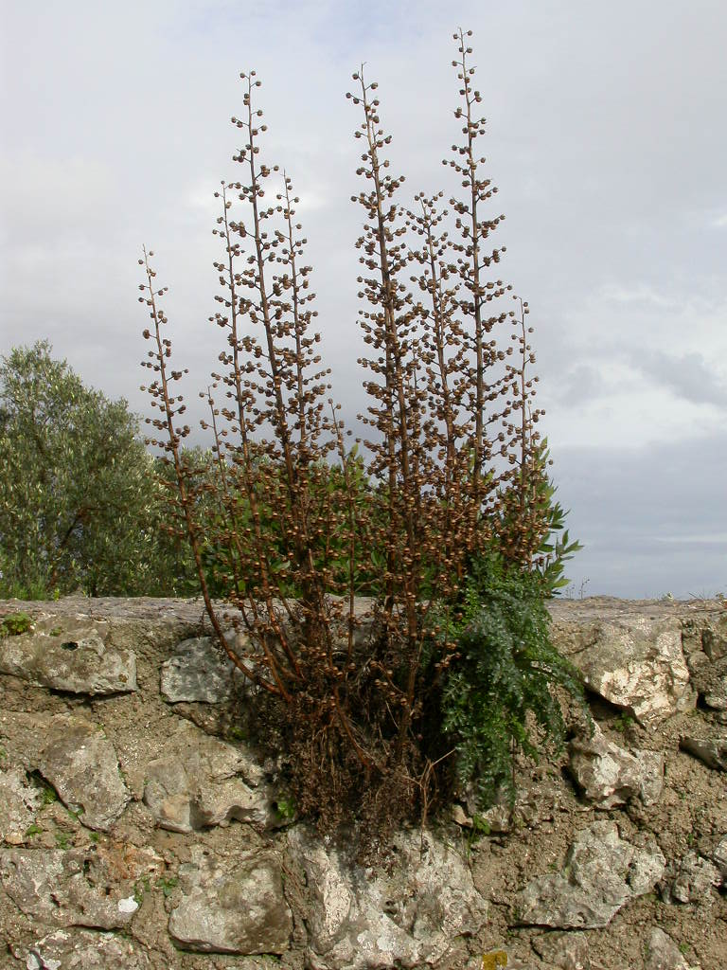
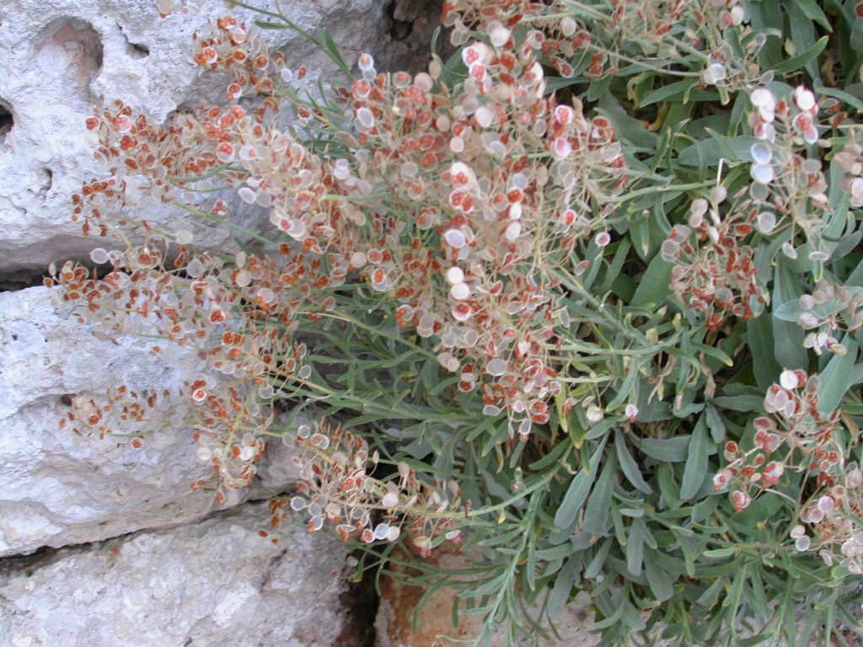
Campanula
versicolor
(National Red List)
Umbilicus cloranthus
(National Red List)
Scrophularia lucida
Aurinia leucadea
(National Red List)

Slide 25
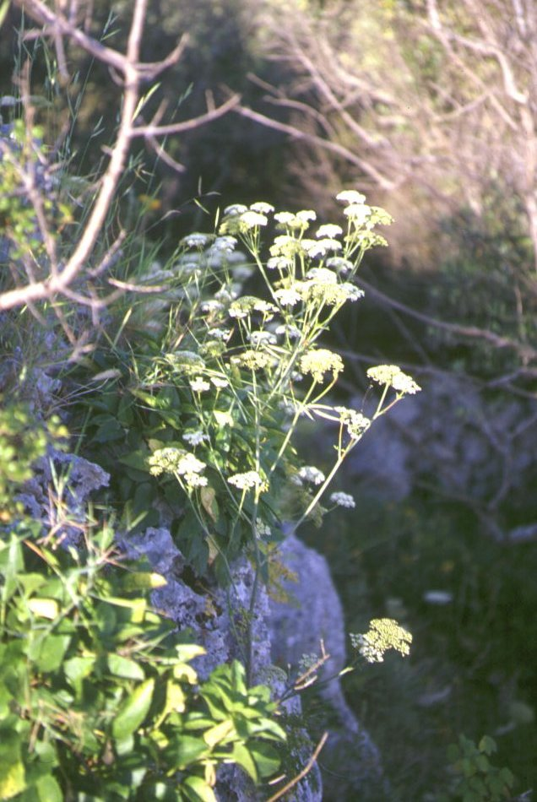
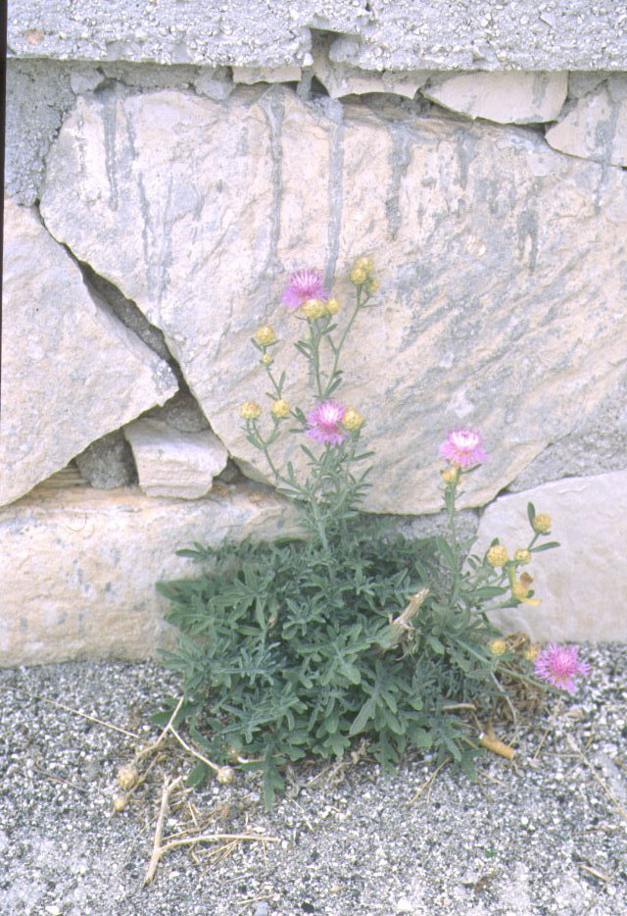
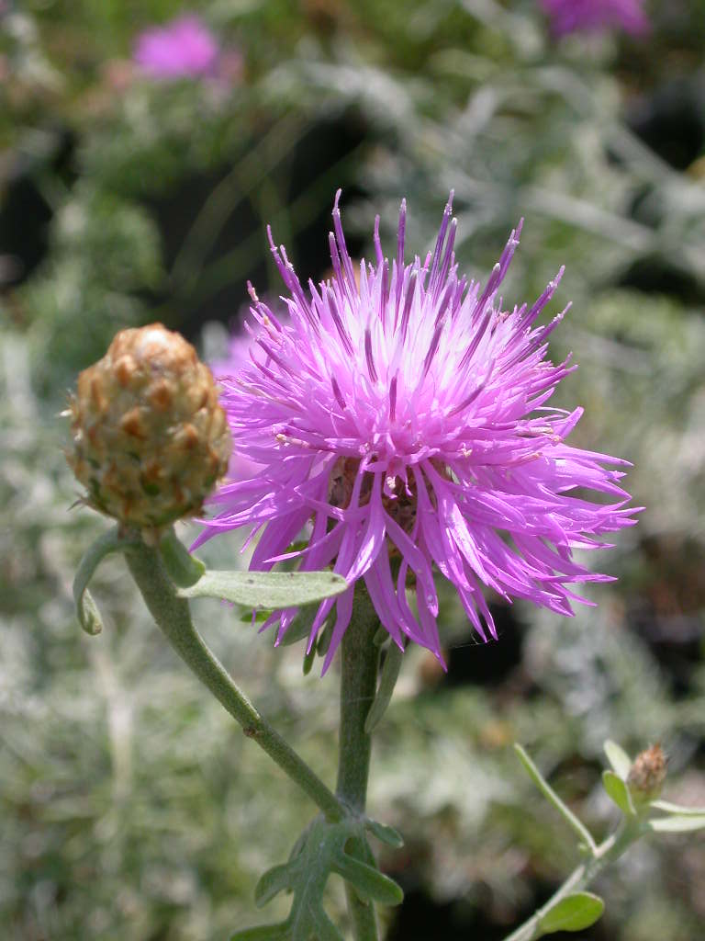
Carum multiflorum
(National Red List)
Centaurea nobilis
(National Red List)

Slide 26
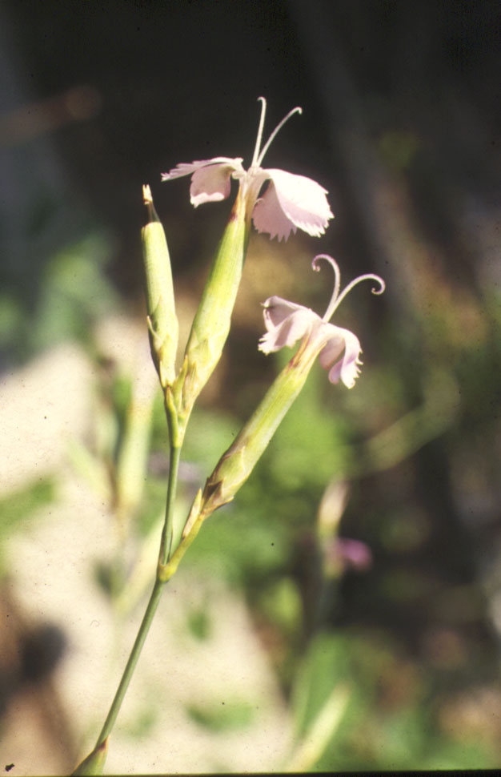
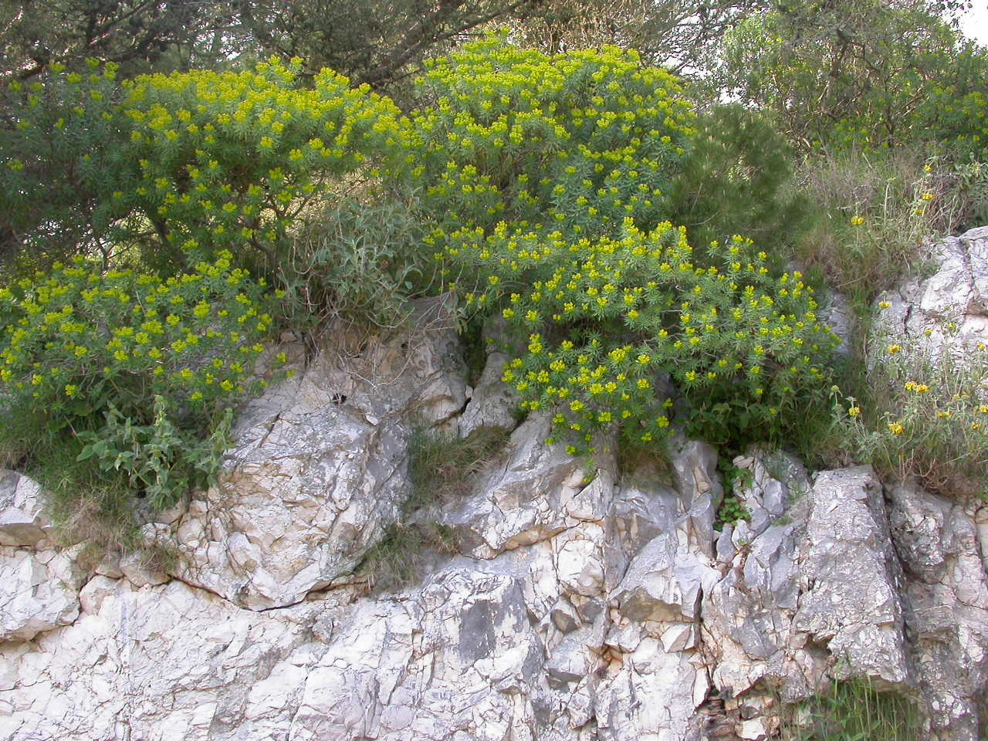
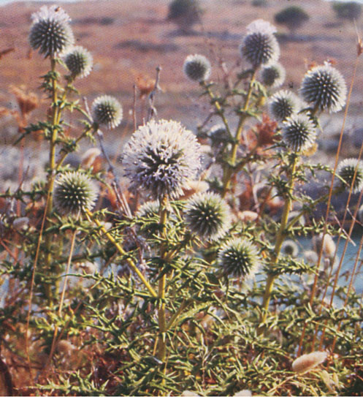
Euphorbia arborea
Dianthus japigicus
(National Red List)
Echinops spinosissimus
(National Red List)

Slide 27
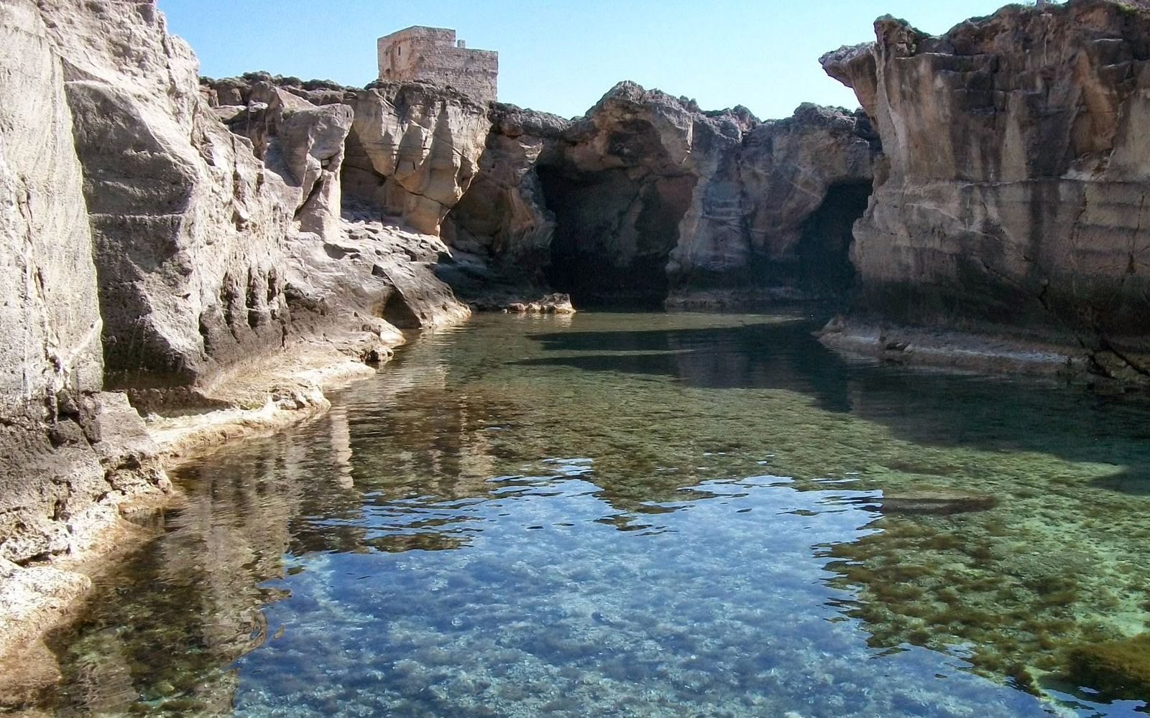
The results will be the subject of a comparison between the working groups in order to evaluate:
The level of knowledge gained in the various places
Positive and negative environmental factors detected
The potential for ecosystem availability expressed by different places.

