Slide 1
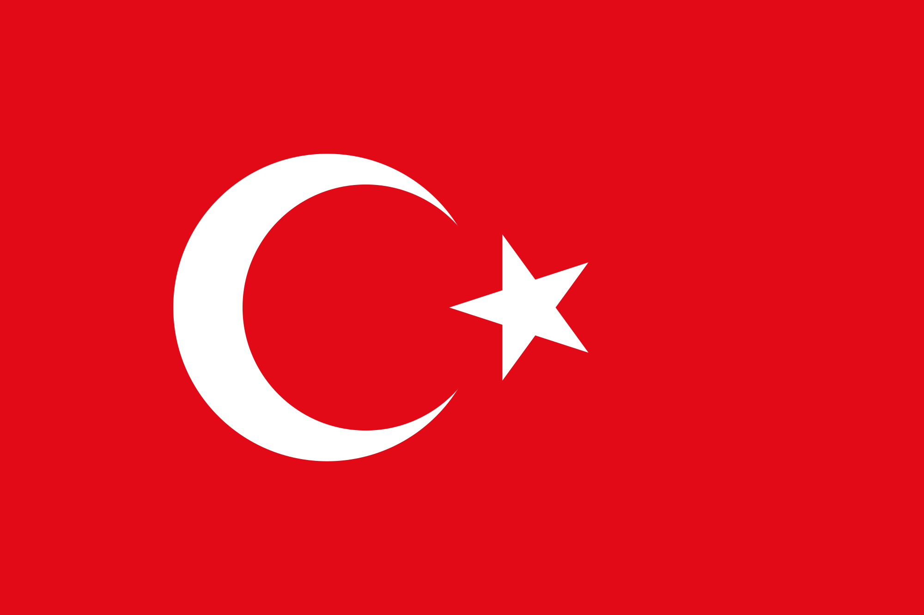
TURKEY

Slide 4
AKHISAR
ANATOLIAN IMAM HATIP HIGH SCHOOL

Slide 5
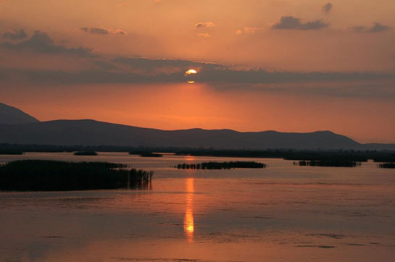
BIODIVERSITY OF LAKE MARMARA

Slide 6
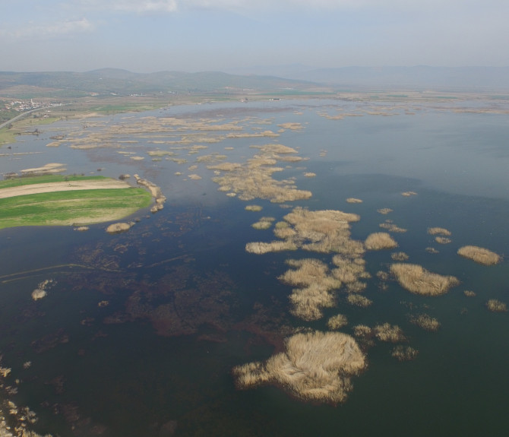
FAUNA &FLORA

Slide 7
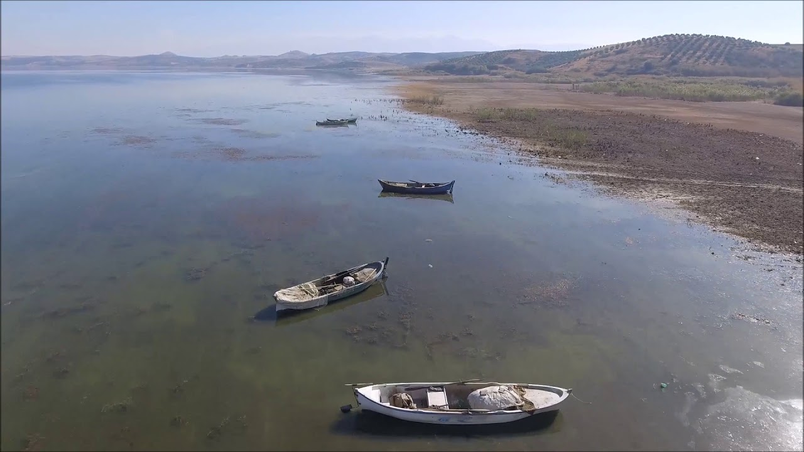
In the Eagean Region, It is a set lake between Salihli and Gölmarmara districts of Manisa. It is an alluvial fresh water lake with a slightly salty water, which is located in an enclosed basin, fed by small rivers and underground waters.

Slide 8
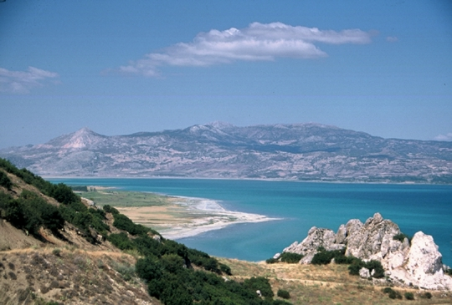
The Marmara Lake, which is located in a hollow area, is surrounded by hills to the west and north. The level of the lake in the Gediz depression basin is lower than the level of Gediz Plain. The eastern part opens to Gediz Plain; the northwest part opens to Akhisar Plain; separated by alluvial sets from here.

Slide 9
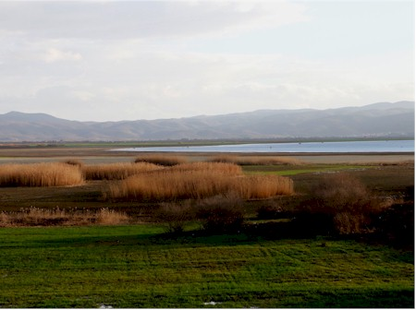
The southern part of the Marmara Lake is surrounded by gardens, agricultural fields, oak forests in the north, and redwood forests. On the northern coast there are large reeds, wet meadows, and water birds feed and breed in these reeds..

Slide 10
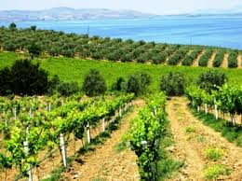
Grapes and olives are the major agricultural products in the elevated waters around the country.

Slide 11
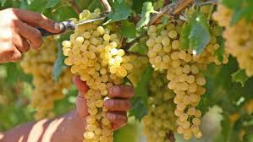
Grape growing around Marmara Lake,

Slide 12
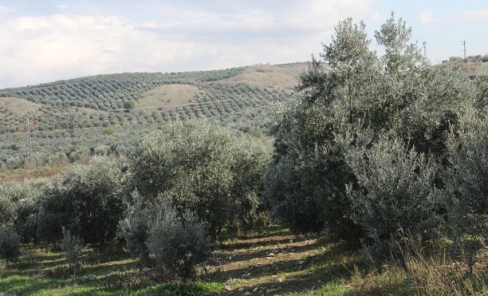
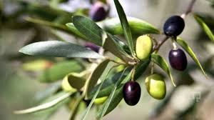
Olive and olive trees around the lake

Slide 13
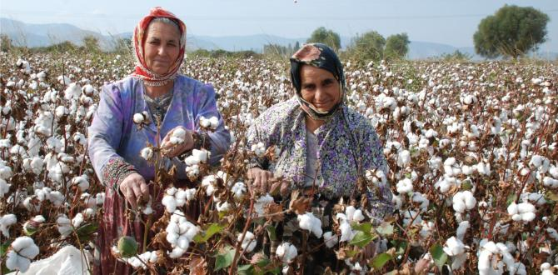
Cotton is planted extensively on the plains inside and outside the lake saddles

Slide 14
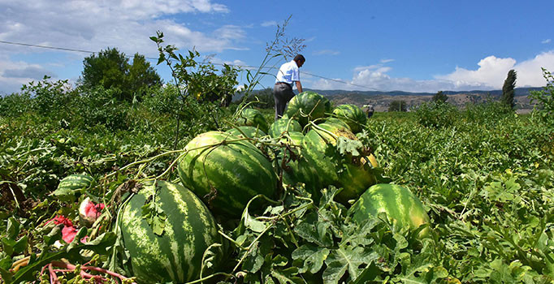
Melon, watermelon and tobacco are among the agricultural products grown

Slide 15
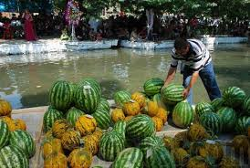
Every year in the first week of August the melon watermelon festival is held in the Akpinar promenade close to the lake.

Slide 16
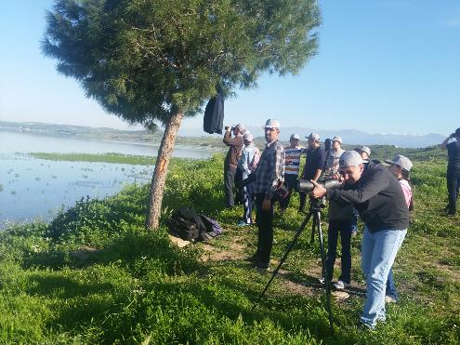

Slide 17
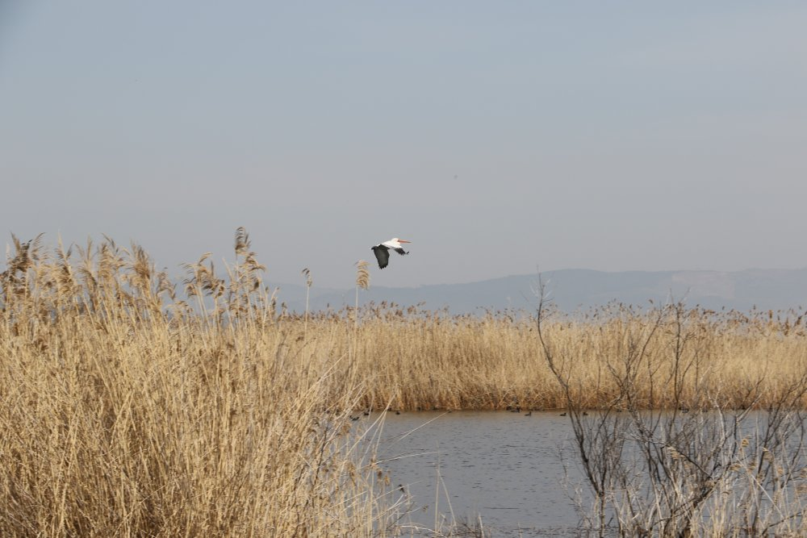
A study on birds in Marmara Lake found that 101 birds were found in the lake, 39 of them were native, 38 were summer migrants, 17 were winter migrants and 5 were transit species .
Another study on bird species in the following years recorded 144 birds, 59 of which were found in the region.

Slide 18
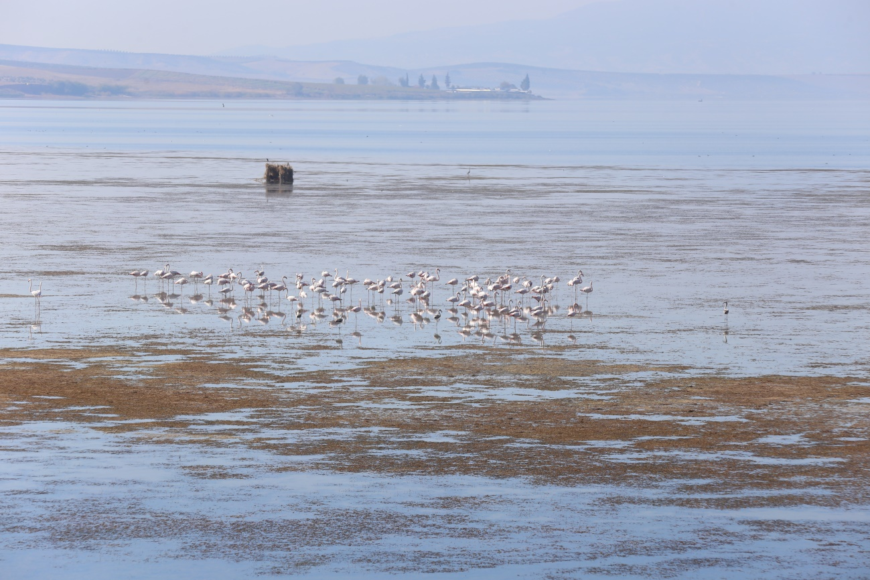
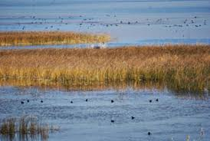
Marmara Lake is home to more than 20.000 birds on its list of international wetlands. There are many species of small birds such as cormorant, horned pelican, big eagle, fiyu, angit, steed, sword beak

Slide 19
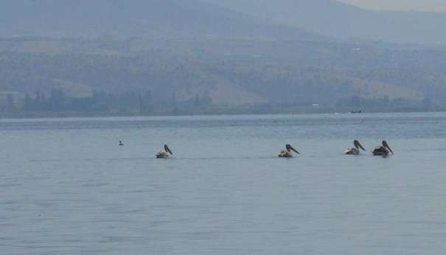
In the middle part of the lake there are few individuals of Tepeli pelican (Pelecanus crispus)
Tepeli Pelikan is in the red list of endangered animals by the World Nature Conservative . And all around the World, 10% of Tepeli PELİKAN live and breed in Marmara Lake.

Slide 20
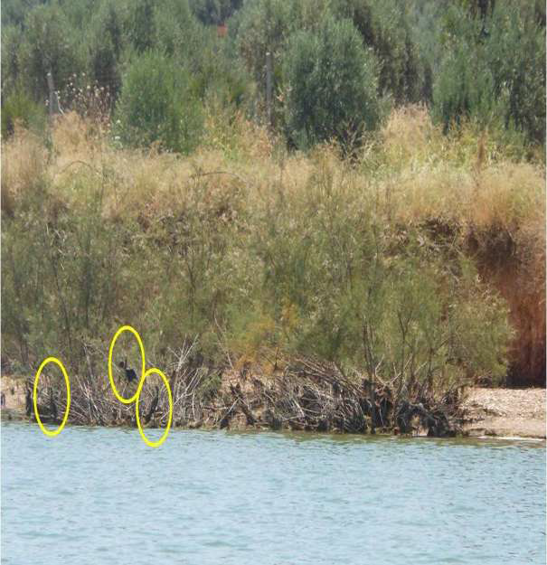
The Marmara is the resting area of ​​the small cormorants (Phalacrocorax pygmeus).

Slide 21
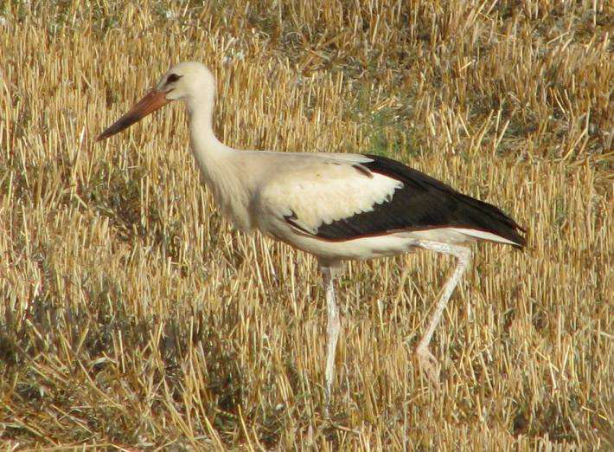
A stork fed on the fields around the Marmara Lake(Ciconia ciconia)

Slide 22
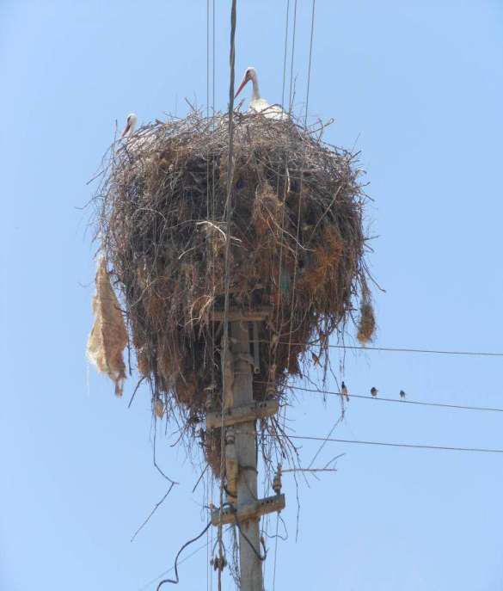
A Stork (Ciconia ciconia) nest on the electric pole and Studs nestled in(Passer domesticus)

Slide 23
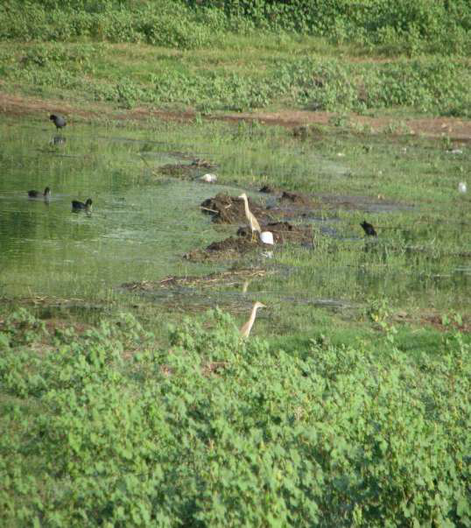
Farsighted heron (Ardeola ralloides) in the middle, Sakarmeke (Fulica atra) on the left and reedchicken (Gallinula chloropus) on the right

Slide 24
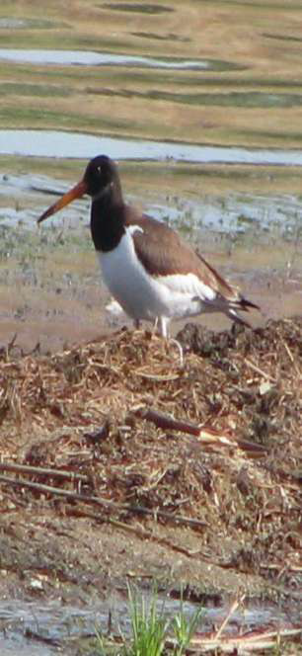
Shore bird which was observed as the first and only individual in Marmara Lake(Haematopus ostralegus)

Slide 25
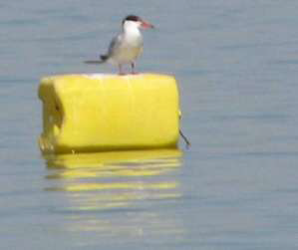
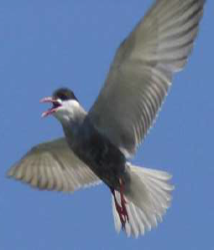
Sumru (Sterna hirundo) on the left and Bydonica sumru (Chlidonias hybridus) on the right

Slide 26
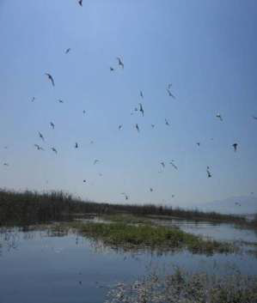
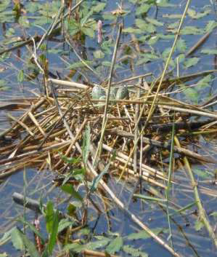
A view from the nesting field of the bearded tern Chlidonias hybridus (on the left)
A Moustache sumru nest and hatchery eggs (right)

Slide 27
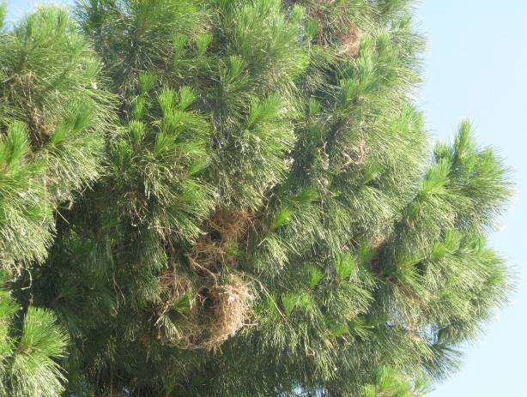
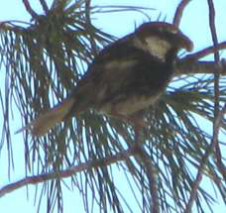
One of the species in the Passeriformes team that includes the birdsong is the Söğüt fern (Passer hispaniolensis) and the nesting area

Slide 28
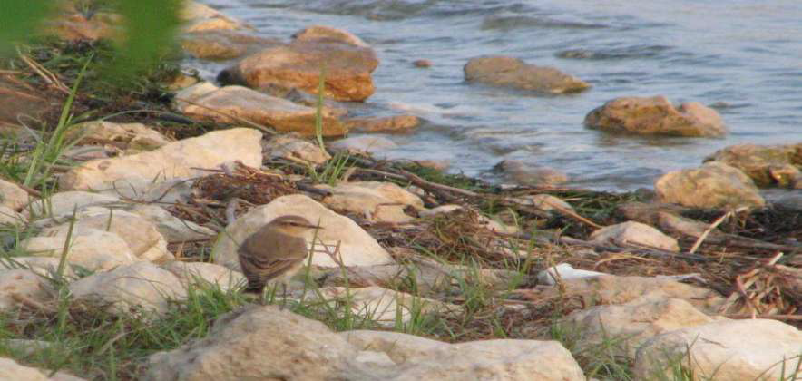
One of the most common snake birds, the Kuyrukakan(Oenanthe oenanthe)

Slide 29
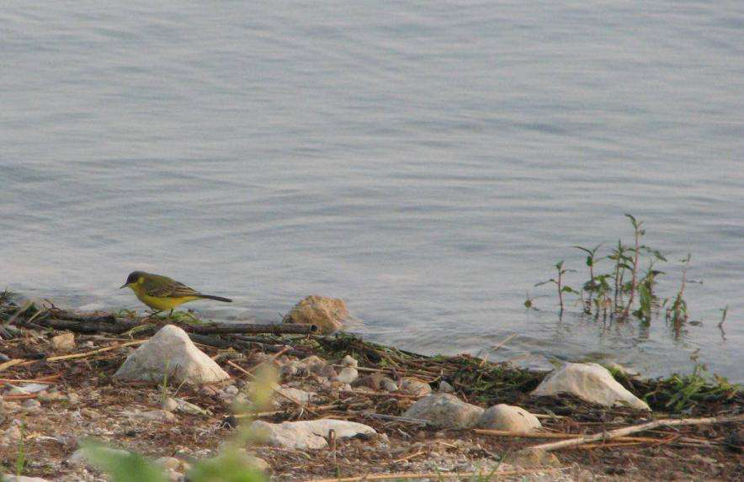
Yellow wagtail (Motacilla flava feldegg) looking for food at the lake

Slide 30
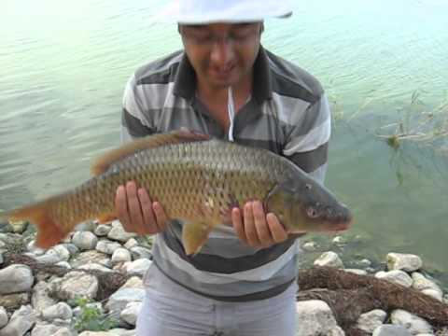
Marmara Lake has important fishing activities. It is seen that the least hunted fish species in the sky is the publication, and the most hunted fish species is the carp.

Slide 31
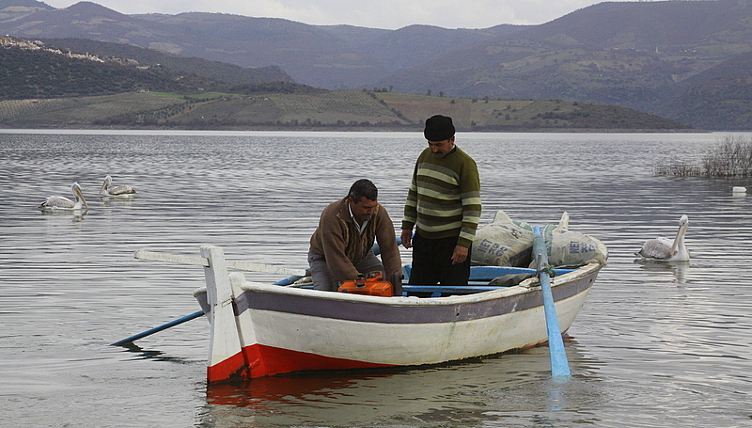
According to the information received from the Fisheries Cooperative, the number of fishermen hunting on the lake is 104, the number of boats is 55, and the number of active boats entering the lake is 40.

Slide 32
The work carried out at the Marmara Lake and at the Sand (Gördes) Stream in the lake has identified 11 fish species belonging to four different families in the basin

Slide 33
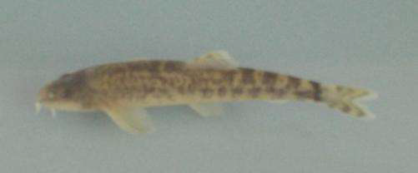
FAMILY: BALITORIDAE (FASHION FISH) Oxynemacheilus sp.
The body is cylindrical and covered with very small scales. Eyes are small and top.

Slide 34
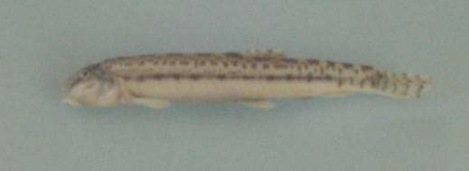
FAMİLY: COBITIDAE (SAND FESTIVALS)
The body is shaped in cylindrical form and quite elongated.

Slide 35
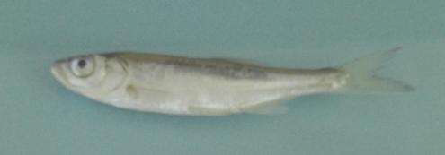
FAMİLY: CYPRINIDAE (Cyprinidae) (Alburnus battalgili) Freshwater Collie
The body is elongated and is covered with medium sized scales. His eyes are strong. The color is silver-white on the back, gray on the sides, and in the abdominal region. Endemic fish species of Marmara Lake.

Slide 36
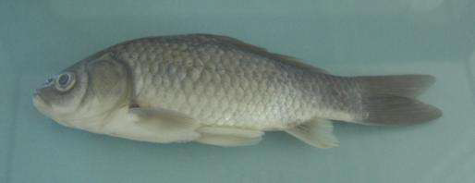
Carassius gibelio (Bloch, 1782)-İsrail Sazanı
It is known as the pool fish. Although Cyprinus carpio (carp) is similar, it is easily distinguished by the absence of a moustache around the mouth.

Slide 37
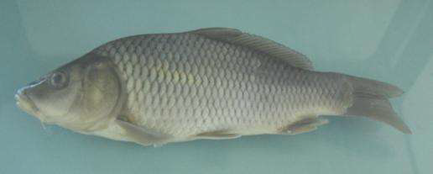
(Cyprinus carpio) Carp
The body is slightly elongated and oval-shaped, usually covered with large scales.

Slide 38
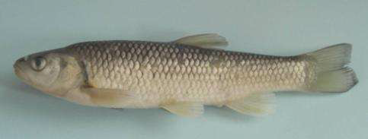
(Squalius fellowesii ) Chub
This species, which is typically known as a river fish, adapts very well to ponds or sores The body is generally long.

Slide 39
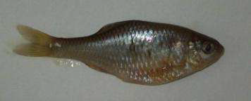
Rhodeus amarus (Bloch, 1782): Bitterling
Rhodeus amarus, found in groups in freshwater with sandy and national grounds, who prefer the freshwater which the mids.

Slide 40
Pseudorasbora parva (Temminck ve Schlegel, 1846)-Dişli Sazancık- Pebble Fish
In general they live more than 3-4 years. The lengths are generally 80-90 mm and the weights are about 17g.

Slide 41
FAMİLY: SILURIDAE (FRESHWATER CATFISH) (Silurus glanis ) CATFISH
Their bodies are long, the head is flat and very strong. Their mouths are ventral and have three pairs of long moustaches around them.

Slide 42
THE END

Slide 43
THANKS FOR YOUR ATTENTION

Slide 44
PREPARED BY MEHMET AK, ABDULLAH SAİDNUR ALTINOLUK, CİHAT KÜÇÜK

