Slide 1
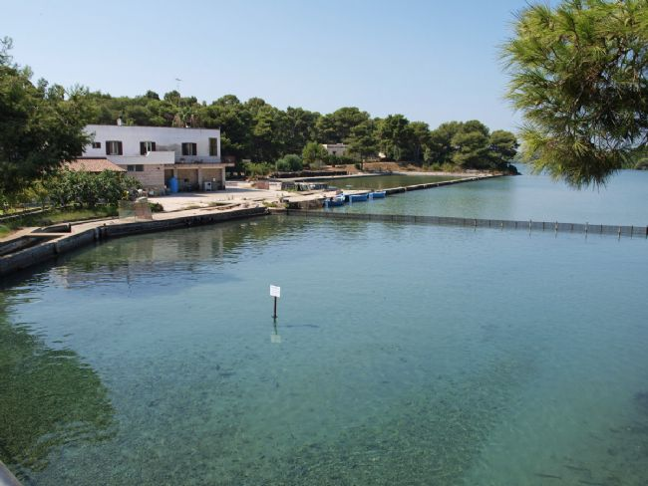
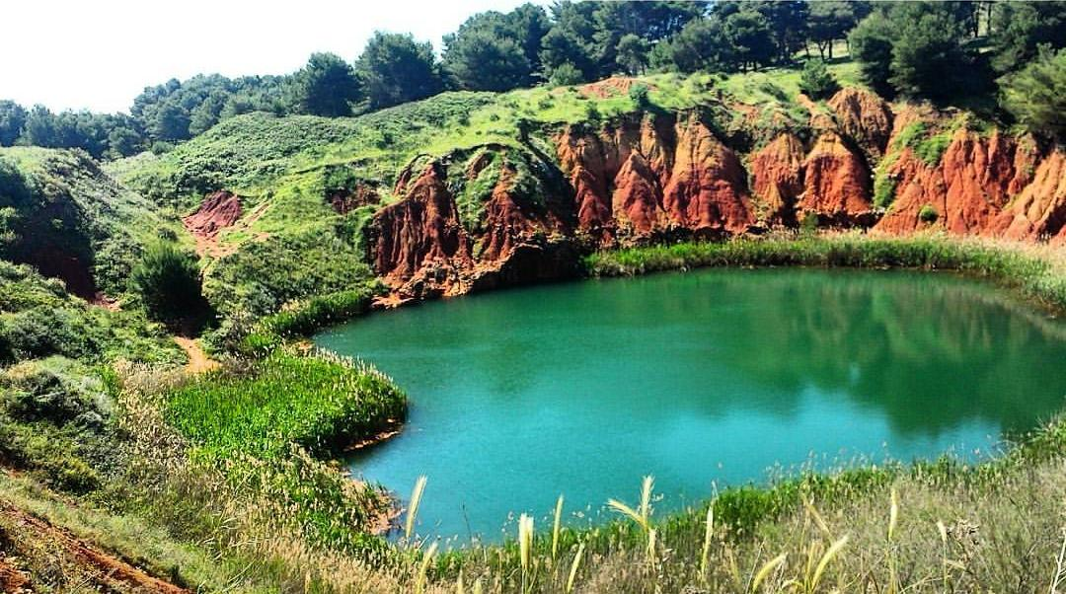
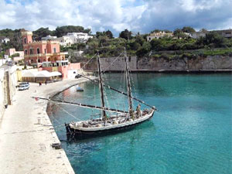
ANALYSIS AQUATIC ECOSYSTEMS
Abiotic Parameters
Alimini Lakes
Bauxite Quarry
Tricase Harbor

Slide 2
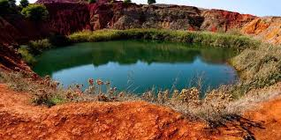
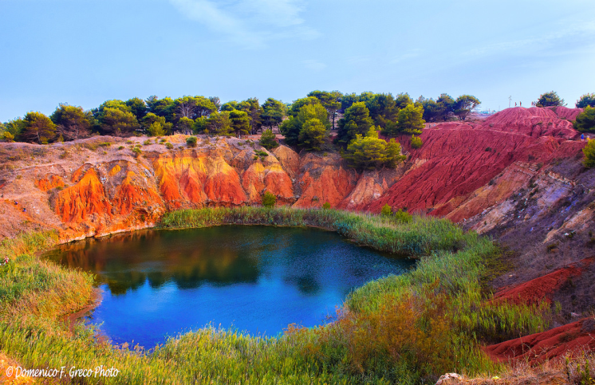
BAUXITE QUARRY
This is a quarry for extracting bauxite, a mineral from which alluminium is made. The quarry was abandoned and the presence of a water table encountered during the excavation phase, led to the formation of a small pond.
The surrounding area has therefore been enriched with aquatic and marshy plants such as marsh reed. Nowadays, the place has become a real spot for the flora and fauna of the mediterranean both migratory and local.
The waters are particularly limpid and, although the enviroment is strongly eutrophic, there are very few algae.
What is striking in the spontaneous renaturalization of a strongly anthropized emviroment, which took place within a few decades.

Slide 3
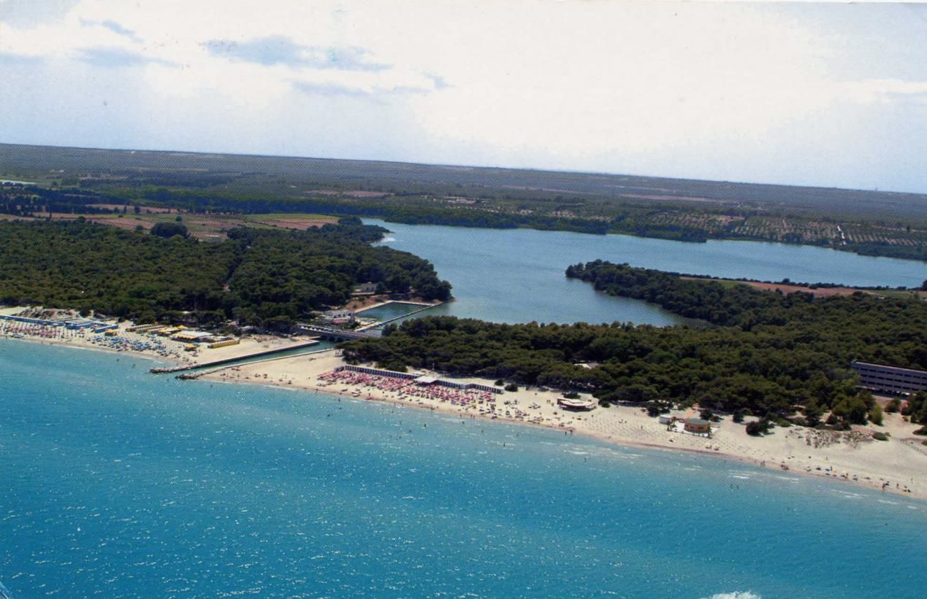
ALIMINI GRANDE
ALIMINI GRANDE IS A LAKE BASIN OF CASTRIC ORIGIN AND IT IS ALMOST COMPLETELY SURROUNDED BY A ROCKY STRIP, RICHLY COVERED BY THICK PINEWOODS AND MEDITERRANEAN SCRUB. IT IS IN COMMUNICATION WITH SMALL ALIMINI (FONTANELLE), A BASIN THAT WAS FORMED BY THE ABRASIVE DEVIATION FROM THE SEA, THROUGH A NATURAL CHANNEL CALLED “LU STRITTU” BIG ALIMINI GRANDE IS A LAKE WITH A HIGH PERCENTAGE OF SALINITY, WHILE, ALIMINI PICCOLO IS FED BY FRESH WATER SPRINGS.

Slide 4
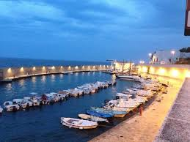
TRICASE HARBOR
Tricase Harbor is a natural inlet whose coast is mainly low and rocky, full of caves and small sandy and free inlets. The natural coves have been joined by two small ports, one ancient and a second more modern from which to explore the coast by boat. Despite being a marina with many boats moored, the clear and crystalline water with a thousand shades of blue that catches the eye during the whole course of the year jumps to the eye.

Slide 5
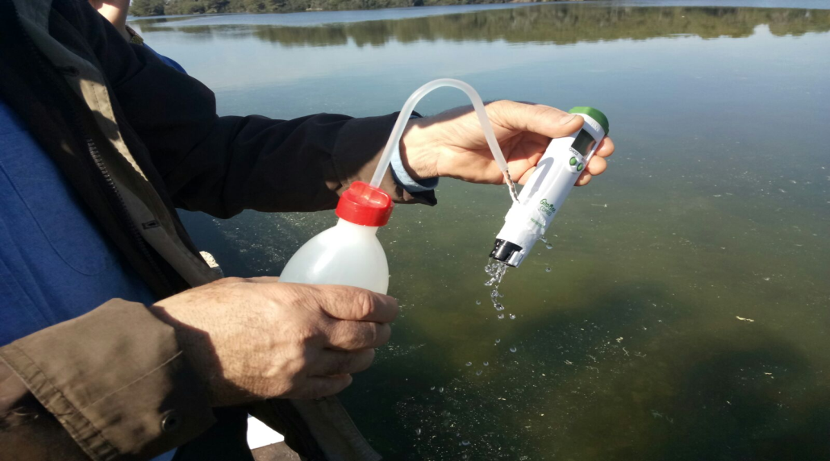
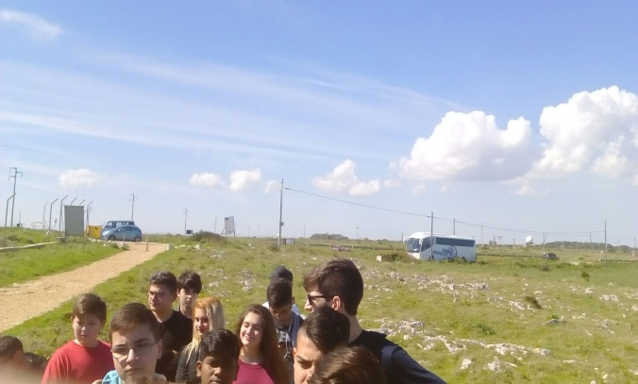
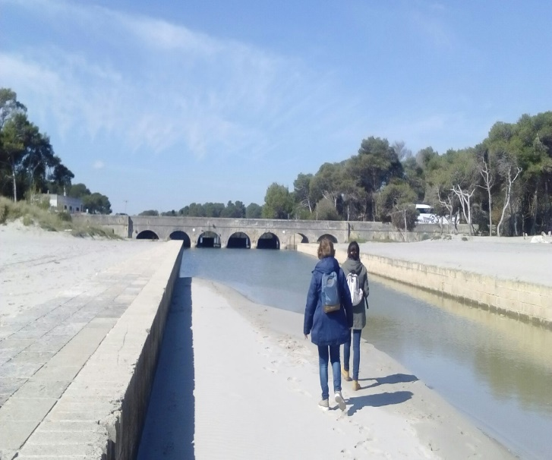
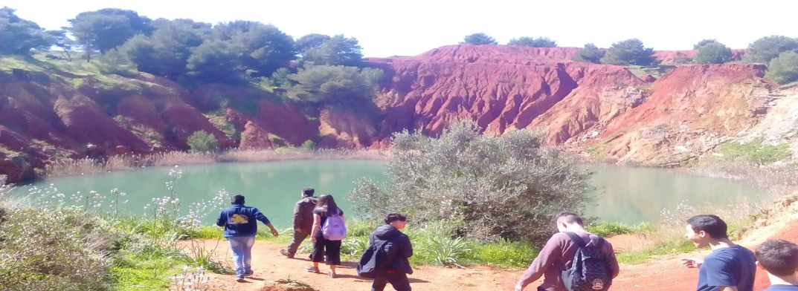
The research of the abiotic parameters of the ecosystems in question is aimed at the knowledge of:
Water eutrophication risk
Biodiversity

Slide 6
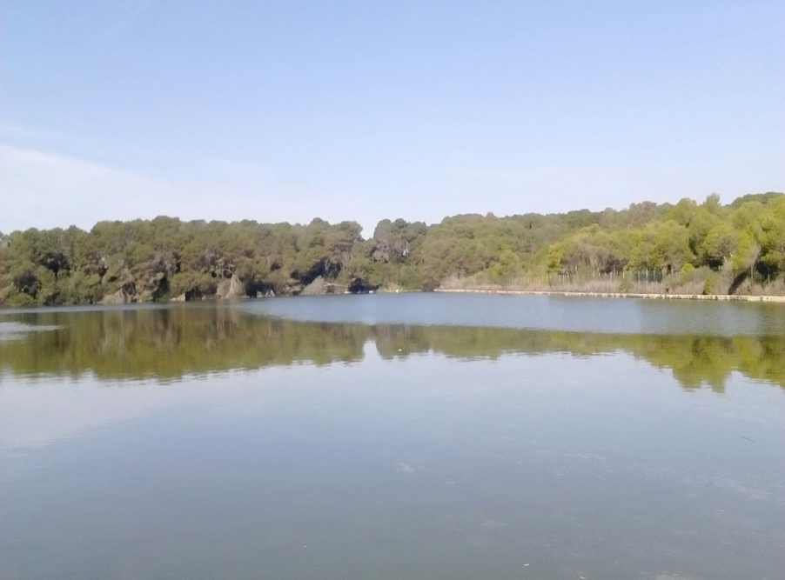
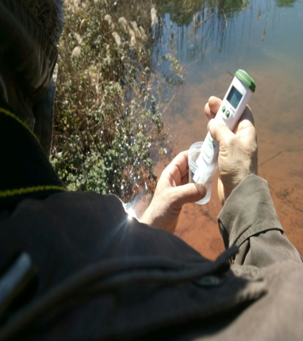
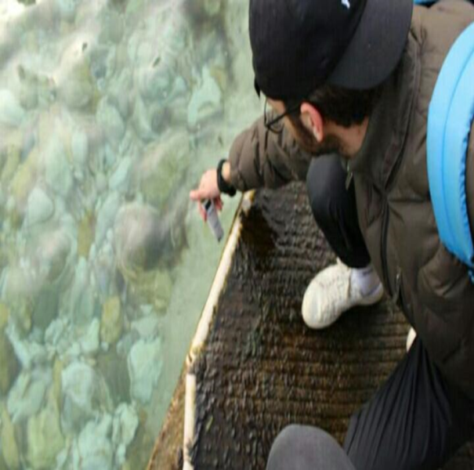
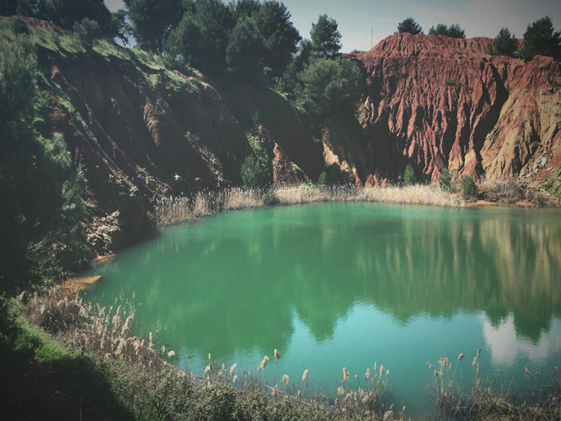

Slide 7
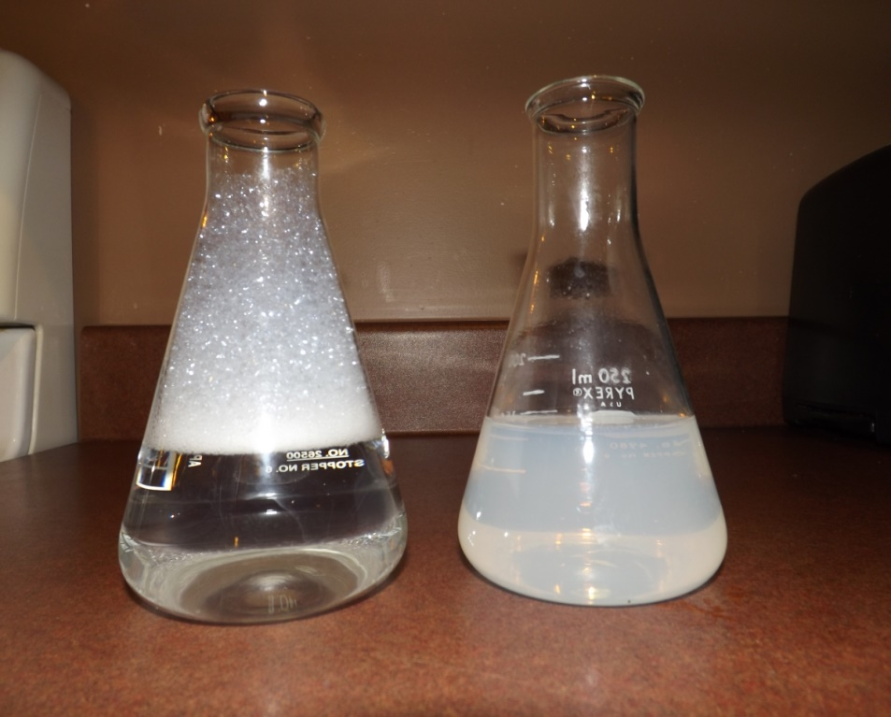
ANALYSIS OF THE WATER HARDNESS
HARD WATER IS WATER THAT HAS HIGH MINERAL CONTENT (IN CONTRAST WITH "SOFT WATER"). HARD WATER IS FORMED WHEN WATER PERCOLATES THROUGH DEPOSITS OF LIMESTONE AND CHALK WHICH ARE LARGELY MADE UP OF CALCIUM AND MAGNESIUM CARBONATES.
You need…
HI 3842-0 Hardness HR Reagent, 1 botte with dropper (30 mL);
Calmagite Indicator, 1 bottle with dropper (10mL);
1 calibrated plastic vessel (50 mL);

Slide 8
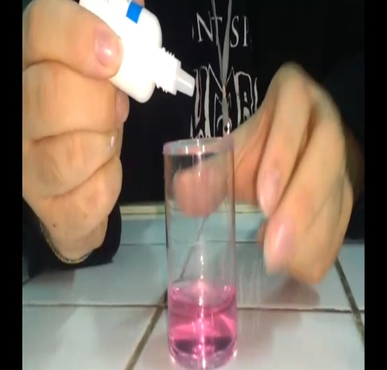
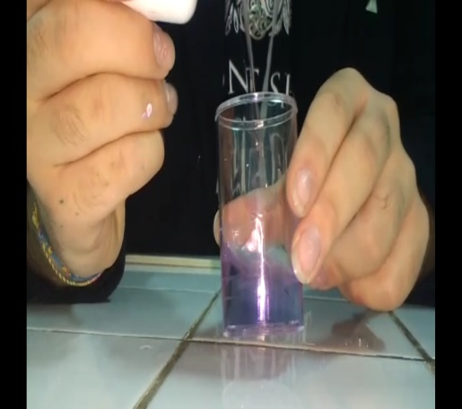
Add a drop of Calmagite Indicator and fil it to whe water sample and swirl the beaker.
Add drops of HI3842-0 reagent until color changes from pink to blue while counting the drops needed to obtain the color change.
Alimini Lakes
Bauxite Quarry
Tricase’s Harbor
45 drop of reagent
450 ppm CaCo3
450 mg/L
4.5 °f
2.502 °D
3.15 °E
22 drop of reagent
220 ppm CaCo3
250 mg/L
2.2 °f
12,232 °D
15,4 °E
74 drop of reagent
740 mg/L
7,4 °f
4,1144 °D
5,18 °E

Slide 9
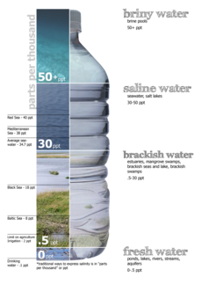
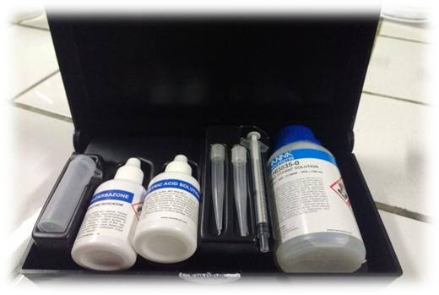
SALINITY
SALINITY IS THE SALTINESS OR AMOUNT OF SALT DISSOLVED IN A BODY OF WATER (SEE ALSO SOIL SALINITY). SALINITY IS AN IMPORTANT FACTOR IN DETERMINING MANY ASPECTS OF THE CHEMISTRY OF NATURAL WATERS AND OF BIOLOGICAL PROCESSES WITHIN IT, AND IS A THERMODYNAMIC STATE VARIABLE THAT, ALONG WITH TEMPERATURE AND PRESSURE, GOVERNS PHYSICAL CHARACTERISTICS LIKE THE DENSITY AND HEAT CAPACITY OF THE WATER.
You need…
Diphenylcarbazone Indicator, 1 bottle with dropper (15 mL);
Nitric Acid Solution, 1 bottle with dropper (30 mL);
HI 3835-0 Reagent Tritrant Solution, 1 bottle(120 mL);
1 plastic vial;
1 calibrated syringe (1 mL) with tip.

Slide 10
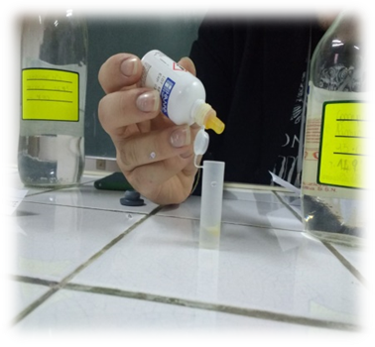
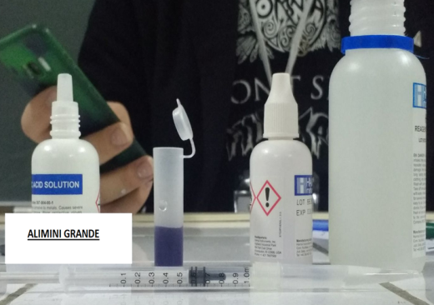
Take the tiration syringe and push plunger completely ito the syringe. Insert tip into water sample and pull pluger out until the lowr edge of pluger seal is on the 0 mL mark of the syringe. Add the sampe in the syringe to the plastic vial.
Add a drop of Diphenycarbazone Indicator and cap the vial. Swirl the solution. The solution will become a violet color. While swirling the vial, add Nitric Acid Solution drop by drp until the solutin turns yellow. Take the titration syringe and insert a new pipet tip. Push plunger completely into the syringe. Intert tip into HI 3835-0 Reagent Titrant Solution and pull plunger out until the lower edge of the plunger seal i son the 0 mL mark of the syringe.
Place syringe tip into the plastic vial and slowly add the titration solution drop by drop, swirling to mix after each drop. Continue adding titration solution until the solution in the vial changes from yellow to violet.
Alimini Lakes
27,5 g/Kg
Bauxite Quarry
2,6 g/Kg
Tricase’s Harbor
34 g/Kg

Slide 11
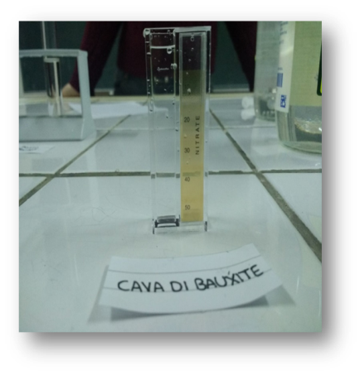
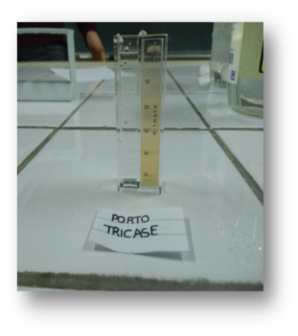
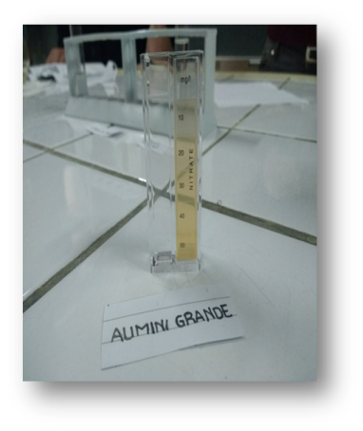
Nitrates analysis
Necessary:
1 beaker with perforated lid;
Distillated water;
Nitrates indicator;
Colorimetric scale;
Execution of the experiment:
Insert 10 ml of distillated water into the beaker with perforated lid and then insert the nitrates indicator. Mix for a few seconds and let the mixture work for some minutes. Then transfer everything to the container with a colorimetric scale and, basing on the color obtained, exame the result.
Observation:
There are no considerable values of Nitrates

Slide 12
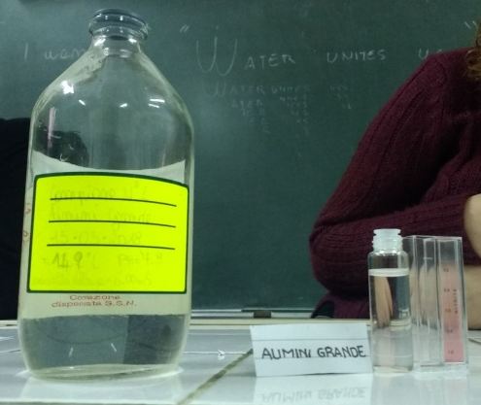
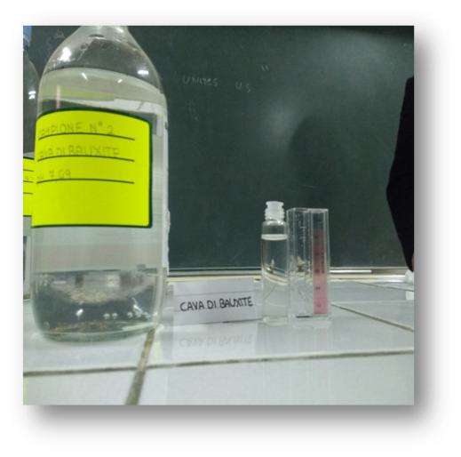
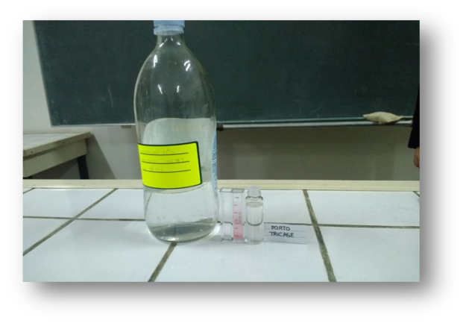
Nitrites analysis
Necessary:
1 beaker with perforated lid;
Distillated water;
Nitrites indicator;
Colorimetric scale;
Execution of the experiment:
Insert 10 ml of distillated water into the beaker with perforated lid and then insert the nitrites indicator. Mix for a few seconds and let the mixture work for some minutes. Then transfer everything to the container with a colorimetric scale and, basing on the color obtained, exame the result.
Observations:
There aren’t considerable values of Nitrites.

Slide 13
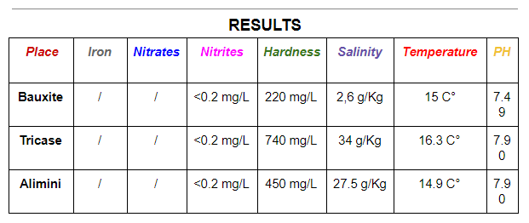

Slide 14
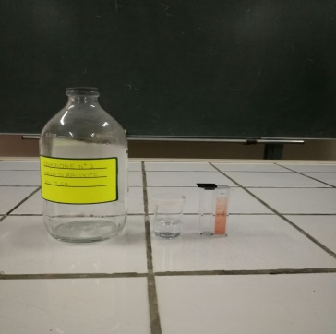
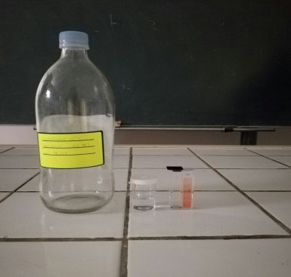
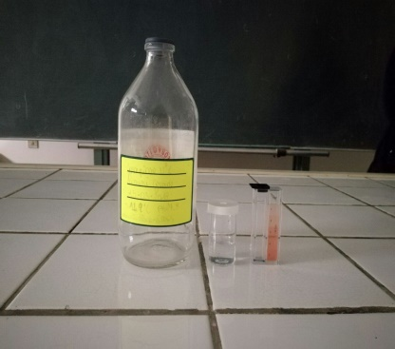
Iron analysis
Necessary:
1 beaker with perforated lid;
Distillated water;
Iron indicator;
Colorimetric scale;
Execution of the experiment:
Insert 10 ml of distillated water into the beaker with perforated lid and then insert the iron indicator. Mix for a few seconds and let the mixture work for some minutes. Then transfer everything to the container with a colorimetric scale and, basing on the color obtained, exame the result.
Observations:
There isn’t iron inside the water of the Alimini Lake.
A very little bit of iron is present inside the water of the Bauxite Quarry.
A very little bit of iron is present inside the water of the Port of Tricase.

Slide 15
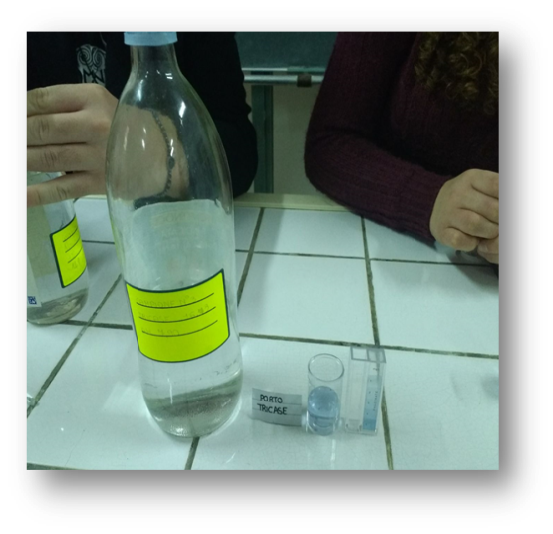
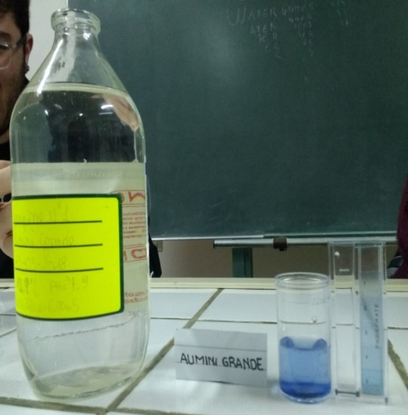
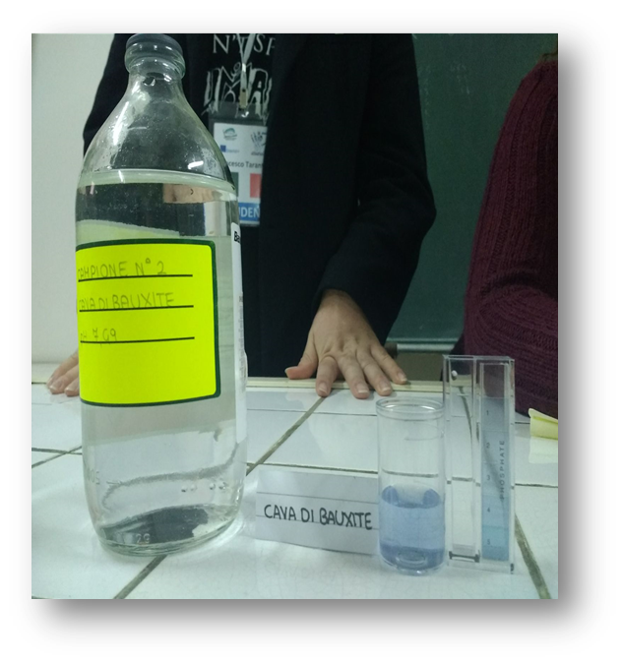
Phosphates analysis
Necessary:
1 beaker with perforated lid;
Distillated water;
Phosphates indicator;
Colorimetric scale;
Execution of the experiment:
Insert 10 ml of distillated water into the beaker with perforated lid and then insert the phosphates indicator. Mix for a few seconds and let the mixture work for some minutes. Then transfer everything to the container with a colorimetric scale and, basing on the color obtained, exame the result.
Observations:
There is a large quantity of phosphates inside the water of the Alimini Lake (1° posto).
There is a large quantity of phosphates inside the water of Bauxite Quarry (2° posto).
There is a large quantity of phosphates inside the water of the port of Tricase, despite it is a port; this is caused by the currents of theOtranto Channel (3° posto).

Slide 16
SUMMARY
Chemical - physical analysis of water samples taken from Alimini Grande, from the lake of bauxite Quarry and the Port of Tricase have highlighted the presence of high concentrations of phosphates, especially in Alimini Grande, while there were no nitrate presences, but only very low concentrations of nitrites. Phosphates, mainly from fertilizers and detergents, stimulate the growth of photosynthetic organisms that contribute to the eutrophication of water. This phenomenon, object of our investigation, is not particularly visible in any of the sites examined. The high concentration of phosphates of Alimini Grande is probably due to fertilizers used in the cultivation of vines (production of rooted cuttings) practiced in the fields surrounding. The waters of Tricase Porto are crystal clear enough to be the waters of a port, thanks to the continuous exchange of water. Tricase is located in the Canale d'Otranto, a stretch of open sea, from the waters stirred by the prevailing winds of Tramontana and Scirocco that favor the oxygenation of the waters themselves, preventing the phenomenon of eutrophication. Also the water of the Bauxite Quarry is quite clear, the phenomenon of eutrophication is not observed. The phosphates come used by the marsh reed, which grows lush on the banks of the Quarry. The marsh reed is a freshwater plant that tolerates low concentrations of salinity; in fact the analyzes there they say the waters of the quarry are slightly brackish.

Slide 17
The salinity value of Alimini Grande is close enough to that of Tricase Porto, for direct connection with the sea. In none of the samples was the presence of iron, even in that of the quarry of bauxite, where iron oxides and hydroxides, which, despite being particularly abundant, just look at the typical red earth, they are insoluble in water and therefore can not be detected.
The hardness of the water of our samples, or the content of calcium and magnesium ions (coming from the presence of soluble salts in water), is in accordance with salinity values. The values ​​of pH are typical of brackish waters and sea waters (7.5 - 8.5). These values ​​depend not only from total dissolved oxygen and temperature, but also from salinity: these values alkaline, i.e. greater than 7, are due to the surplus of carbonate and bicarbonate ions.

