Slide 1
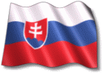
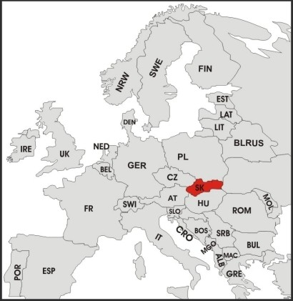
All about us SLOVAKIA
Slovakia is a beautiful country in central Europe.
The capital and largest city is Bratislava.
We have got mountains, valleys, national parks, forests, rivers, lakes, caves
and national curiosities.

Slide 2
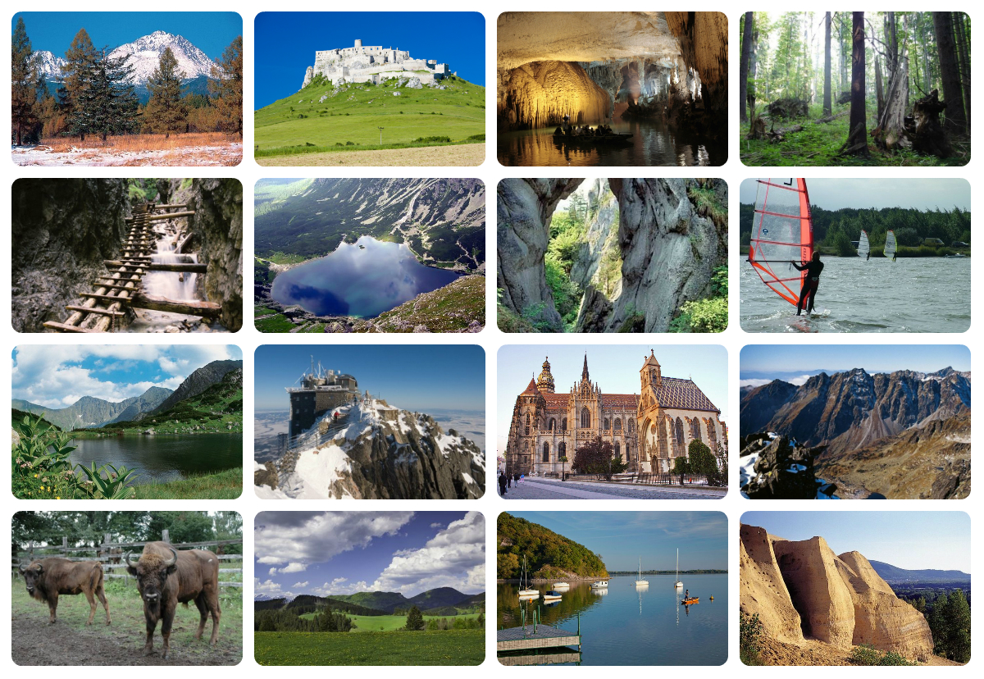

Slide 3
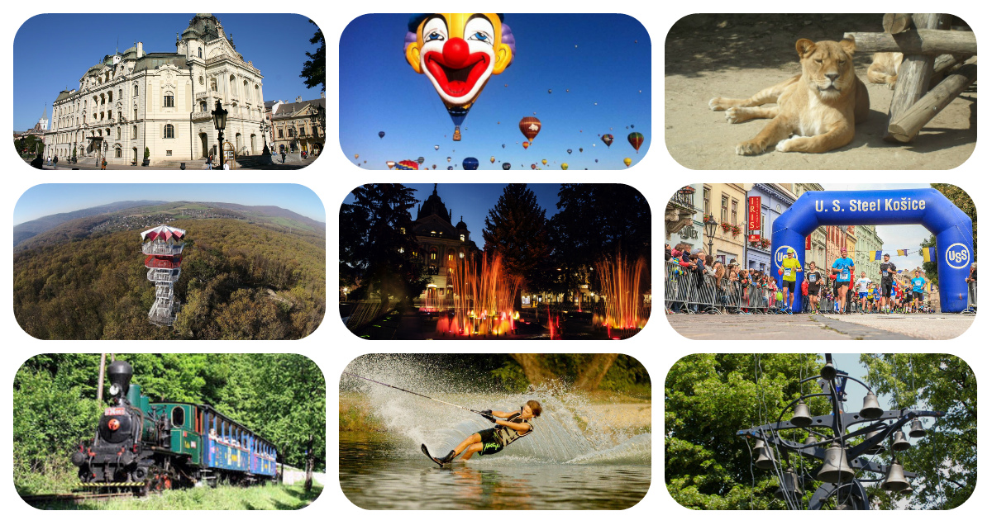
KOSICE
We live in Kosice, the second largest town in Slovakia.
We run Kosice Peace Marathon.
We have Slovakia's largest church - The St. Elisabeth Cathedral,
The State Theatre, Singing fountain, ZOO, Botanical garden, museums, stadiums and other attractions.

Slide 4
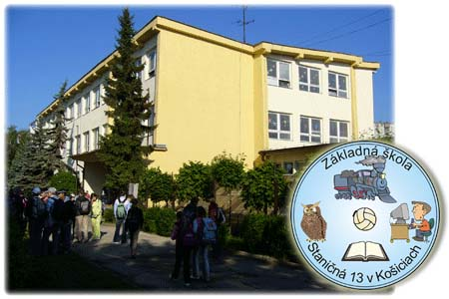
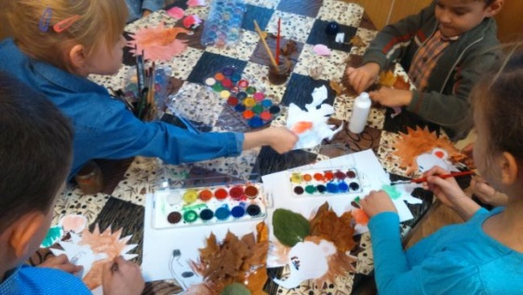
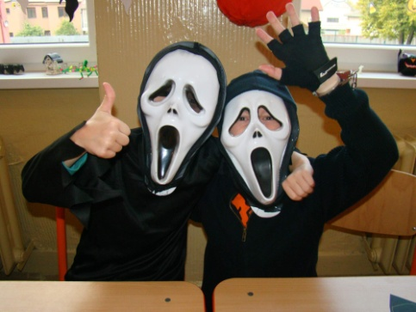
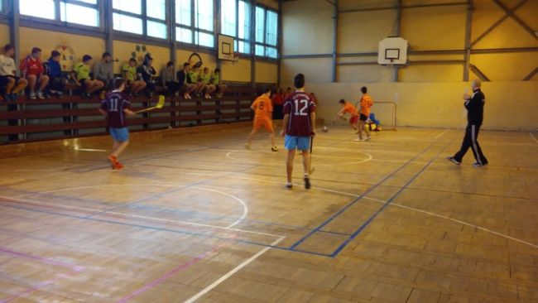
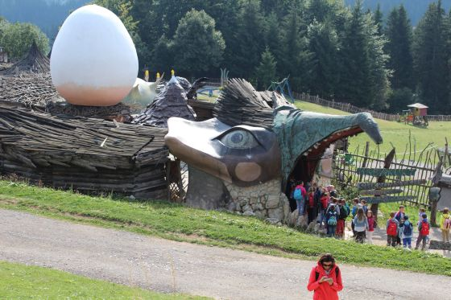
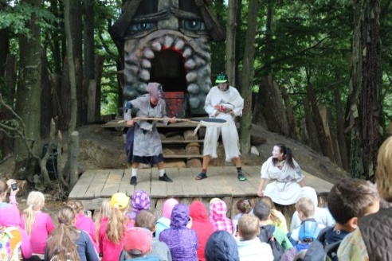
STANICNA PRIMARY SCHOOL
We love ART
We love fun
We love
learning
languages!
We love sports
We love theatre
We love outing

Slide 5
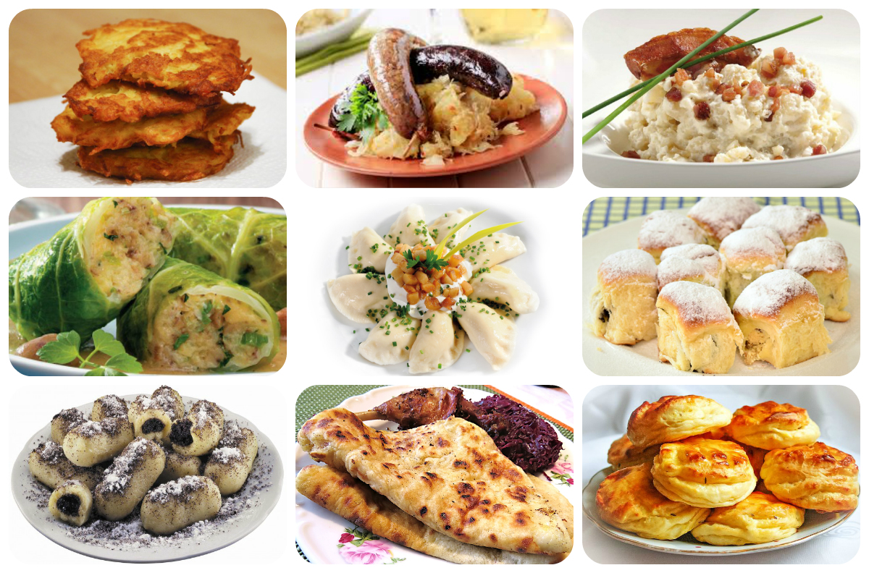
...and we love EATING traditional Slovak food!

