Slide 1
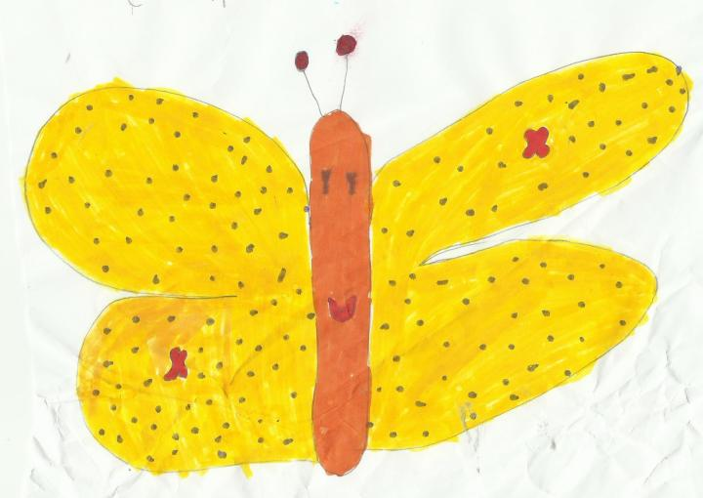
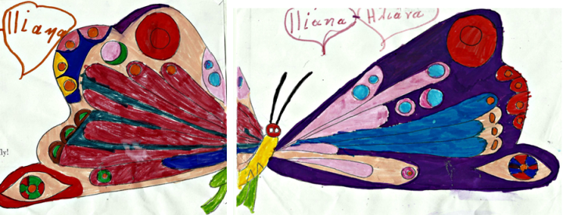
A COCOoN FOR TWO
A story created by firstgraders from Paris, France, based on the drawings of Pyrgos pupils, from Greece, for the eTwinning project « Land of Ambrosia. (Try me! I’m delicious.) »

Slide 2
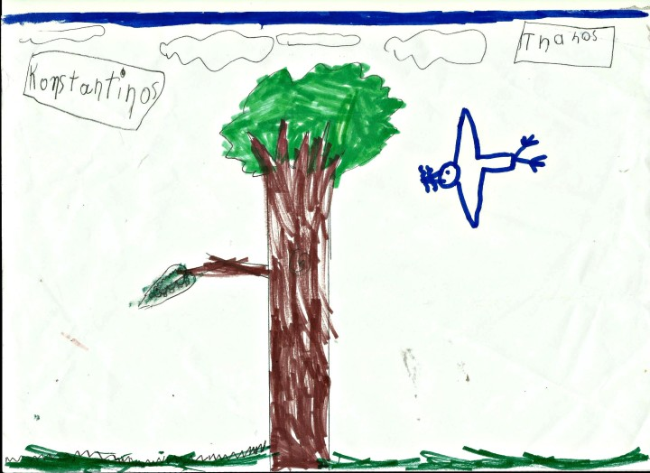
Once upon a time, there was a a white headed red bird
who was carrying two caterpillars in his beak to feed his
nestling.

Slide 3
He caught sight of two little fishes in a ducks’ pound
and decided to catch those too.

Slide 4
He opened his beak and doing so, he let the caterpillars
fall down. They fell on the top of a little drop shaped
creature, leaving a hole in the middle of its head.

Slide 5
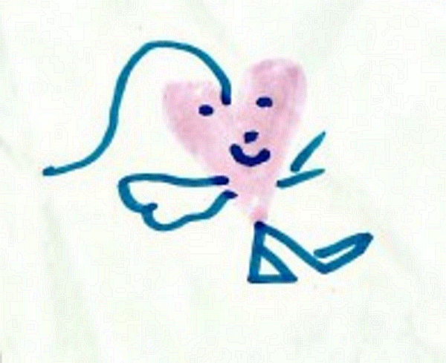
The drop shaped creature had become heart shaped . That is the exact day the heart shape was created !

Slide 6
The heart creature , happy with his new shape, offered to the caterpillars an apple, a pear, a banana and a bag of candies.

Slide 7
The caterpillars ate it all, and then spun a cocoon for both of them, because they liked each other a lot, and wanted to stay together.

Slide 8
They stayed there for nine months, transforming slowly from caterpillar to butterfly. When the cocoon opened, they both flew away.

Slide 9
One of the butterflies wasn’t feeling well, it had been squeezed too tight in the cocoon. When he was out, he felt cold. He flied to the sun to warm up, but his wings were burnt by a sun ray.

Slide 10
When his friend heard him ask for help, he called a vet who put plasters on his wings.

Slide 11
Since those days, the butterflies, who are not stupid, never spun a cocoon for two, and if they have a very good friend, they just place their cocoons very closed one to the other.

Slide 12
A COCOoN FOR TWO
Thank you to Pyrgos pupils who draw for us Eric Carle’ book :
The Very Hungry Caterpillar.
A literary task included in the eTwinning projet 2015/2016
Land of Ambrosia (Try me ! I’m delicious.)
Teachers :
Sophia Kouzouli, Pyrgos, Grèce
Dominique Ducamus, Paris, France

