Slide 1
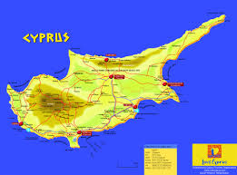
Cyprus
This is our small island in the Mediterranean Sea
Here the Greek Goddess of Beauty and Love Aphrodite was born in the ancient years thus the island is called the Island of Aphrodite (Το νησί της Αφροδίτης)
The Ancient Greek Gods ate ambrosia(αμβροσία) as the name of our project the food that gave them immortality.
Limassol

Slide 2
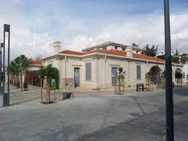
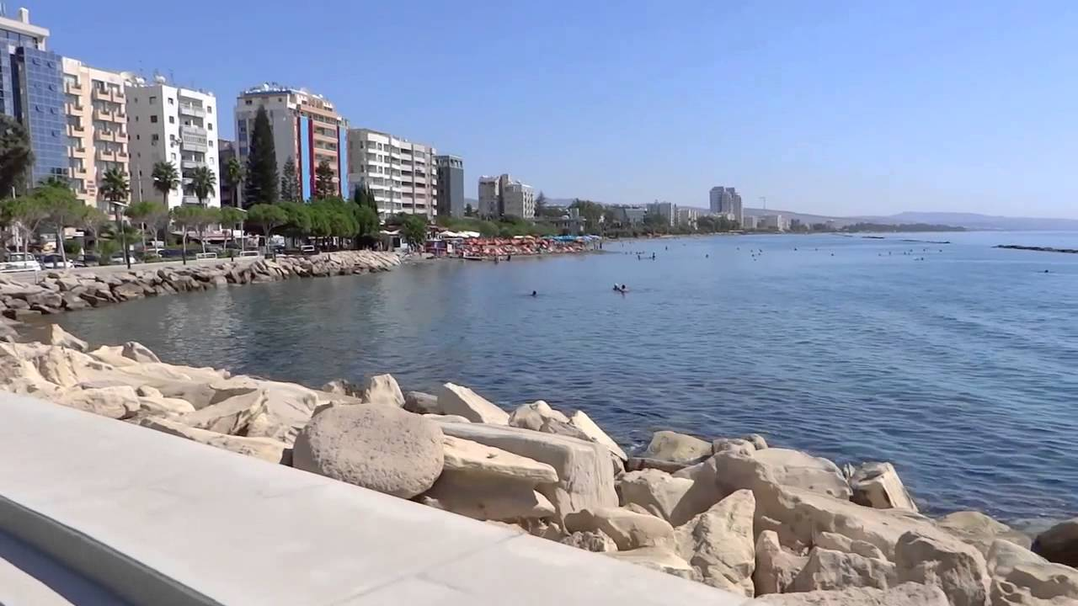
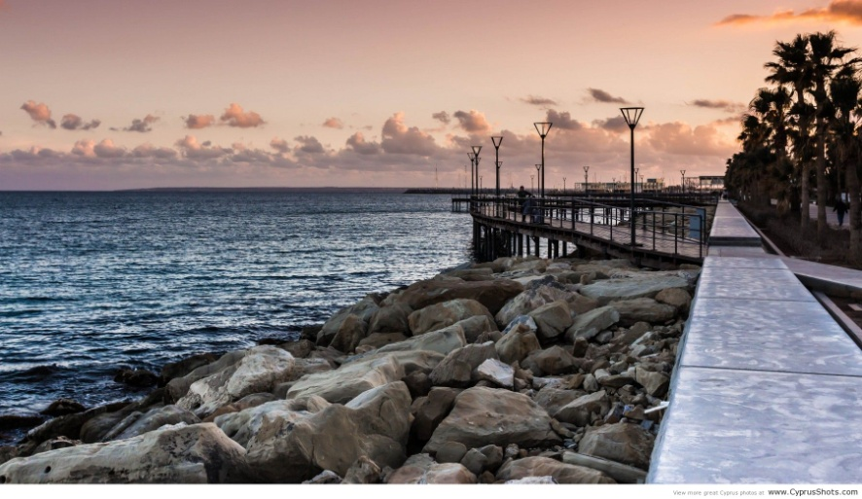
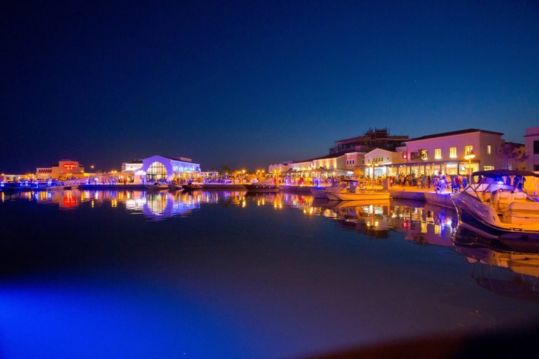
Limassol
This is our town – Limassol (Λεμεσός - Lemesos in Greek)

Slide 3
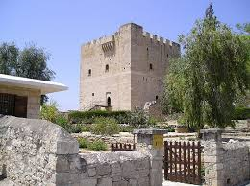
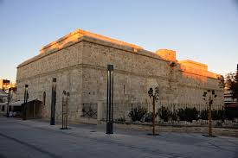
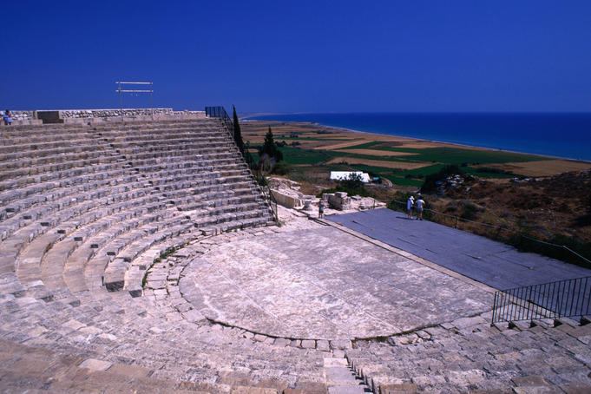
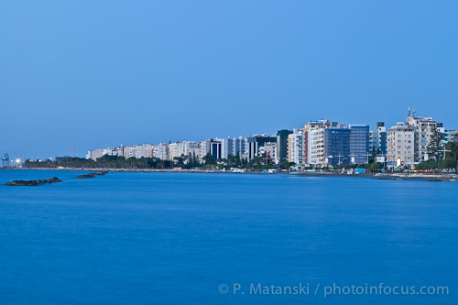
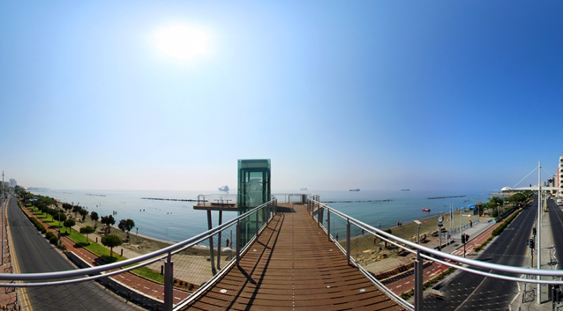
Limassol
Limassol is situated at the southern part of the island and it has a lot of historical places to visit as well as tourist attractions
Here you can watch a video along the coastline of Limassol
https://www.youtube.com/watch?v=K2LUu59hT2U

Slide 4
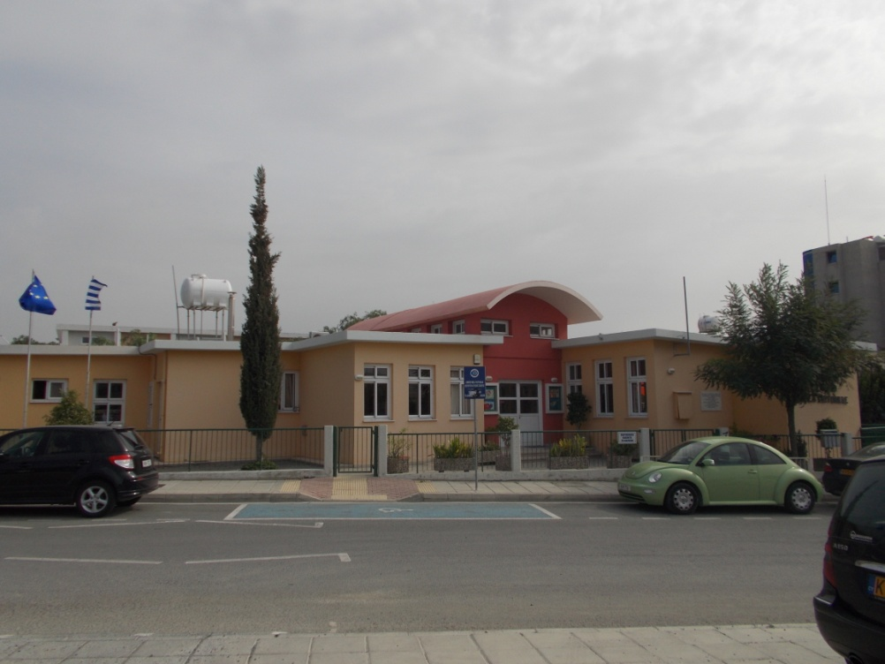
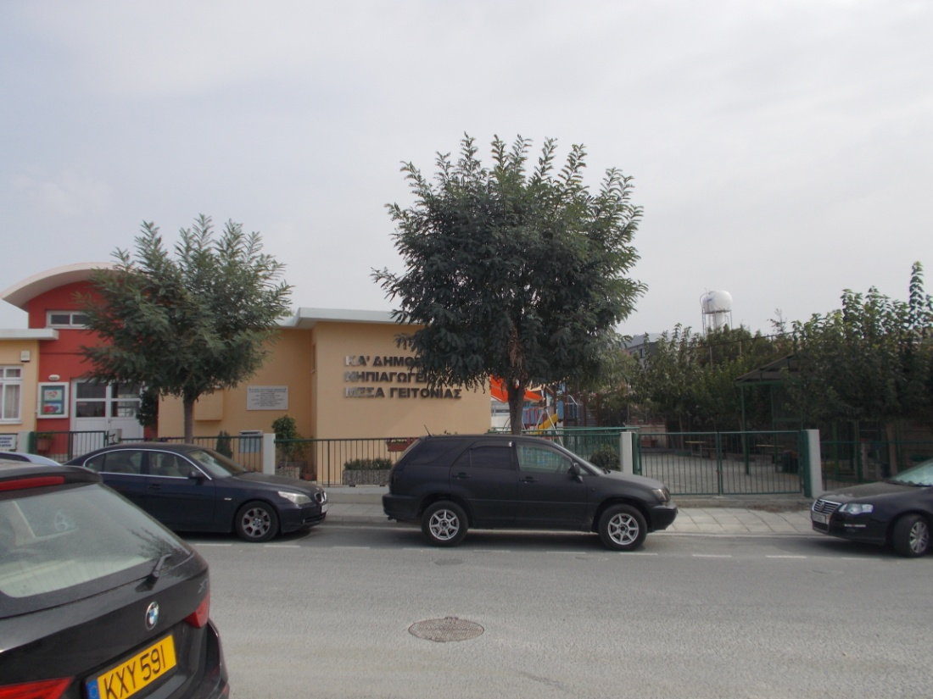
Our school
Our school is located in the centre of the town in the area of Mesa Geitonia
and it has three pre-primary classes
with 25 children in each class

Slide 5
Our school’s entrance
Our Head teacher

Slide 6
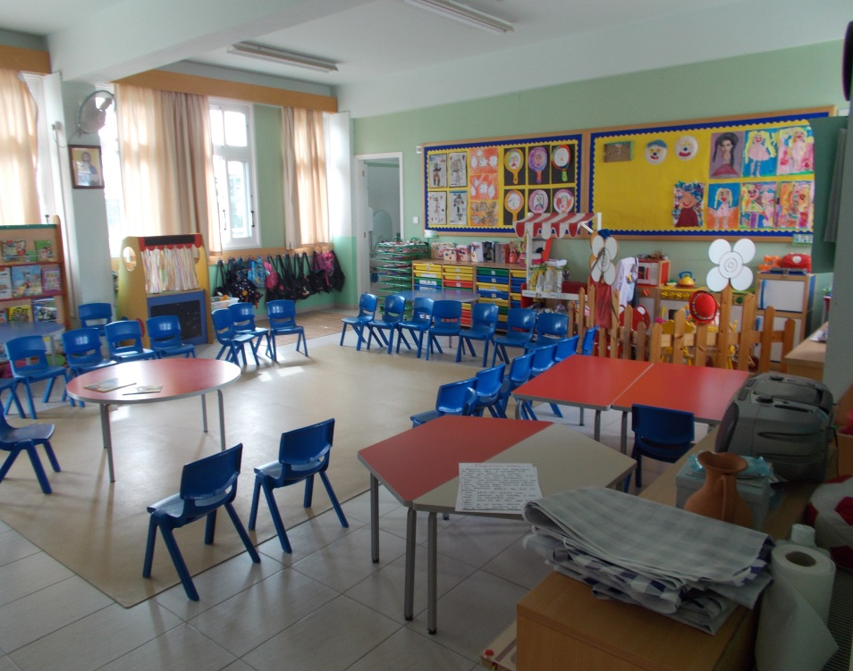
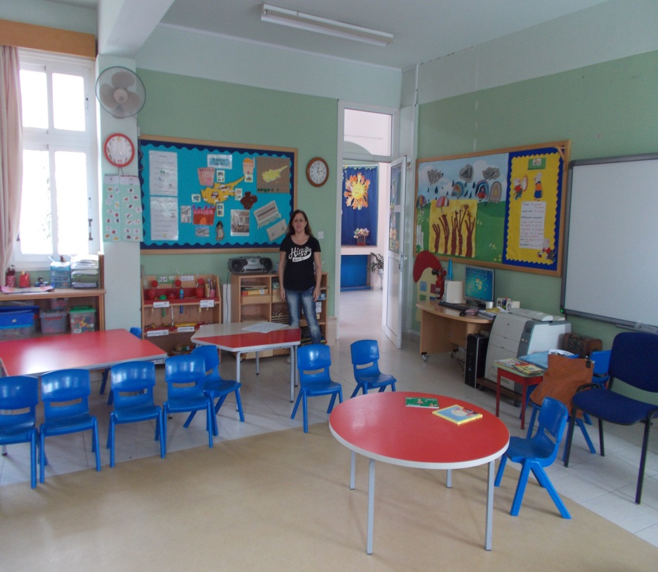
Our classes
Ms. Kiriaki’s Class
N1

Slide 7
Our classes
Ms Antrie’s Class N2

Slide 8
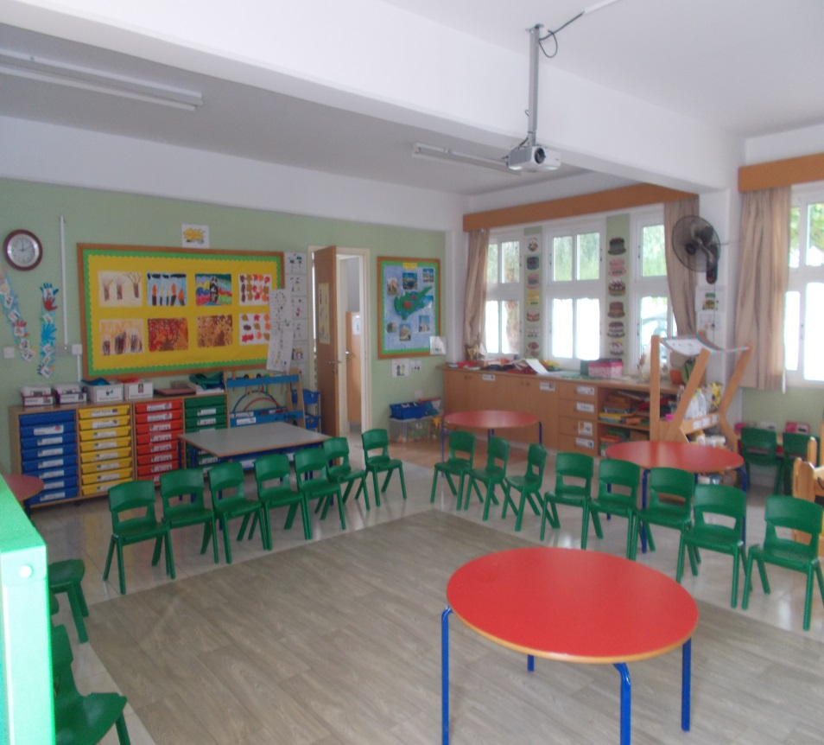
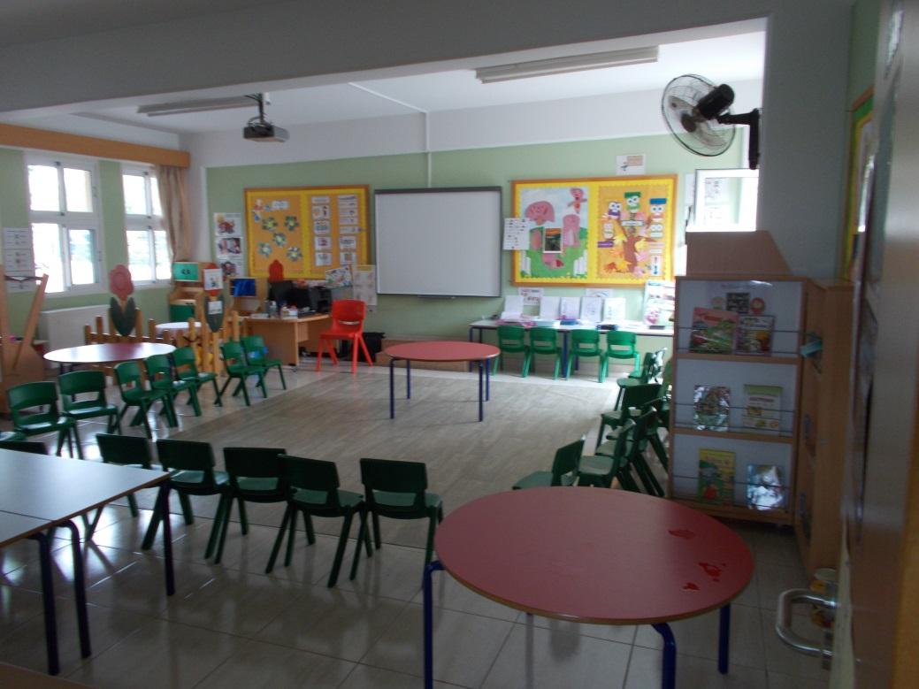
Our classes
Ms. Eleni’s Class
N3

Slide 9
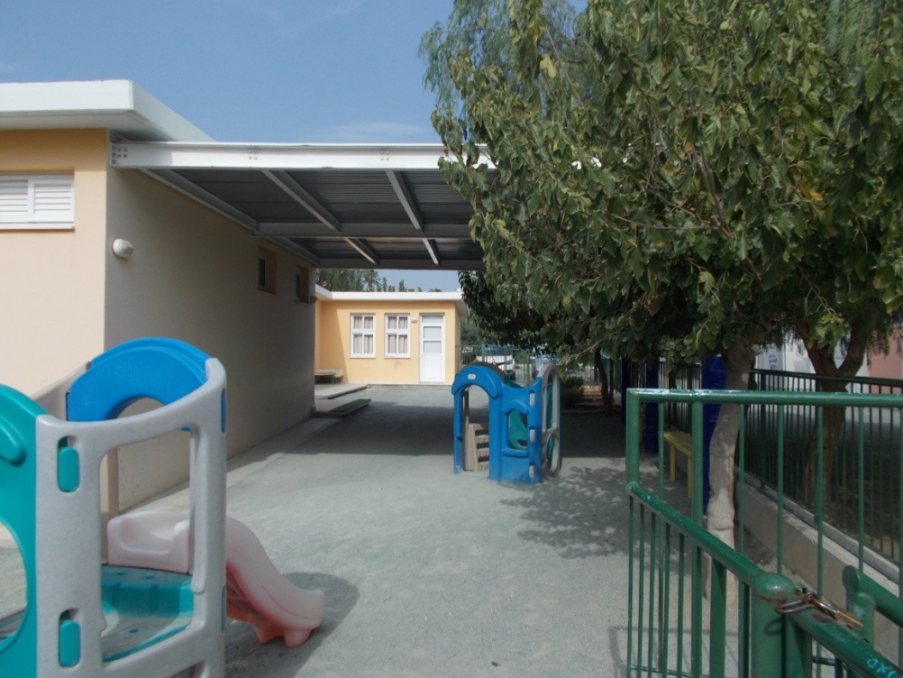
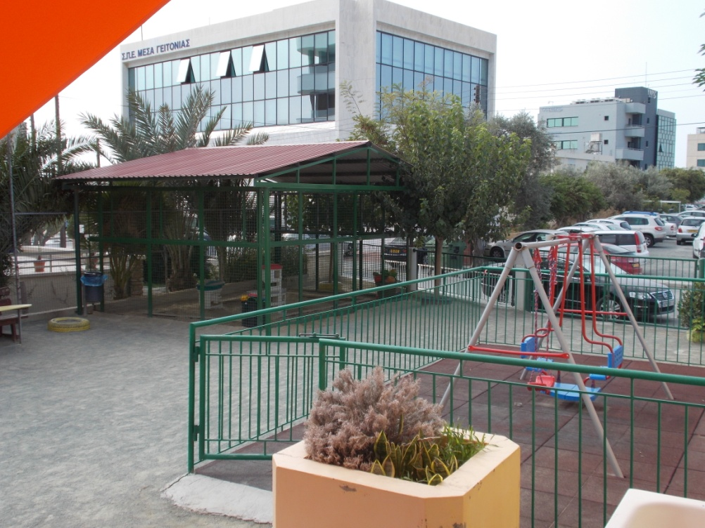
Our playground

Slide 10
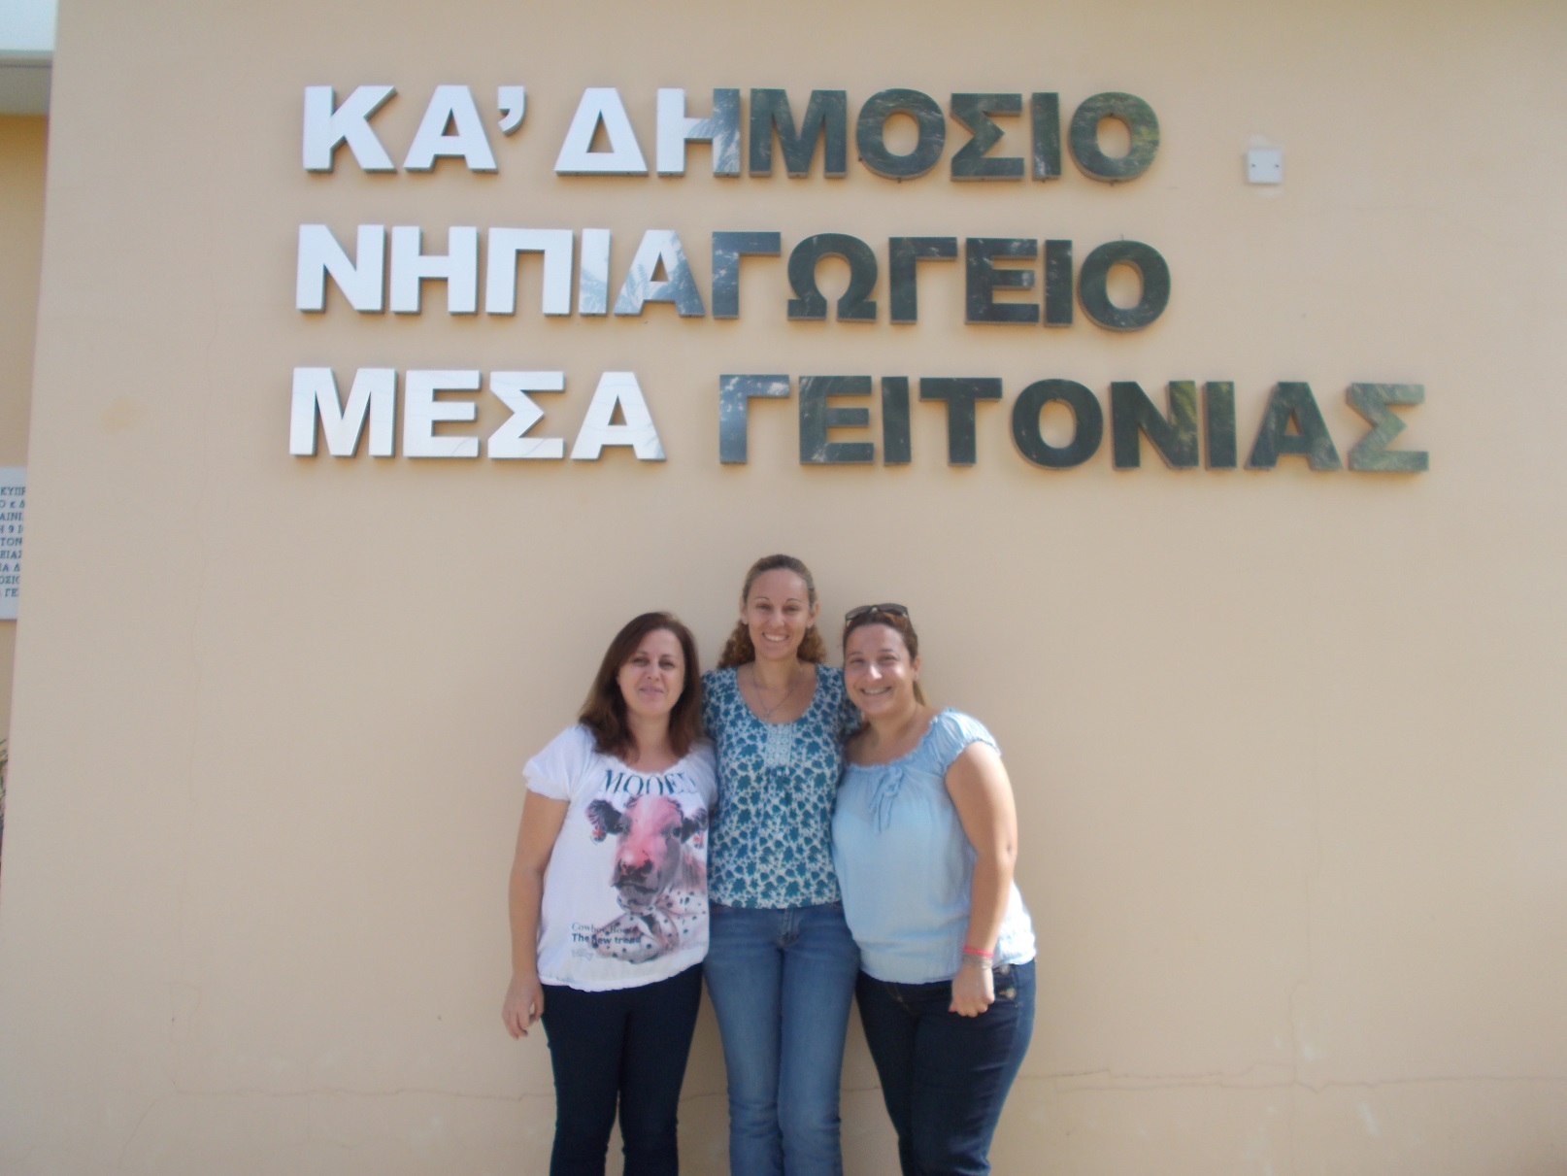
The teachers!

Slide 11
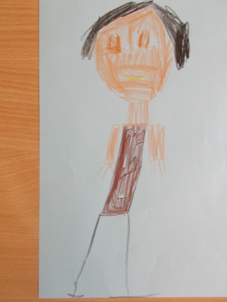
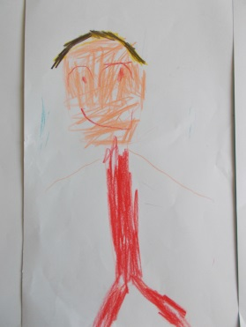
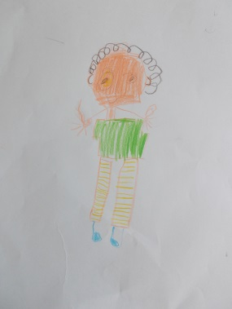
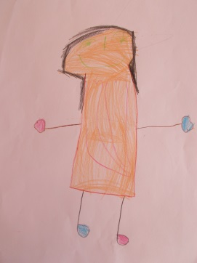
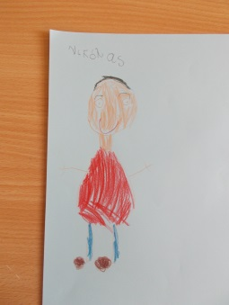
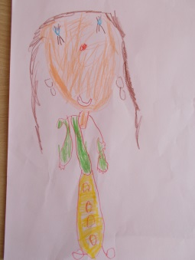
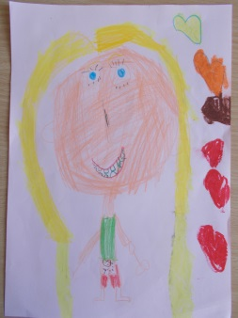
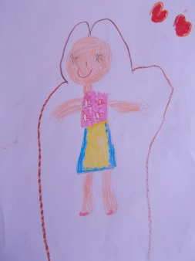
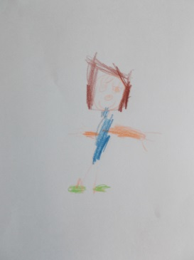
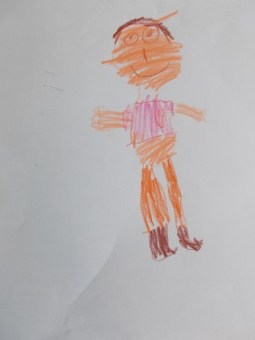
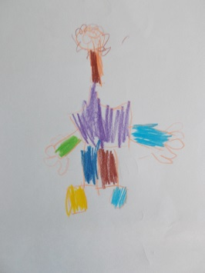
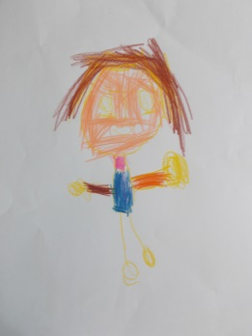
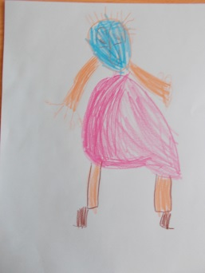
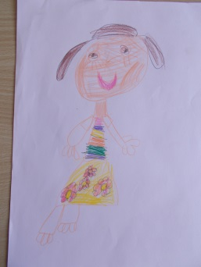
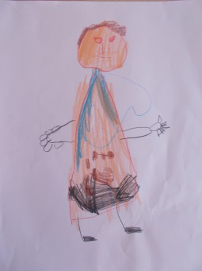
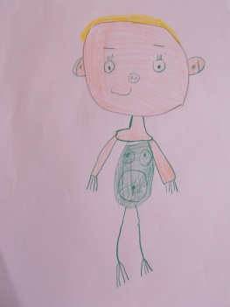
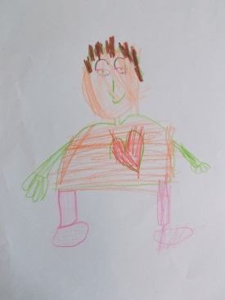
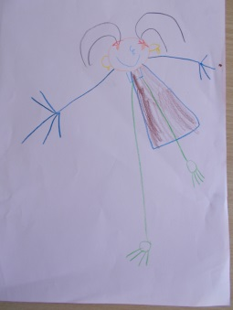
And of course….some of our students☺

Slide 12
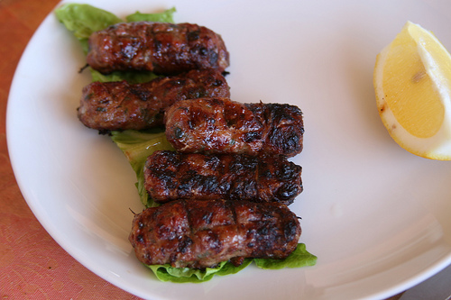
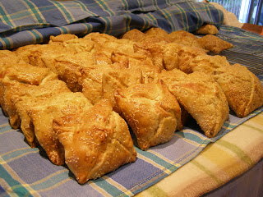
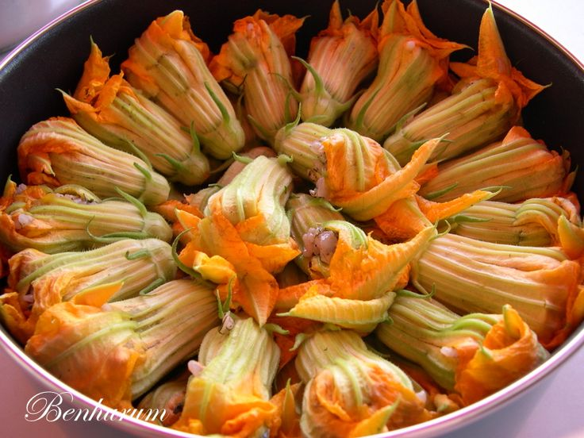
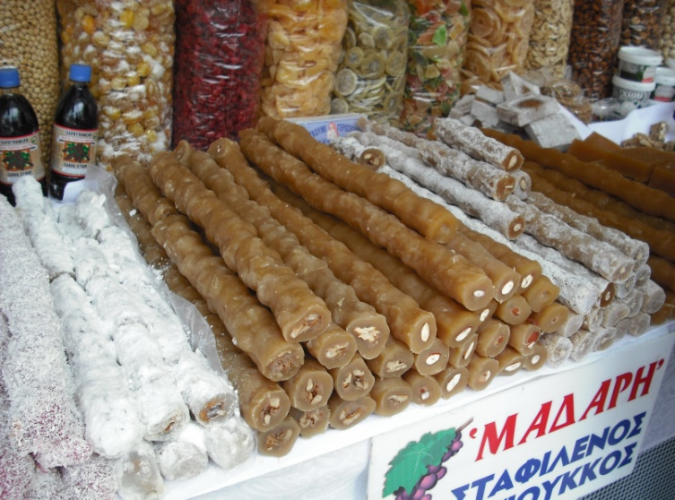
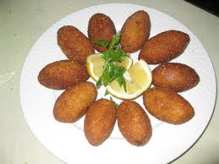
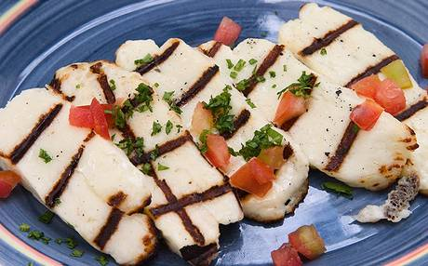
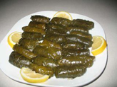
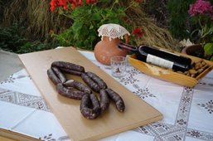
Some traditional goodies of our Country…

Slide 13
We thought this is something you would like to play with your students…
The aim of the game is to match the same pictures
with food from the Cypriot cuisine.
Click on the pictures to find out if you are right or wrong.
Good luck !!!!
☺

Slide 14
siousioukos (σιουσιούκος)

Slide 15
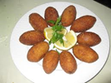
flaounes (φλαούνες)

Slide 16
αnthoi (ανθοί)

Slide 17
halloumi(χαλλούμι)

Slide 18
Koupepia(κουπέπια)

Slide 19
loukanika(λουκάνικα)

Slide 20
koupes(κούπες)

Slide 21
Sieftalia(σιεφταλιά)

