Slide 1
Hello etwinners! This is 1st Primary school of Vartholomio.
We made our masks!

Slide 2
We shall need..
Black and white pictures
Markers
Laminating foils
Plenty of happiness

Slide 3
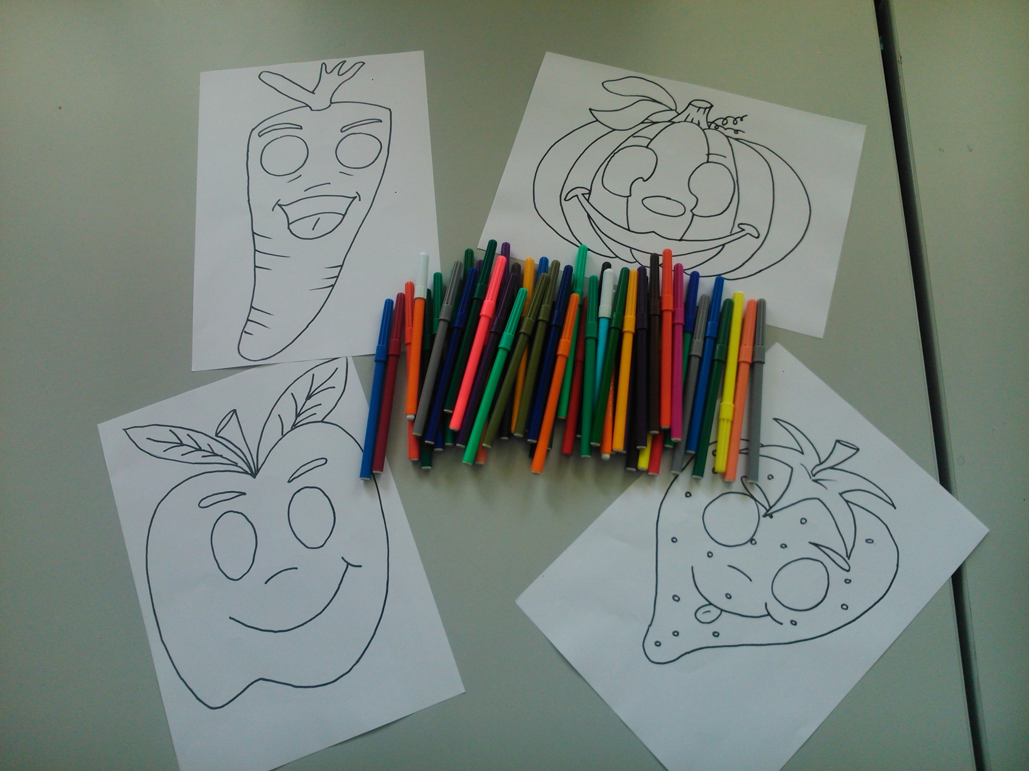

Slide 4
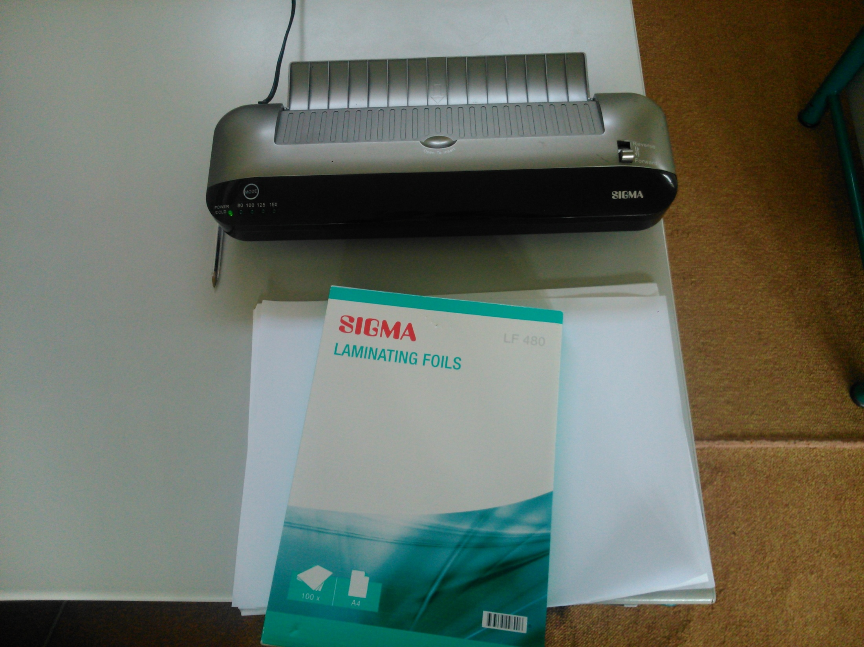

Slide 5
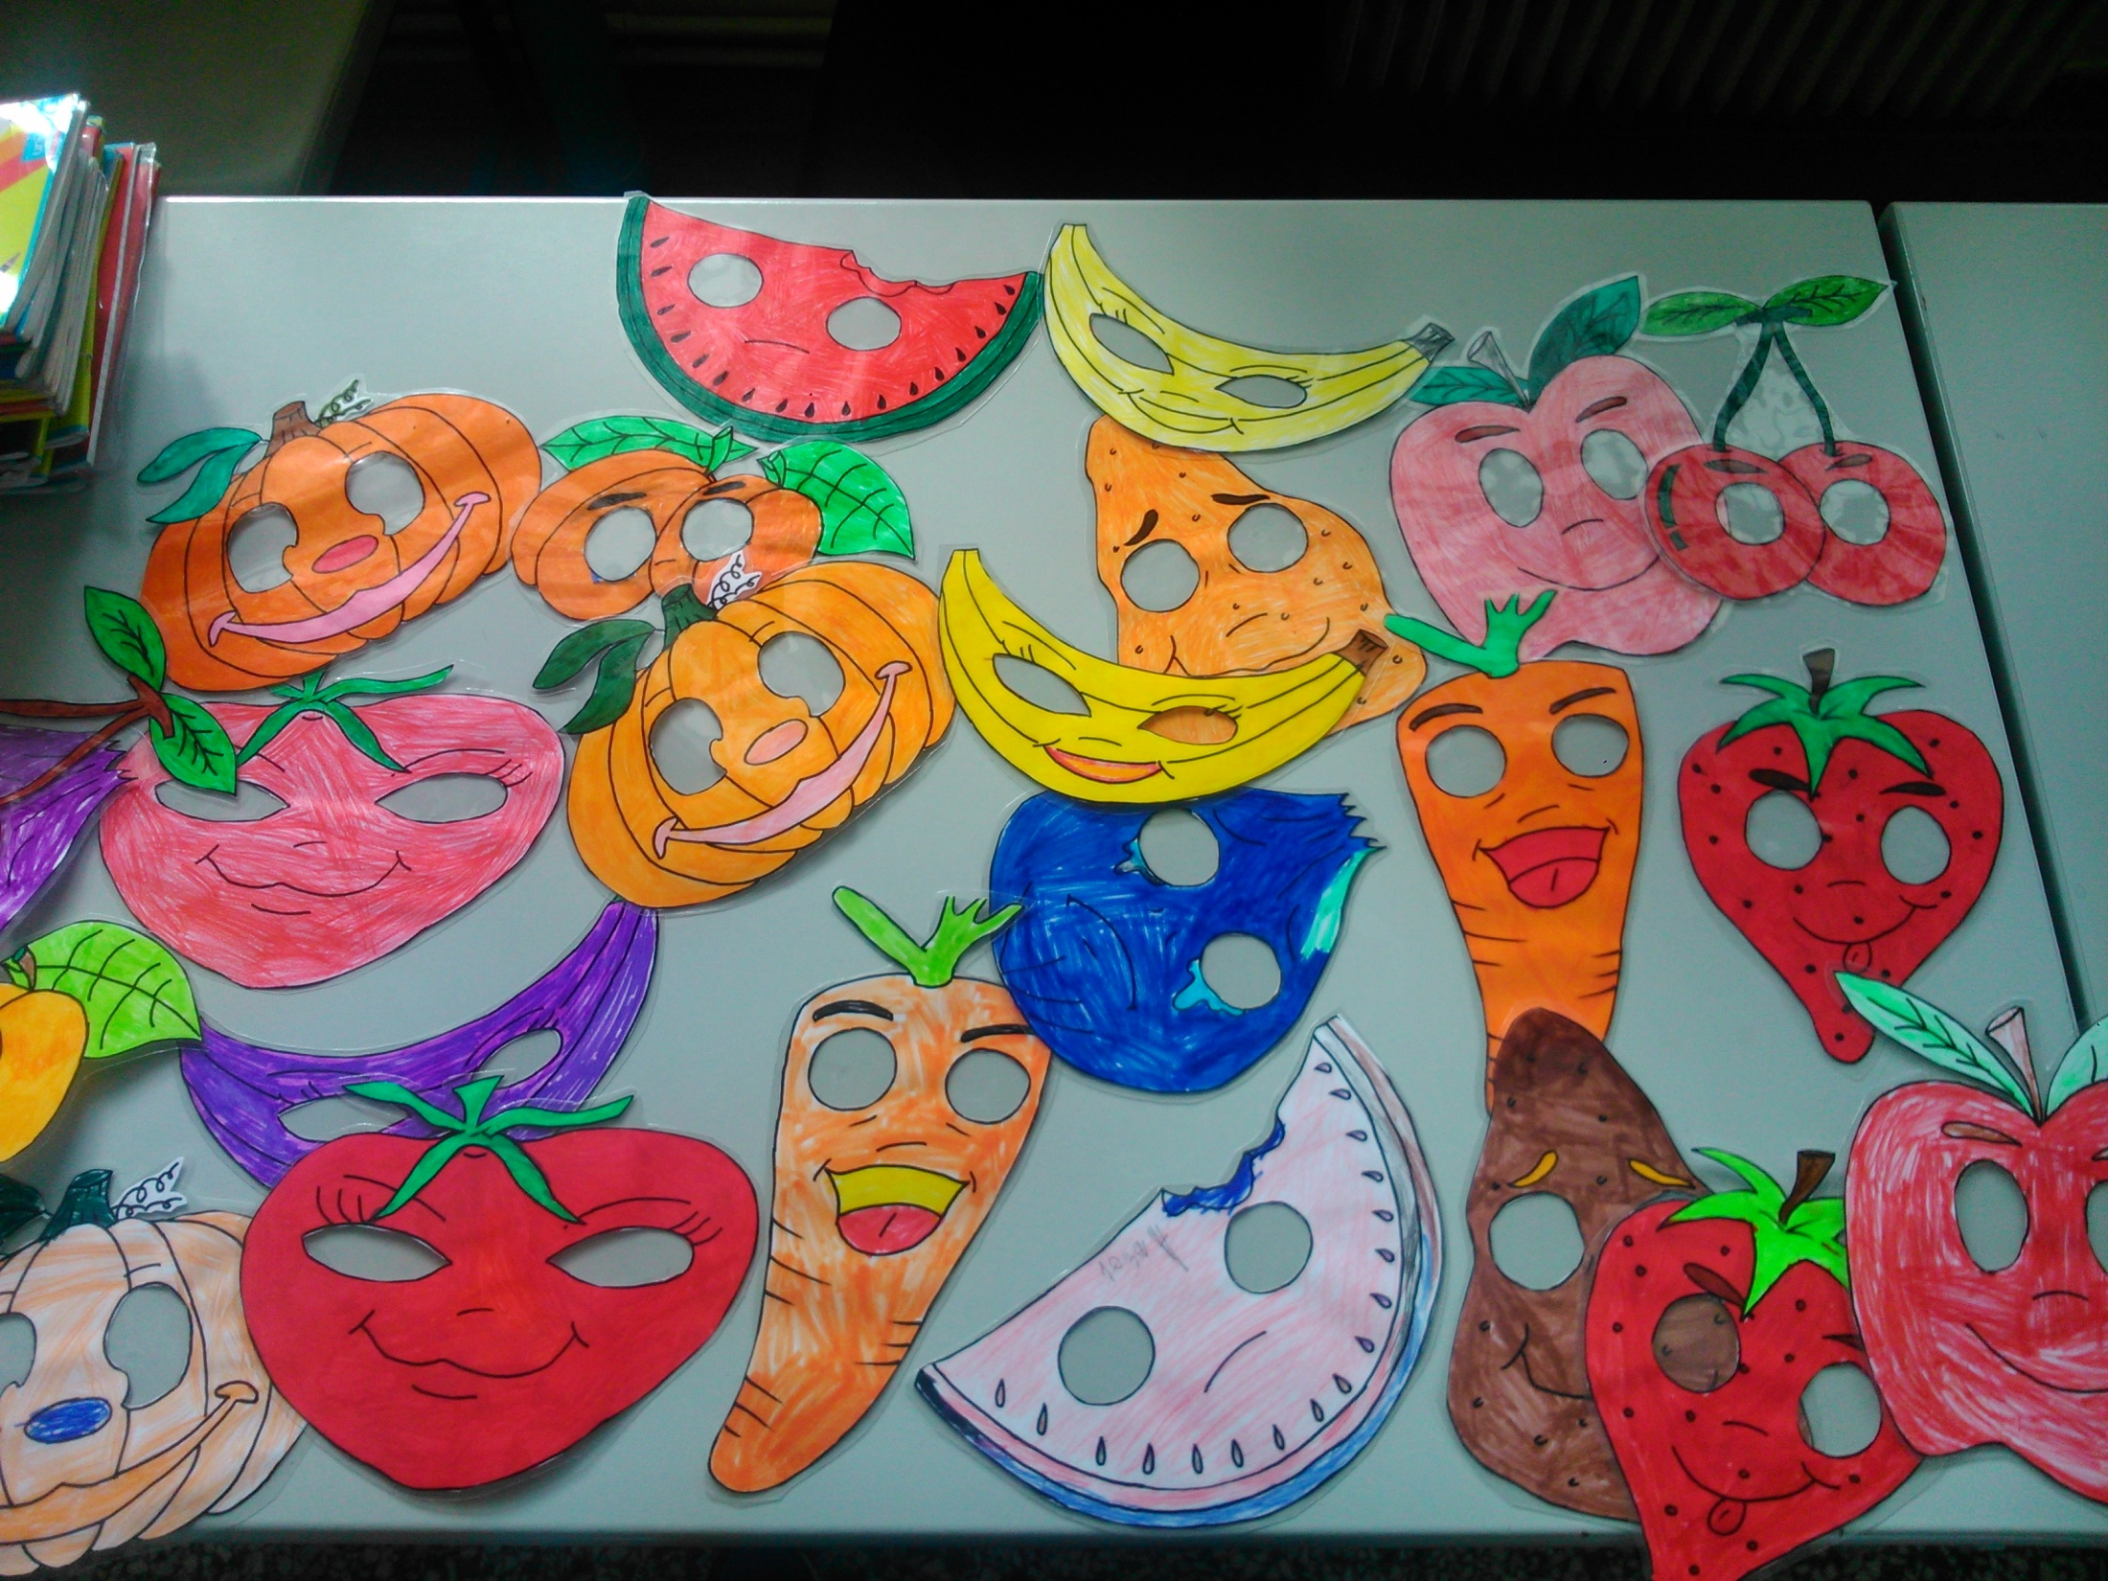

Slide 6
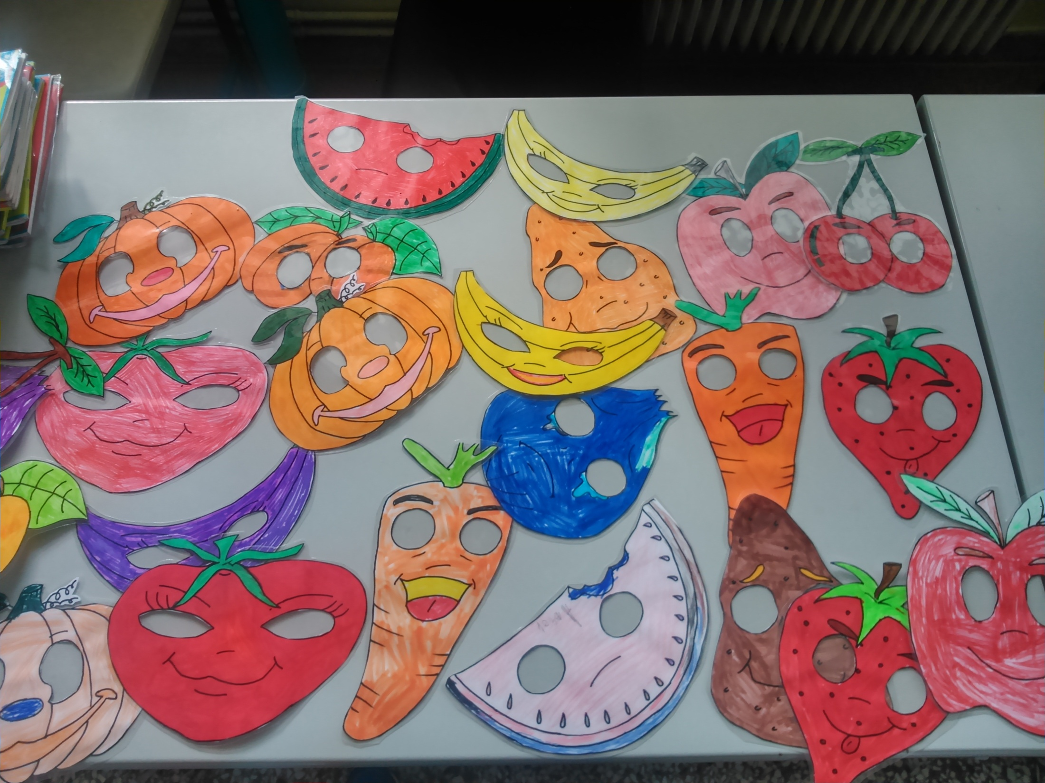

Slide 7
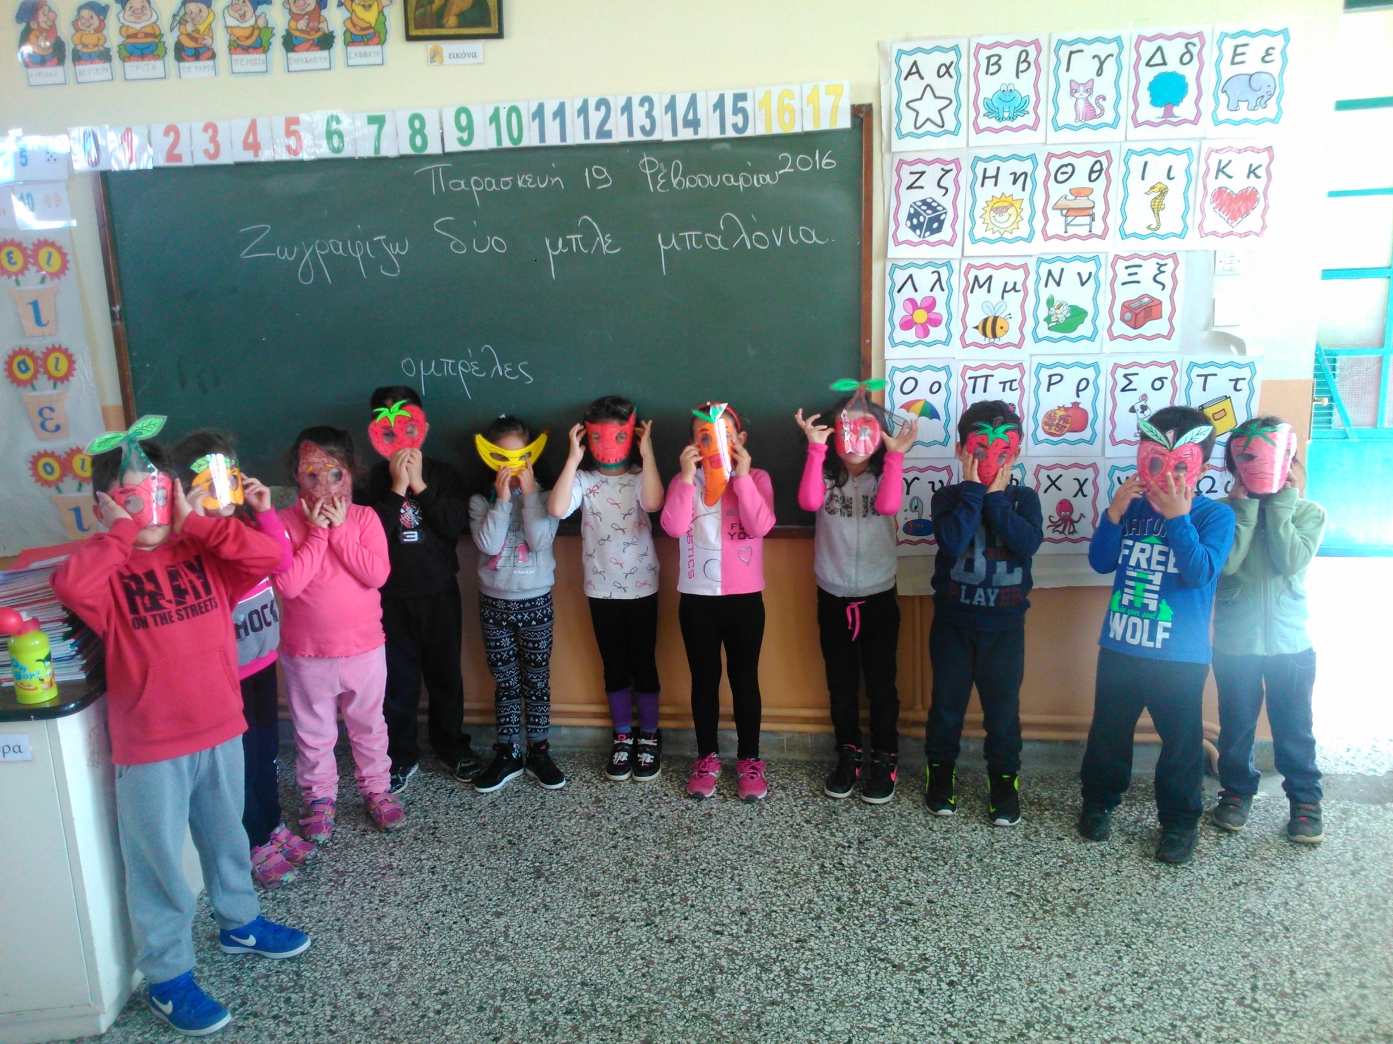

Slide 8
Did you like our masks? We have already uploaded them at Materials. Download them and use them! We are looking for yours!

