Slide 1
Hello etwinners! This is 1st Primary school of Vartholomio.
You may download our masks.
You can draw them!

Slide 2
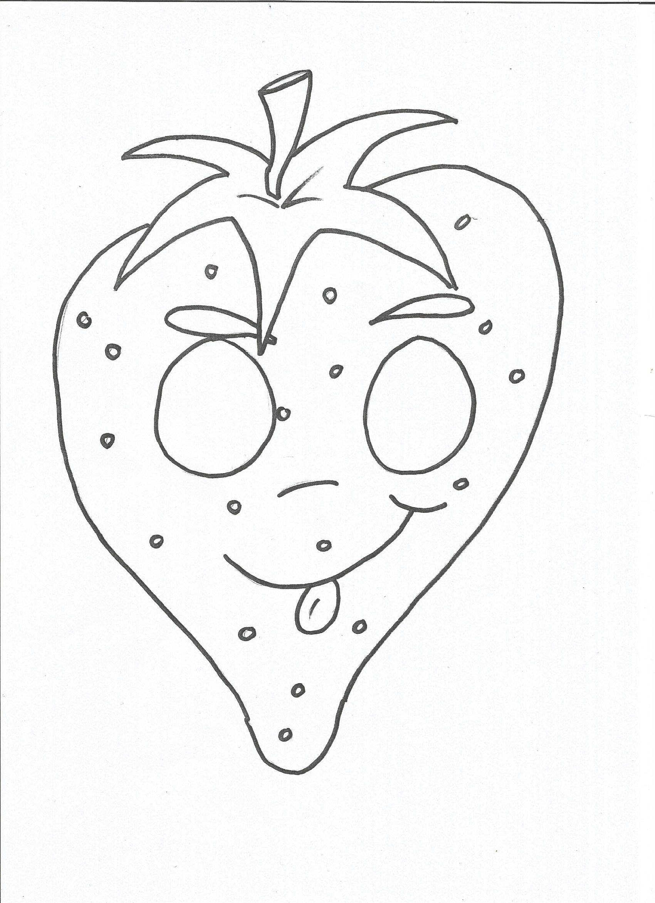

Slide 3
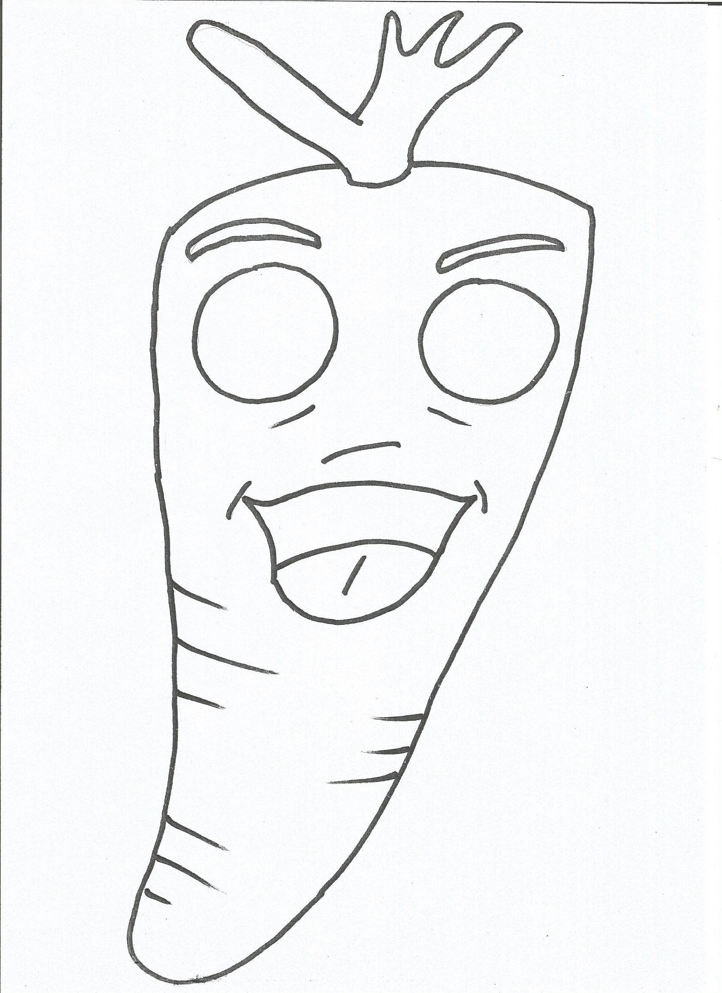

Slide 4
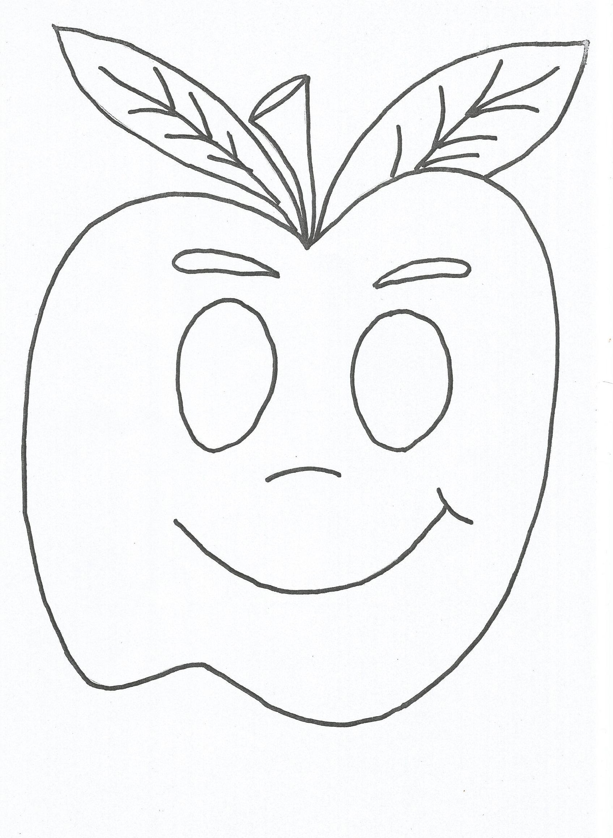

Slide 5
