Slide 1
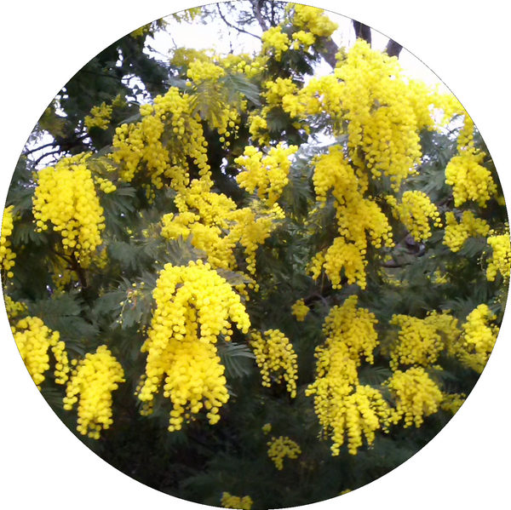
Mimosa (deviled) eggs

Slide 2
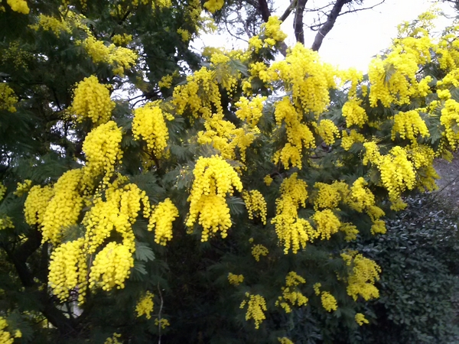
Mimosa
In the south of France, at the end of winter, the mimosa trees are flowering.

Slide 3
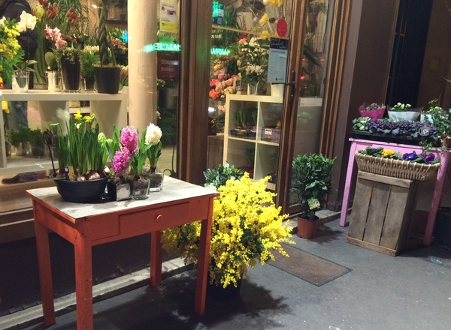
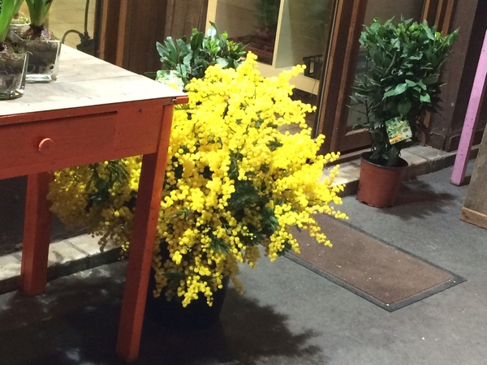
Mimosa
In the streets of Paris too…

Slide 4
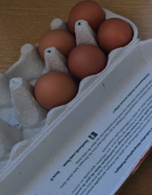
To prepare mimosa eggs…
You need:
Hard-boiled eggs*
Raw eggs*
* Soon, in the scientific part of « Land of Ambrosia », you’ll find a video explaining how to know which is which…

Slide 5
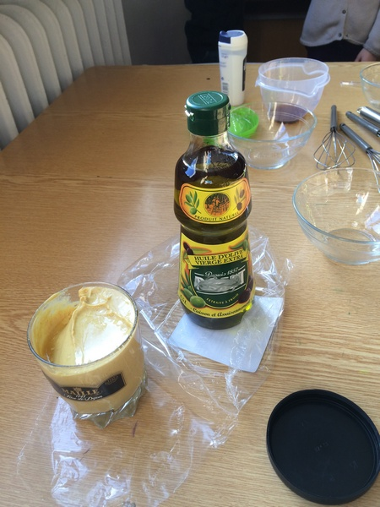
You also need…
Oil
Mustard
A hint of vinegar
Some salt

Slide 6
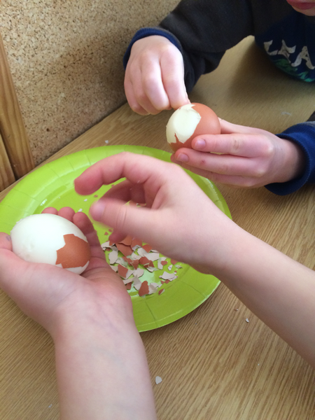
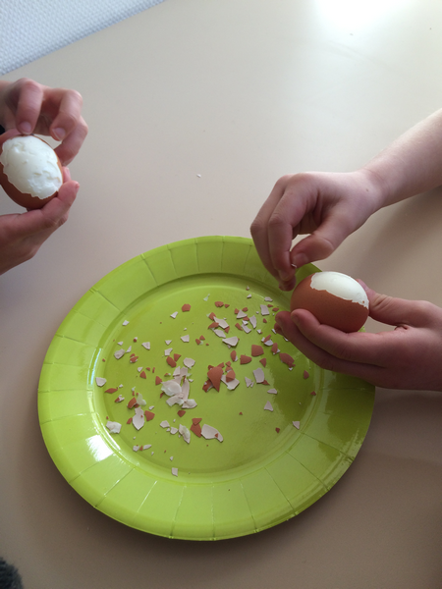
First, peel the eggs

Slide 7
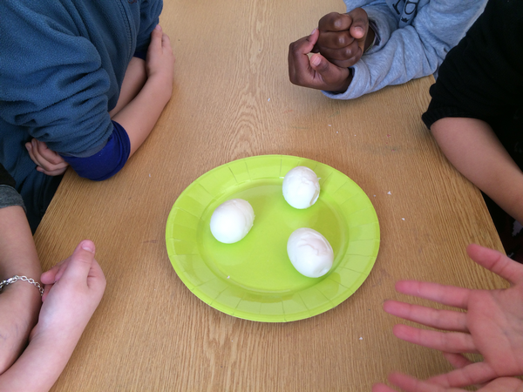
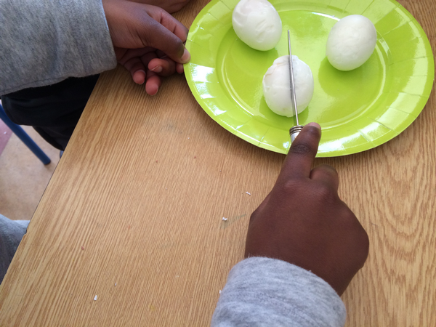
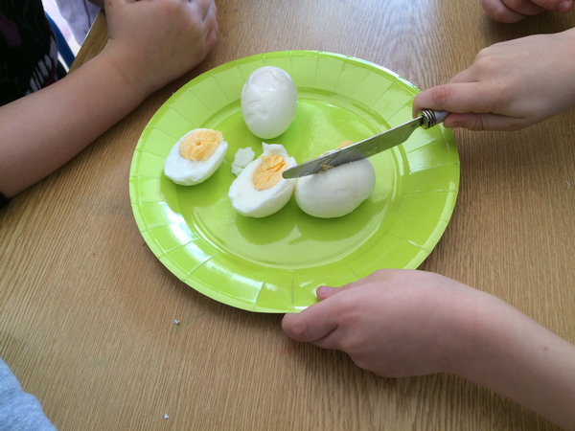
Then cut them in halves and put them aside …

Slide 8
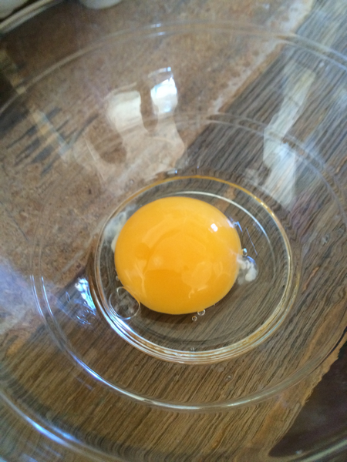
It’s time now to prepare a mayonnaise…
You need a raw egg yolk. Dissolve a pinch of salt in a drop of vinegar and mix it with the yolk.
(Salt needs the vinegar to dissolve, or the salt grains will be visible and undissolved.)

Slide 9
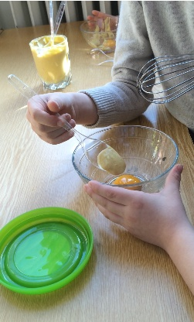
Add a teaspoon of mustard.

Slide 10
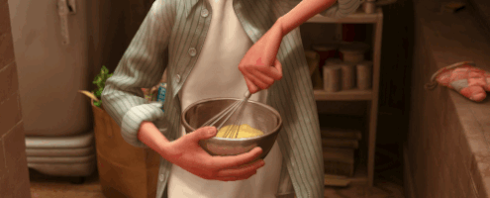
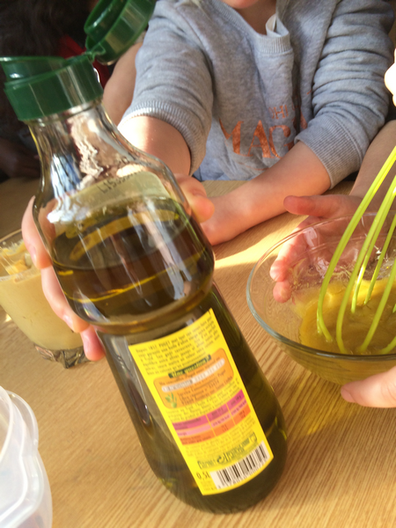
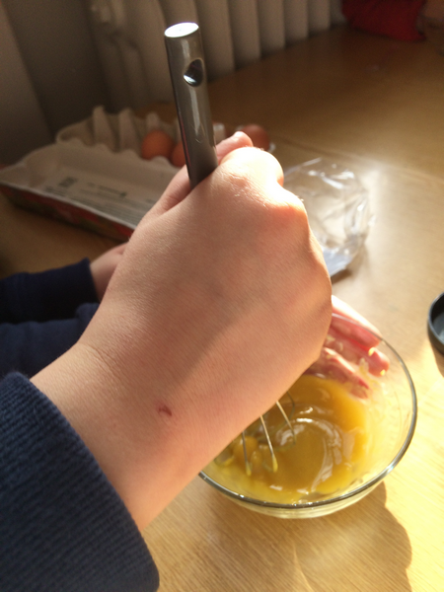
Whisk the yolk and mustard, adding oil little by little, till it has got the right texture.

Slide 11
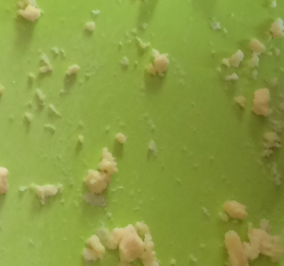
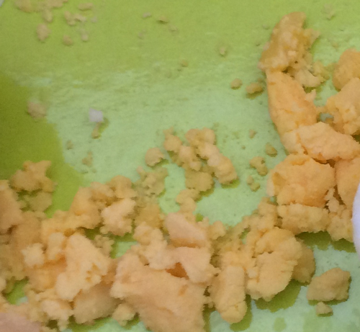
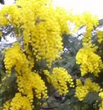
Once the mayonnaise is ready, carefully take out the yolk of the hard-boiled half eggs and smash it.

Slide 12
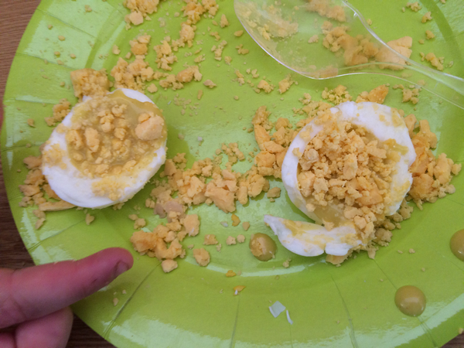
Mix some mayonnaise with one half of the smashed yolks, put this back in the half-eggs, and sprinkle the rest over the mixture to make them look like mimosa flowers.

Slide 13
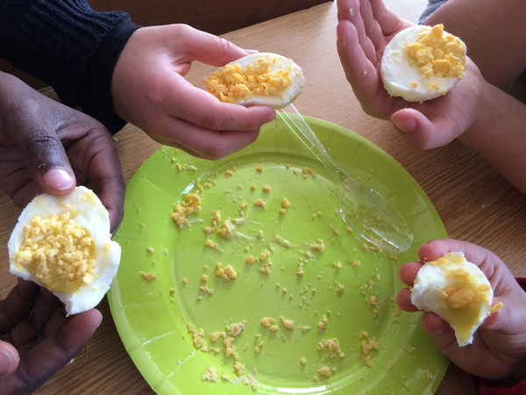
Oops ! Usually, people use knives and forks to eat them …

Slide 14
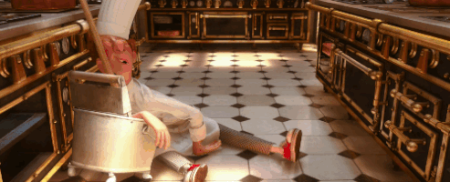
This recipe was cooked and deavoured by CPD firsgraders, Alésia, Paris, France.
After cleanning off the cooking room, I thought about making a slight suggestion : using ready-made mayonnaise could be a better option. (The teacher)

Slide 15
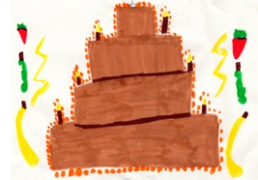
Recipe put into action and pictures by CPD, Alésia, Paris For the eTwinning project Land of Ambrosia Try me! I’m delicious (Or not !)
2015/2016

