Slide 1
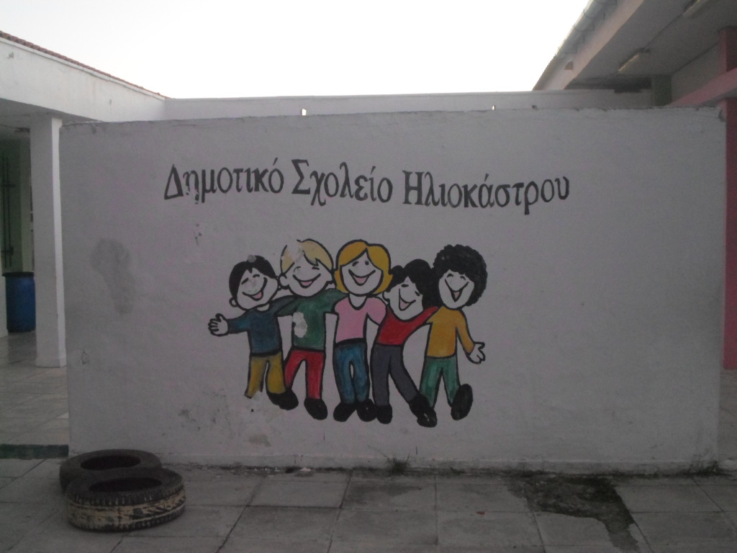
Primary school Of Iliokastro
Iliokastro Ermionidas

Slide 2
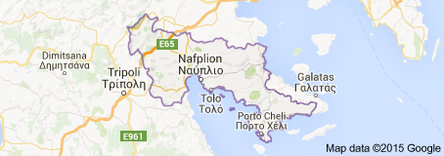
Hallo to everyone!!!
We are named as “ Primary School of Iliokastro” and we are placed at a wonderful location in Argolida, Peloponnese
Iliokastro is small village and his population is almost 600 people. The majority is farmers and cattle raisers. On summer holidays they work at the hotels, because this place has beautiful beaches (Ermioni, Porto Heli, Spetses, Ydra)
Right here!!!

Slide 3
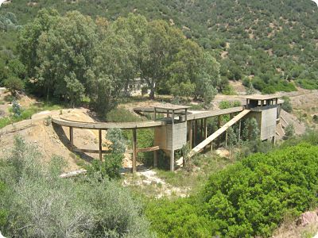
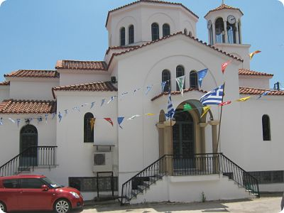
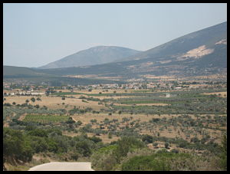
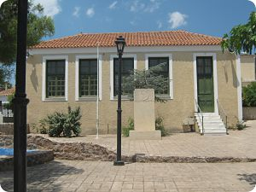
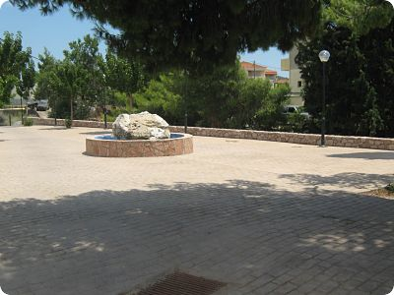
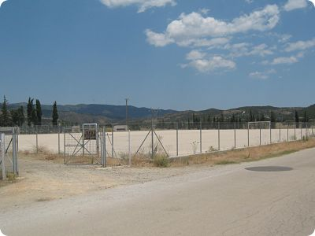
Some photos of our place

Slide 4
Our school
Our school is a small one with 34 pupils, but all of our pupils are very active and they want to participate to every new activity.
If you want to see our specific location, technology can bring you to us via googleearth. Just visit http://dim-iliok.arg.sch.gr/autosch/joomla15/index.php/2013-07-07-00-20-01
At this page you will find our googleearth location as well as some other ways of communication with us.
Unfortunately most of the information are in greek, but if there is spare time, we are going to translate some of our work in greek, especially everything which is going to be relevant to our topic
Our site is www.dim-iliok.arg.sch.gr
Please forgive us if our site has minor – I hope – problems, but it is created for amatuers, because our school has no programming teacher.

Slide 5
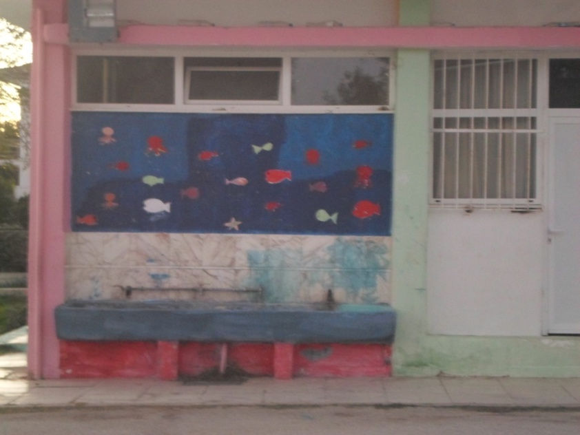
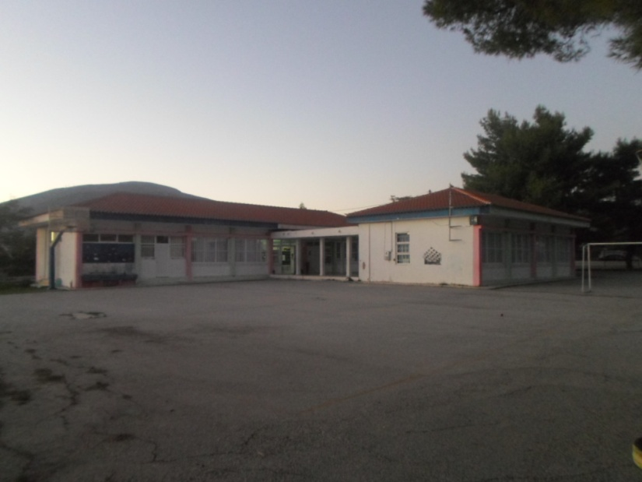
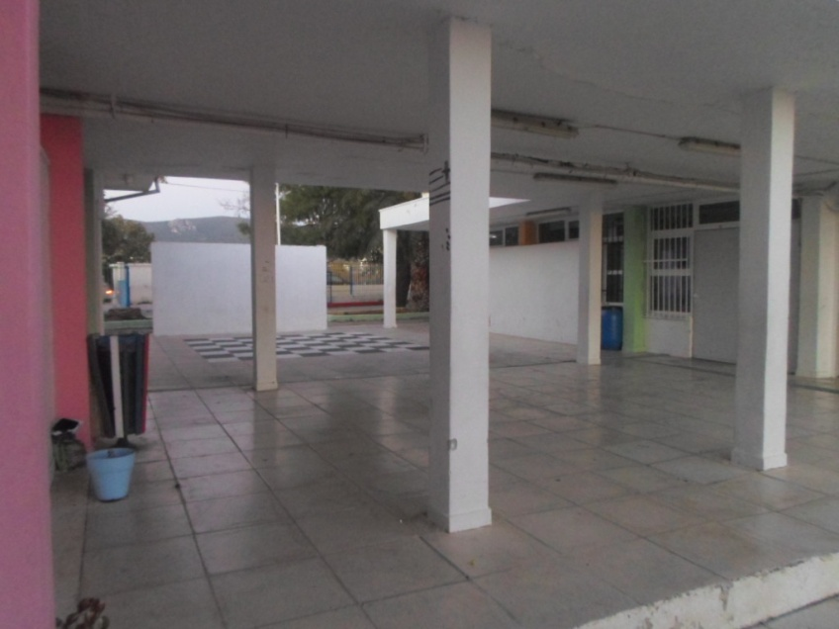
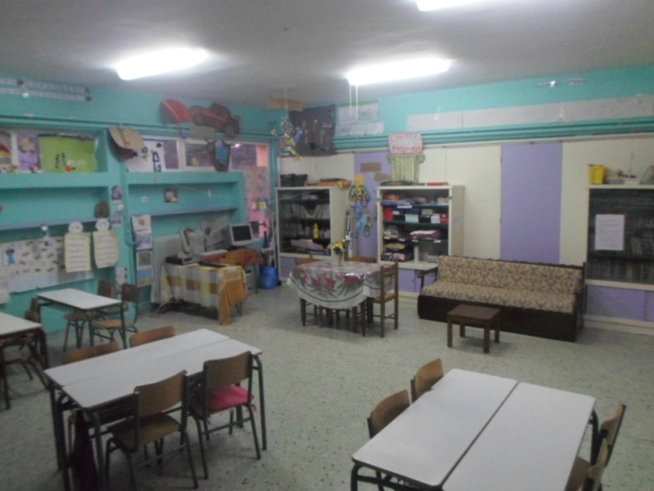
Some photos of our school

Slide 6
Our goal through our participation
Our place has many traditional products and recipes, as well as a rich history, which we would like to share with you.
It is a fine chance for our pupils to meet, even electronically, with other pupils and their culture.

Slide 7
Contact with our School
Address Δημοτικό Σχολείο Ηλιοκάστρου
Ηλιόκαστρο Ερμιονίδας
21051, Αργολίδα
Ελλάδα (Greece)
Phone 2754091100
www (easier): www.dim-iliok.arg.sch.gr
E-mai (easier): mail@dim-iliok.arg.sch.gr

