Slide 1
1st Primary School of Vartholomio
Hello etwinners. We are Alex, Maria and Angeliki. Our school is primary school. 150 students from 1st to 6th grade study to our school!
This is our second year at etwinning project.
Let us guide you to our school.

Slide 2
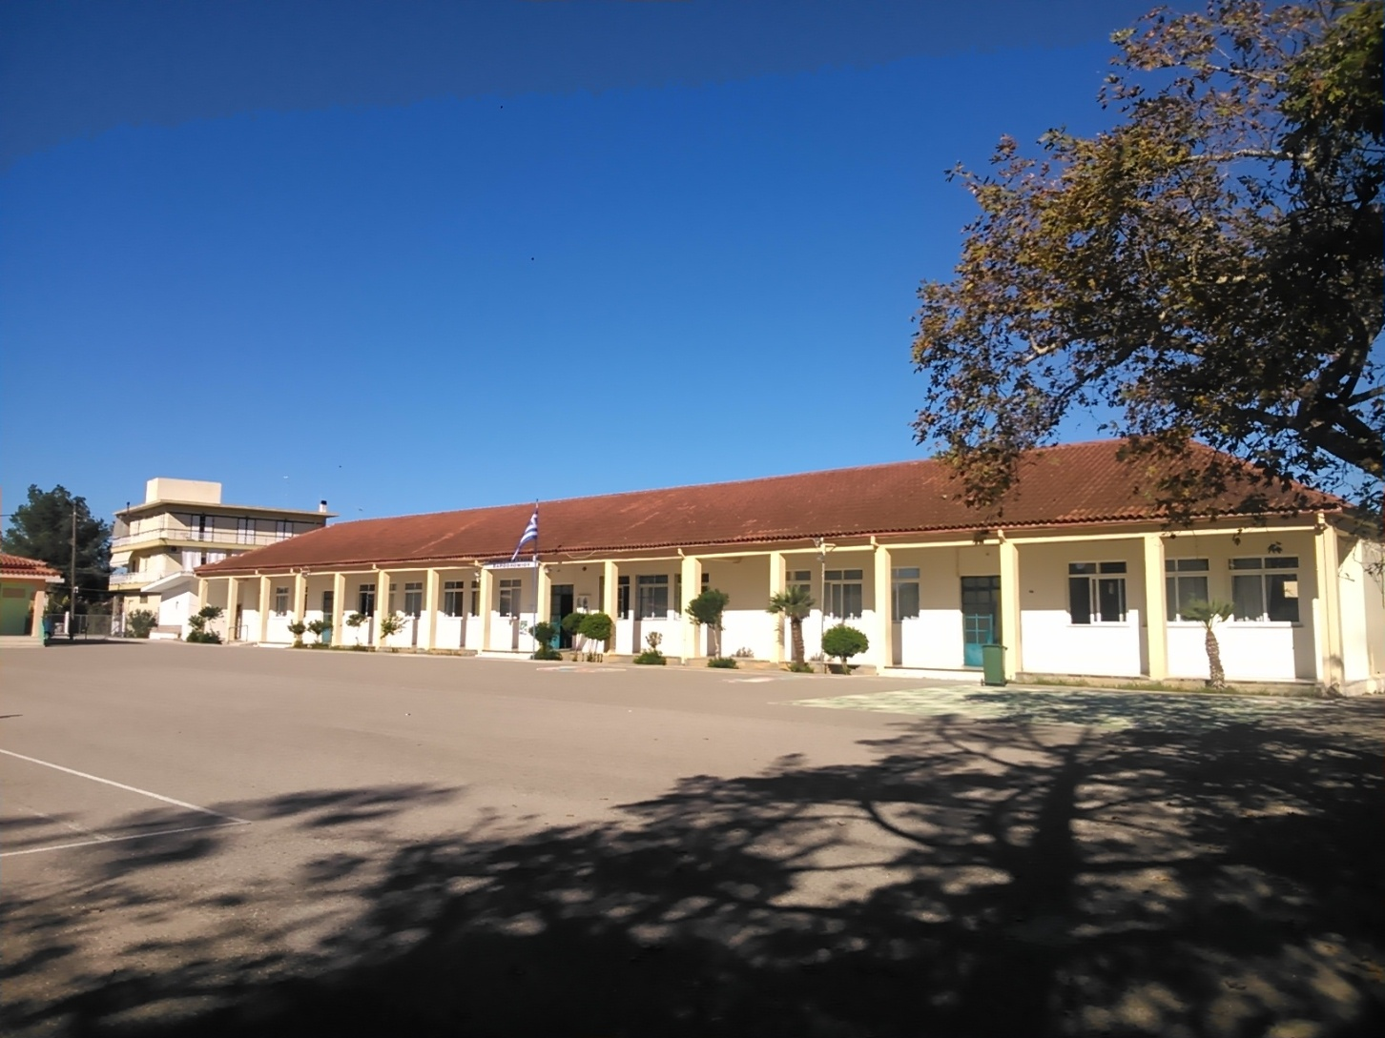
Our school

Slide 3
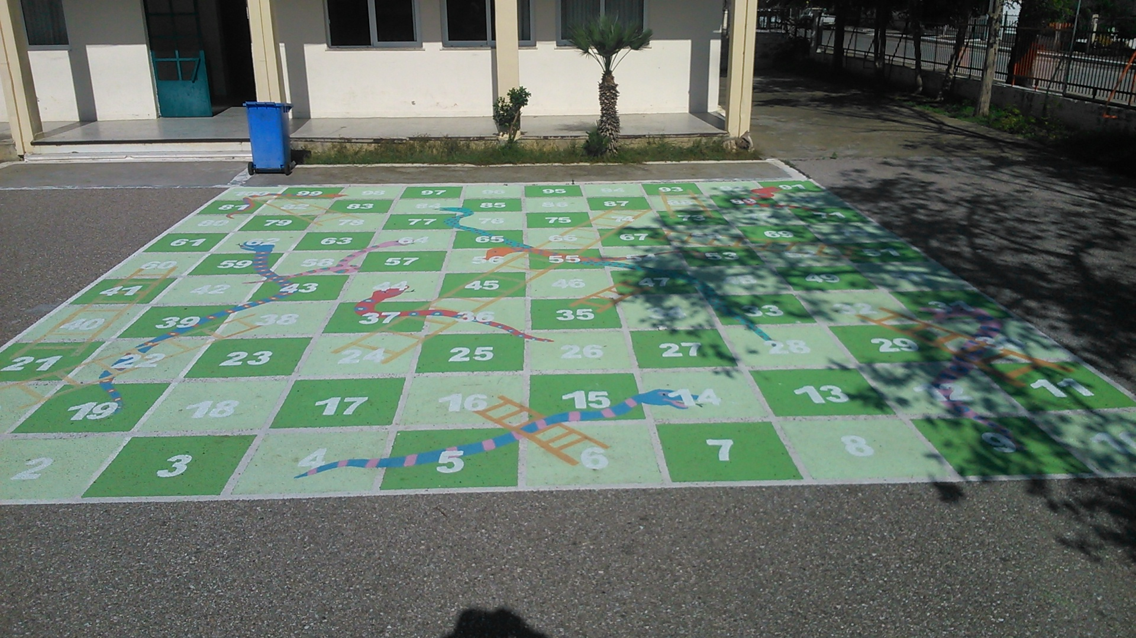
Our school

Slide 4
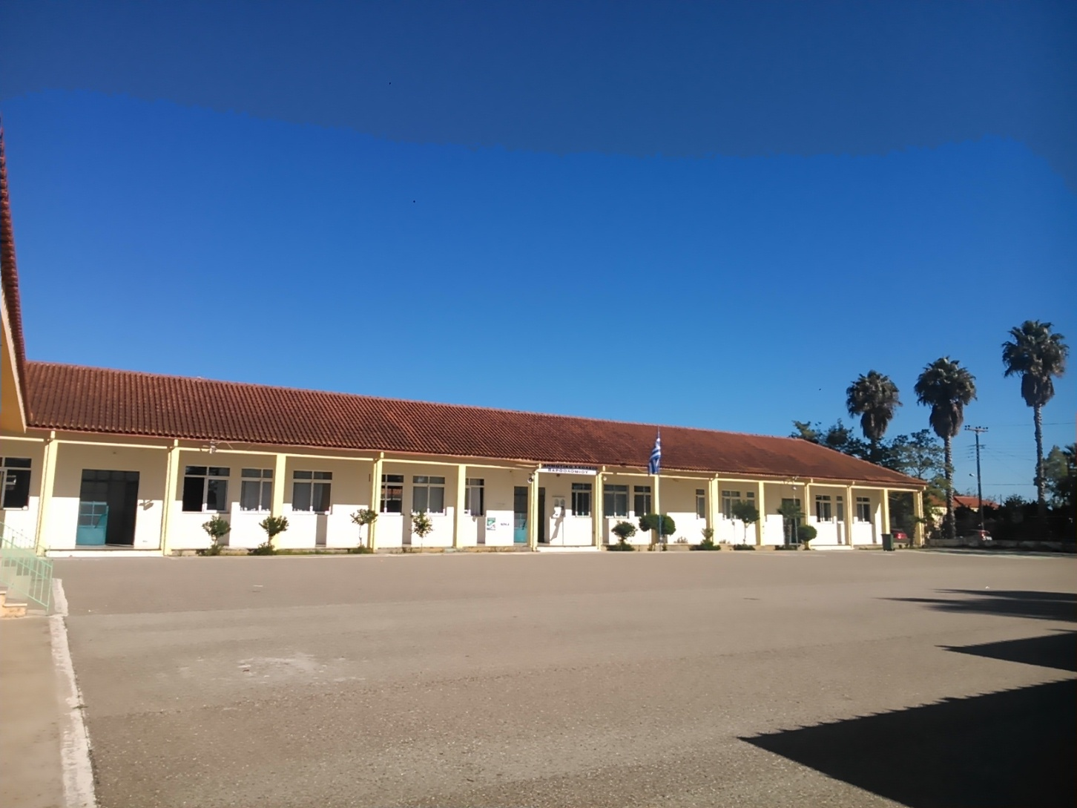
Our school

Slide 5
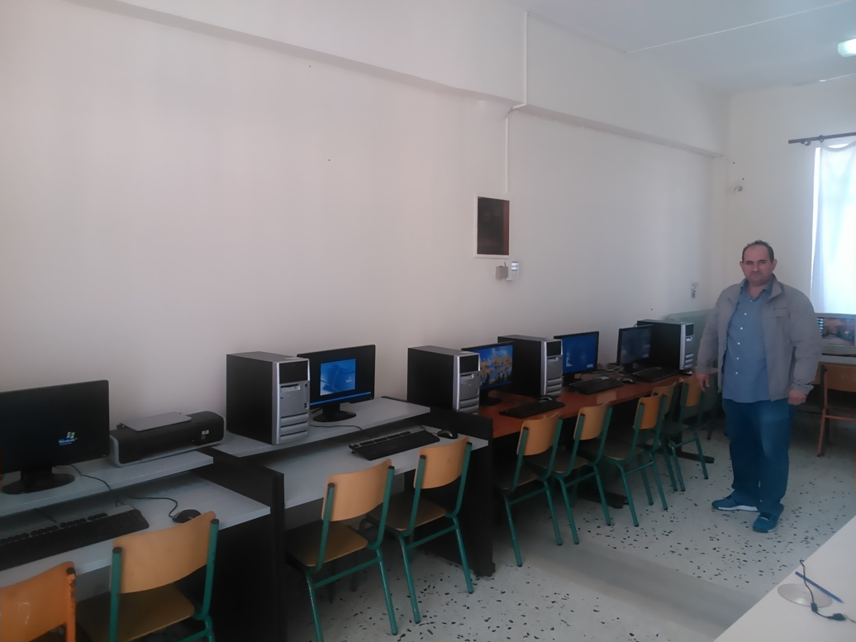
Our school’s
ICT laboratory

Slide 6
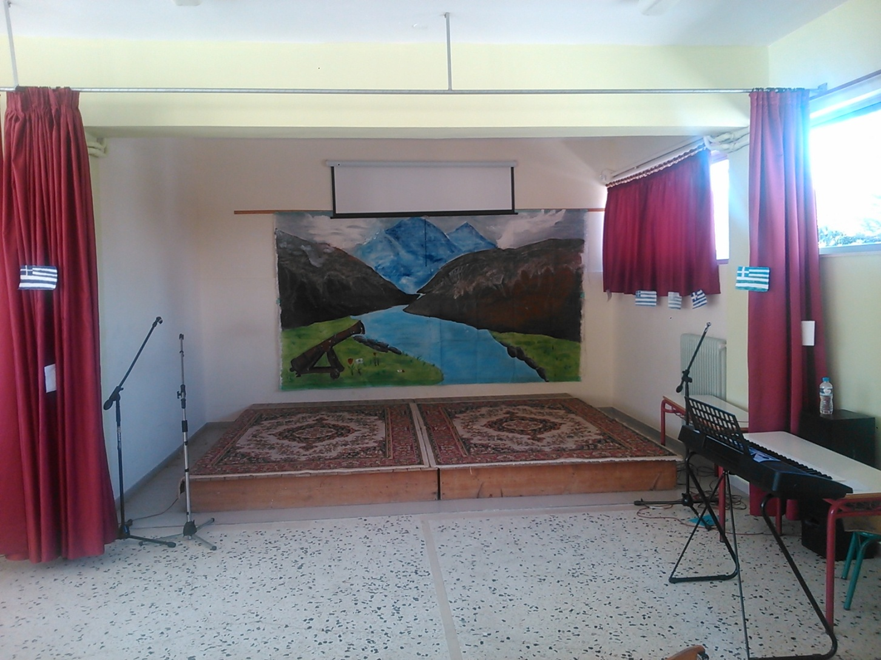
Drama hall

Slide 7
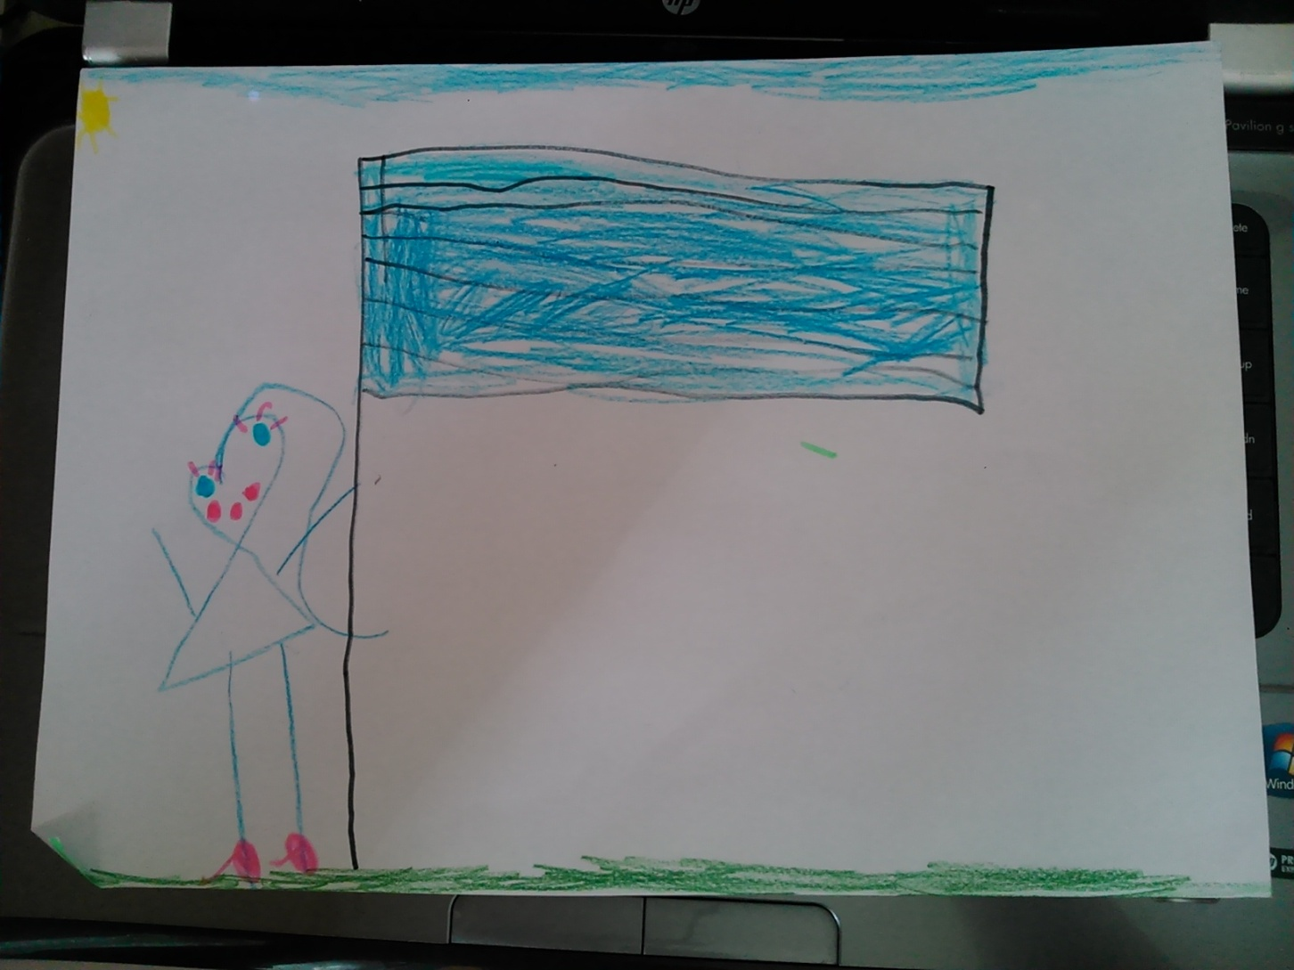
The symbol of our first class

Slide 8
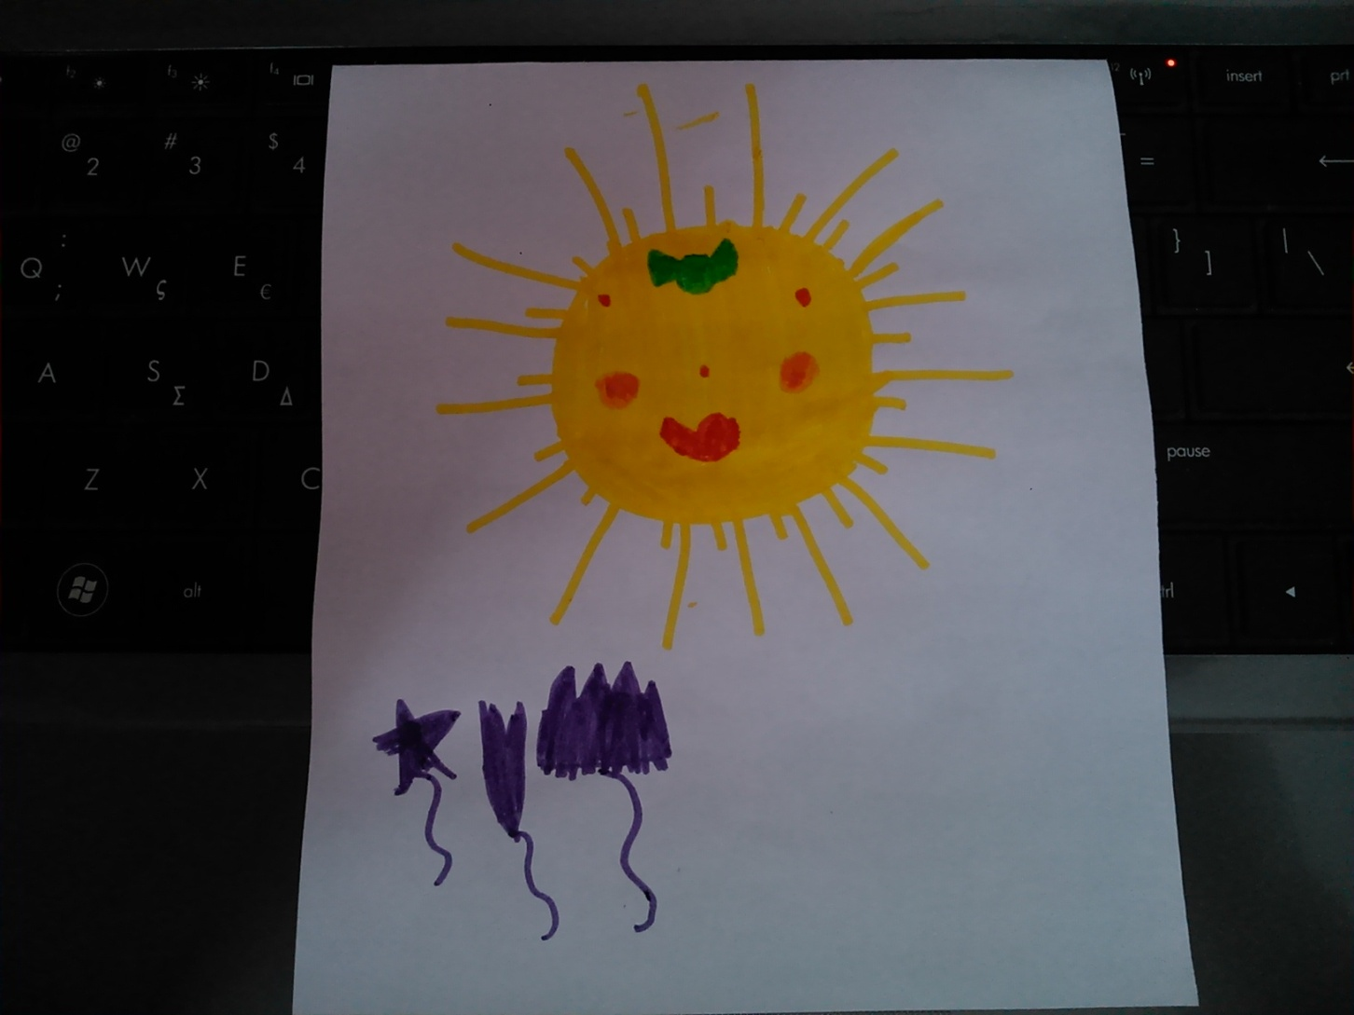
The symbol of our second class

Slide 9
The blogspot of our school
http://1dimvartholomiou.blogspot.gr/

Slide 10
Our team
Alex Konstantopoulos
Maria Dioli
Angeliki Toumpou

Slide 11
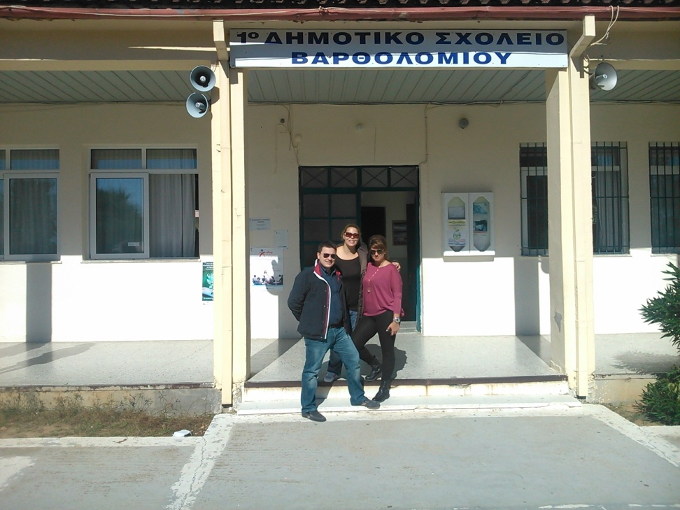
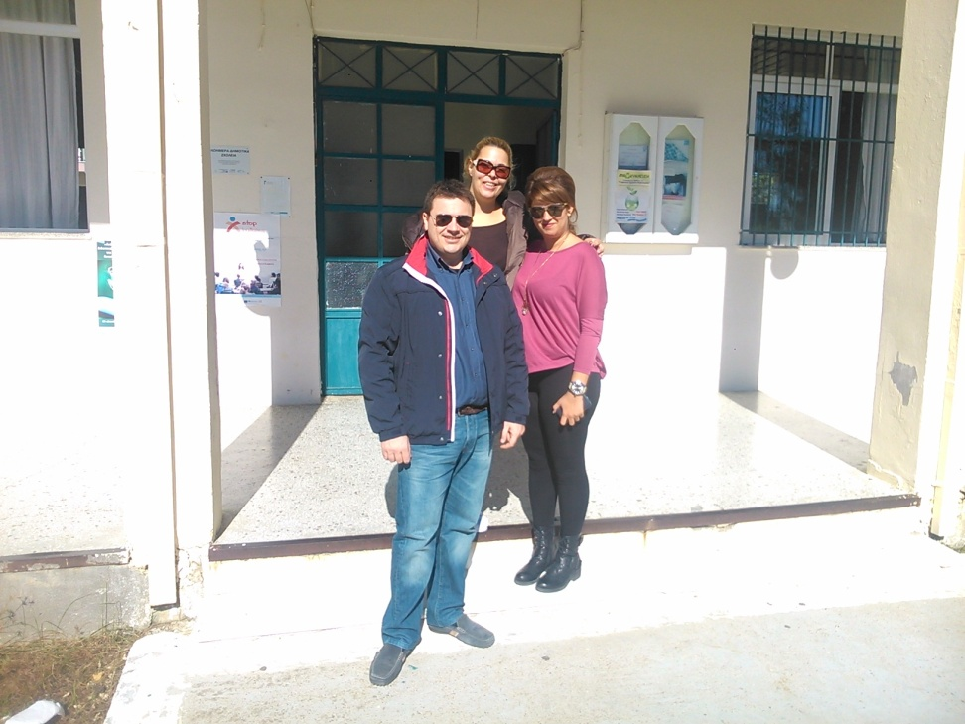
Let the actions begin

