Slide 1
Etwinning project Land of Abrosia
This is our presentation of a greek traditional song talking about the marriage of Prince Lemon with a beautiful Onion.

Slide 2
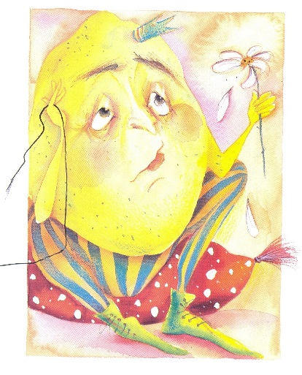
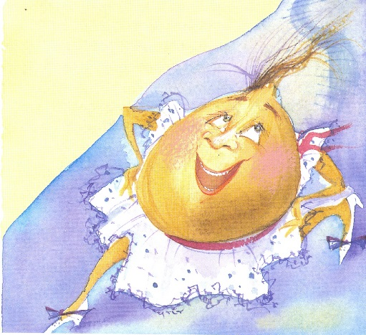
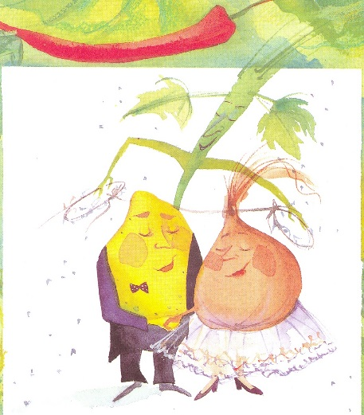
While talking about vegetables we read and heard a greek traditional song of George Sakellarios talking about the marriage of prince Lemon with the beautiful Onion that came to the palace one day to decorate the salad and he fell in love with her.
So we decided to draw their marriage…

Slide 3
This is prince Lemon

Slide 4
This is the beautiful Onion

Slide 5
And this is their marriage in which they invited all their relatives…

