Slide 1
THE MAKING OF “souvlakia” and “POUREKIA”
Traditional products

Slide 2
On Thursday 3/3/2016 we celebrated the beginning of the Carnival festivities here in Limassol which is the Carnival city of our island. During this day we eat traditional products of meat and traditional sweets.

Slide 3
So here at our school…..
We ate “souvlakia” which is barbequed pork or chicken inside of “pita”(a kind of bread) with salad(cucumber, tomato, parsley and onion)

Slide 4
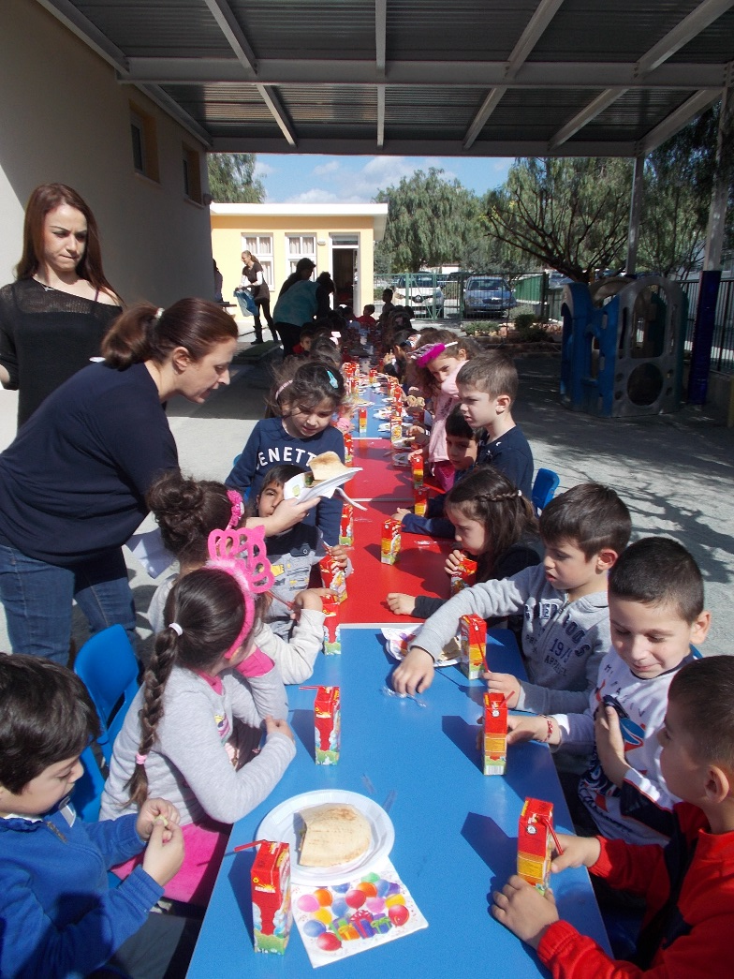
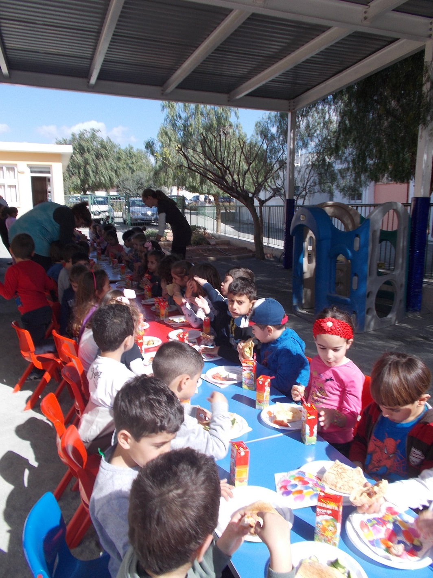
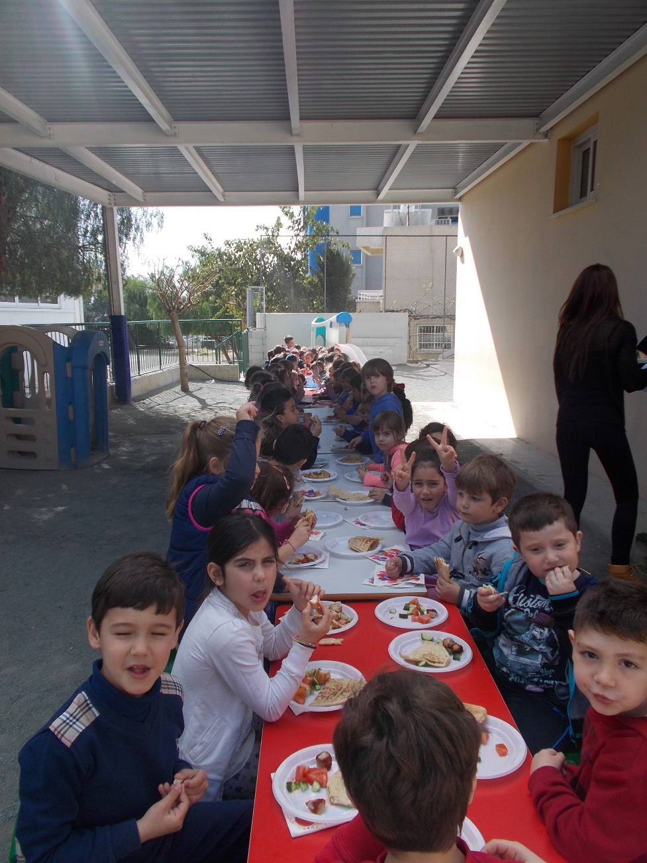

Slide 5
We invited mothers and grandmothers to our school to make “pourekia” which is a traditional product made with dough and filled with “anari” (a kind of cream cheese) and is deep fried in oil and later covered with icing sugar.

Slide 6
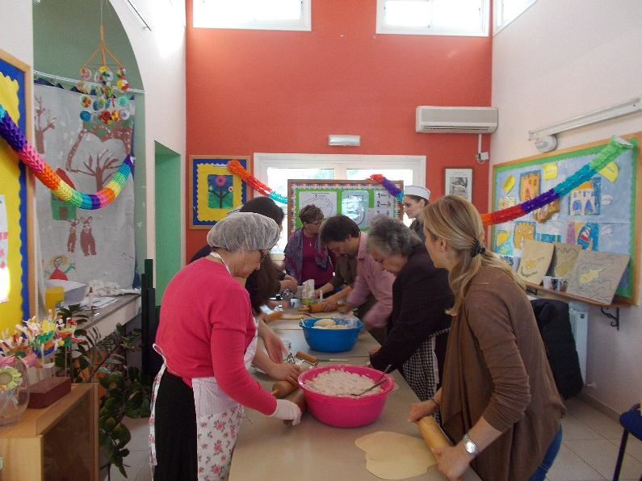
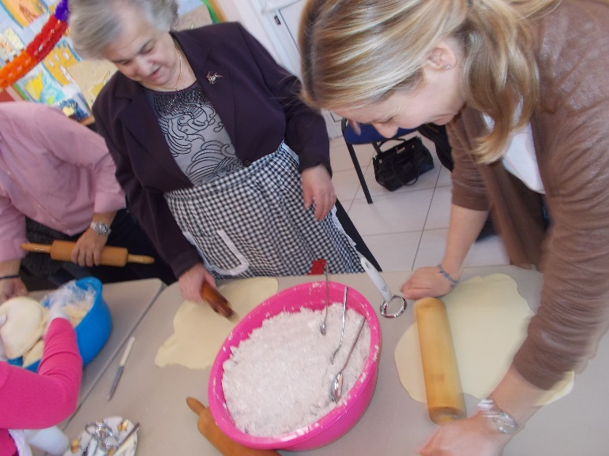
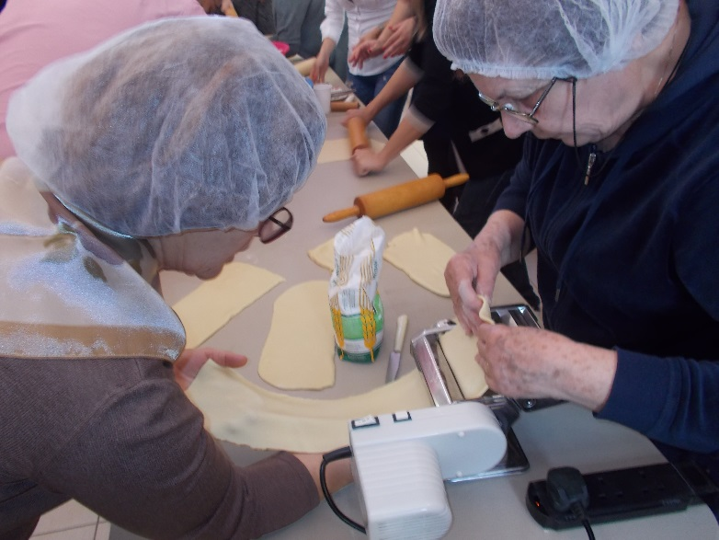
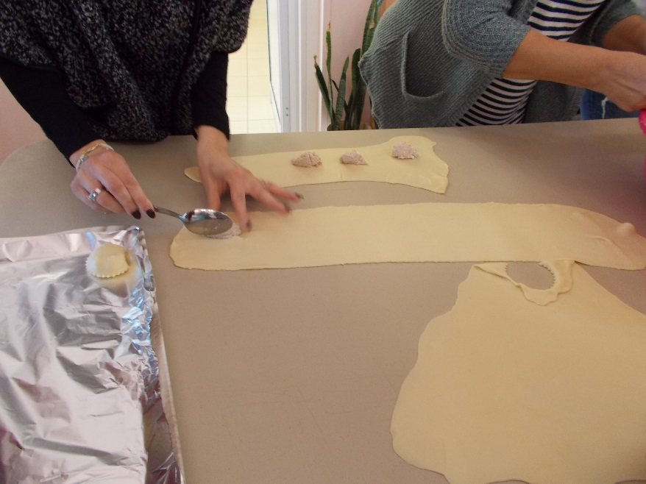
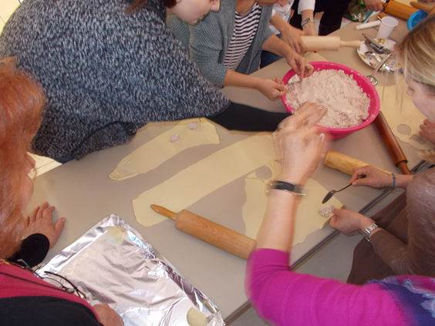
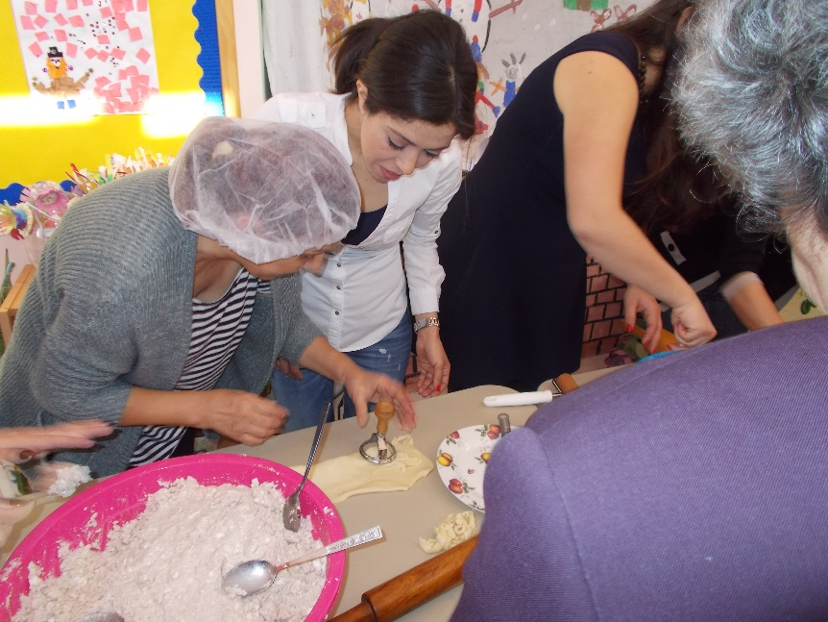

Slide 7
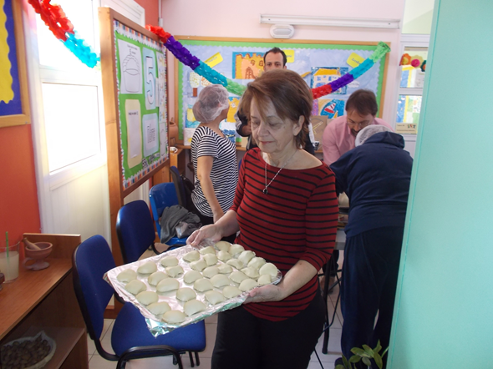
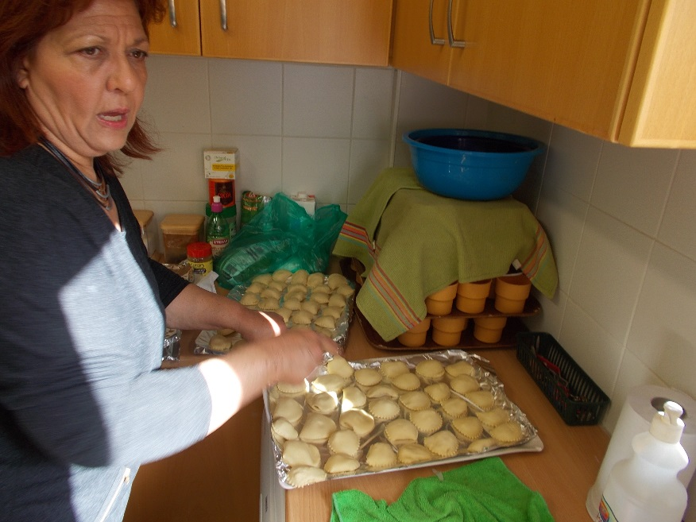
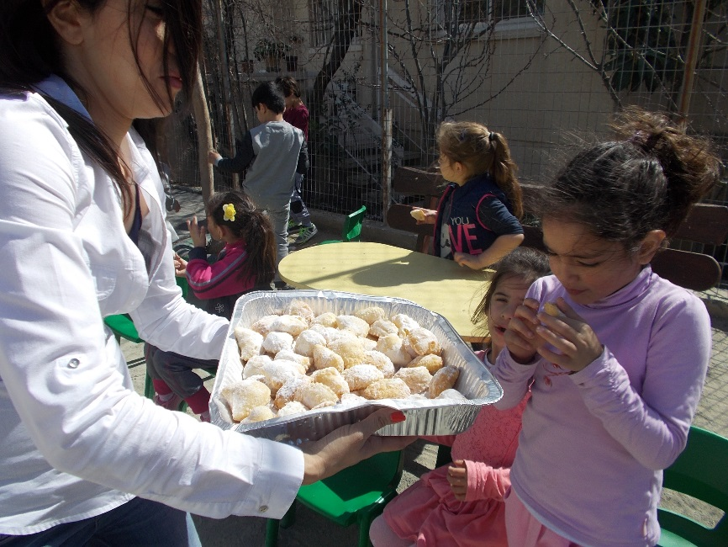
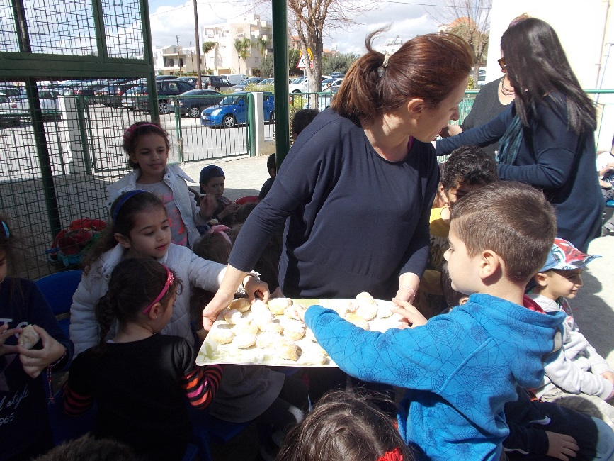

Slide 8
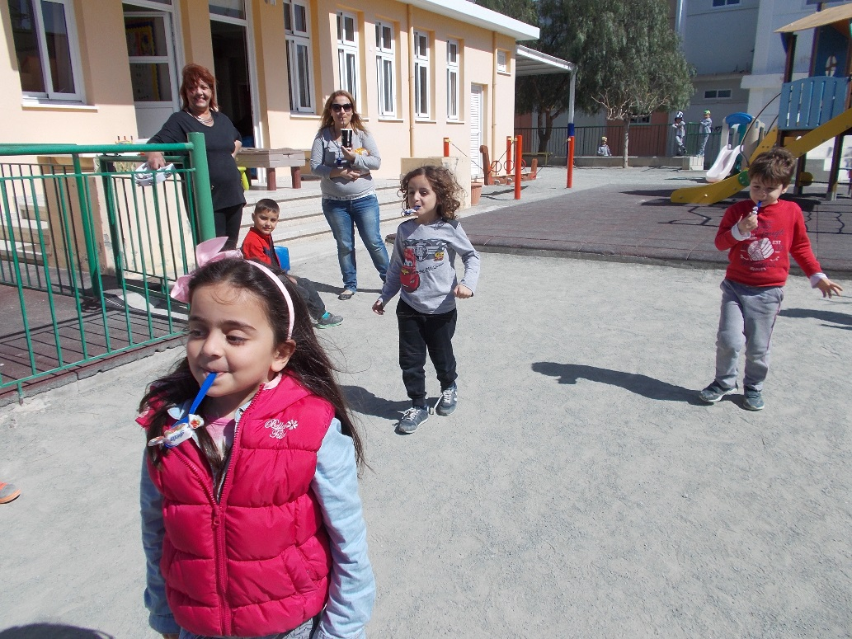
And later we played traditional games at our school yard. Here are some of them…
Children are trying to catch the candy with their mouth. Hands behind the back!
Trying to finish the race with a spoon in the mouth without dropping the candy and not using hands!!(the traditional game is played with eggs instead of candies)

