Slide 1
KINDERGARTEN OF PLOIESTI ROMANIA TEACHER COMAN FLORICA
OUR
CARNAVAL

Slide 2
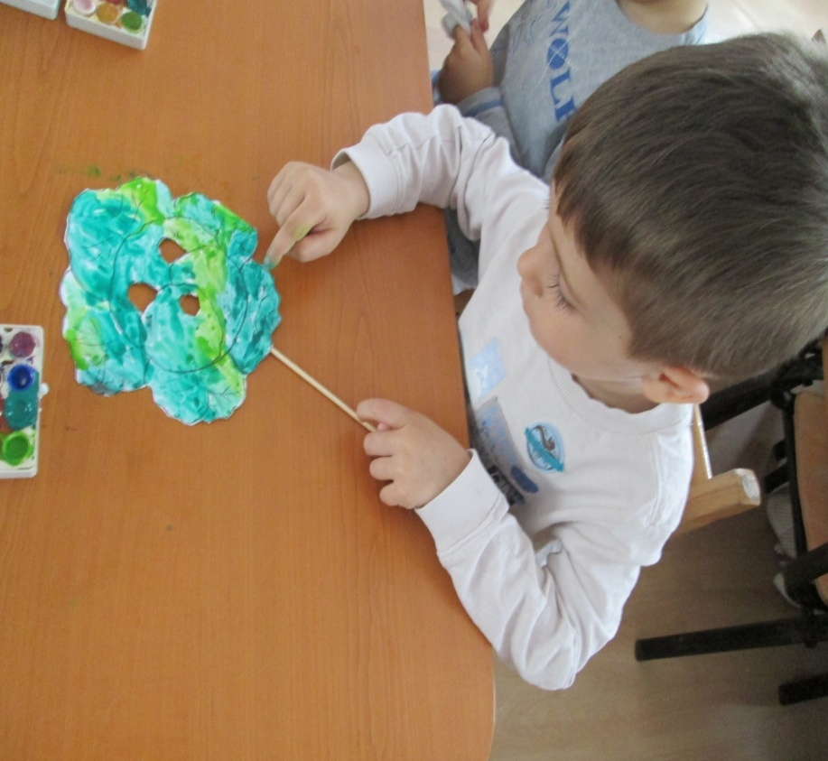
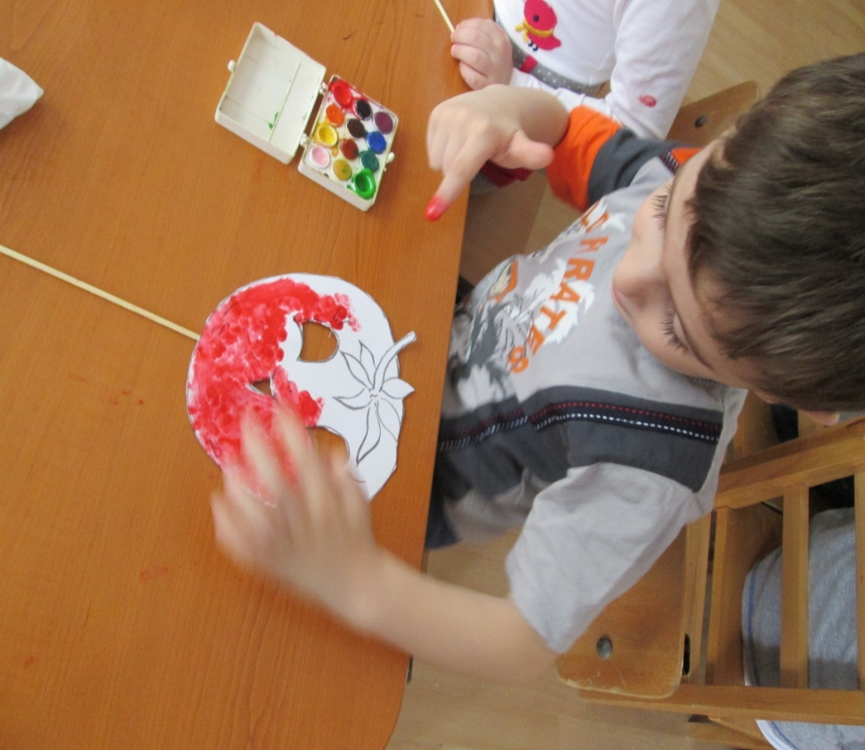
OUR CARNAVAL

Slide 3
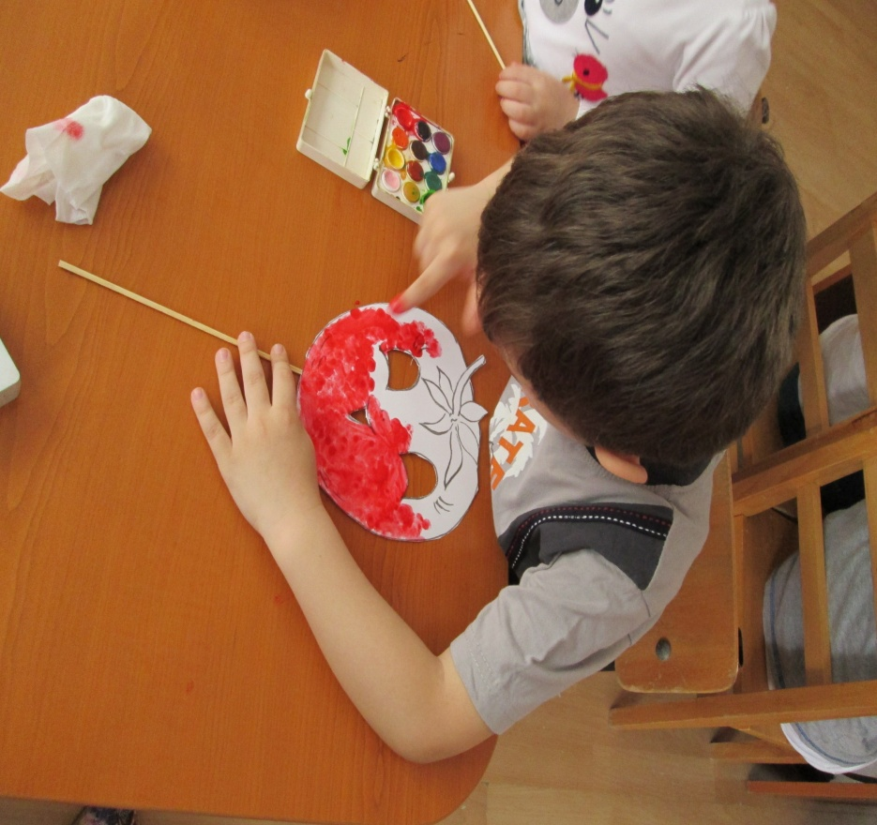
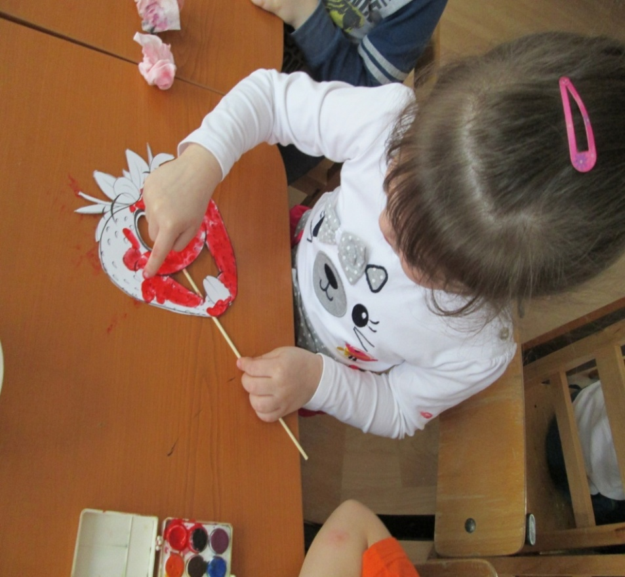
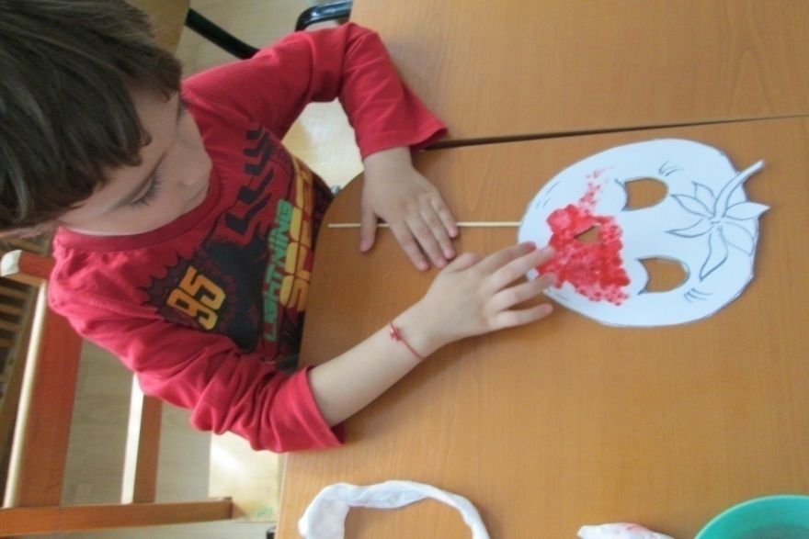
OUR CARNAVAL

Slide 4
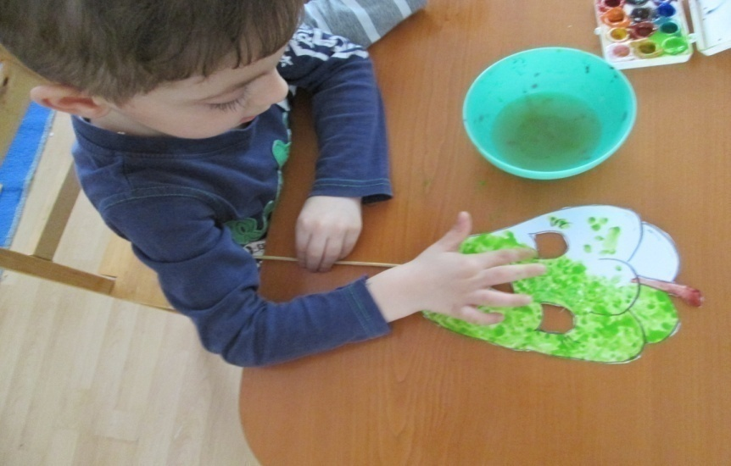
OUR CARNAVAL

Slide 5
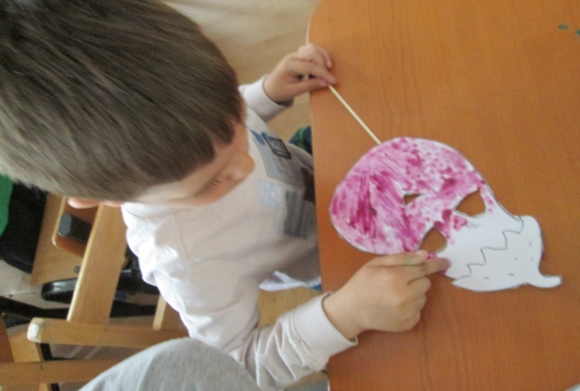
OUR CARNAVAL

Slide 6
OUR CARNAVAL

Slide 7
OUR CARNAVAL

Slide 8
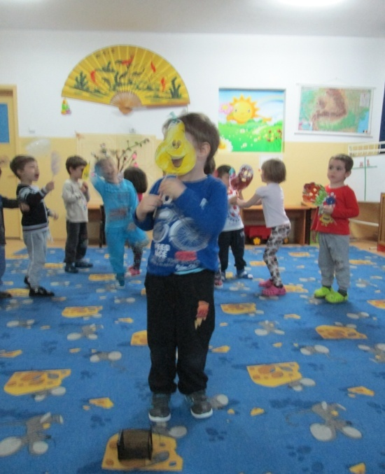
OUR CARNAVAL

Slide 9
OUR CARNAVAL

Slide 10
OUR CARNAVAL

Slide 11
OUR CARNAVAL

Slide 12
OUR CARNAVAL

