Slide 1
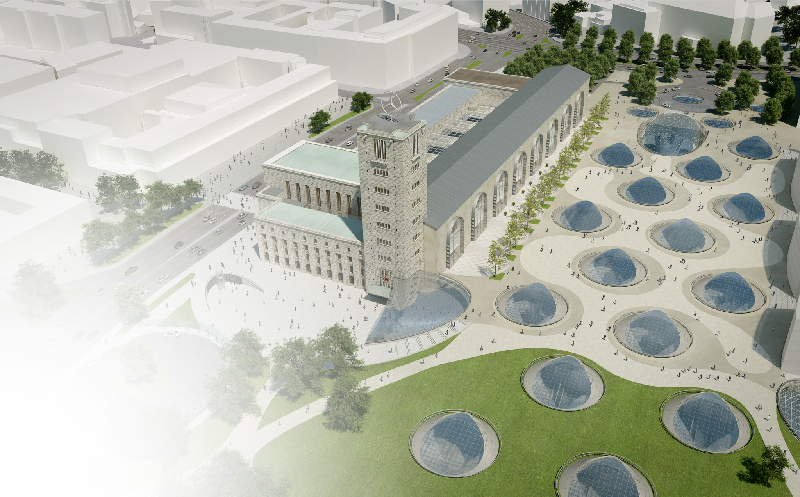
Urban development- Stuttgart
Stuttgart 21- Mainstation

Slide 2
Structure
Stuttgart 21 – The construction project
Advantages & criticism of the reconstruction
Impact on urban development
Changes for the metropolitan area of Stuttgart & Europe
Influence of the lizard and hermit beetle on the project

Slide 3
Stuttgart 21 –The construction project
Transformation of the old terminal station to an drive-trough mainstation.
180 degree turn of the railconnection
Building of two new tunnelsystems to run the new mainstation underground
Building of a new highspeed track between Stuttgart and Ulm. (increased time of 30 minutes)

Slide 4
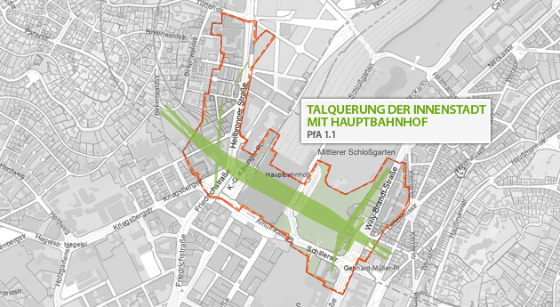
Old extention
New extention

Slide 5
Advantages - Stuttgart 21
Traffic project
Ecological project
Urbanistic project
Economical boost

Slide 6
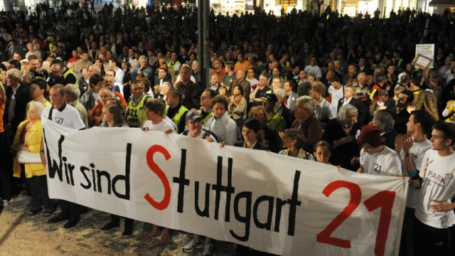
S21 – Traffic project Advantages
Greater capacity
Switching trains becomes easier
International connection
Expanding of the regional and intercity transport
Faster urban development
New jobs during the construction
New, modern mainstation

Slide 7
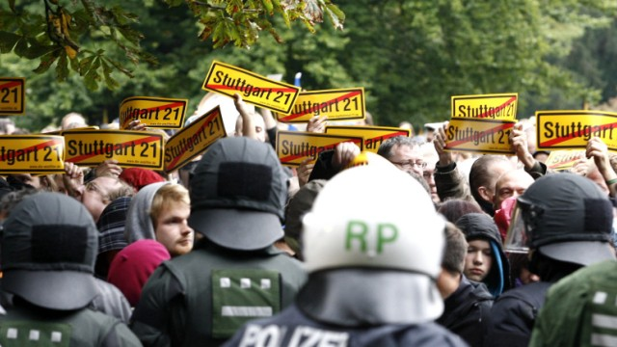
S21 – Traffic project Disadvantages
Cheaper alternative possible (terminal station)
False calculation
Noises & exhausts fumes
Massiv impact on the cityscape
Infrastructure
Unclear time saving
Unilateral improvement
Risks in construction

Slide 8
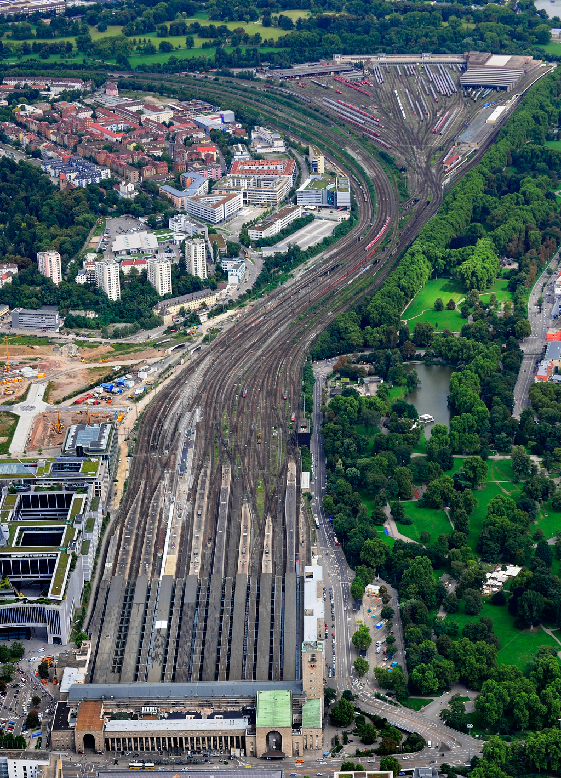
Impact on urban development
New building areas available
Improvement of urban climate
Reshaping of mainstation area
Connection of more districts around Stuttgart

Slide 9
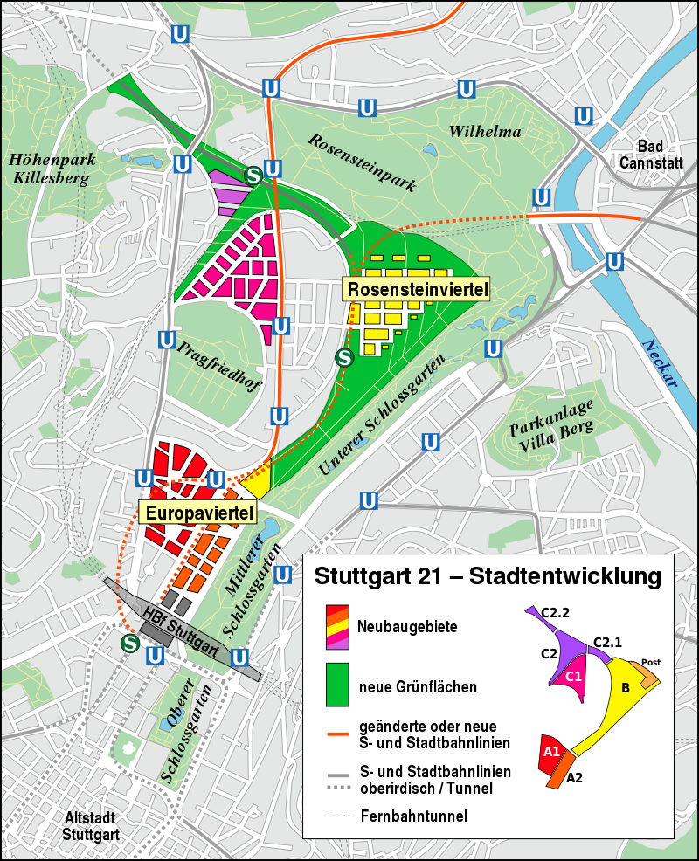

Slide 10
Projects against...
Projects against social seperation
Social apartments
Home for the aged
Social infastructur for ethnic minority´s

Slide 11
Problems of reurbanisation
Inner city districts were suffering a loose in population until 21st century
There is a demand, but no offering in living space
„Inner development“ before “external development“ to stabilise the population
Monitoring system „NBS“ informs potential investors about available buildingspace
Creating living space without expanding the city itself

Slide 12
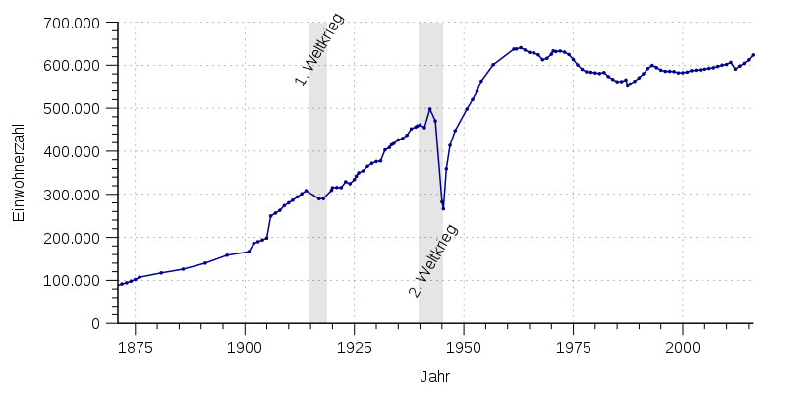
Population development& current situtation
Urbanisation in times of industrialisation
Big employers (like Daimler-Benz, Porsche, Bosch) were a pullfactor
WWI and WWII caused drops of the population
Growing economy -> urbanisation
Deurbanisation from between 70‘s and 90‘s
Today reurbanisation

Slide 13
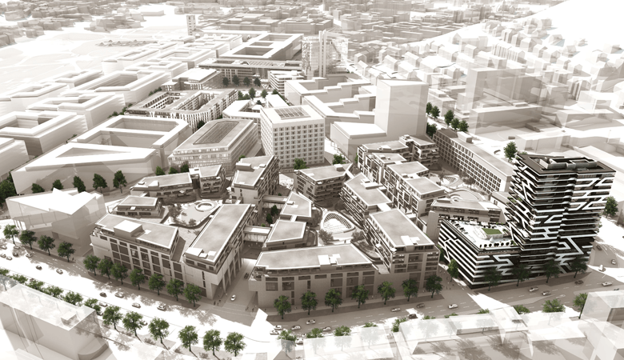
European district

Slide 14
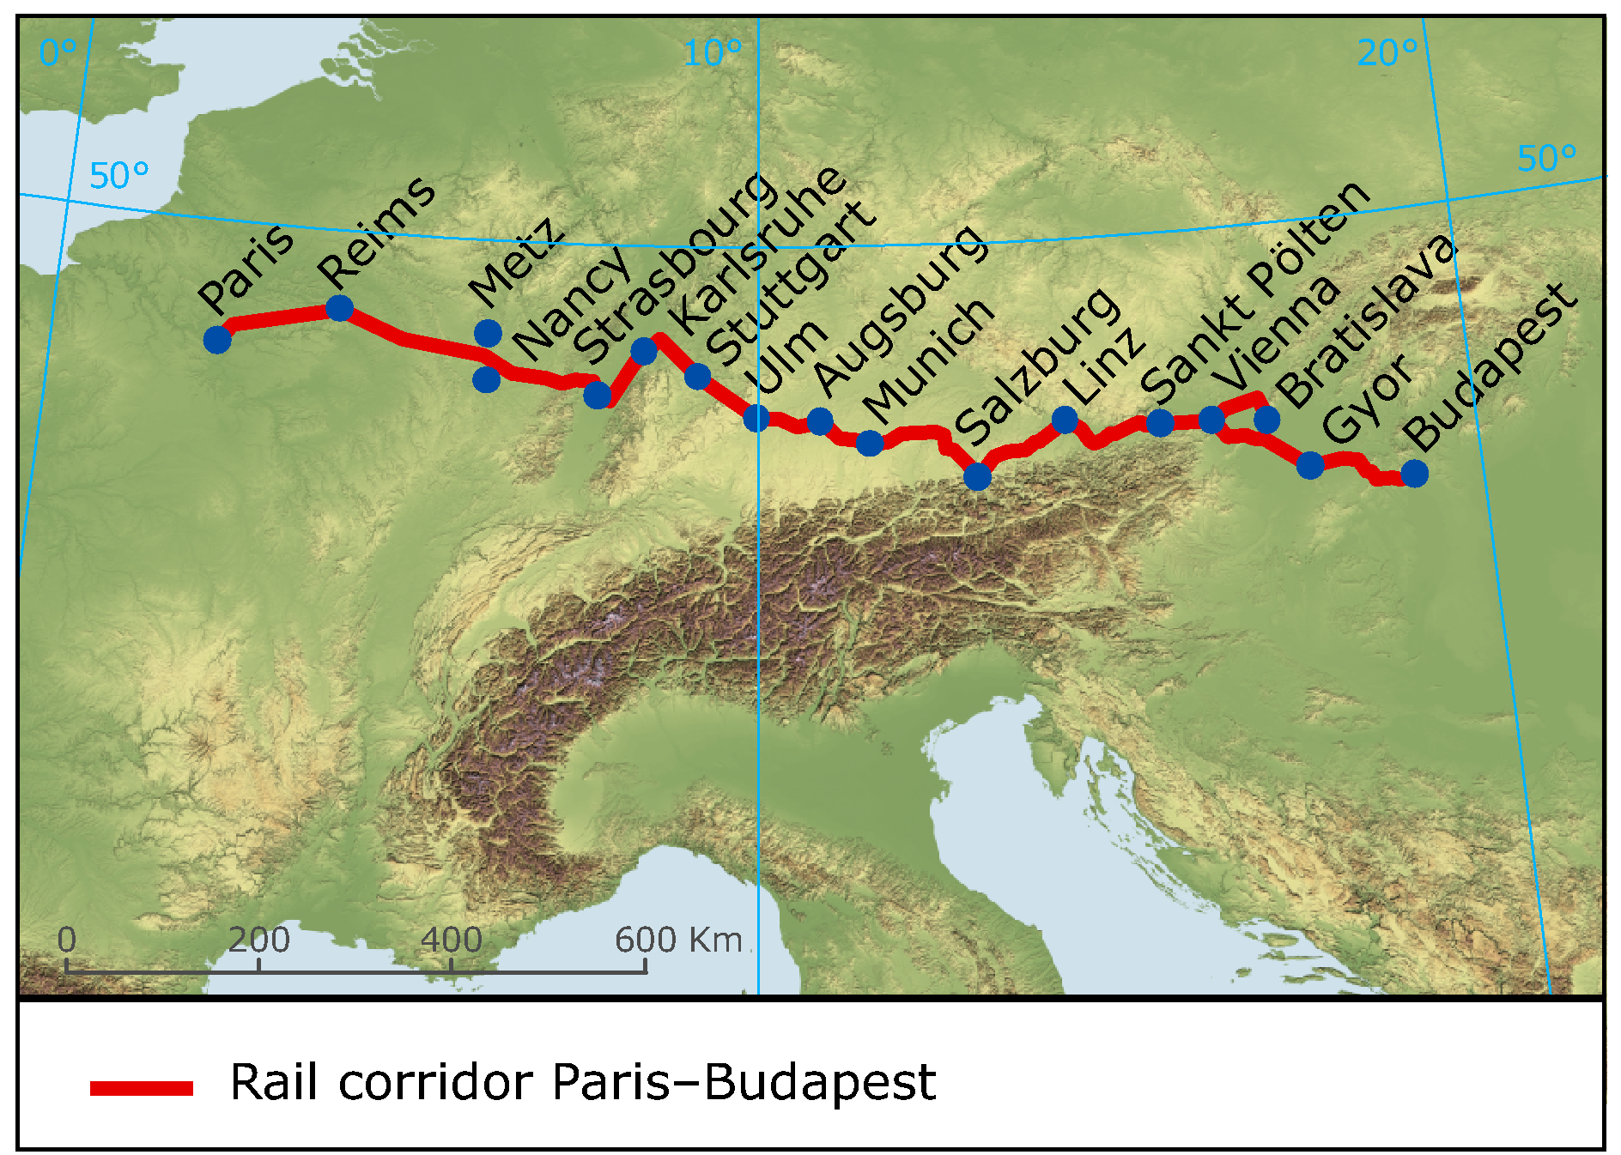
Changes for metropolitan Stuttgart & Europe
Magistrale for Europe
-railroad connection Paris-Bratislava
Critics on EU-facilitation
-europe-wide standards
Germany
- 6 corridores of the core network in Germany

Slide 16
Influence of the lizards and the hermit beetle
Nature protection
Resettlement
Stopped the construction process partly
Caused costs and time
For opponents reason to stop the building process

Slide 17
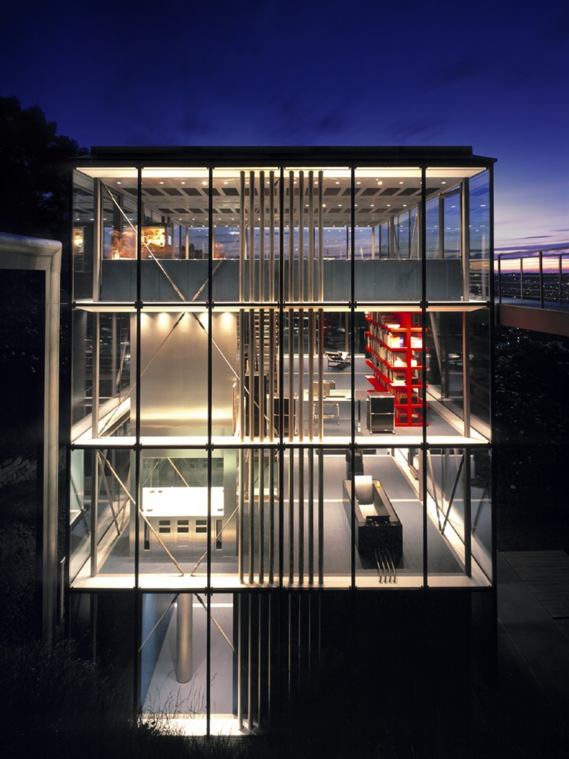
Current architecture trends
Reflexive Modernism:
Germany owns an enormous rail operation and infrastructure
A complex system of strategic planning is inevitable
Quality and innovation instead of trends
Reflexive modernsim is our future
Self-awareness and self-criticism

Slide 18
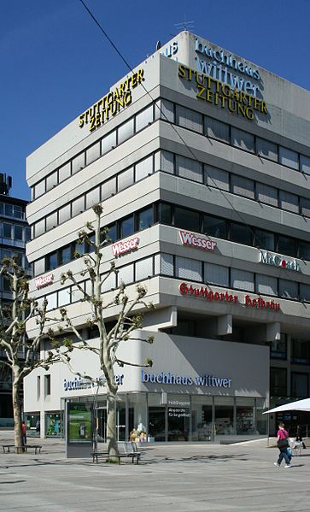
Current architecture trends
Brutalism:
Refers to the french word béton brut, which basically means raw concrete
Area flourished 1950-1970
Started out as an experiment
New approach for cheaper materials as a design medium

Slide 19
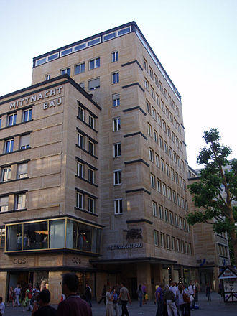
Regeneration of buldings
Stuttgart is a city that is constantly changing ist facet
The transformation from the past in the presence is a lot of work
Buildings from 1945-1979 own impressive economical, technical and social aspects
Right approach of these bulidings is a great concern

Slide 20
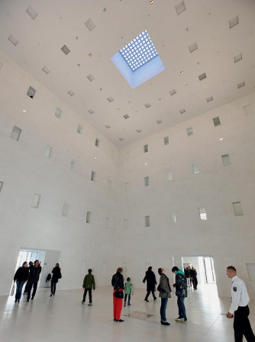
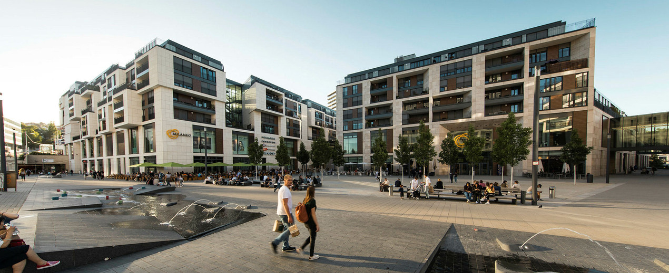
New buildings and projects
Plenty projects for the future
Stuttgart 21 the most established one
Central libary
Malls in the inner city

Slide 21
The issue with the constant trends and changes
The process of buldings has become increasingly expensive
Conntection between trends and sustainbility
Scheduled timing and limited budget
Various tasks that should be considerd
Modern today but outdated tomorrow
Solution:
Digitalisation is our future –> more complex data models for planning
Work more efficient and organized
Develop more security and to conserve energy

Slide 22
Measures against social desperation
Social apartments: 14.800 apartments in the wider area of Stuttgart
Social retirement homes: 120 apartments in Stuttgart
Apartments for inhabitants with middle sellery: nearly 500 in Stuttgart were built in 2017

