Slide 2
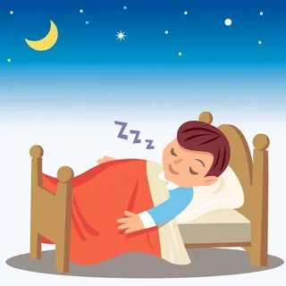
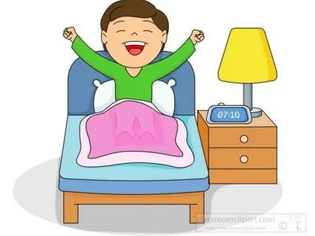
“MY DAY”
Mehmet Rayan Gürkan

Slide 3
I wake up.

Slide 4
I have a delicious breakfast.

Slide 5
I had my breakfast and now it is time to play.

Slide 6
Let’s study!

Slide 7
I have a waterpolo match.

Slide 8
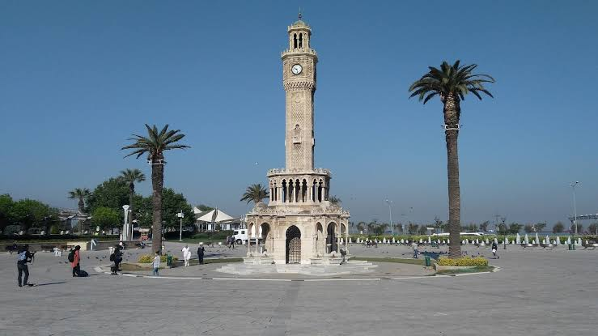
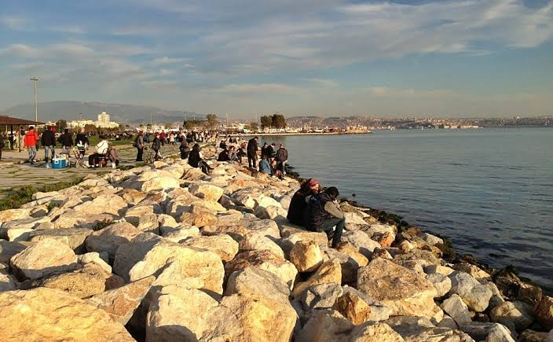
Photos of Izmir

Slide 9
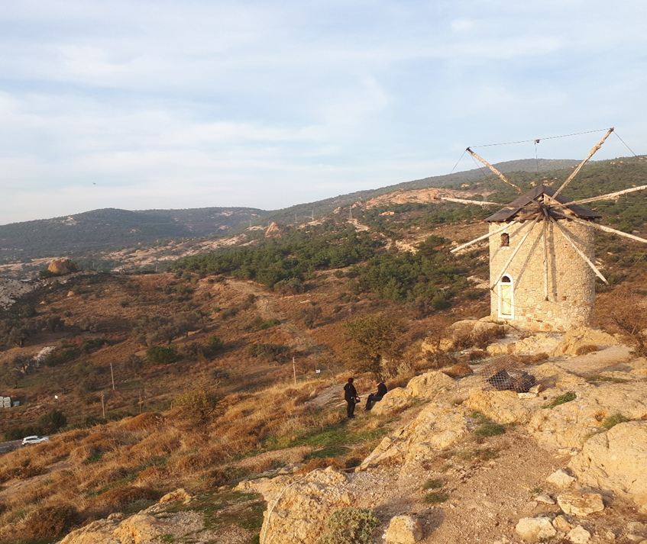
I go to Foça.

Slide 10
Foça is a place which is near the sea.

Slide 11
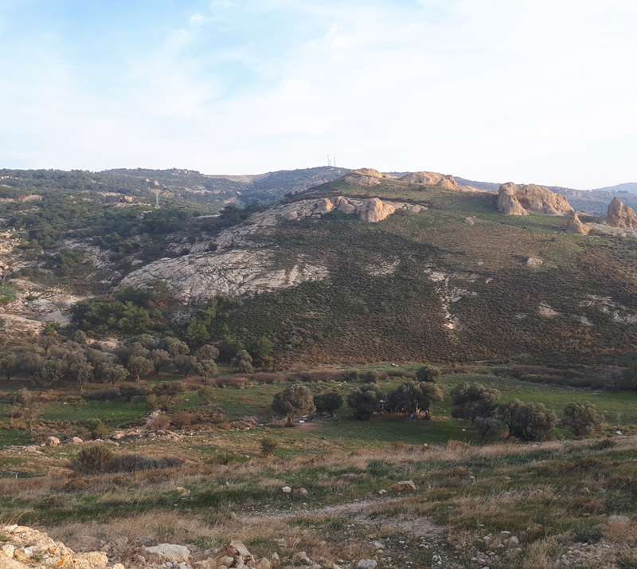
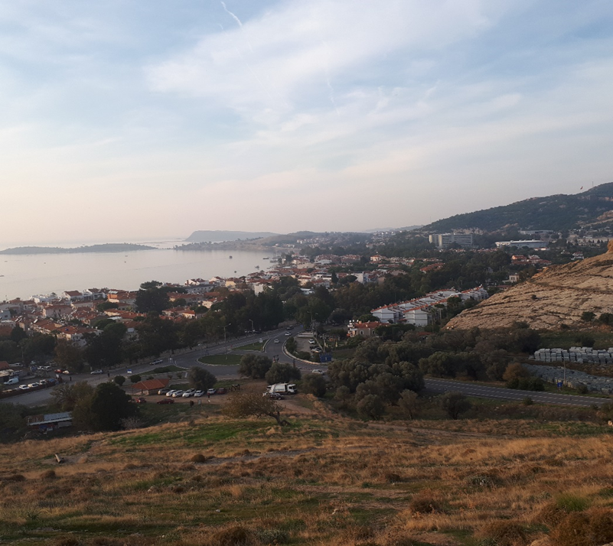
Photos from Foça.

Slide 12
I eat fish.

Slide 13
At the end of the day I read “Harry Potter” before I go to sleep.

