Slide 1
MY DAY
Focus your cameras on Europe
ROMANIAN TEAM

Slide 2
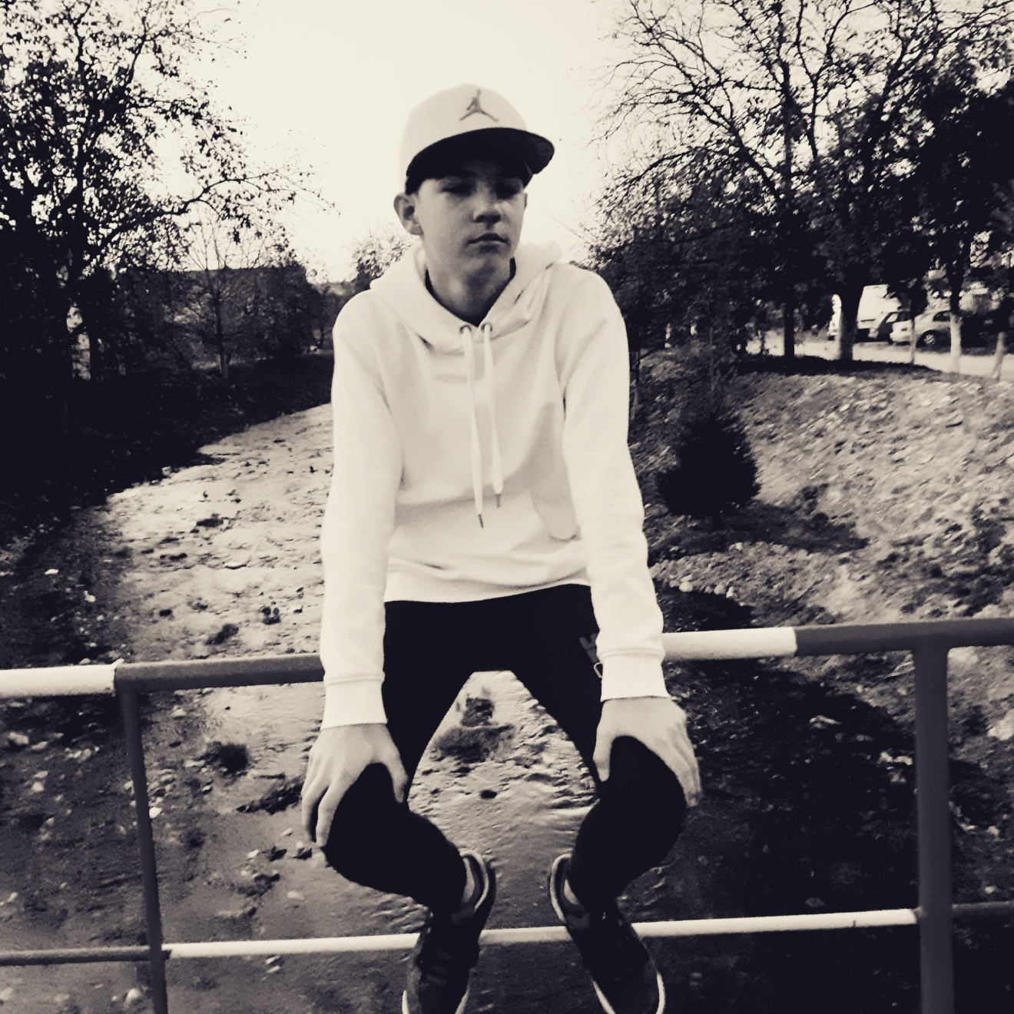
Nicholas
Buz

Slide 3
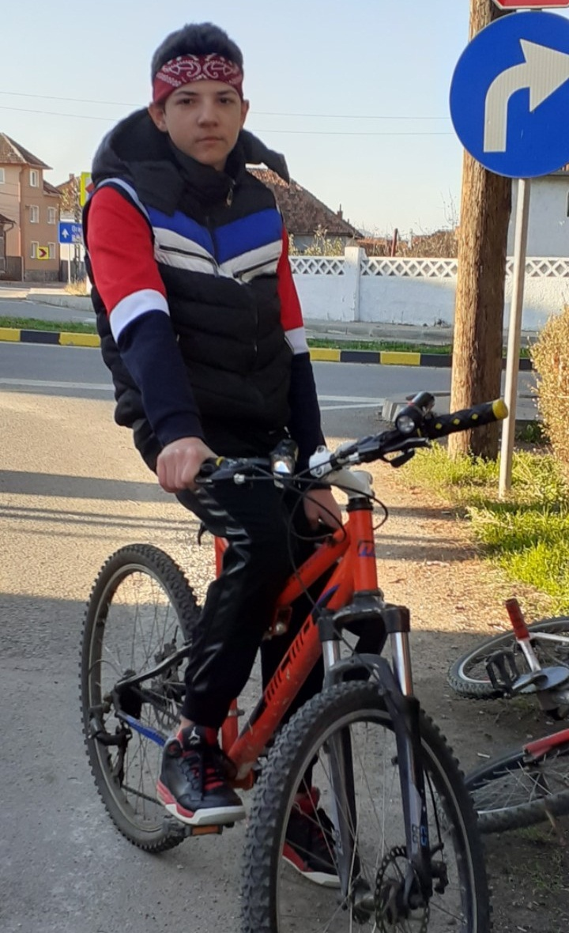
Riding
the bike
in my
hometown!

Slide 4
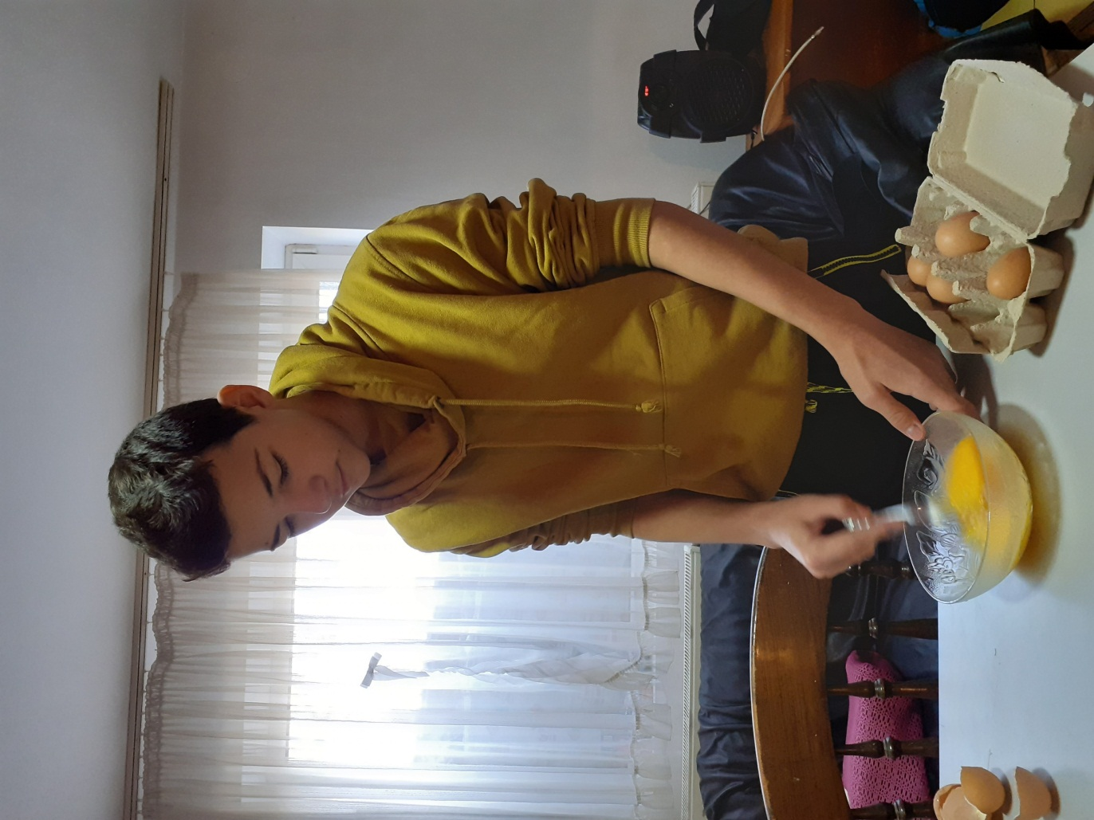
The next
winner of
Masterchef!

Slide 5
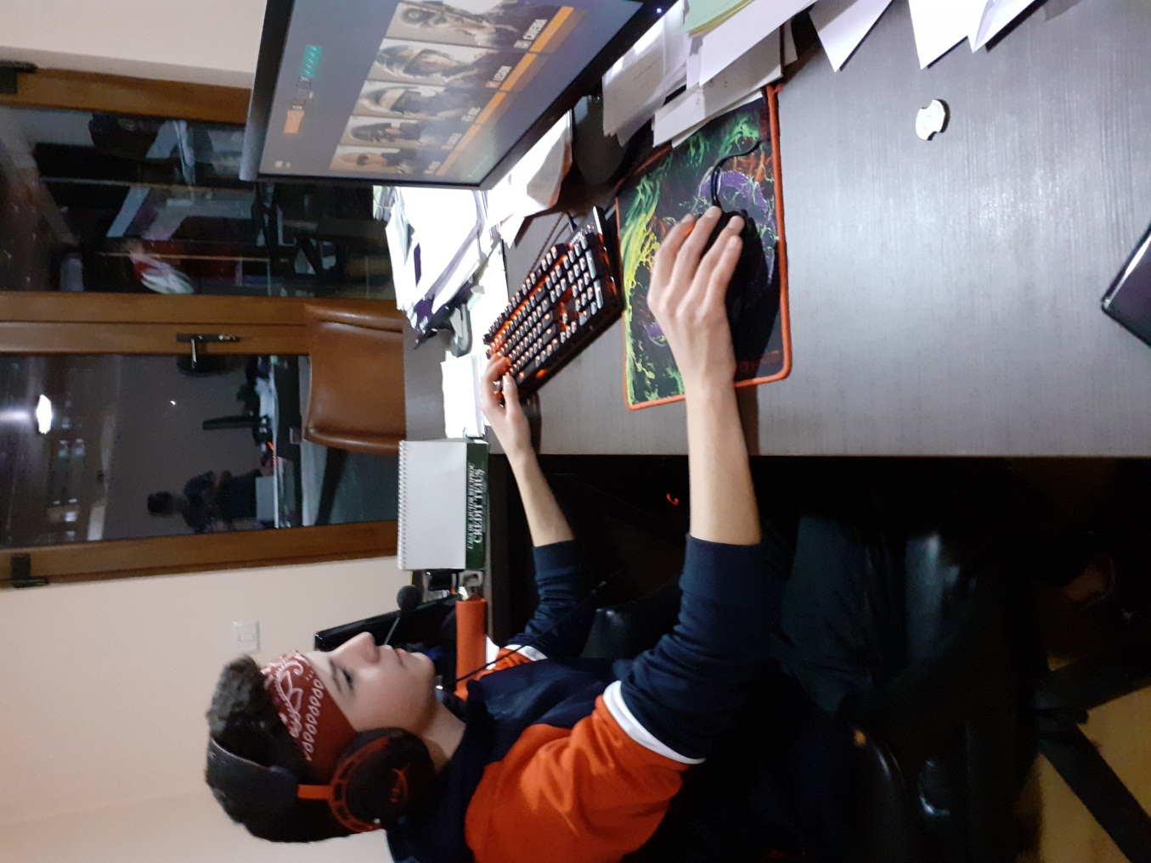
Playing
Some
games…

Slide 6
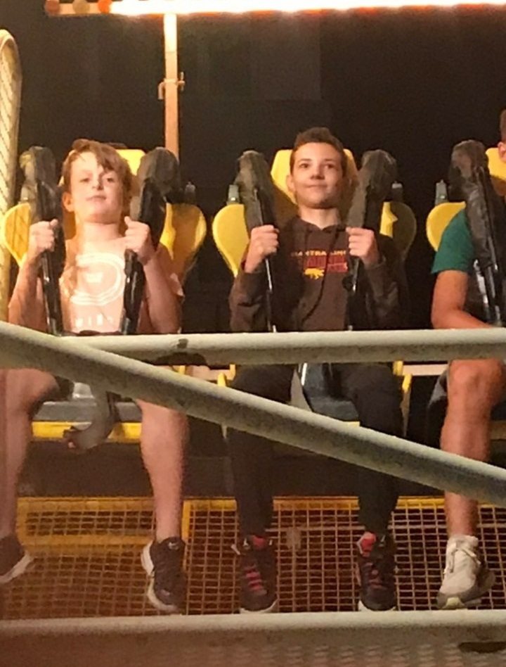
A good
example
of courage

Slide 7
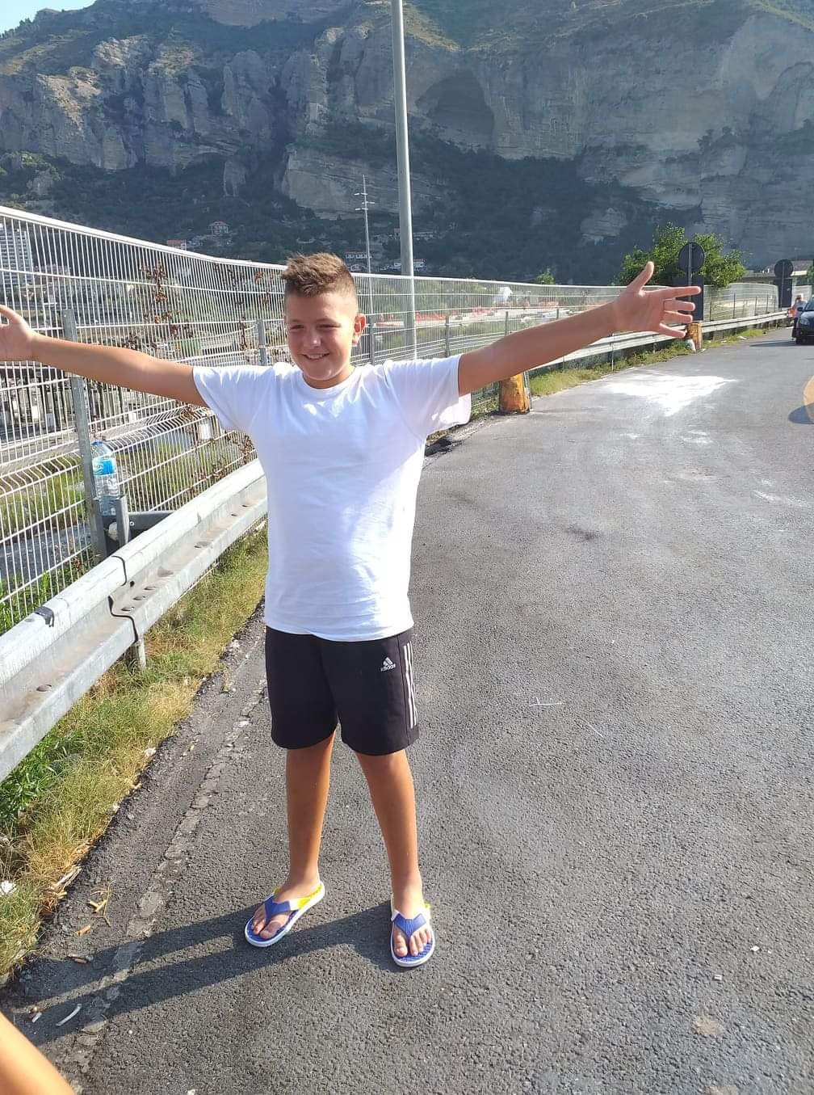
Andrei
Chioran

Slide 8
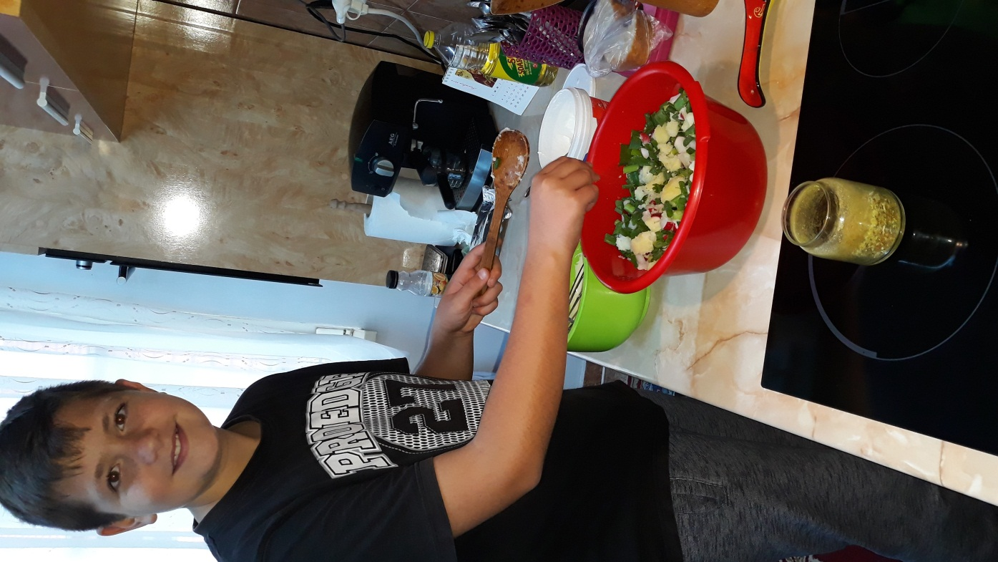
When I
want to
surprise my
mom!

Slide 9
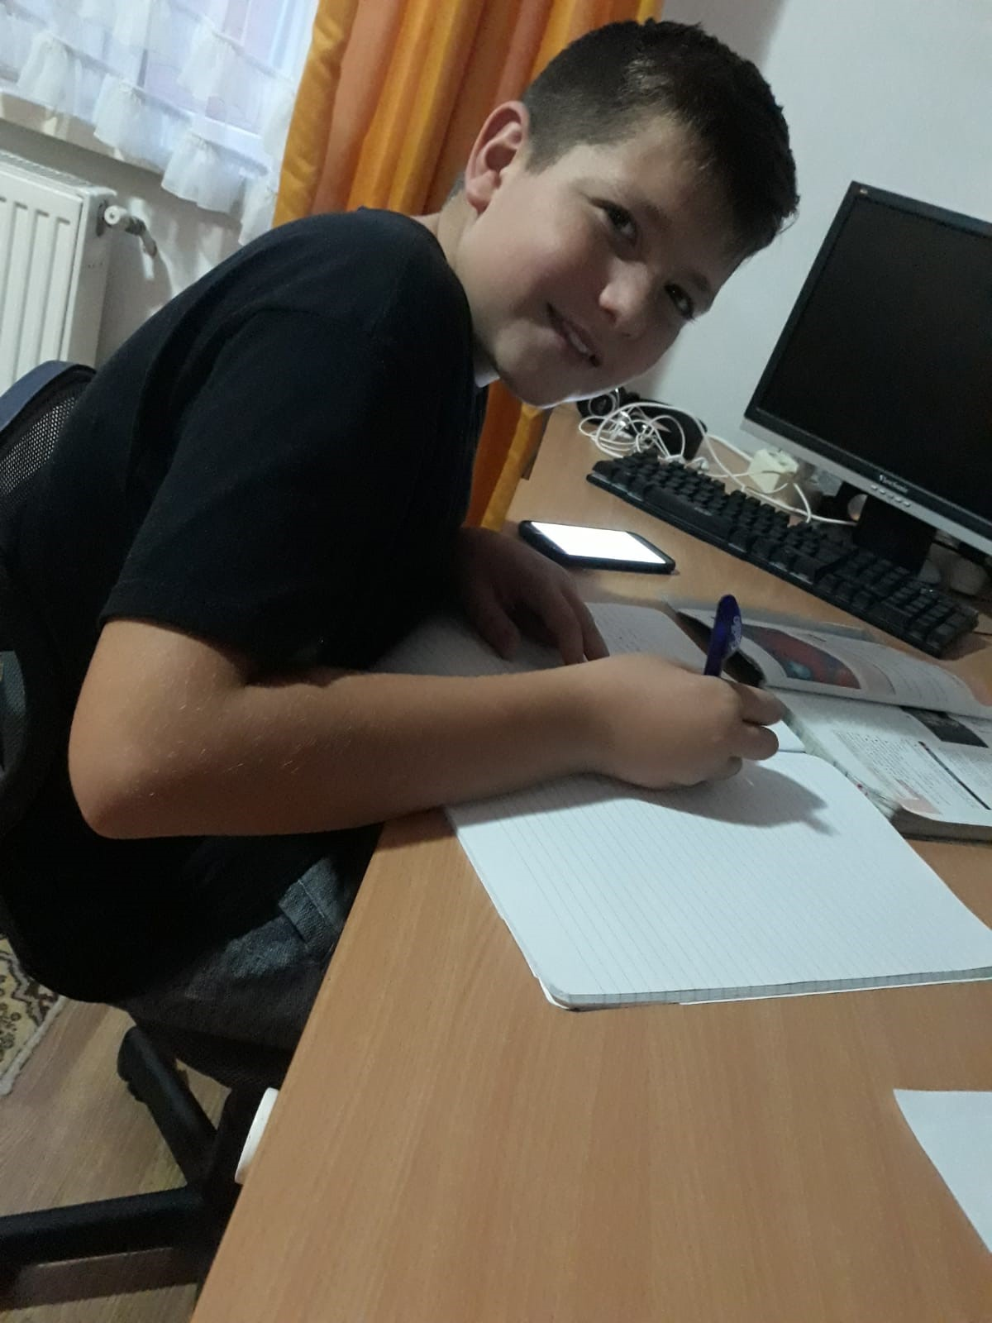
Studying
and
studying…

Slide 10
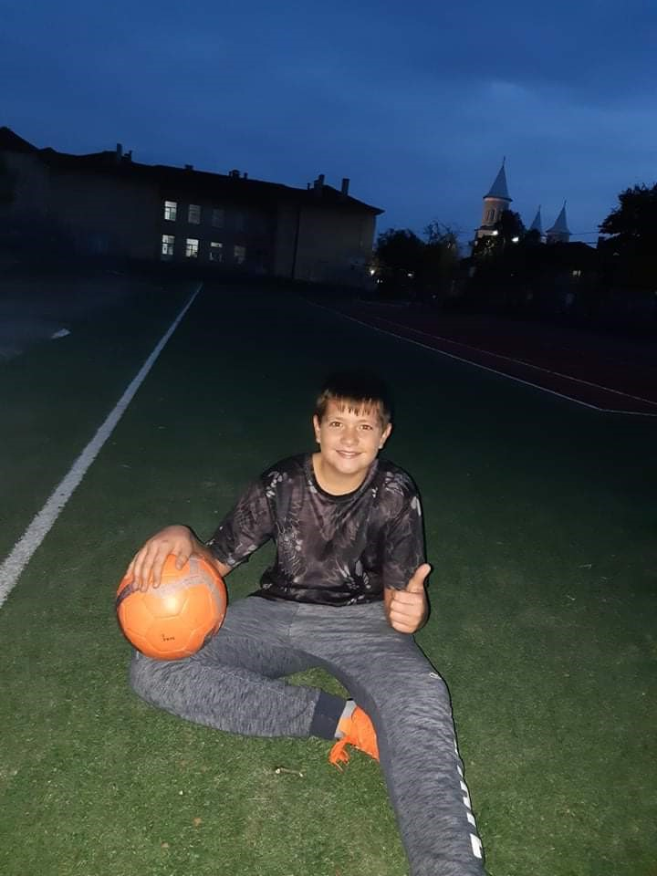
Playingsoccer

Slide 11
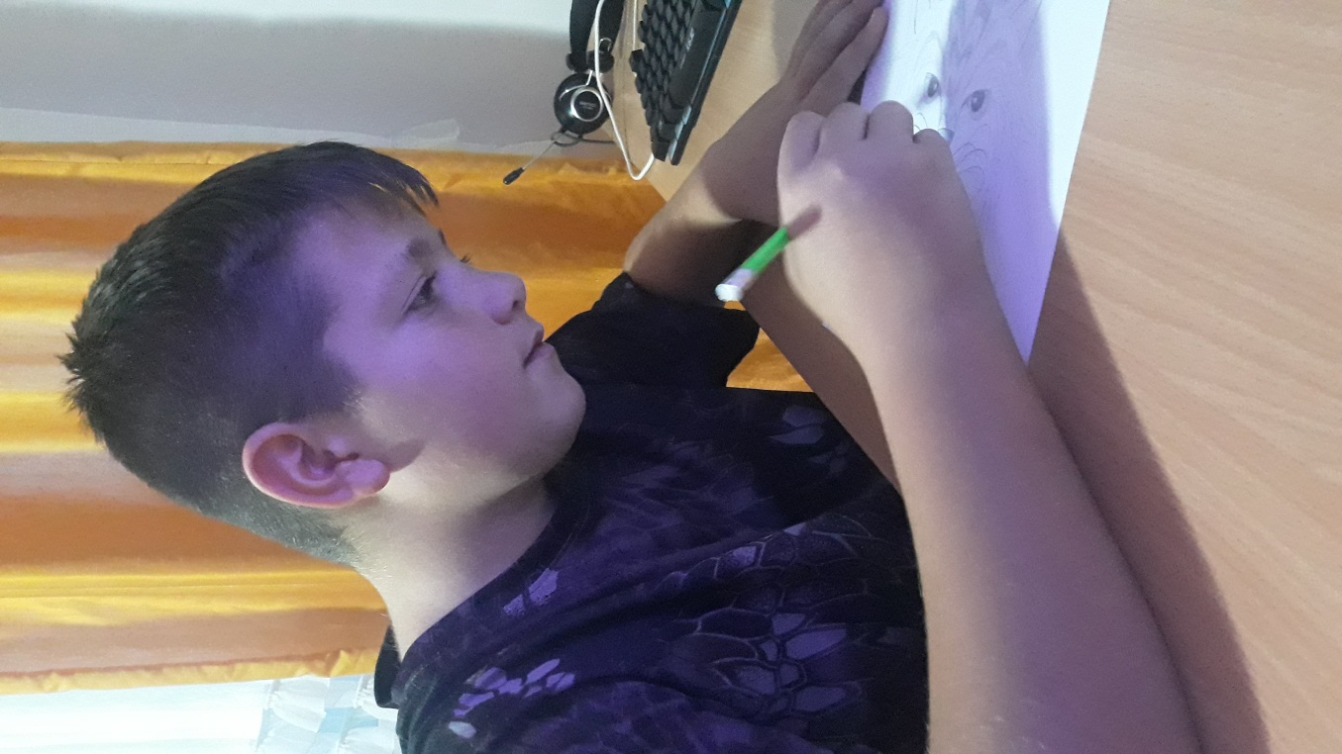
Picasso

Slide 12
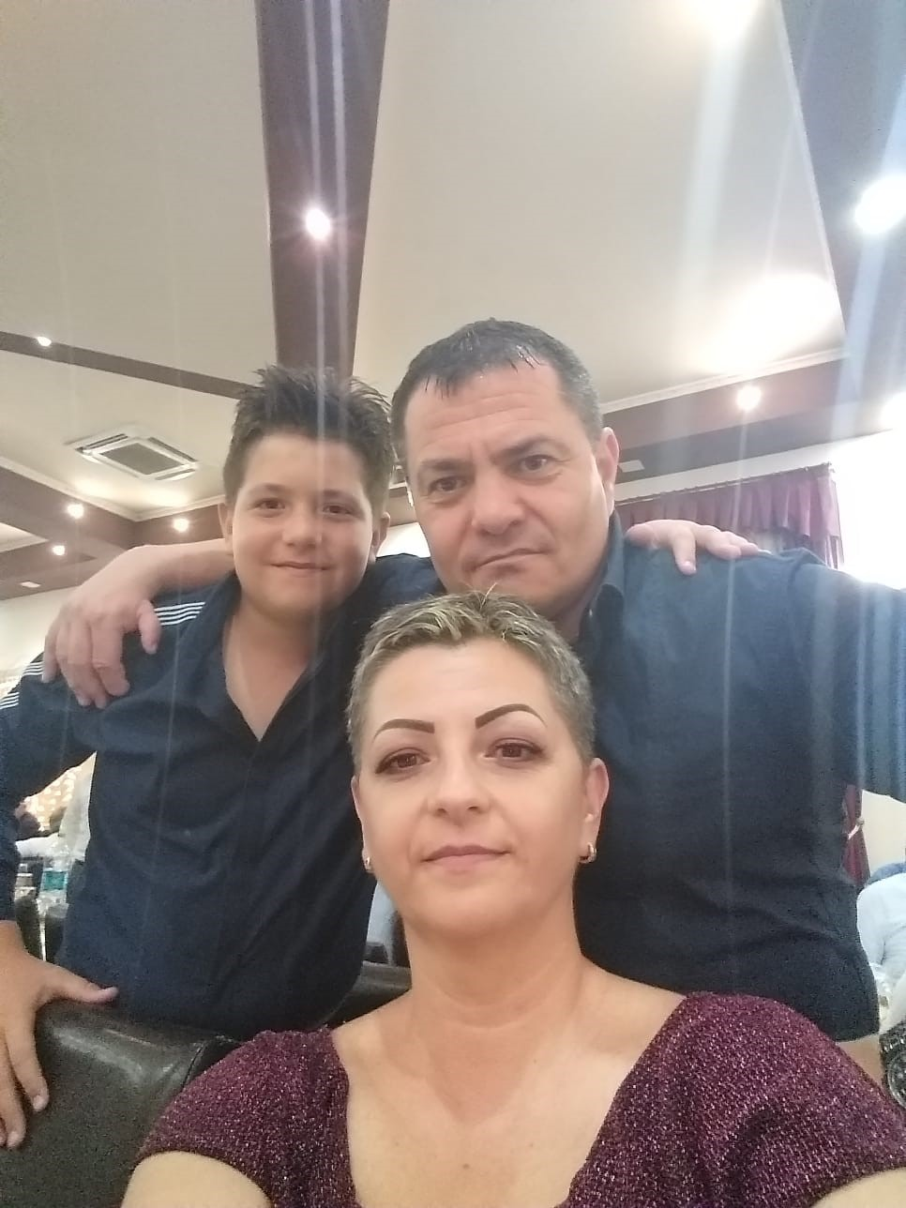
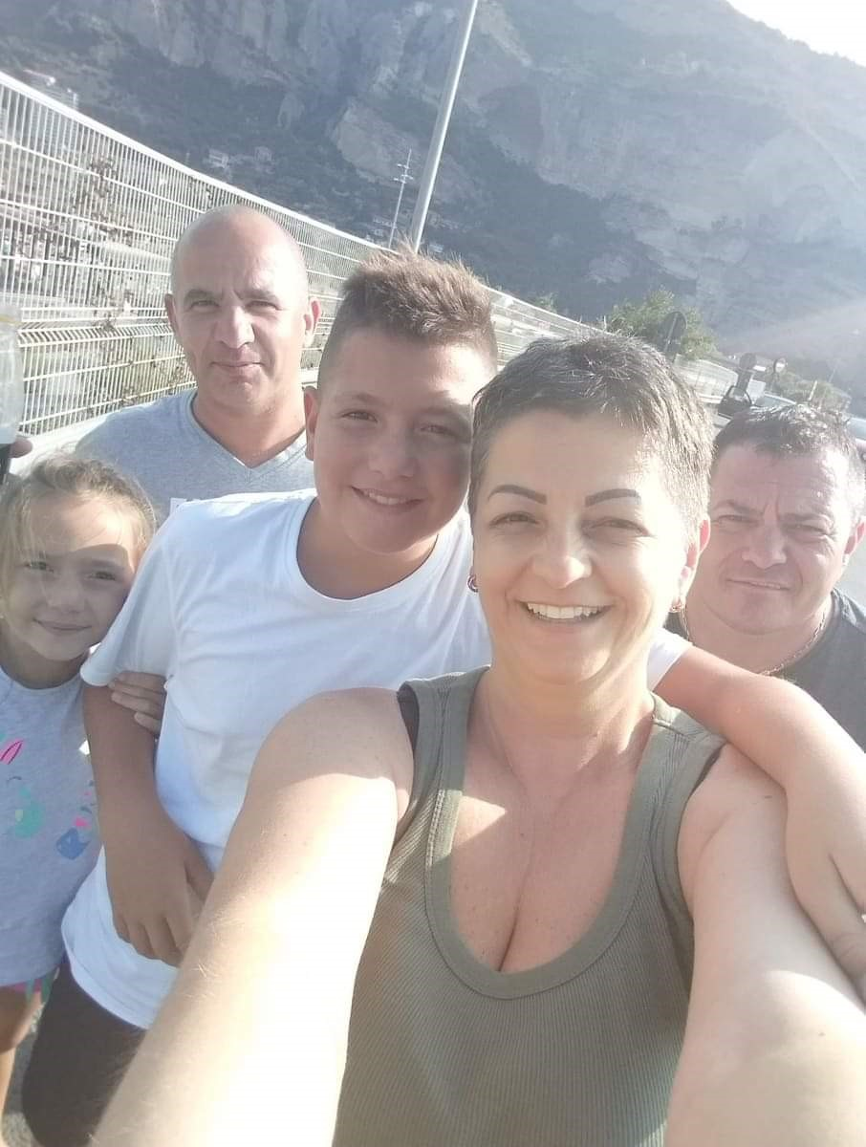
Having some
good time
with my
family!

Slide 13
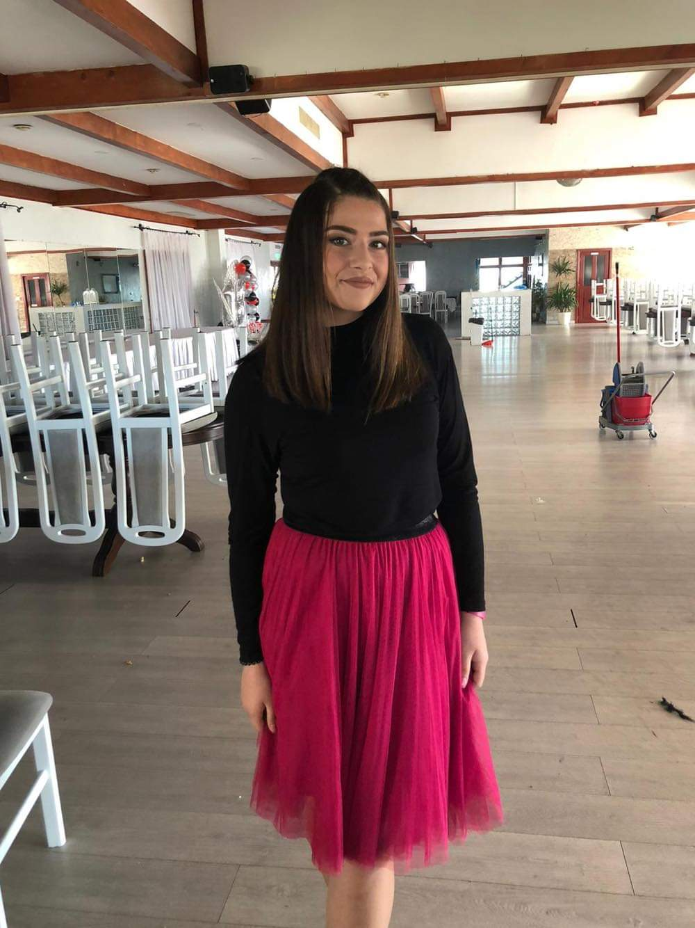
Daria
Luca

Slide 14
I enjoy
playing
volleyball!

Slide 15
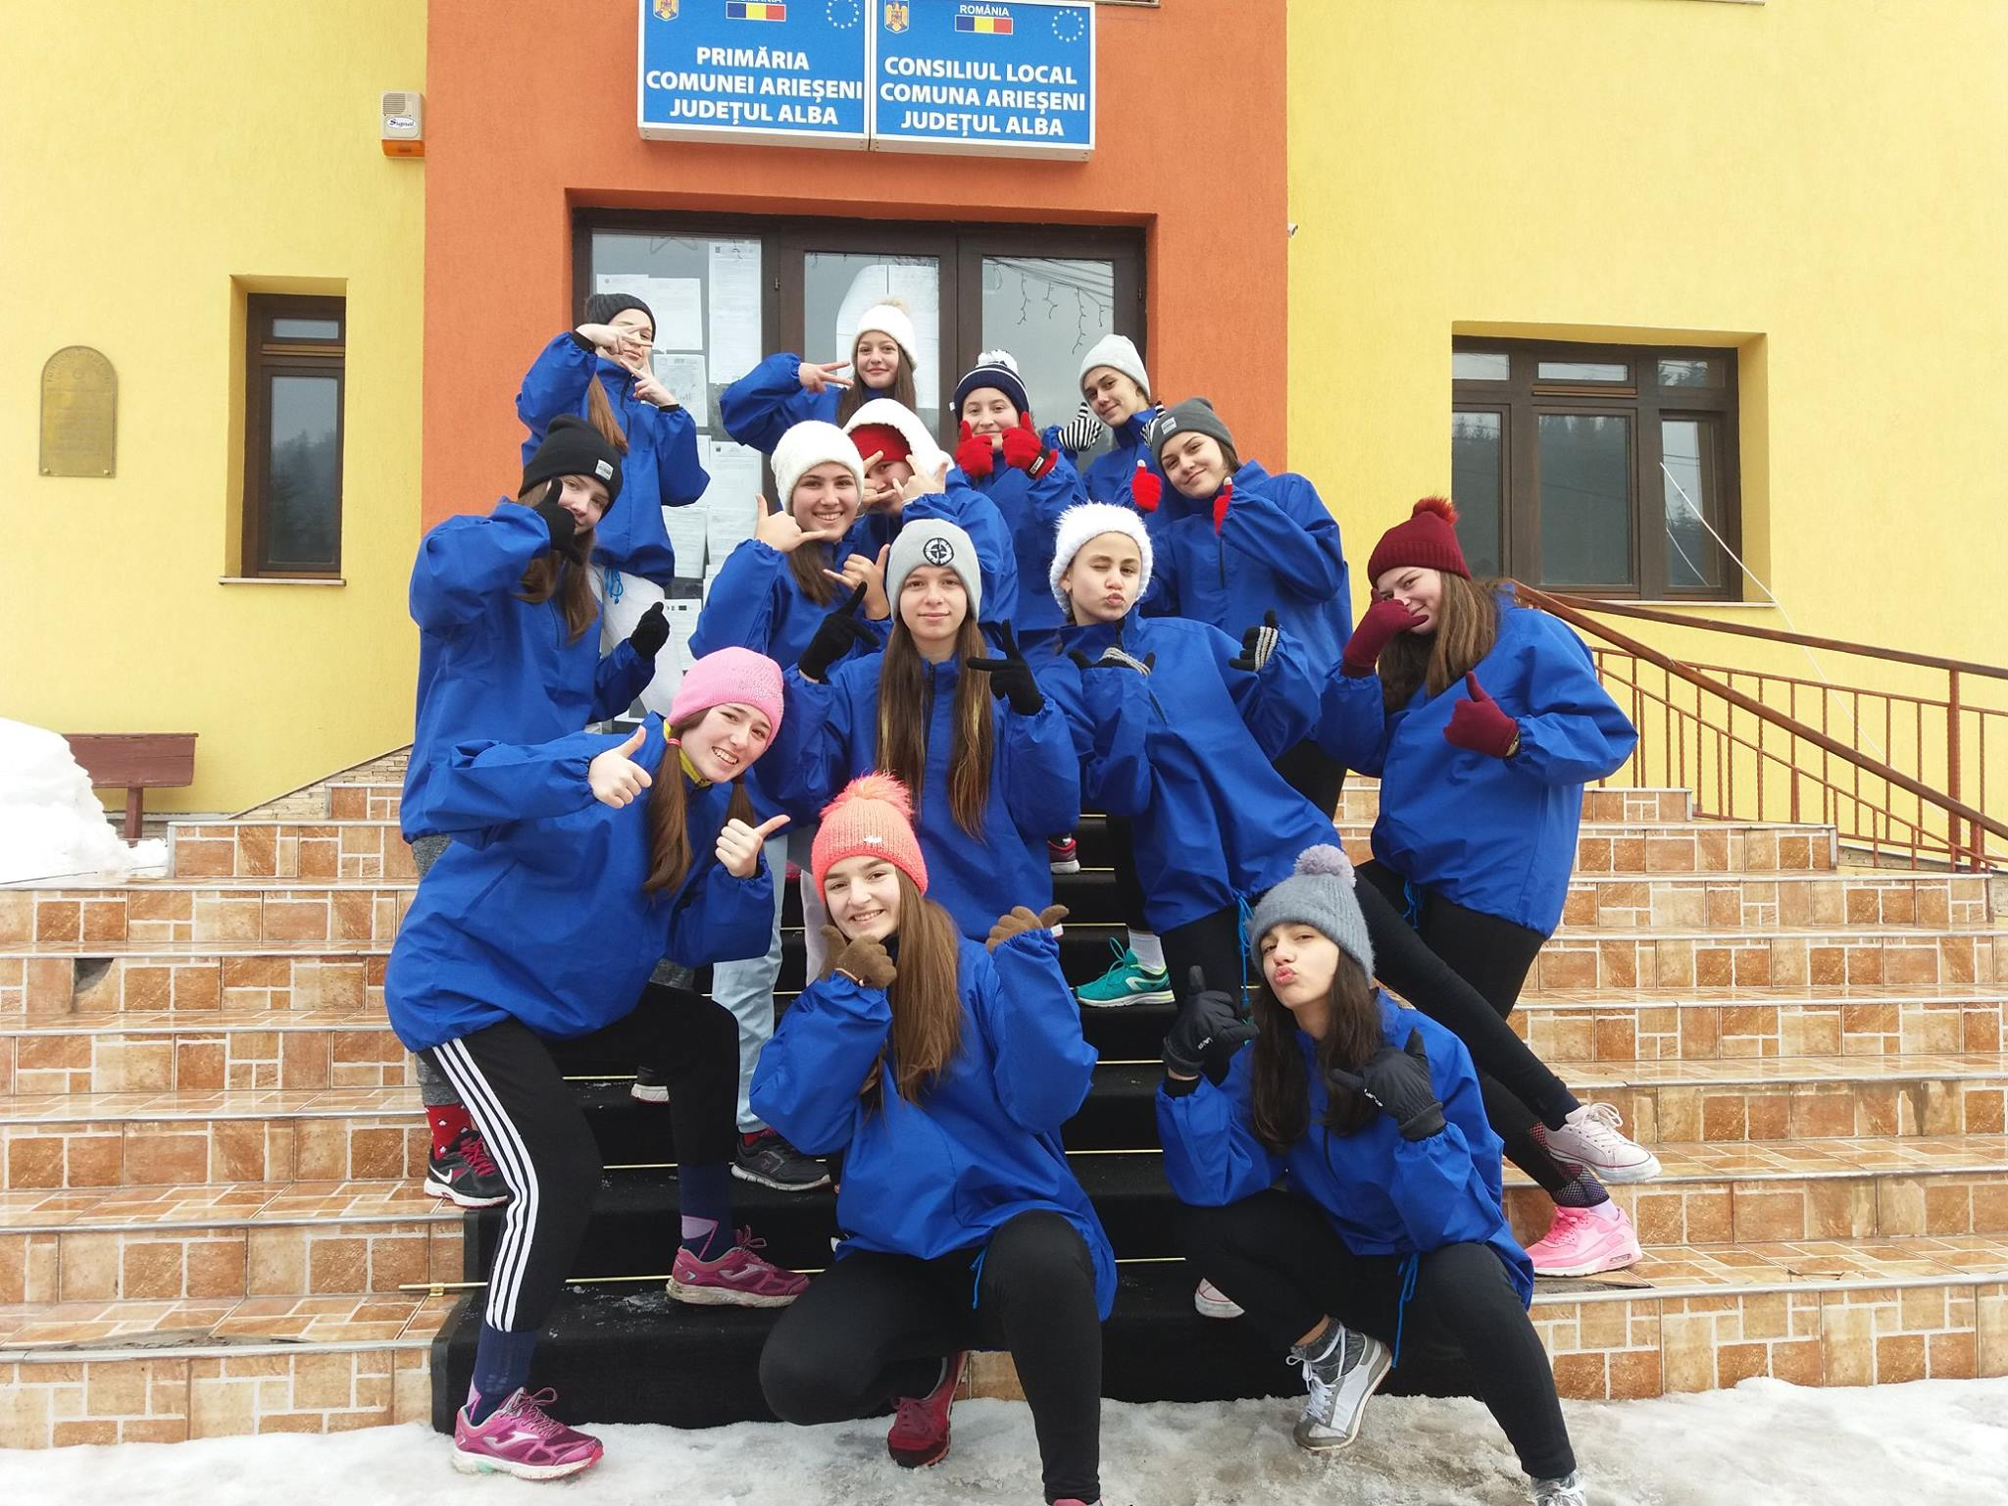
Training hard for the
championship!

Slide 16
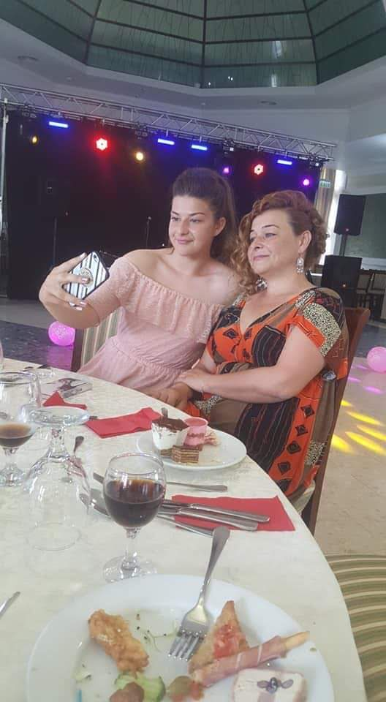
Selfie!

Slide 17
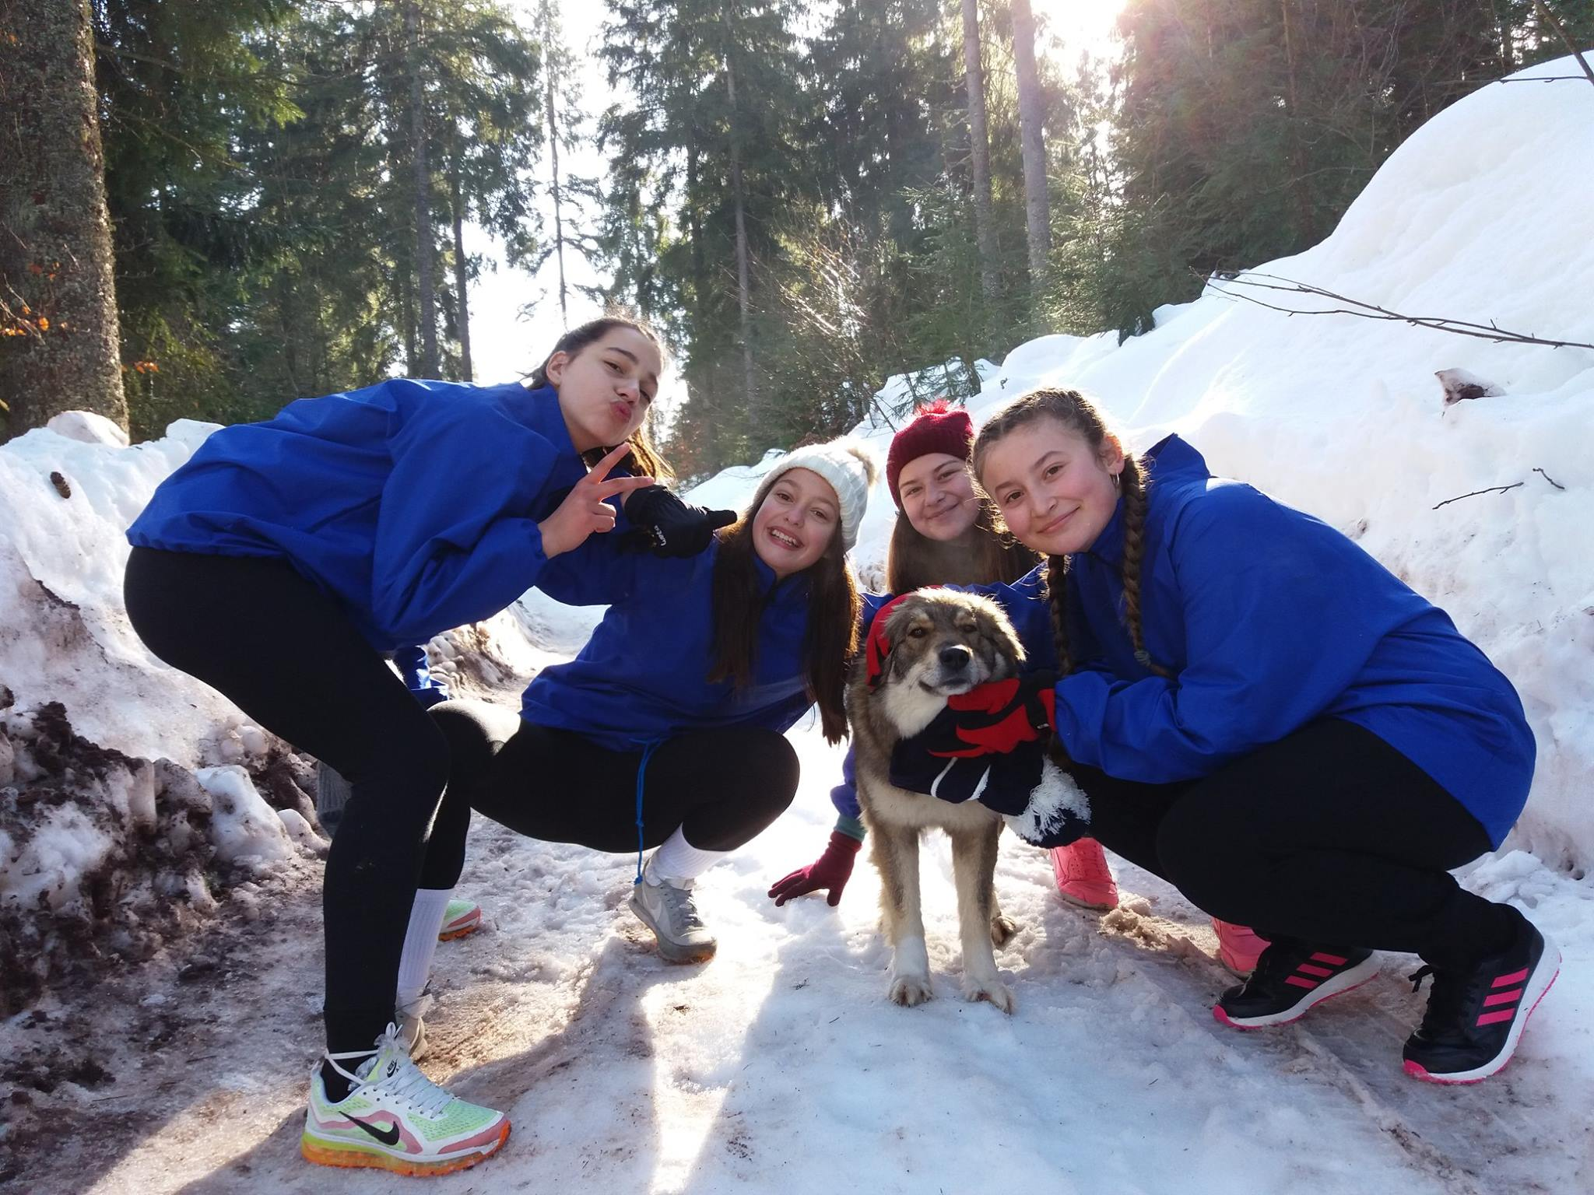
We love mountains!

Slide 18
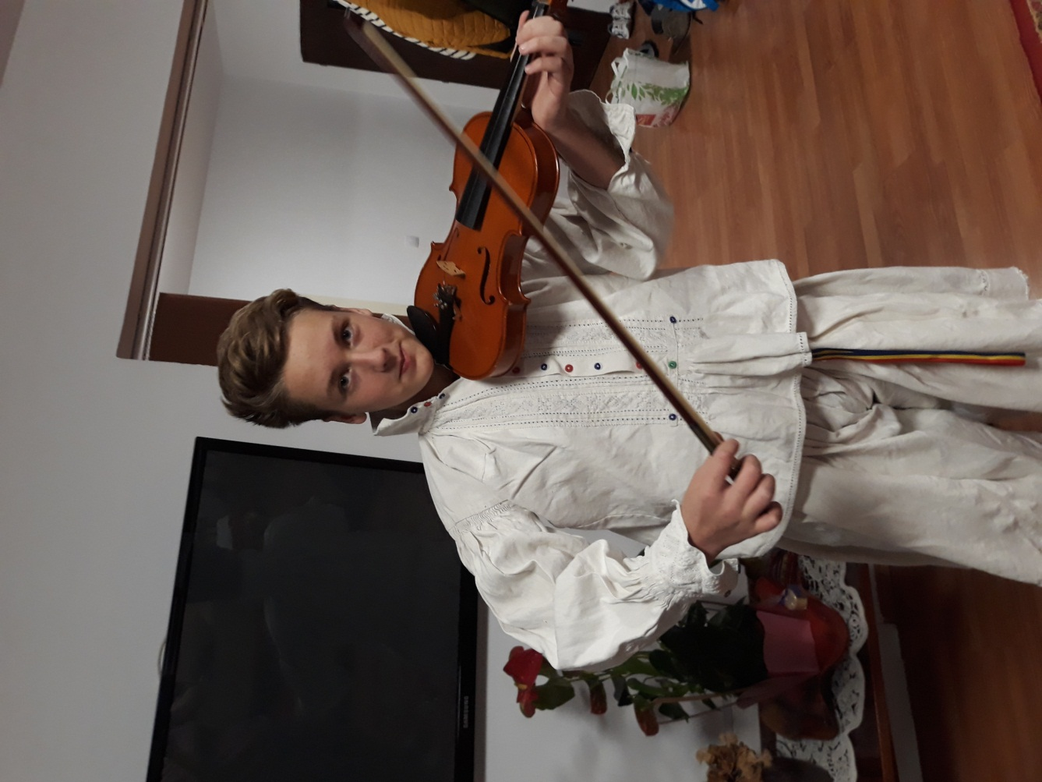
George
Jidoi

Slide 19
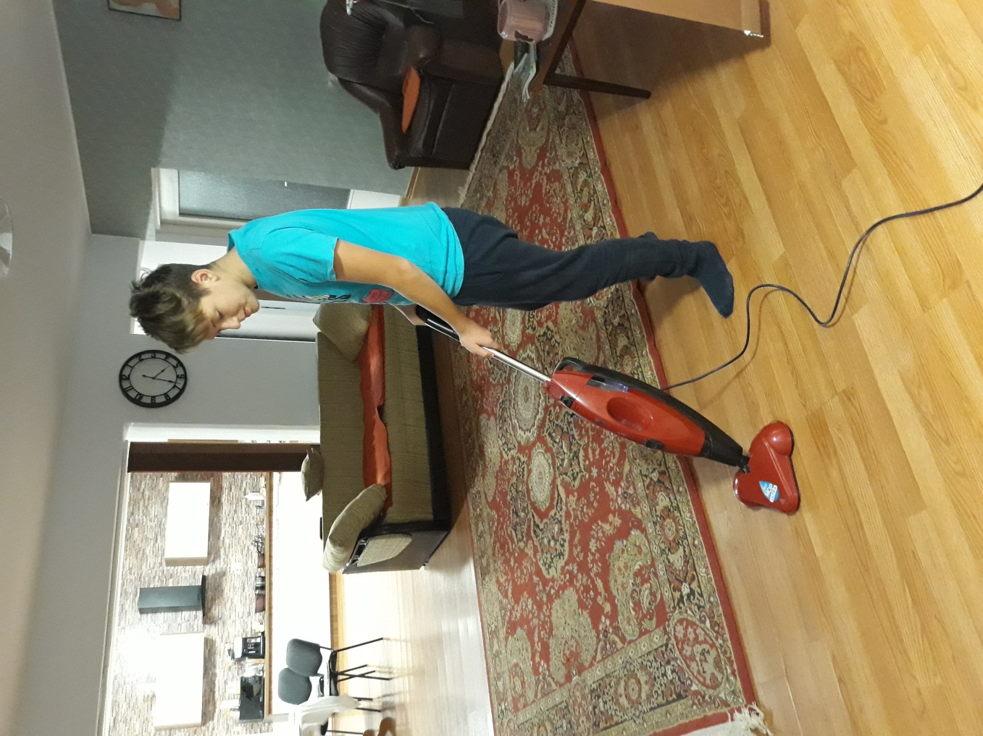
Making sure
that everything
is clean

Slide 20
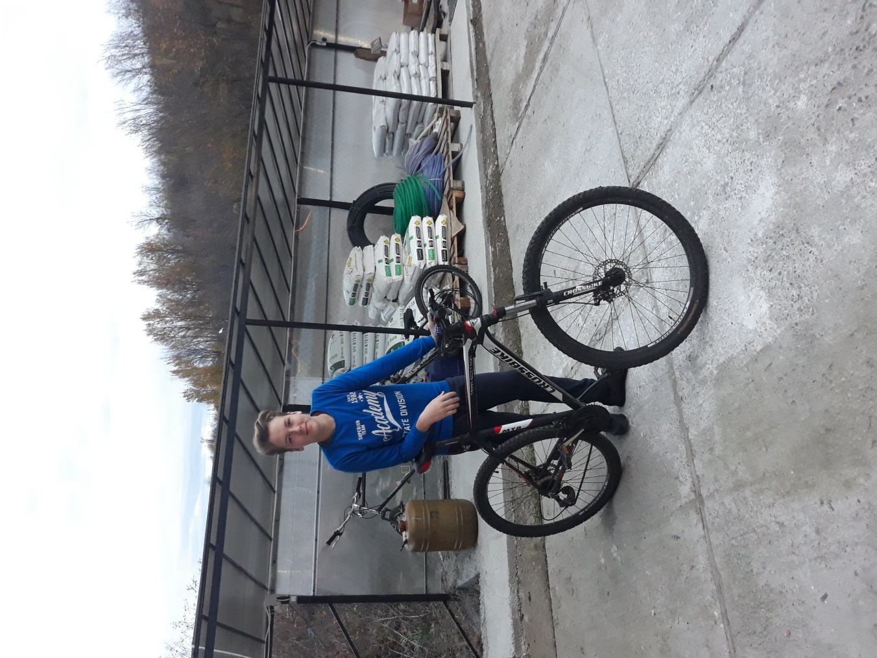
Riding my
bike…

Slide 21
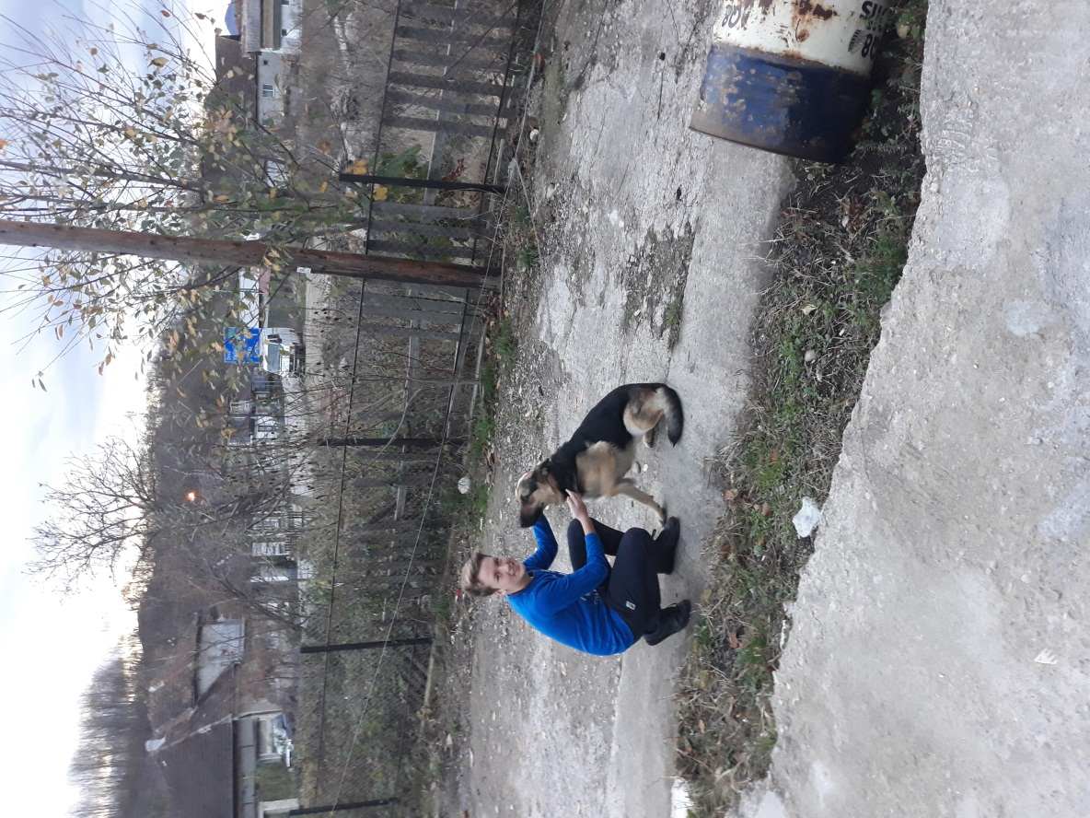
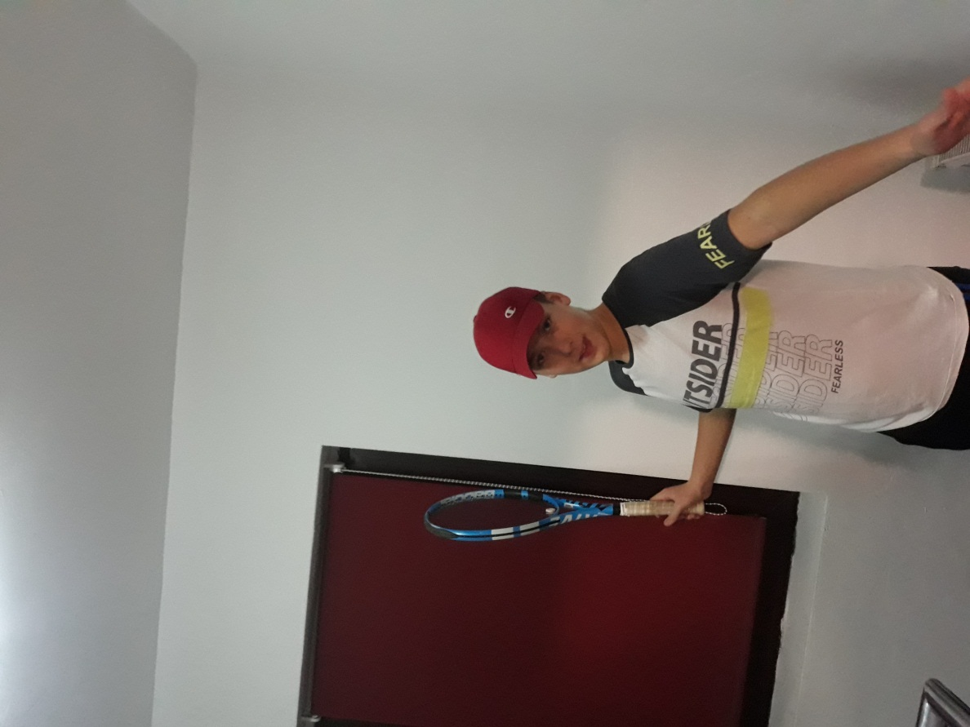
Hobbies and best friends

Slide 22
Doing my
homework

Slide 23
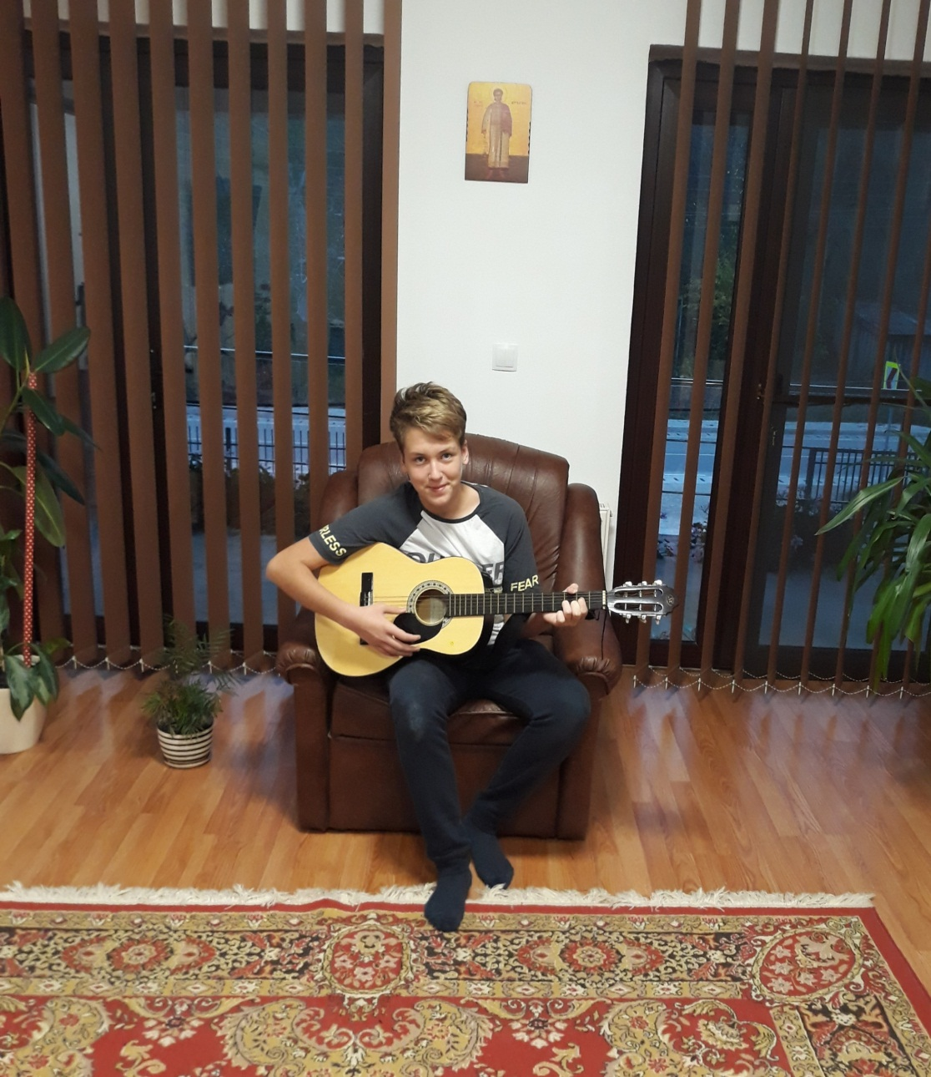
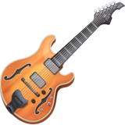

Slide 24
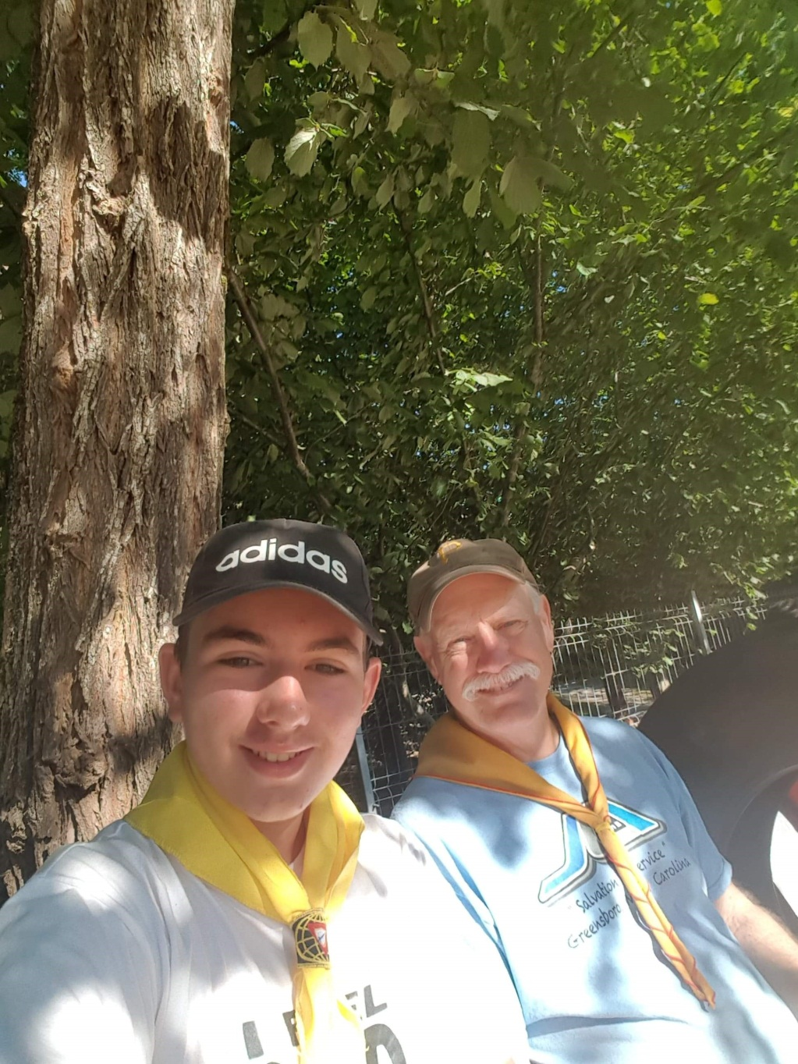
Mihai
Tira
With
pathfinders

Slide 25
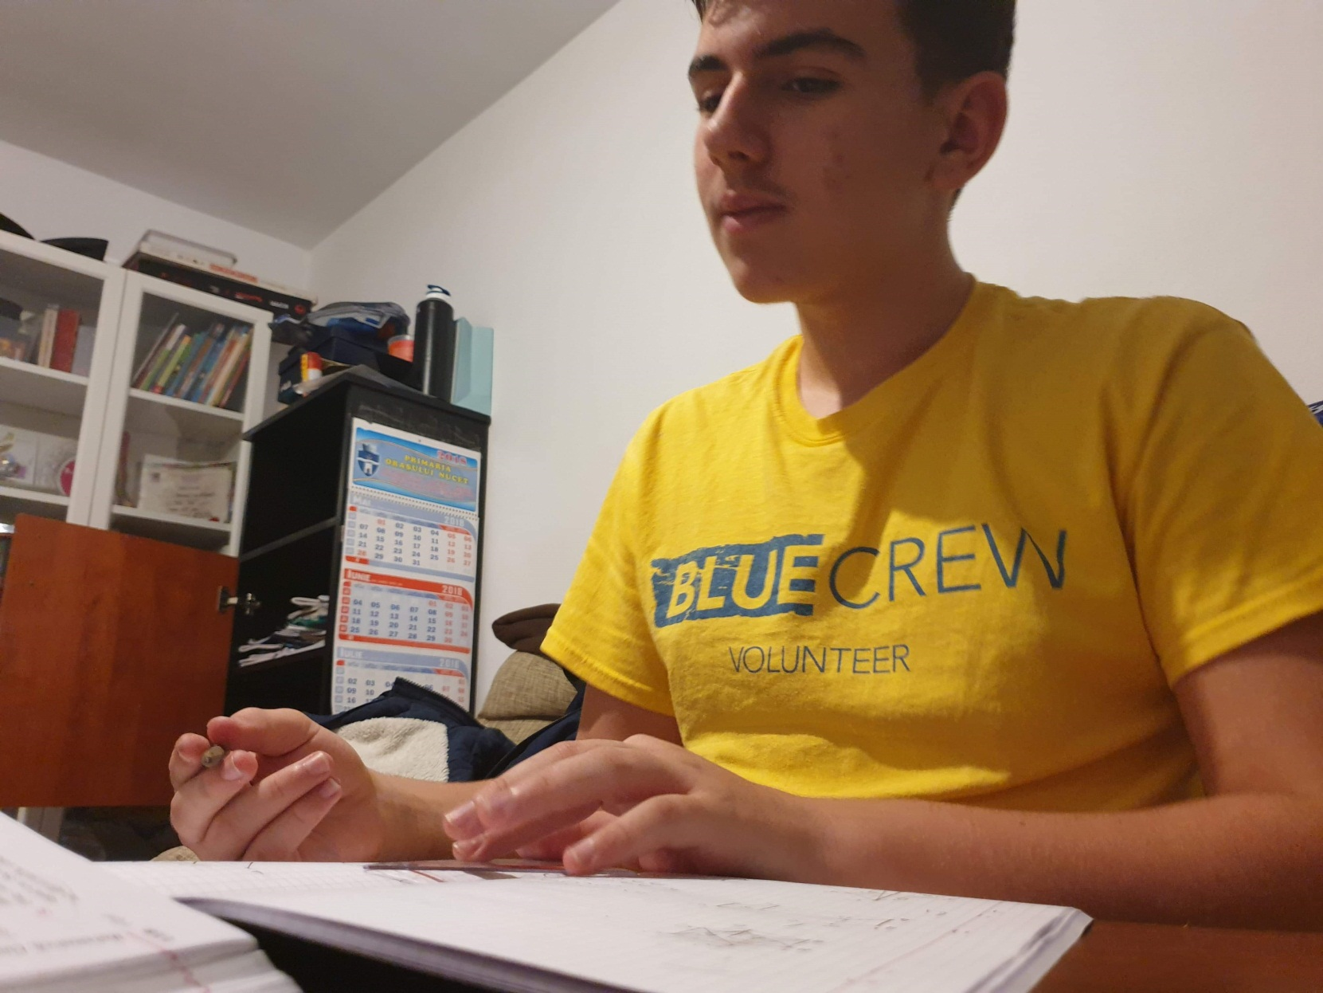

Slide 26
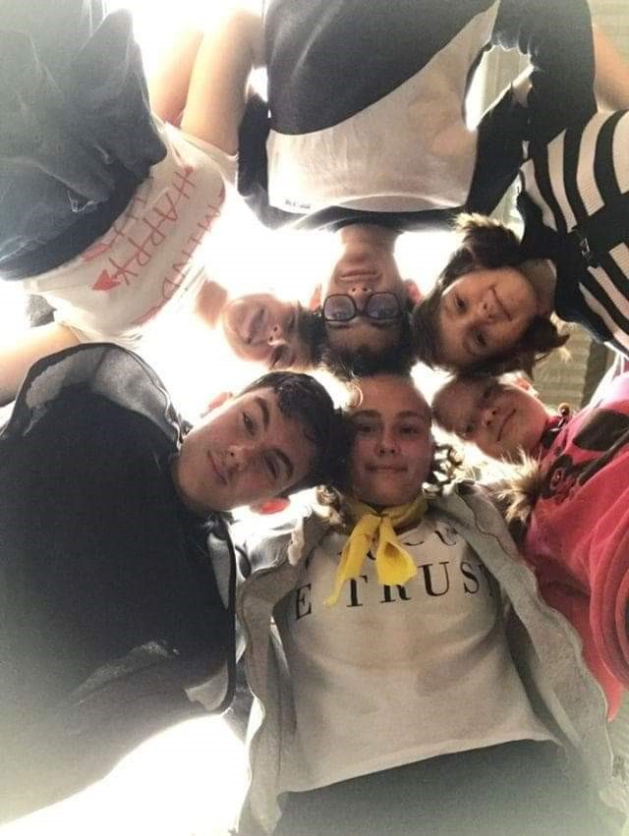
Having some
good time
with my
friends!

Slide 27
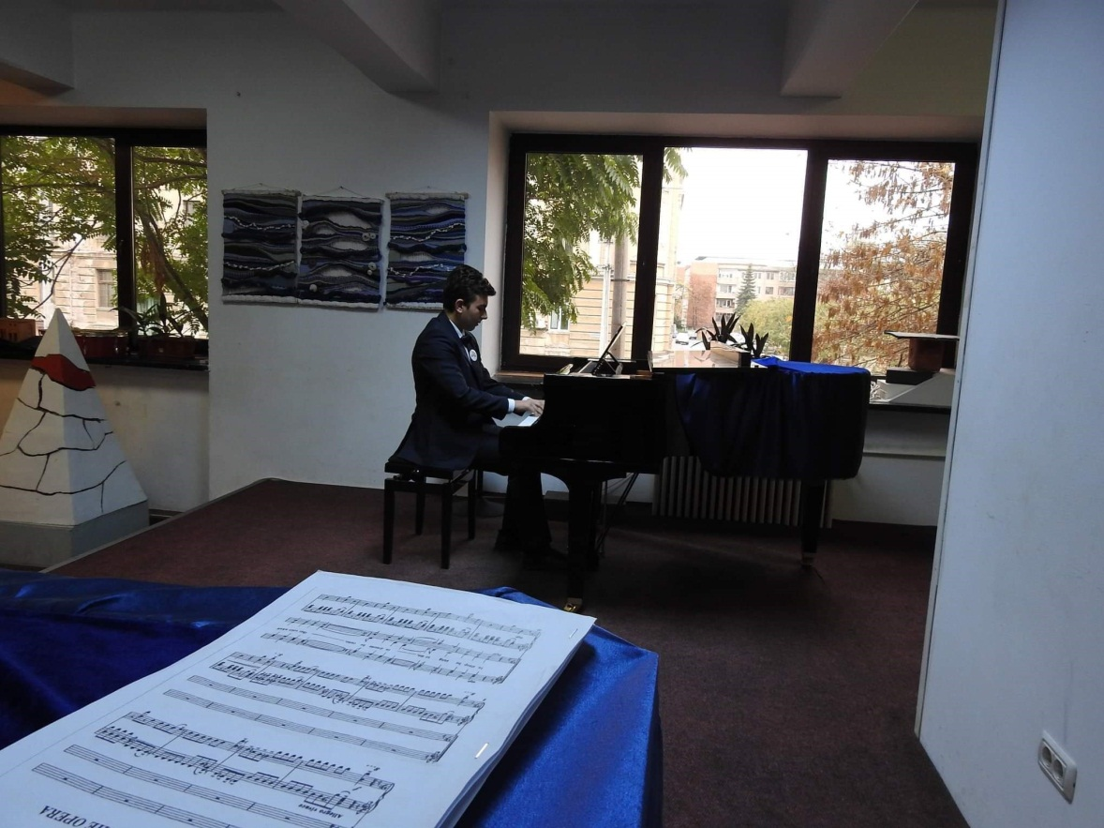
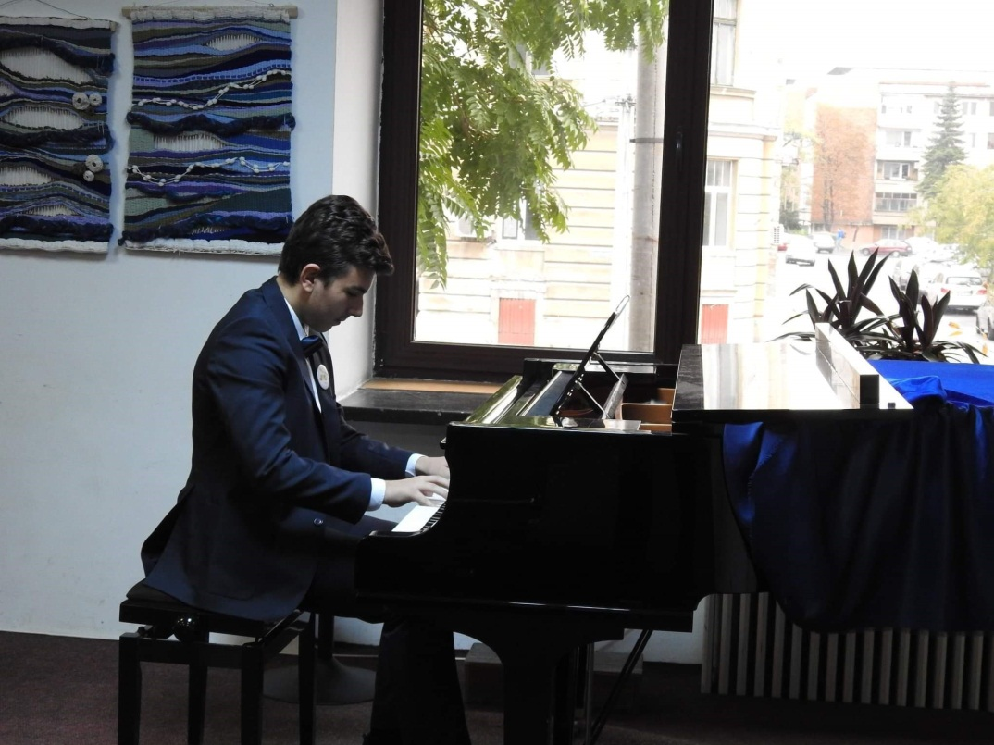
Playing some Chopin

Slide 28
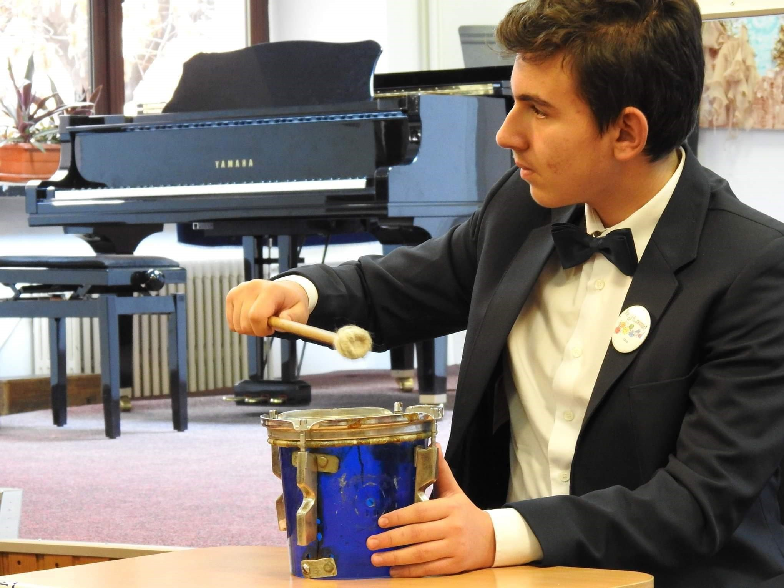
Drummer
boy

