Slide 1
MY HOMETOWN
by Çınar Baykal

Slide 2
My name is Çınar BAYKAL. I am 13 years old. I have a younger brother, Gökberk. Both my parents are Math teachers. I’ve been studying at EKIN COLLEGE for 8 years. I am an 8th grader now. I am going to be a high schooler next year. I live in Bostanlı which is my hometown.

Slide 3
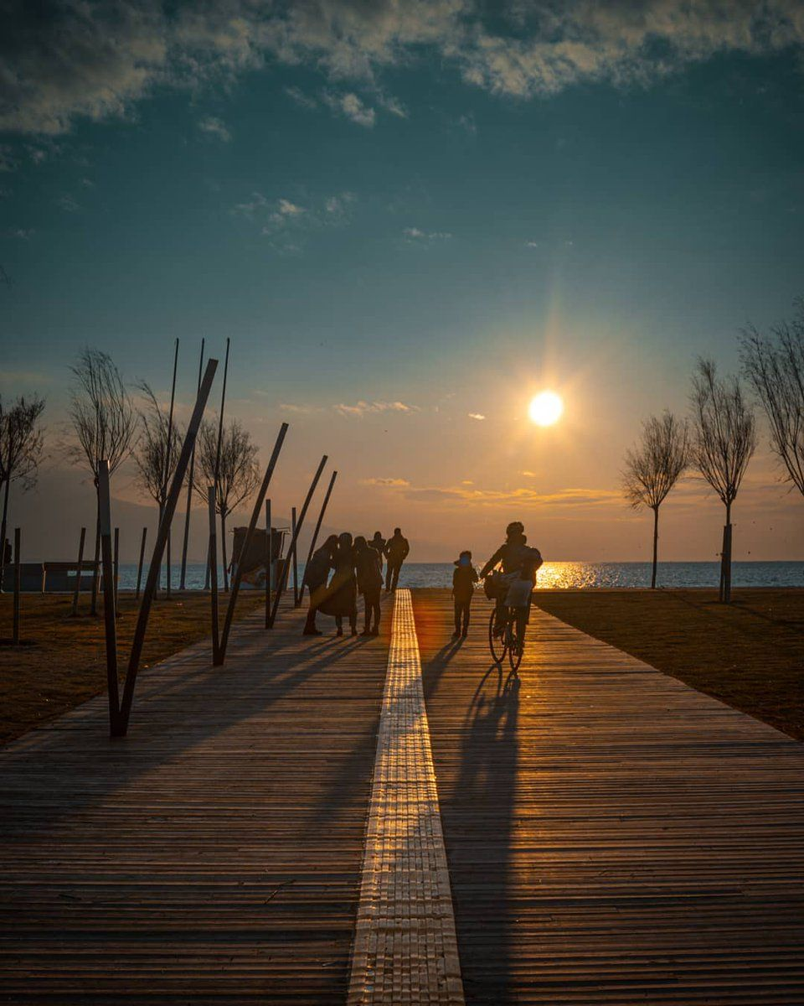
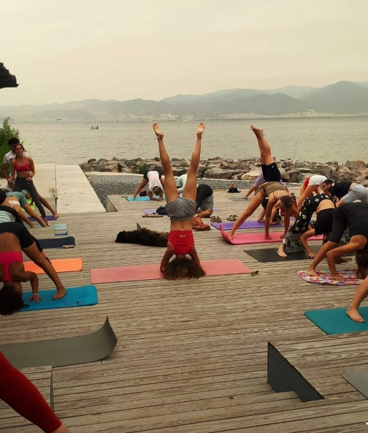
GOOD MORNING FROM BOSTANLI!
You can start your day here by walking, cycling, running.
You can even do yoga ☺

Slide 4
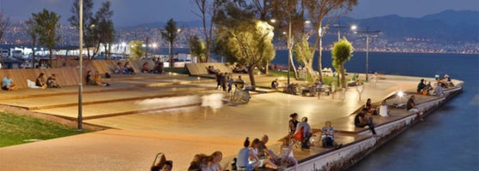
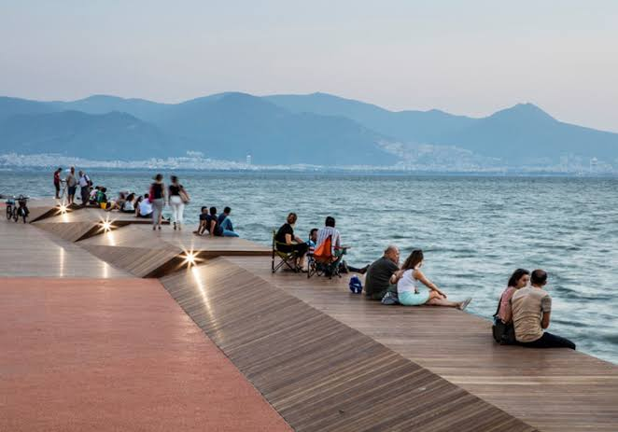
You can chat with your friends and watch the beauty of the sea. You can even catch fish!

Slide 5
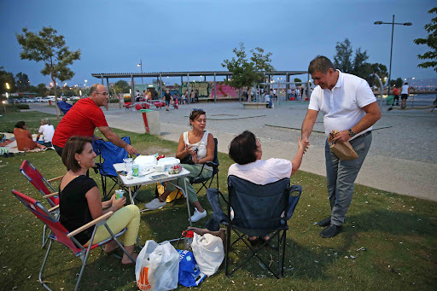
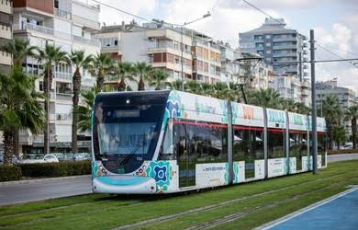
Or you can have a picnic with your friends or family,
play the quitar and sing.
If you are bored (which, I guess, is impossible), you can take the tram to go almost anywhere İzmir.

Slide 6
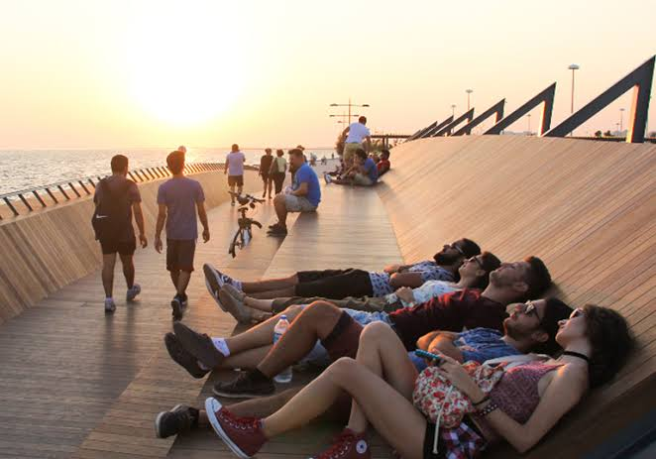
Are you looking for a romantic escape? Nothing can be more romantic than watching the sunset with your lover ☺

Slide 7
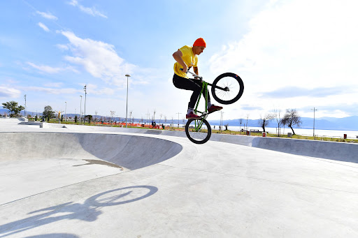
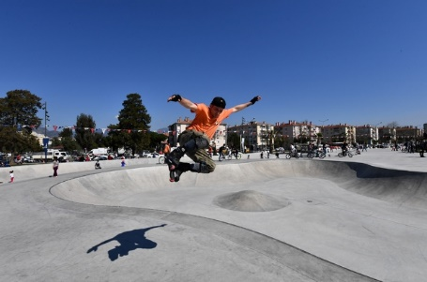
The country's largest skate park is here. You can watch the breath-taking shows of skateboarders and cyclists.
If you seek for adrenaline, you can also join them and have an unforgettable experience. Frankly speaking, it is not my thing! ☺

Slide 8
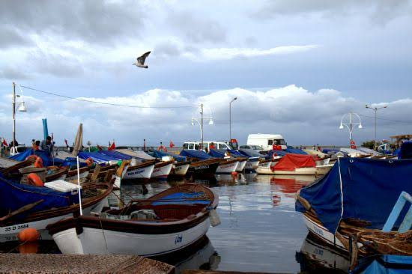
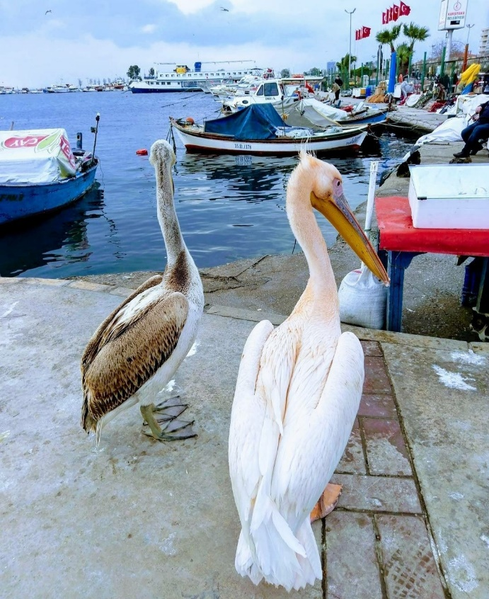
Can you hear the seagulls? They are hoping to be fed by the fishermen coming from fishing.
Boats on the beach , coming from fishing.

Slide 9
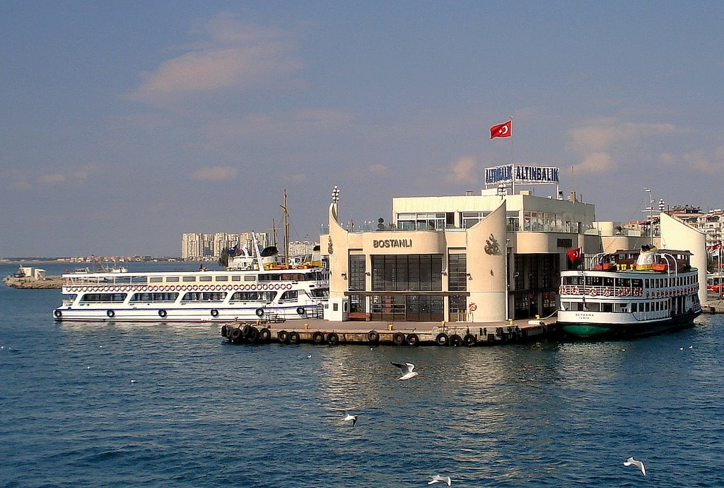
Bostanlı ferry is approaching the pier. You can go to the other side of the bay at any time of the day.

Slide 10
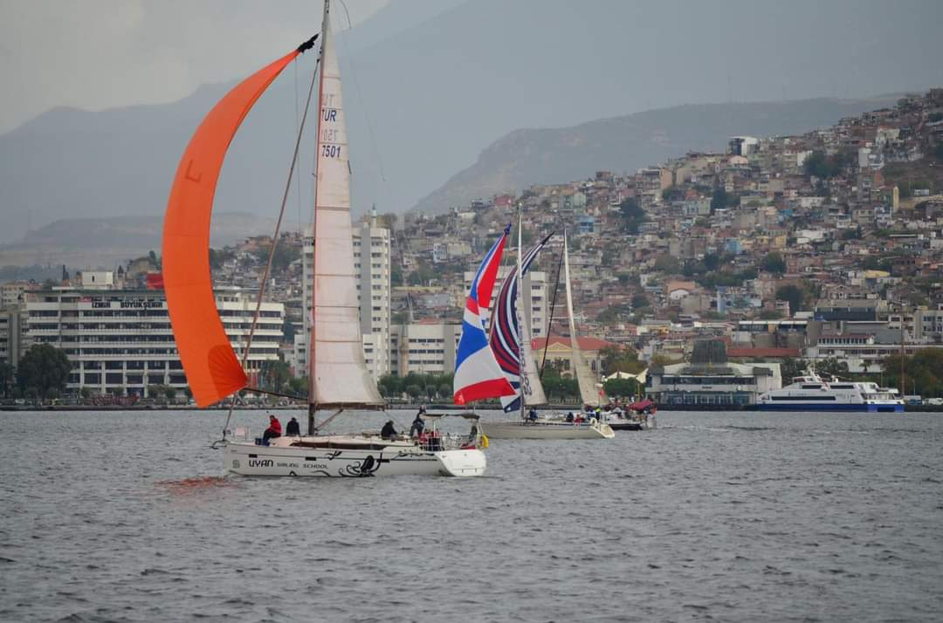
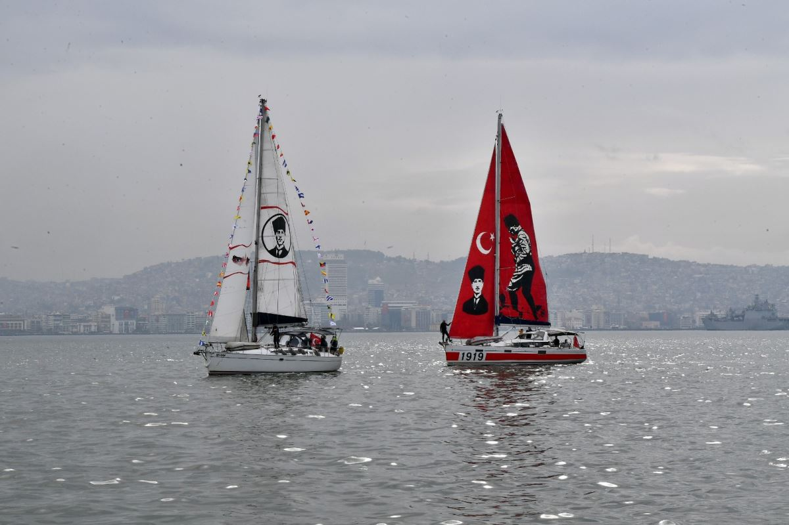
Karşıyaka Sail Club is training here. You can watch the races .
And the greatest Turk ATATÜRK…He is gone but not forgotten…

Slide 11
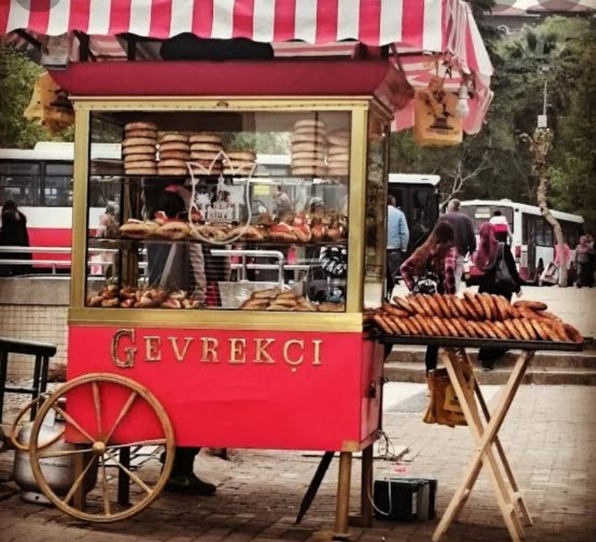
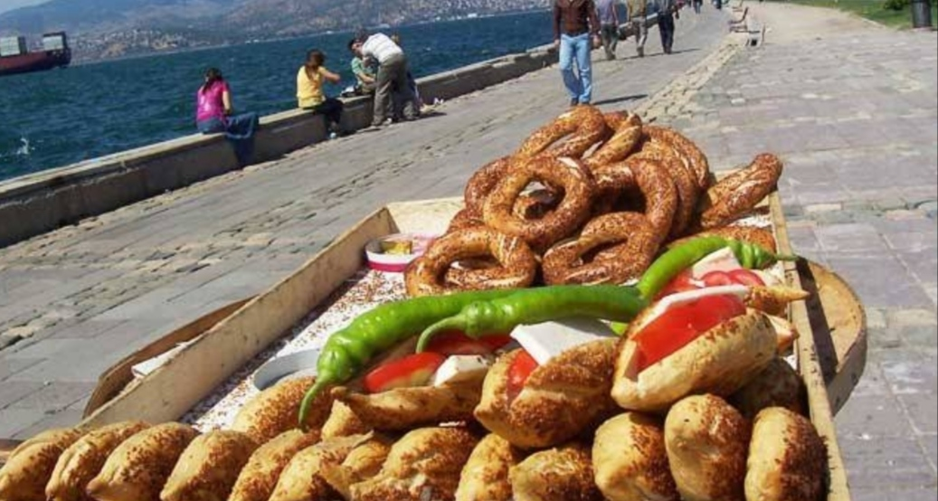
FAMOUS STREET DELICACIES
Did you get hungry while walking on the seaside? You should taste SİMİT, KUMRU and BOYOZ sold in the street.

Slide 12
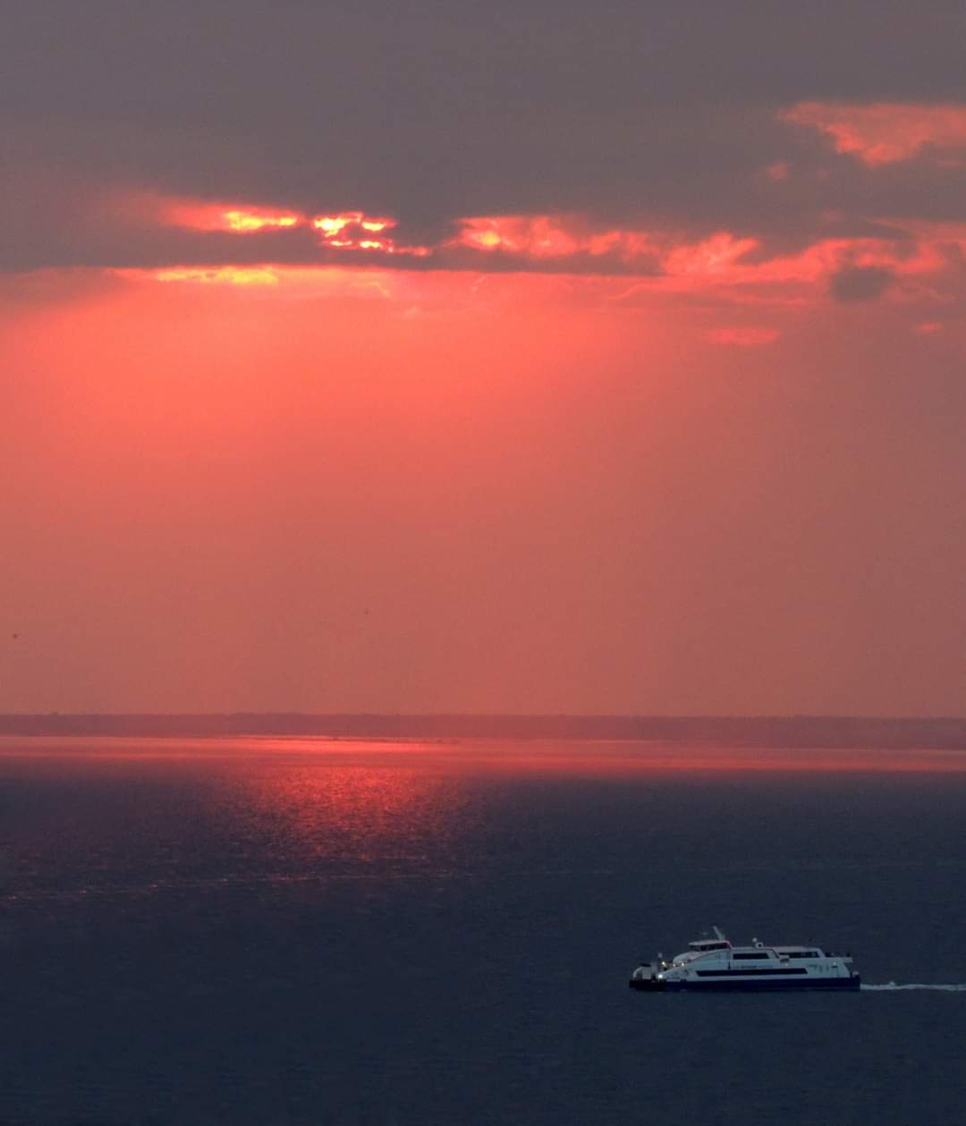
And the beauty of the sunset makes one write poems about it… Sunlight is literally dancing on the water… Dinner time is approaching…

Slide 13
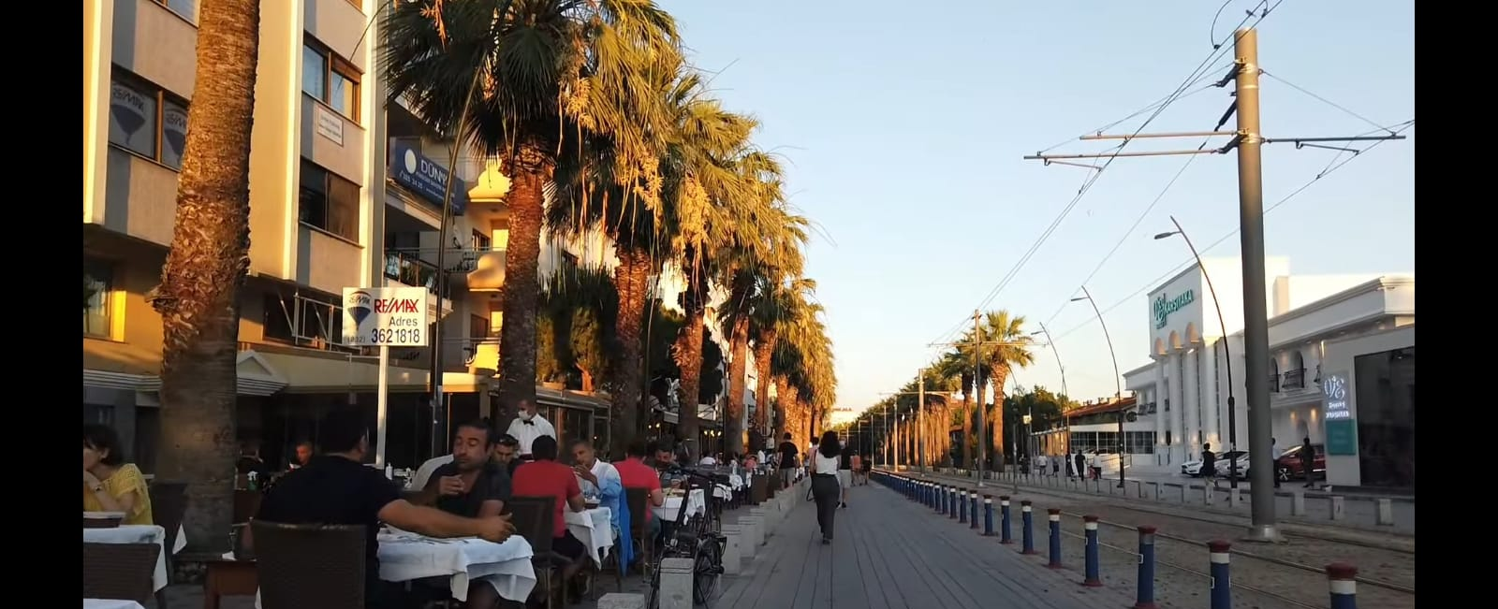
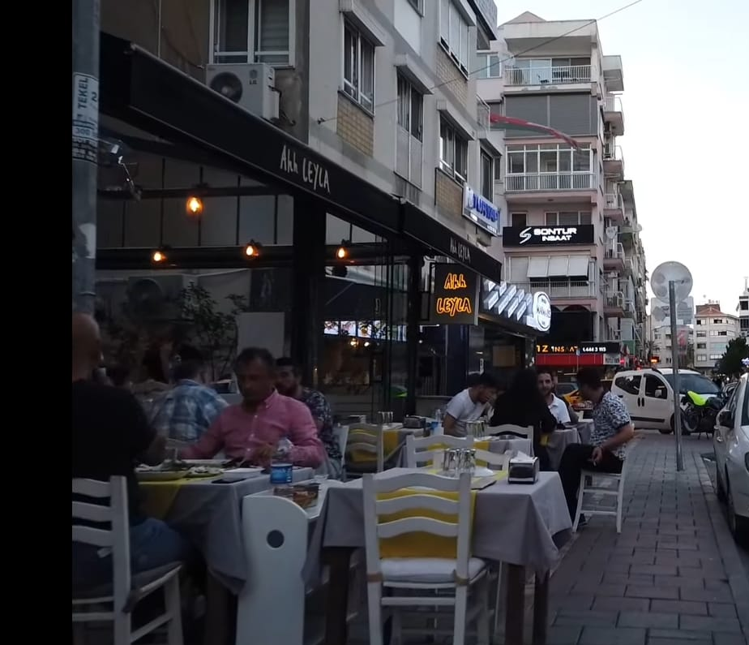
In the evenings, restaurants put their tables in the Bostanlı streets. You can eat outside and enjoy the scenery.

Slide 14
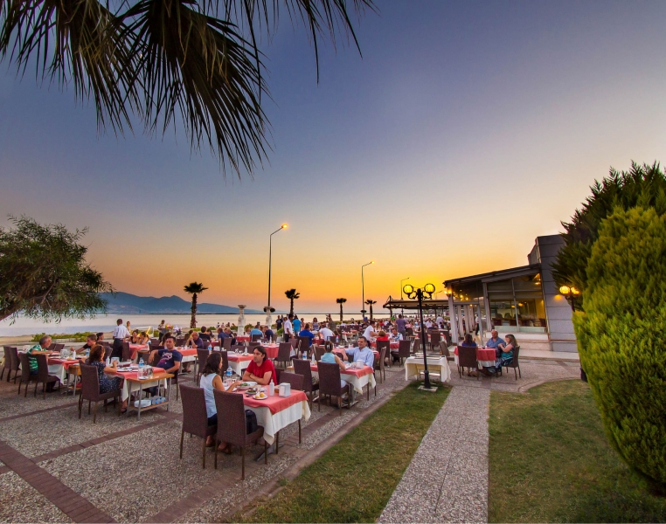
DENIZ KENT RESTAURANT
This is one of the best restaurants in town. If you ever visit Bostanlı, you should definitely eat seafood here. Calamari is my favourite!

Slide 15
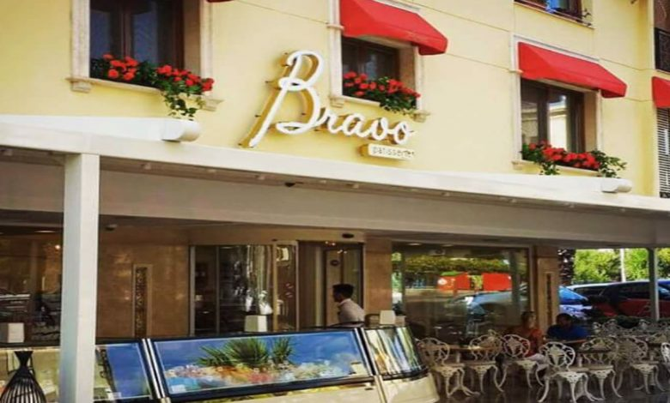
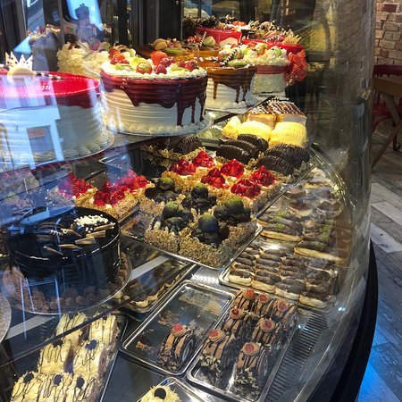
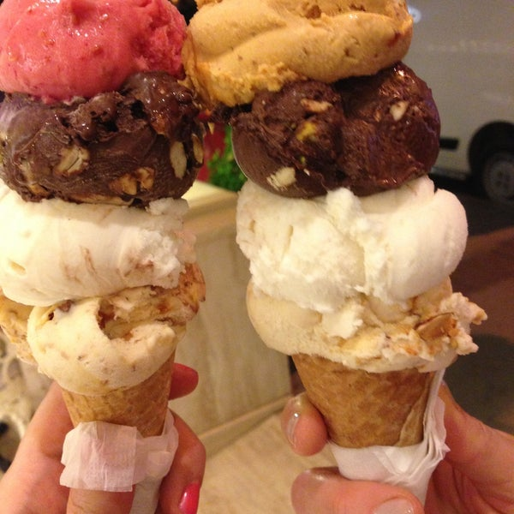
CRAVING FOR ICE-CREAM?
Not only the best ice cream, but also the best cakes and cookies are found at Bravo Patisserie. It’s too hard to choose what to eat!

Slide 16
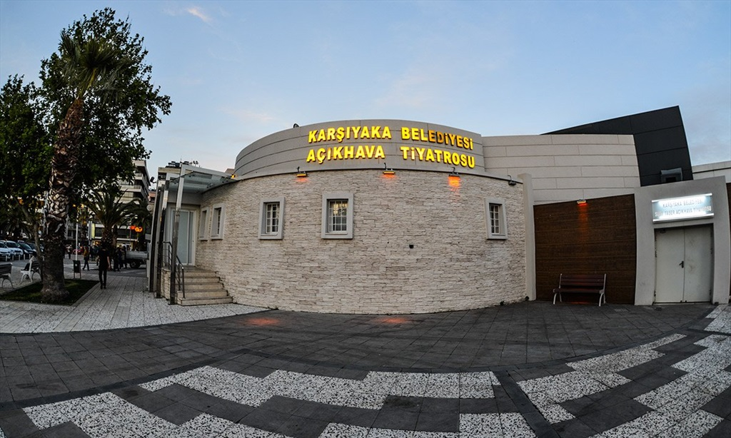
SUAT TAŞER OPEN AIR THEATRE
This open air theatre hosts many people all over İzmir every weekend. Famous musicians give concerts here and many famous plays are staged.

Slide 17
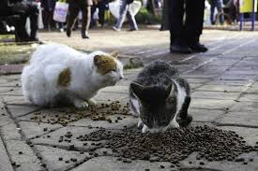
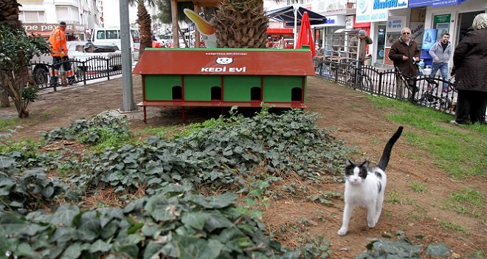
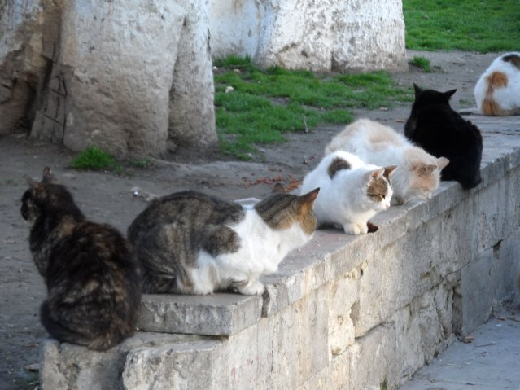
And the cats of Bostanlı streets…
People who live in Bostanlı take good care of them. Animal lovers and the municipality build cat houses in order to protect them from cold weather and possible dangers.

Slide 18
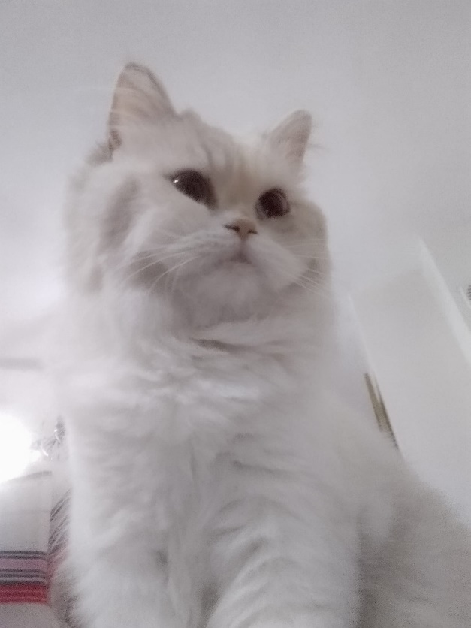
This is my cat ÇİLEK…
thank you for listening ☺

