Slide 1
Our school
Lope de Vega´s School

Slide 2
installations

Slide 3
PRE-SCHOOL CLASS

Slide 4
PLAYROOM

Slide 5
LIBRARY
Kaveh

Slide 6
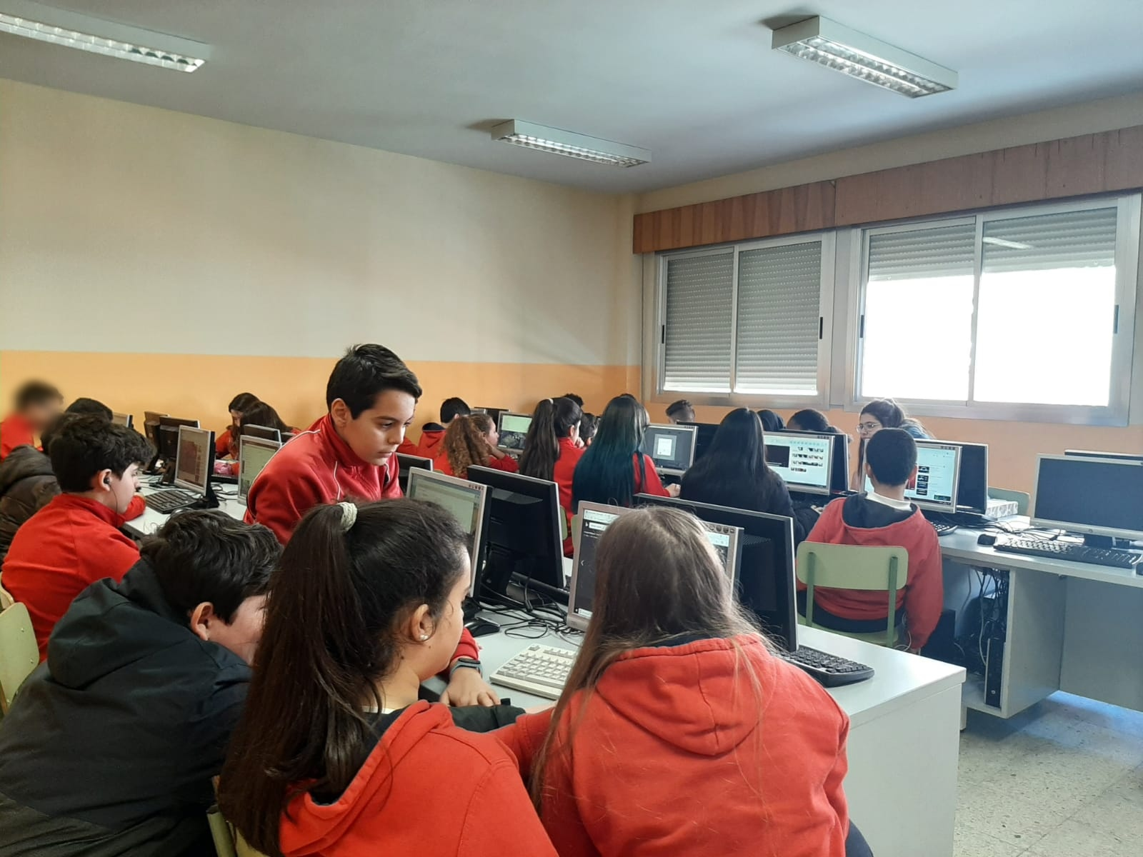
COMPUTER LABS

Slide 7
ART ROOM

Slide 8
SCIENCE LAB
JOSEMA

Slide 9
GYM
JOSE ANTONIO

Slide 10
SCHOOL CANTEEN

Slide 11
Staffroom

Slide 12
HALL OF FAME

Slide 13
Concierge´s office
ILDE

Slide 14
COFFEE MACHINE

Slide 15
Psychologist´s office
MR. MANUEL

Slide 16
Headmistress´ office
SARA

Slide 17
SECRETARY’S OFFICE

Slide 18
AMPA PARENT´S aSSOCIATION

Slide 19
www.colegio-lopedevega.com

Slide 20
THANKS
Colegio Lope de Vega
www.colegio-lopedevega.com

