Slide 1
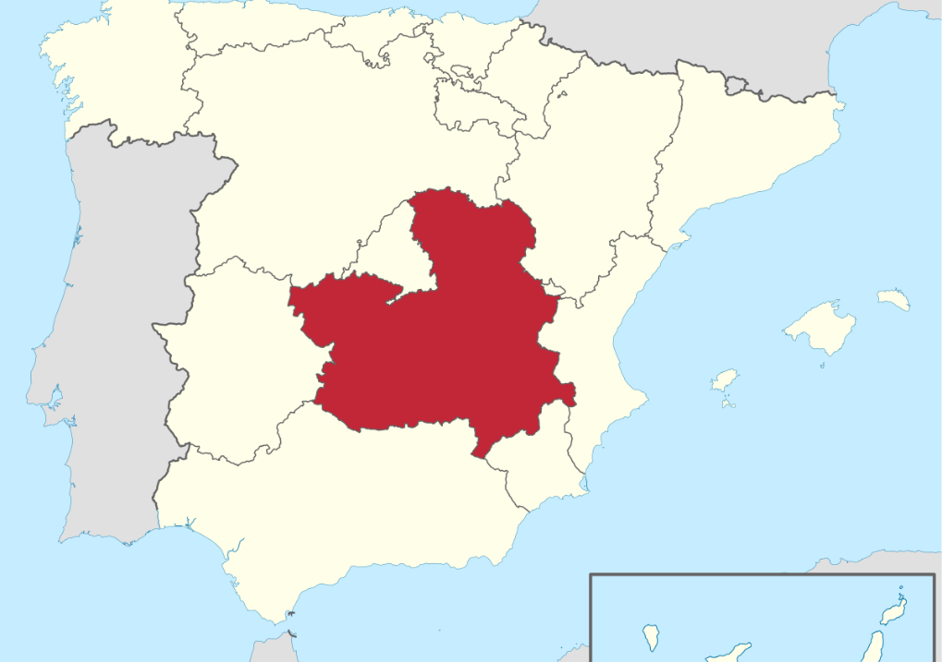
Castilla-La Mancha
My Area

Slide 2
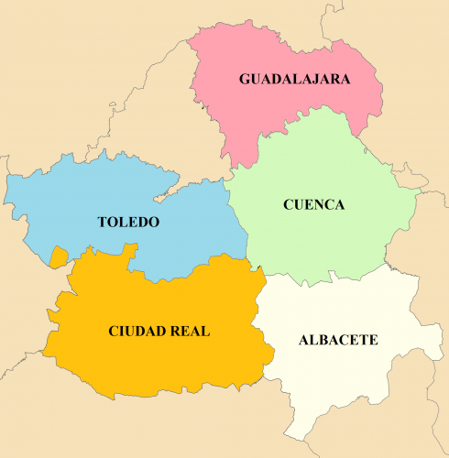
Provinces

Slide 3
The flag of Castilla La Mancha

Slide 4
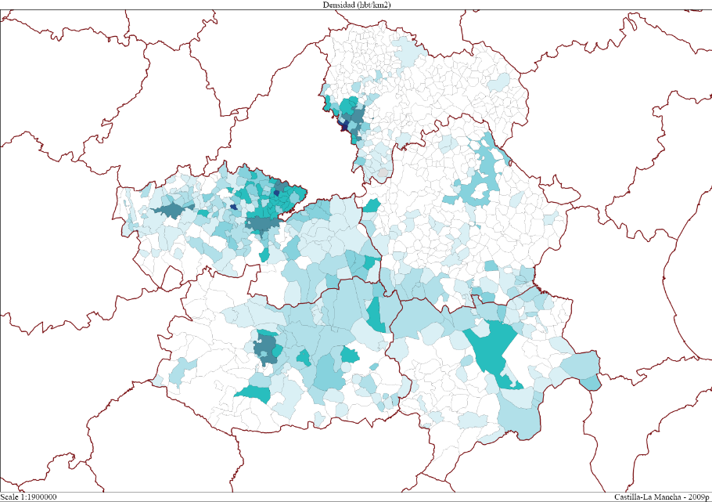
Population 2.047.722 inhabitants

Slide 5
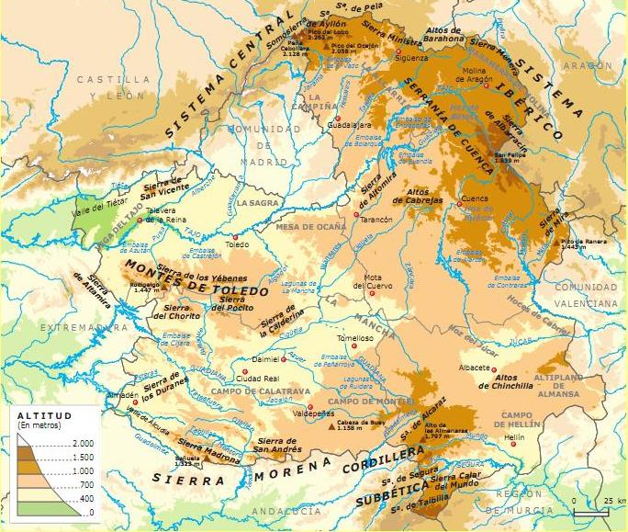
Relief

Slide 6
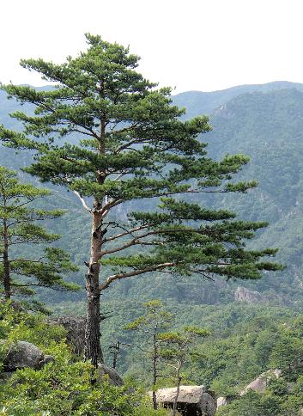
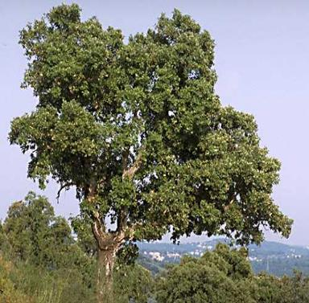
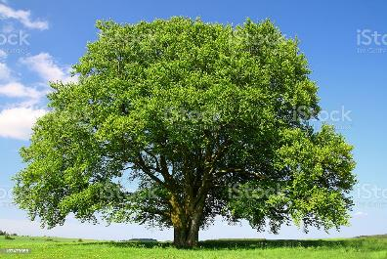
Vegetation

Slide 7
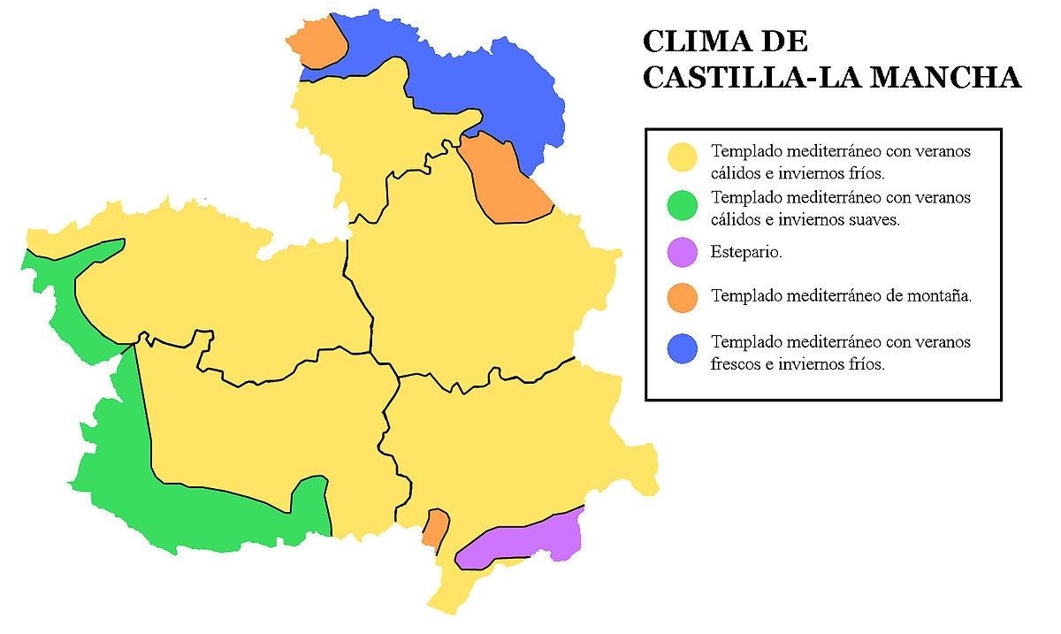
WEATHER OF
Mediterranean temperate with hot summers and cold winters.
Mediterranean temperate with hot summers and mild cold.
Steppe.
Temperate Mediterranean mountain.
Mediterranean temperate with cool summers and cold winters.

Slide 8
Cortes of Castilla La-Mancha

Slide 9
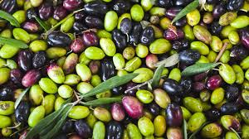
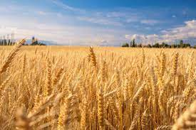
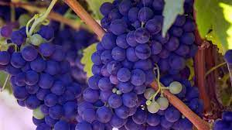
Economy

Slide 10
Talavera de la Reina
Industry

Slide 11
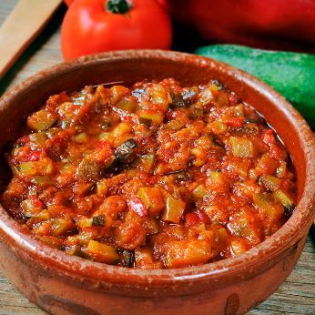
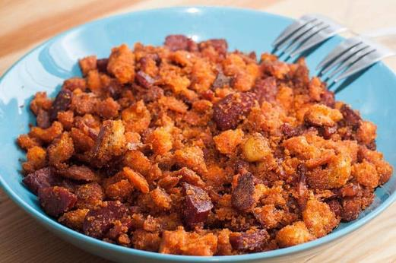
Gastronomy
Pisto
Migas

Slide 12
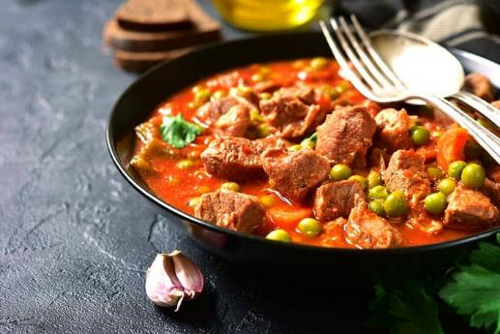
Gastronomy
Gazpacho
Caldereta

Slide 13
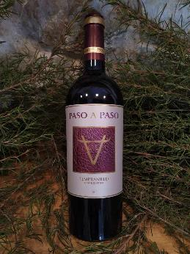
Gastronomy
Red Wine
Cheese Manchego

Slide 14
Toledo

Slide 15
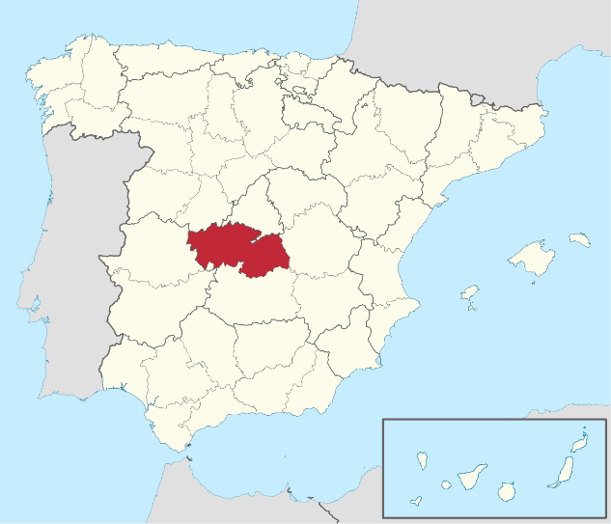
Population 700.000
inhabitants

Slide 17
Flag of Toledo

Slide 18
Relief

Slide 19
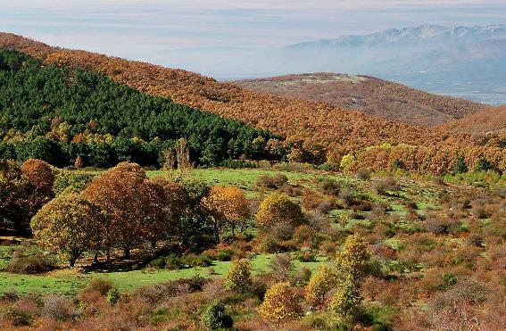
Sierra de San Vicente

Slide 20
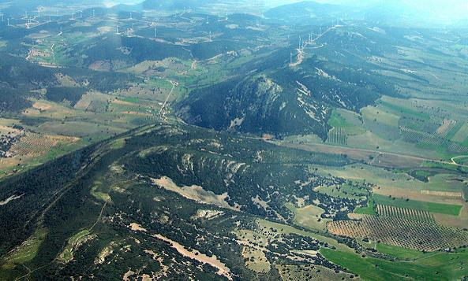
Montes de Toledo

Slide 21
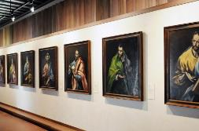
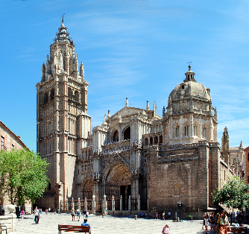
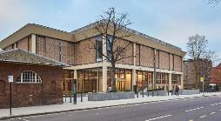
Monuments

Slide 22
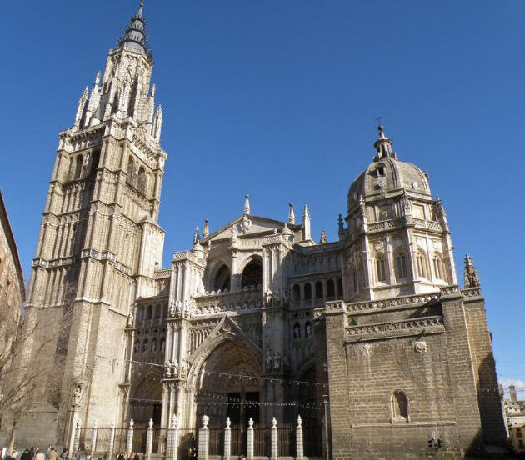
Cathedral

Slide 23
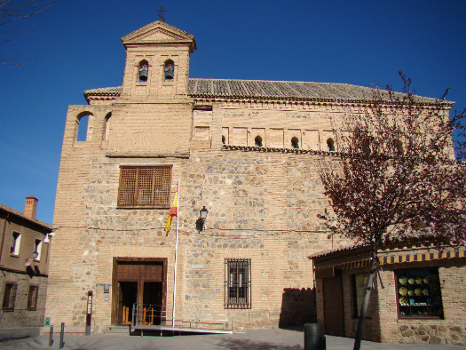
Cristo de la Luz Mosque
Tránsito Synagogue

Slide 24
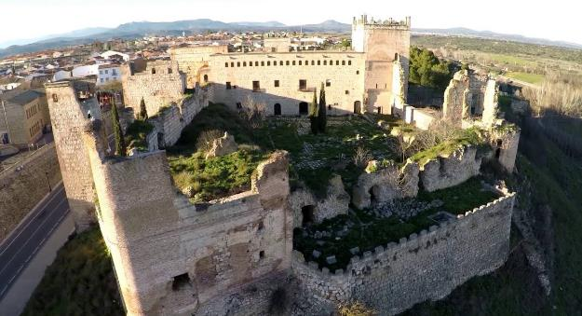
Alcazar
Escalona Castle

Slide 25
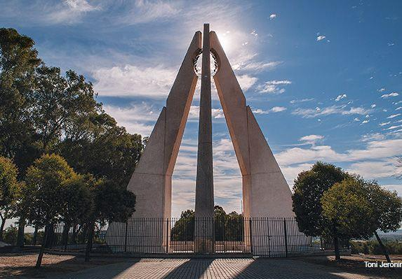
Consuegra Windmills
The Monolith

Slide 26
Gastronomy
Carcamusas

Slide 27
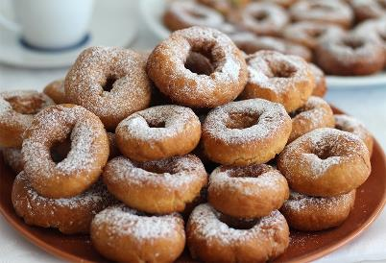
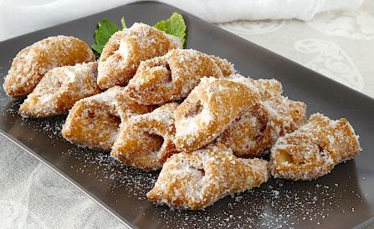
Marzipan
Rosquillas
Pestiños

Slide 28
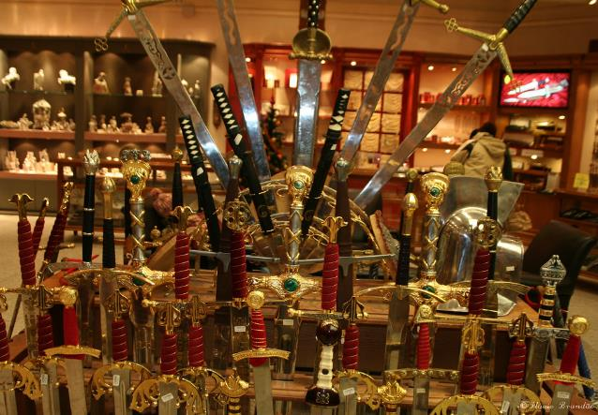
Culture

Slide 29
Festivities
Corpus Christi

Slide 30
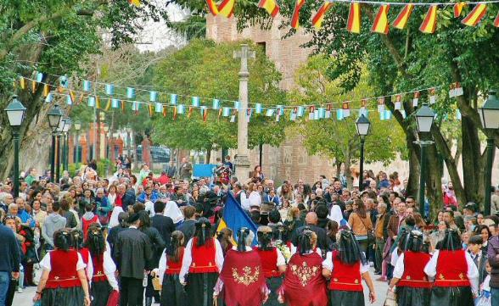
Mondas

Slide 31
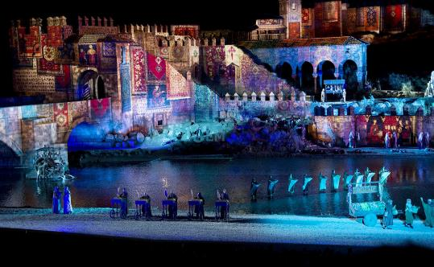
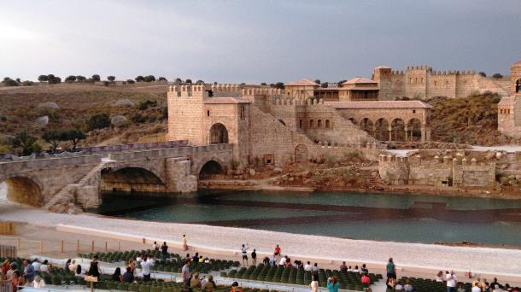
Puy du Fou

Slide 32
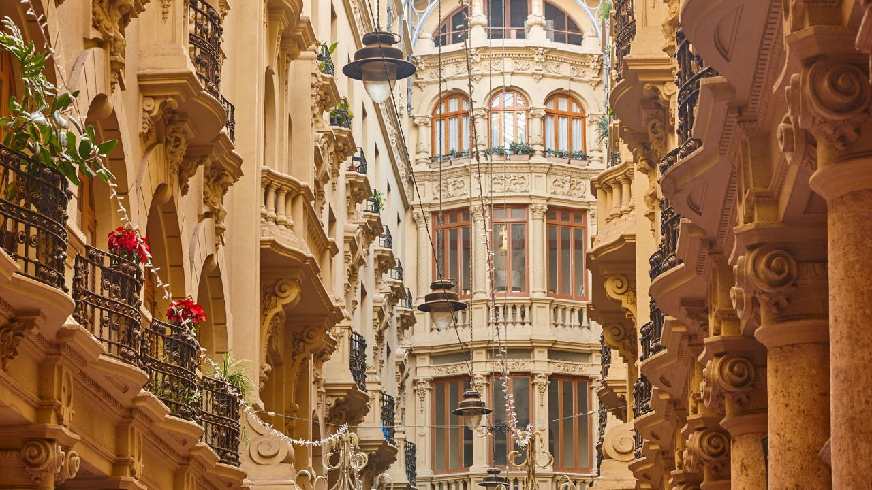
Albacete
Albacete

Slide 33
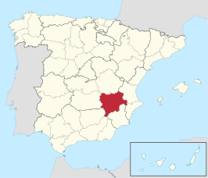
Population
174.000
inhabitants

Slide 34
Flag of the City of Albacete

Slide 35
Relief

Slide 36
Monuments
La Posada Del Rosario

Slide 37
La Cruz de Término

Slide 38
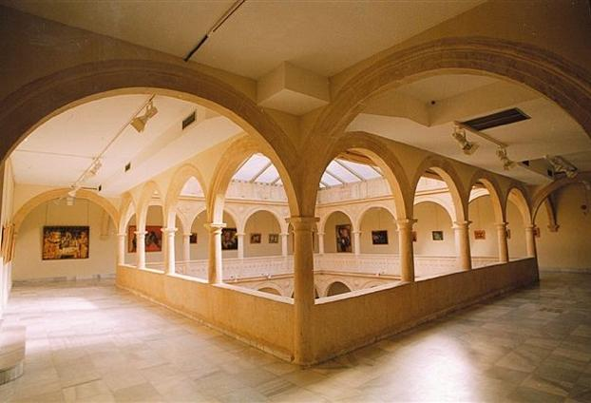
Churches
Monastery of the Incarnation

Slide 39
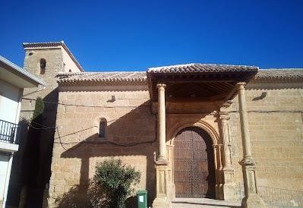
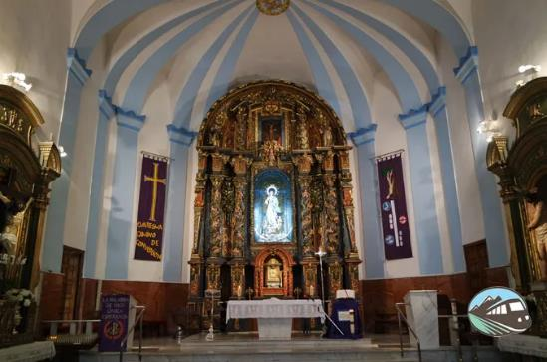
Churches
The Purísima Concepción church
The church of our Lady of the Assumption

Slide 40
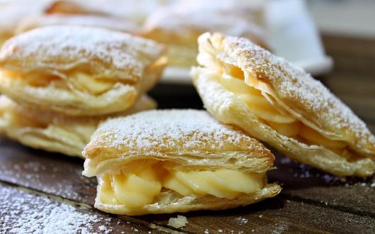
Atascaburras
Gastronomy
Miguelitos de la Roda

Slide 41
The Albacete Provincial Museum

Slide 42
Albacete Circus Theater

Slide 43
Festivities
Albacete Fair

Slide 44
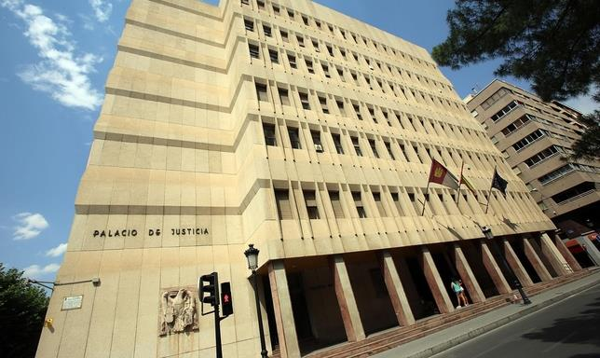
Politics
Vicente Manuel Rouco Rodríguez
High Court of Justice of Castile-La Mancha (TSJCLM)

Slide 45
Campollano (Industry area)

Slide 46
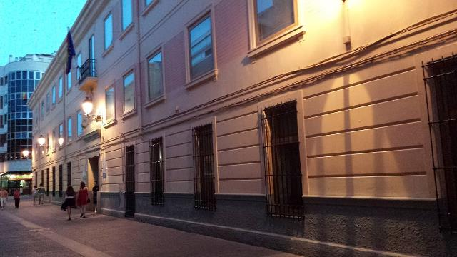
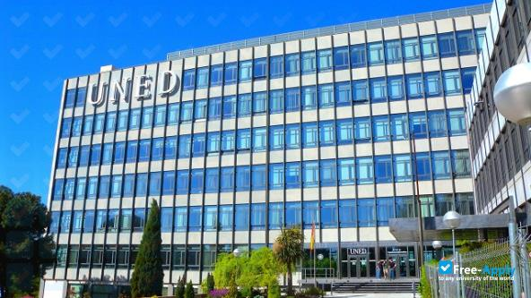
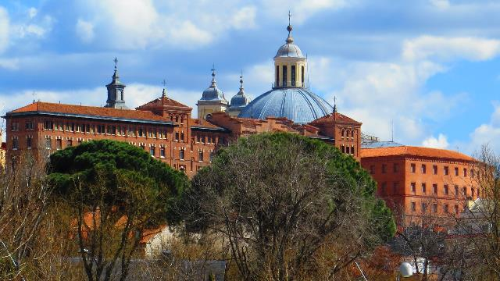
Education
Superior Conservatory of Music of Castilla–La Mancha
National University of Distance Education
Ecclesiastical San Damaso University
University of Castilla–La Mancha

Slide 47
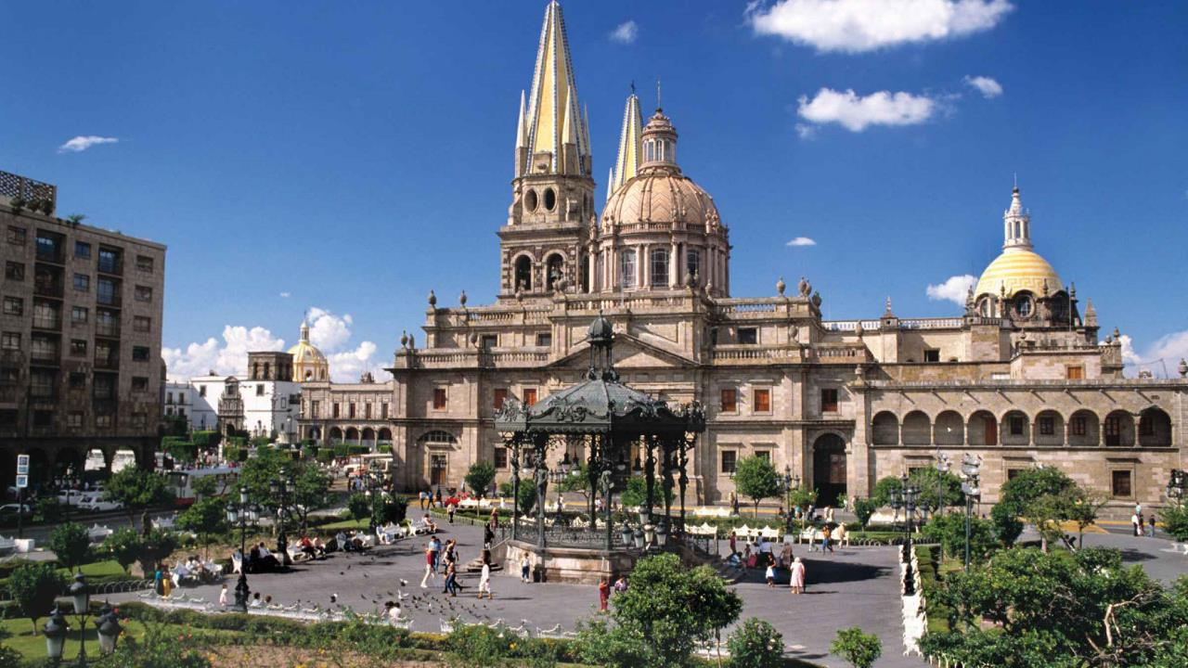
Guadalajara

Slide 48
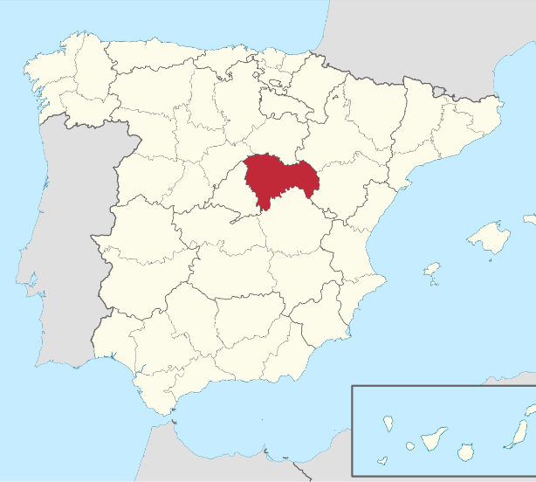
Population
260.000 inhabitants

Slide 49
Flag of Guadalajara

Slide 50
Relief

Slide 51
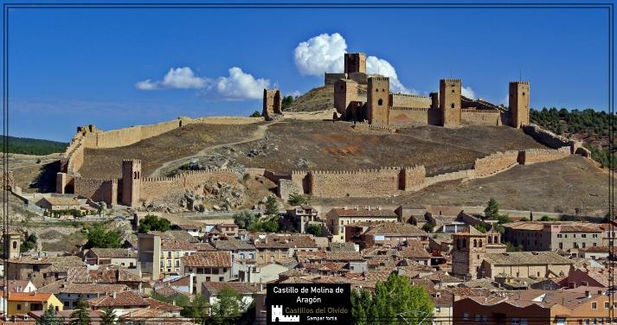
Monuments
Atienza Castle
Castle of Molina de Aragón

Slide 52
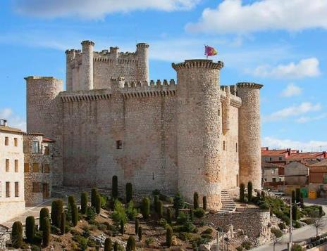
Castle of Sigüenza
Castle of Torrija

Slide 53
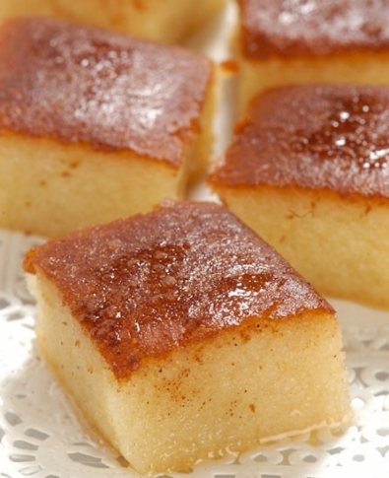
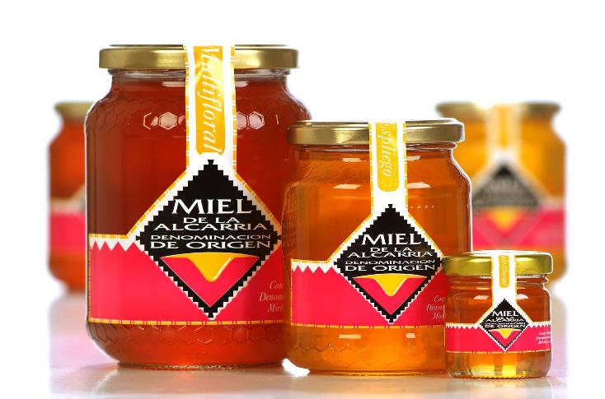
Gastronomy
Bizcochos borrachos
Honey from la Alcarria

Slide 54
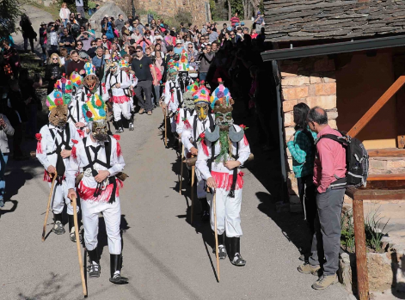
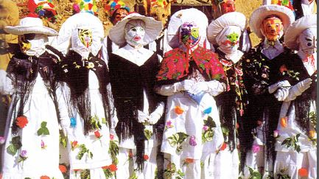
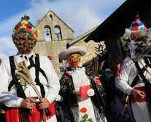
Festivities

Slide 55
Leisure
Alto Tajo Natural Park
Bolarque reservoir

Slide 56
Arab caves
Parish museum

Slide 57
Cifuentes river waterfall

Slide 59
Population
75600 inhabitants

Slide 60
Flag of Ciudad Real

Slide 61
Relief

Slide 62
Monuments
Puerta de Santa María
Puerta de Toledo
Castillo de Alarcos
Torreón de Alcázar

Slide 63
Gastronomy

Slide 64
Festivities

Slide 66
Leisure

Slide 67
CUENCA

Slide 68
Population
200.000 inhabitants

Slide 69
Flag of Cuenca

Slide 70
Relief

Slide 71
Monuments
Hanging houses
Cuenca Cathedral

Slide 72
Bridge of St Paul

Slide 73
Gatronomy
Morteruelo
Alajú

Slide 74
Festivities San Mateo Fair

Slide 75
Leisure
The Enchanted City

Slide 76
Thank you!!
¡¡¡Gracias!!!

