Slide 1
«LET’S SHARE OUR GAMES!»
2019-1-BG01-KA201-062605
Educational Institution of Preschool «Saulīte», Latvia
25.02.2020.-27.02.2020., Constanta, Rumania

Slide 2
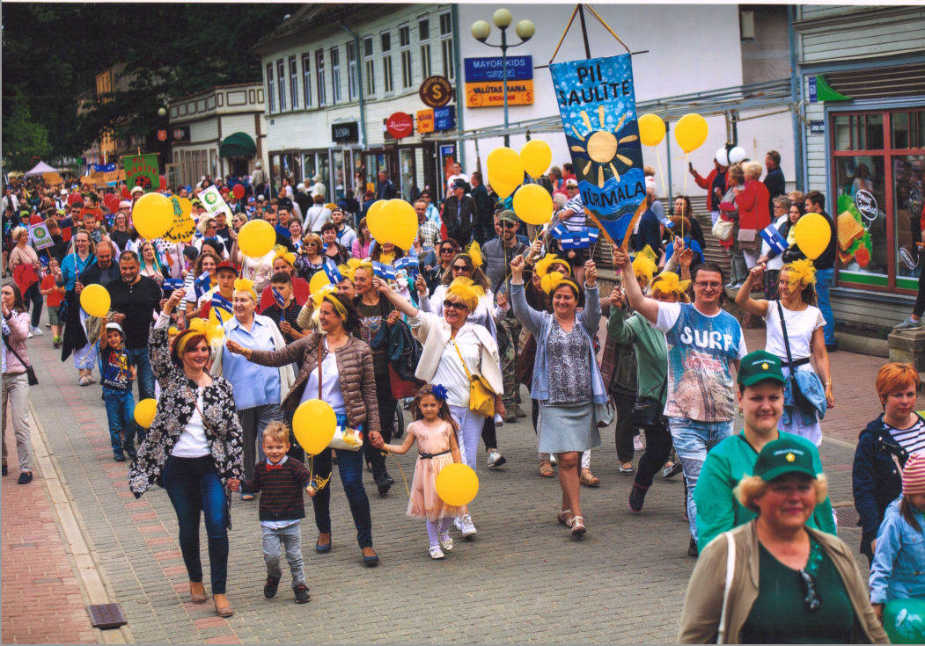
OUR VALUES

Slide 3
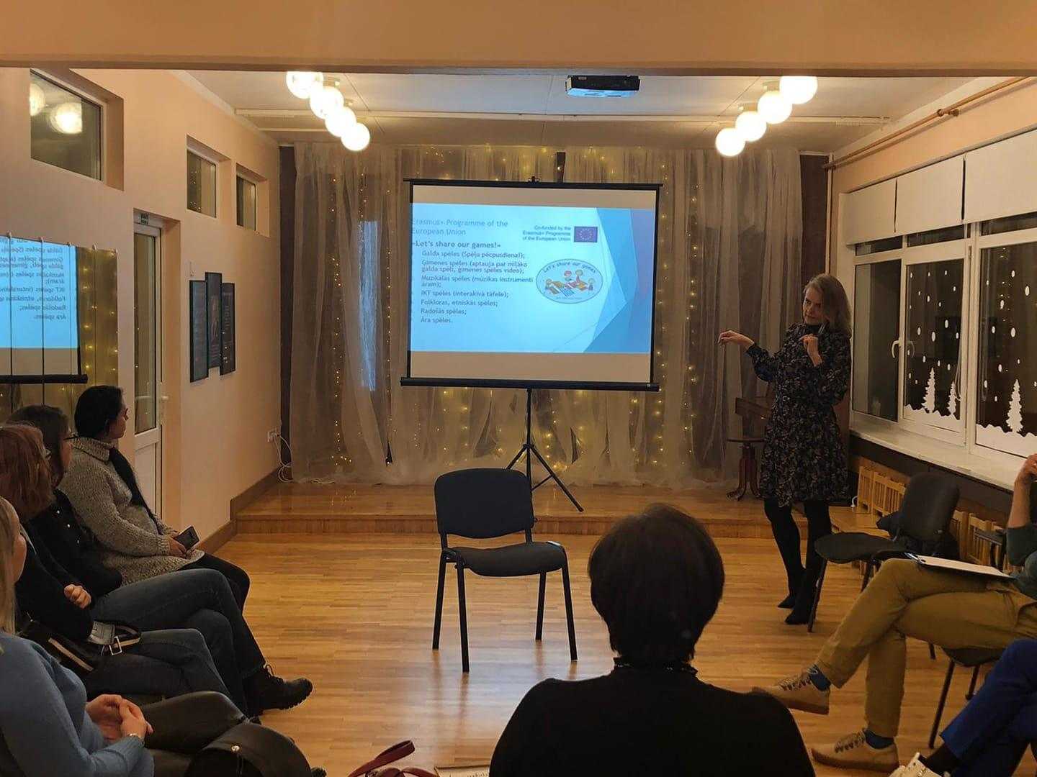
EFFECTIVE METHODS OF COLLABORATION WITH PARENTS
We involve parents in decision-making
Parents council (plans, what have done)
The Supporting Fund
Parent meetings
Pools
Individual consultations
Individual attitude (Let’s talk what is impoirtant for you)
Gratfulnes = Motivation (special celebration cards)
Open door principle

Slide 4
2. Parental responsibility in educational process
Child’s development areas
Parents Teachers
Social development 1.
Cognitive development 2.
Physical development 3.
Emotional development 4.
Talents/ hobbies 5.

Slide 5
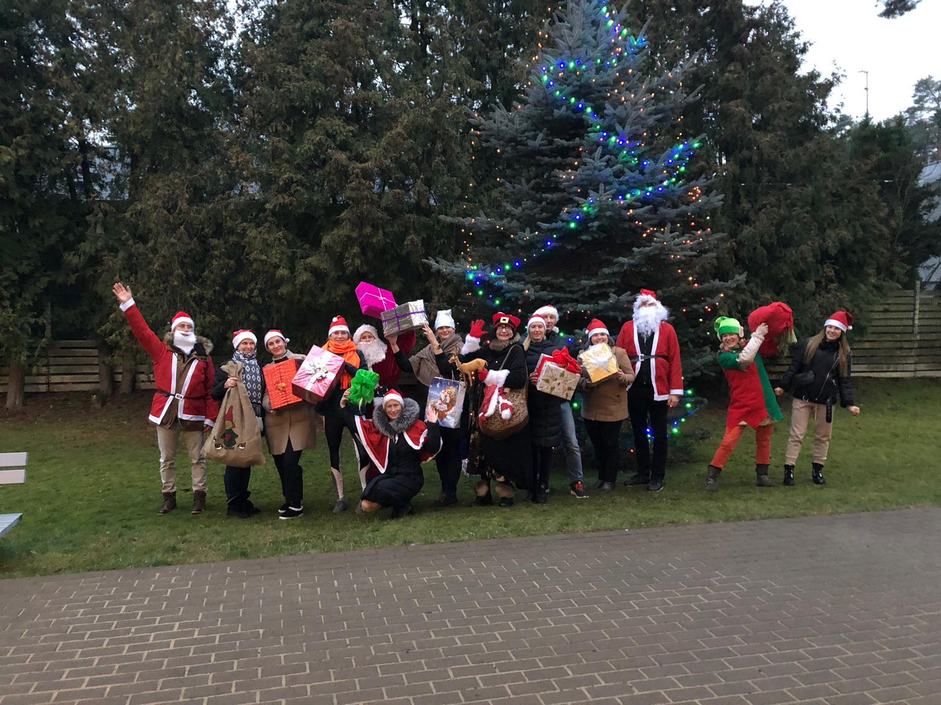
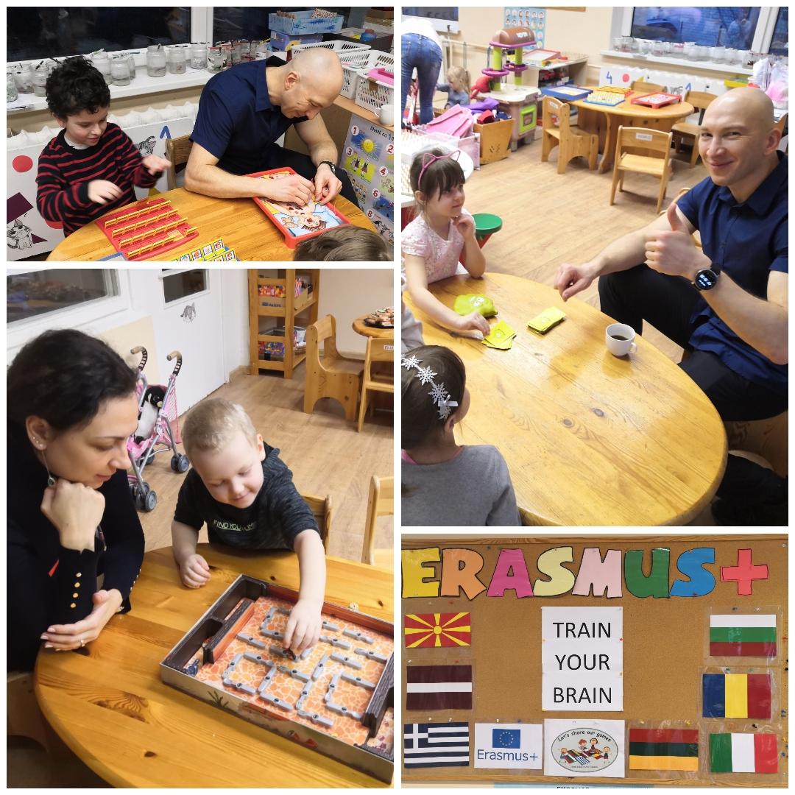
3. Celebrations and events with parents
Notes:
Father’s day
Dwarf Race
Presents for Employees

Slide 6
4. Educate parents
Individual counsultings
How to see/notice
Ideas
Recommendations
Encourage

Slide 7
5.How we make parents want to get involved?
«Transparent» and understandable educational process
-Facebook, whatsapp groups, publications in press
We say thank you to parens
We inform parents about activties
We talk with parents….a lot!
We inform parents about the ways they can be a part of our team!

Slide 8
Thank you for your attention!

Slide 9
BOARDGAMES FOR KIDS
Galery of boardgames - the place where curiosity arises
Afternoon of boardgames with parents

Slide 10
BOARDGAMES ALSO FOR ADULTS
Preparing games
for you
Boardgames for asistents of teachers
Boardgames for teachers

