Slide 1
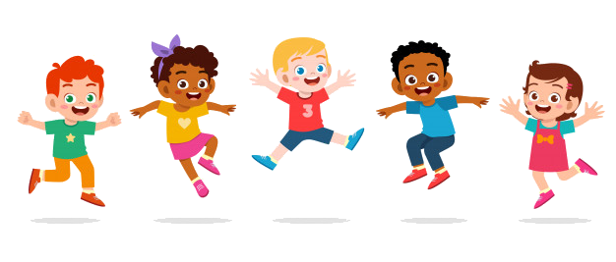
Sport Games Notebook Project: ,,Let’s share our games!’’
Prescschool ,,Saulīte’’, Jūrmala, Latvia

Slide 2
We want to share with you three sport games!
Those are traditional sport games that have been
loved and played from generation to generation.
They are easy to play anytime, anywhere!
Each game makes a lot of fun!
Read the description of the game and check
video to find out the way how the game has to
be played!
Are you ready!? Go!!!

Slide 3
Speedy legs
To play the game you need a rope. Players gather in a circle, and teacher stays in the centre of the circle and start spin the rope around the circle.
Players have to jump over the rope. The player who touches the rope has to come out of the circle and do four squats (or other activity task),
afterwards he comes back to the circle and continue the game.
https://www.youtube.com/watch?v=nkKy_j0r3oE

Slide 4
Ducks and Hunters
Light bell is required for this game. Game space is limited. Game players divide: 2 of them become Hunters and others are Ducks. Ducks stay in the game space, Hunters stay on their game space edges. Hunters have to hit the Ducks with the light ball, whereas Ducks can move around the game space to avoid the ball. In case Duck is touched with the ball, it has to leave the game space. The Duck, who stays in the game space the longest, wins!!!
https://www.youtube.com/watch?v=9fZHIEfSIjE

Slide 5
Day and Night
When the teacher turns on the music, the day starts and all players start randomly moving. When music is turned off, the night starts and everyone freezes. Teacher goes around and check whether anyone is moving. In case a player moves, then he is out of the game. Then again music starts playing, and day begins again. The winner is the one who stays longer in the game!
https://www.youtube.com/watch?v=EmpQigJeDEk

Slide 6
Do sport!
Play games!
Do sport games!
Repeat!
,,Let’s share our games!’’

