Slide 1
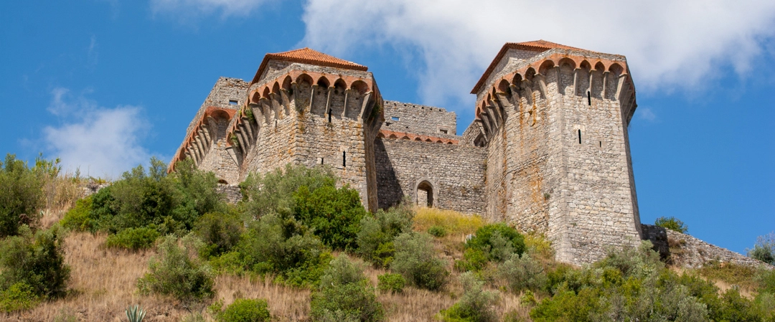

Slide 2
Subject interaction Physics, Mathematics, Geography
Activity: Construction of a model with the Sun, Earth and Moon
Resources/Materials:
Computers, Internet, mobile phones, projector, library, schoolbooks, calculators, google earth, google maps, recycled materials, styrofoam, cardboards, newspapers, modeling paste, glue, scissors, wire, brushes, sponges, glitter ...

Slide 3
Physics
Organizing Topics/Contents:
Planets of the Solar system.
Knowledge, skills and attitudes:
Building a system model using appropriate scales.
Strategic educational actions:
Building a model with the Sun, the Earth and the Moon.

Slide 4
Mathematics:
Organizing Theme/Contents:
Rational numbers
Sorting and Comparing Rational Numbers
Scientific notation with natural exponent
Direct Proportionality / Scales
Knowledge, skills and attitudes:
Solving problems with rational numbers in mathematical and non-mathematical contexts, using the calculator and knowing how to use a scale.
Strategic educational actions:
Choosing a scale for the construction of the Solar System model.

Slide 5
Geography:
Organizing Theme/Contents:
The Earth: studies and representations
Recognizing and selecting different forms of representation of the world according to the geographical position of continents and oceans.
Calculating scales.
Knowledge, skills and attitudes:

Slide 6
BUILDING THE MODEL: Sun, Earth and Moon
TASK:
-Group task definition meeting;
-Calculation of diameters; scales and distances
(to prepare the model)
- Information search;
- Project planning work (final product, sketch, material required,…);
- Distribution of the tasks and materials needed to bring it to completion.
Building the models and final assembly.
Self-evaluation.

Slide 7
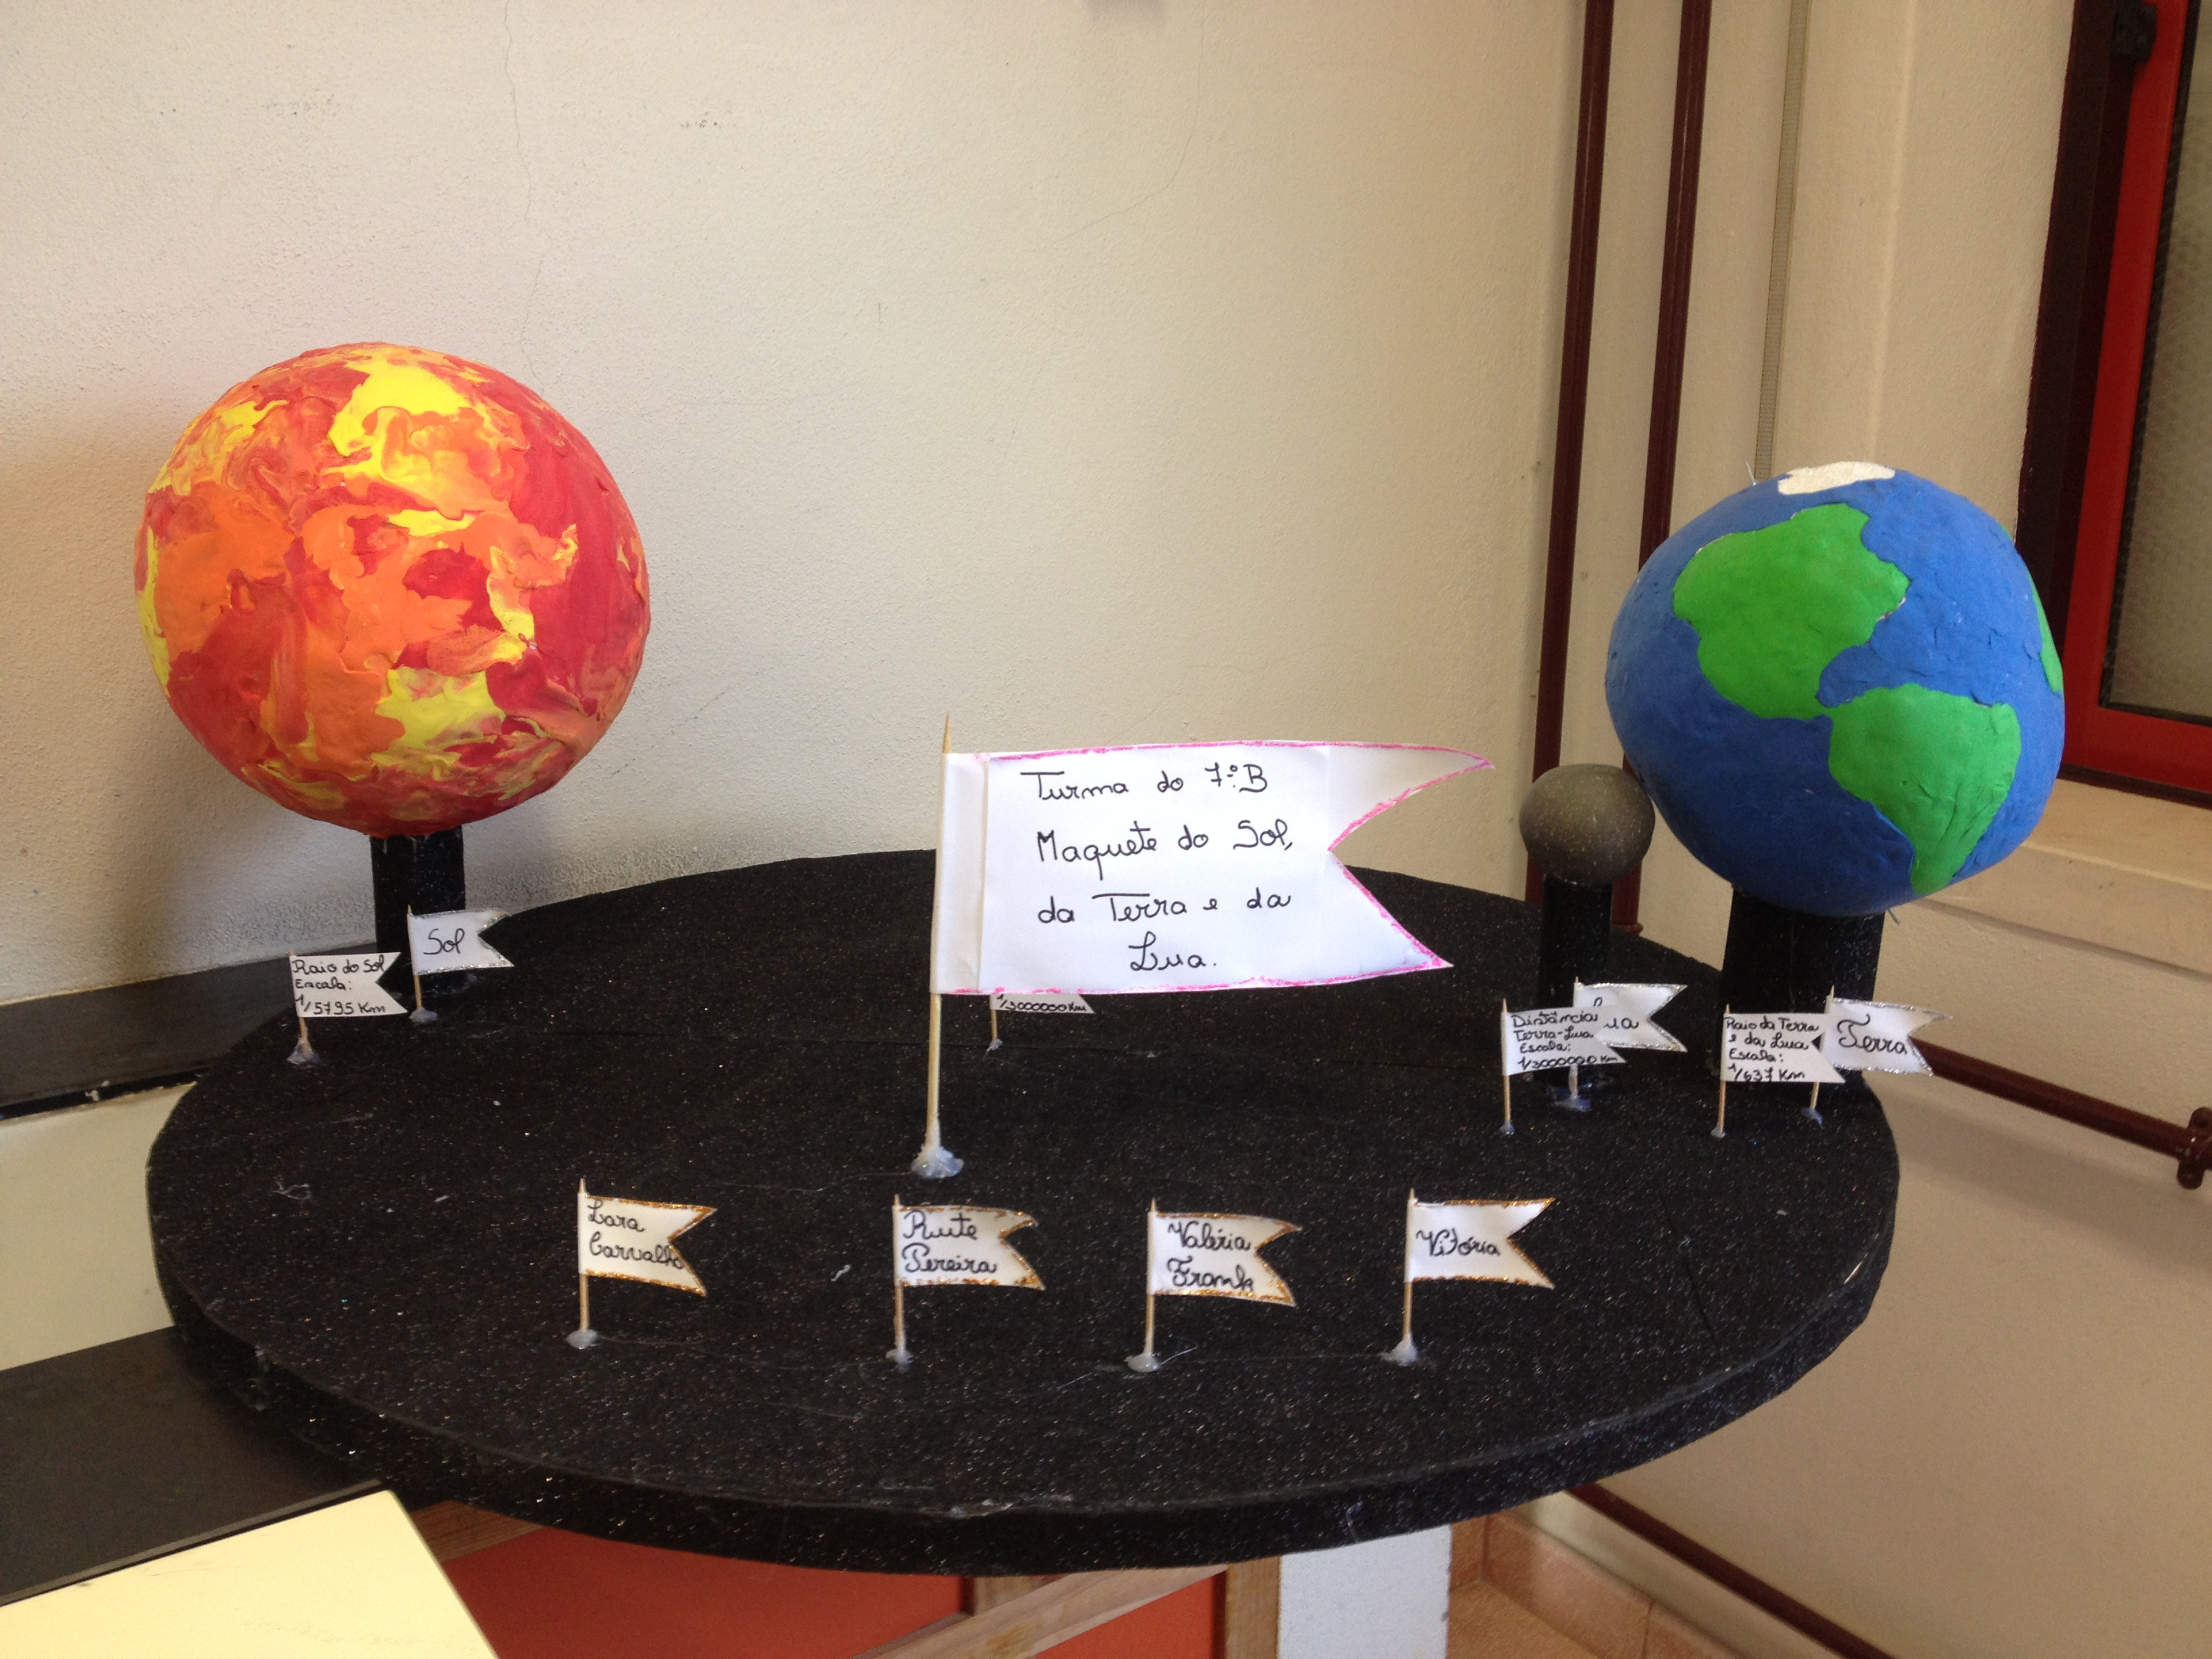
FINAL PRODUCT:

