Slide 1
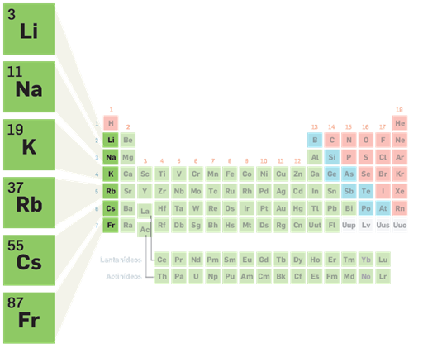
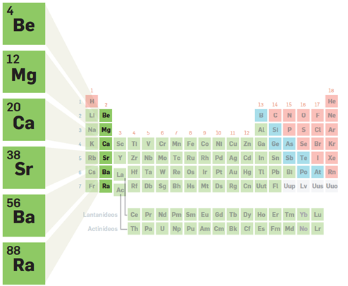
Reactivity of alkali and alkaline Earth metals
1st Group - Alkali Metals
2nd Group - Alkaline Earth Metals

Slide 2
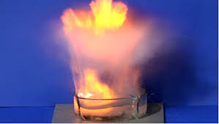
Reactivity of Alkali and Alkaline Earth Metal
Chemical behavior of the Alkali and Alkaline Earth Metals:
Do Alkaline Metals have all the same chemical behavior?
And will Alkaline Earth Metals have the same chemical behavior as Alkali Metals?
We went to our school Lab to test them all….

Slide 3
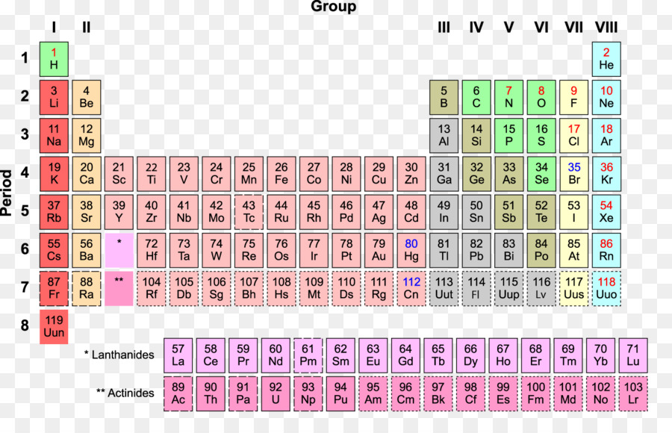
The Periodic Table is organized in 7 horizontal lines (Period) and divided into columns - 18 groups.
The first two are of interest to us:
1st Group - Alkali Metals
2nd Group - Alkaline Earth Metals
Chemical elements that have similar properties are placed in the same groups as PT.
This is what we wanted to prove in our school Lab.

Slide 4
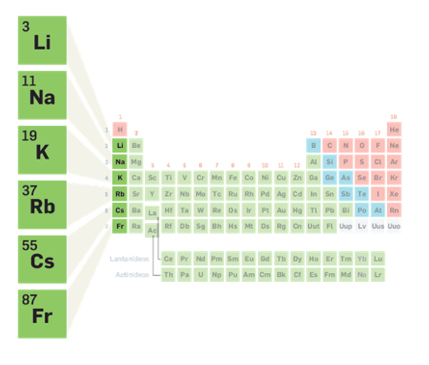
1st Group - Alkali Metals
They are soft: we can cut them easily with a knife.
They are very reactive: they oxidize easily in contact with air (they are kept immersed in oil or liquid paraffin for preservation).
They are very reactive with water: they originate basic solutions.
Lithium hydroxide
Sodium hydroxide

Slide 5
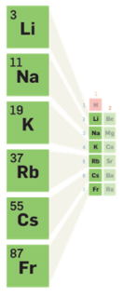
The similar chemical properties in a PT group are due to the similarity in the structure of the atoms of its elements.
atoms of alkaline
metals
ions of alkaline
metals
₃Li : 2-1
₁₁Na : 2-8-1
₃ Li⁺ : 2
₁₁Na⁺ : 2-8
They have 1 valence electron
The last level is complete

Slide 6
2nd Group - Alkaline Earth Metals
Chemical similarities of the elements of this group:
They react easily with oxygen, oxidizing.
They react with water, although much more slowly than alkali metals.
They originate basic solutions.
Magnesium hydroxide
Calcium hydroxide

Slide 7
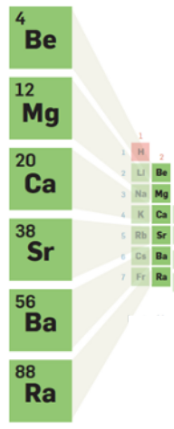
The similarity of the properties between the Alkaline Earth Metals comes from the similarity in the structure of these particular atoms.
atoms of alkaline
earth metals
ions of alkaline
earth metals
₁₂Mg : 2-8-2
₂₀Ca : 2-8-8-2
₁₂Mg²⁺ : 2-8
₂₀Ca²⁺ : 2-8-8
They have 2 valence electrons
The last level is complete

Slide 8
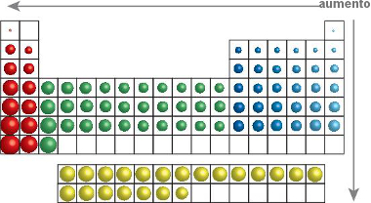
Reactivity is related to how easily atoms lose electrons to become ions.
We can also say that the reactivity of the elements is directly linked to the atomic ray.
The larger the atomic radius, the greater the distance these valence electrons are from the nucleus. The force that the nucleus exerts on valence electrons is becoming weaker and weaker, thus making it easier to lose valence electrons.
Increase
As we can see in the table, the atomic radius increases from top to bottom and from right to left
Of the elements we studied (Li, Na, Mg and Ca). Sodium is the most reactive.

Slide 9
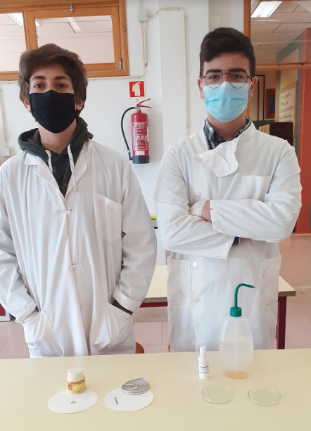
Materials
Lab material:
- spatula;
- tub;
- petri dish;
- phenolphthalein;
- water;
Reagents:
- lithium;
- sodium;
- magnesium;
- calcium;

Slide 10
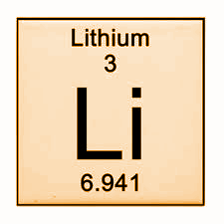
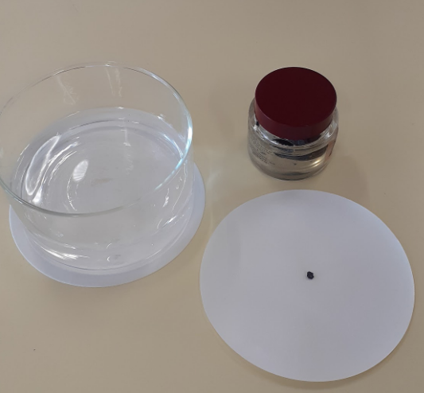
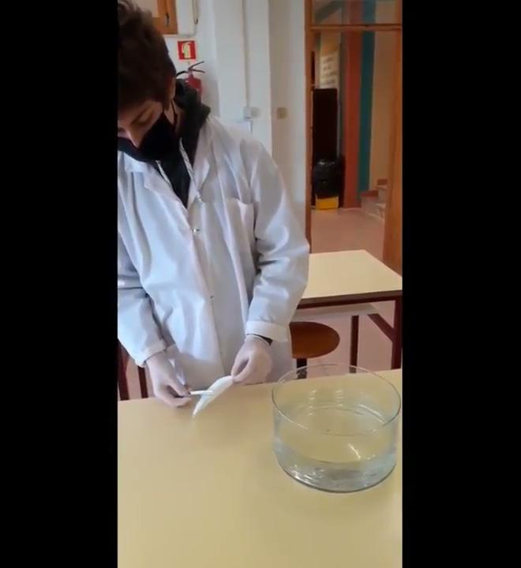
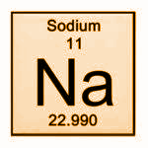
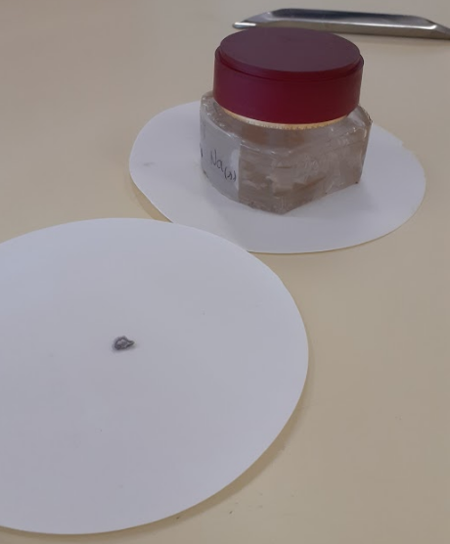

Slide 11
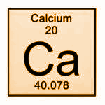
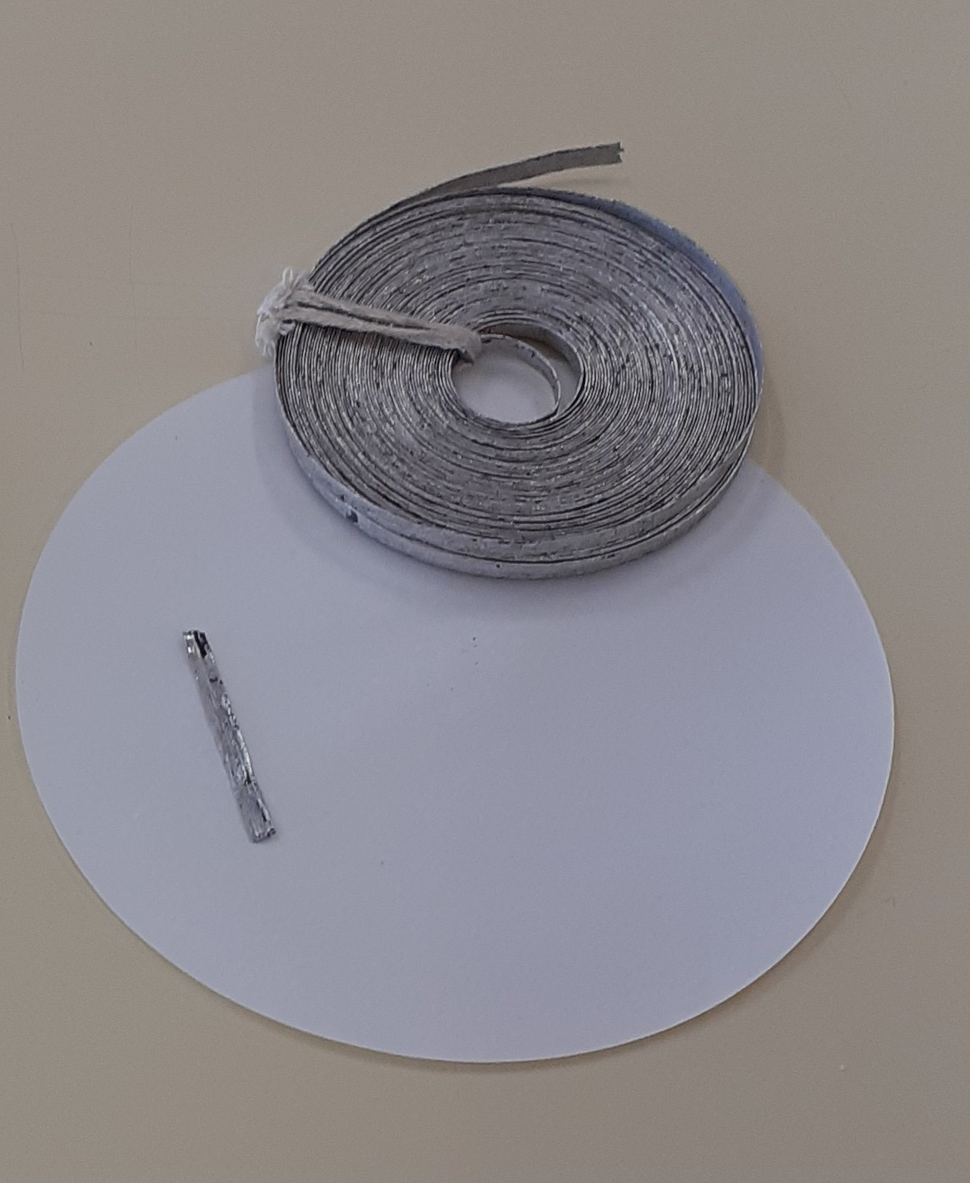
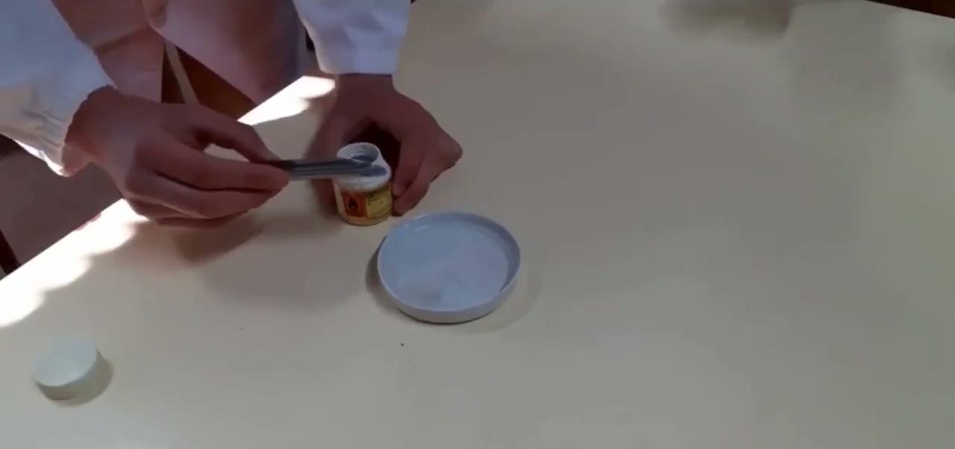
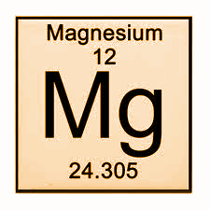
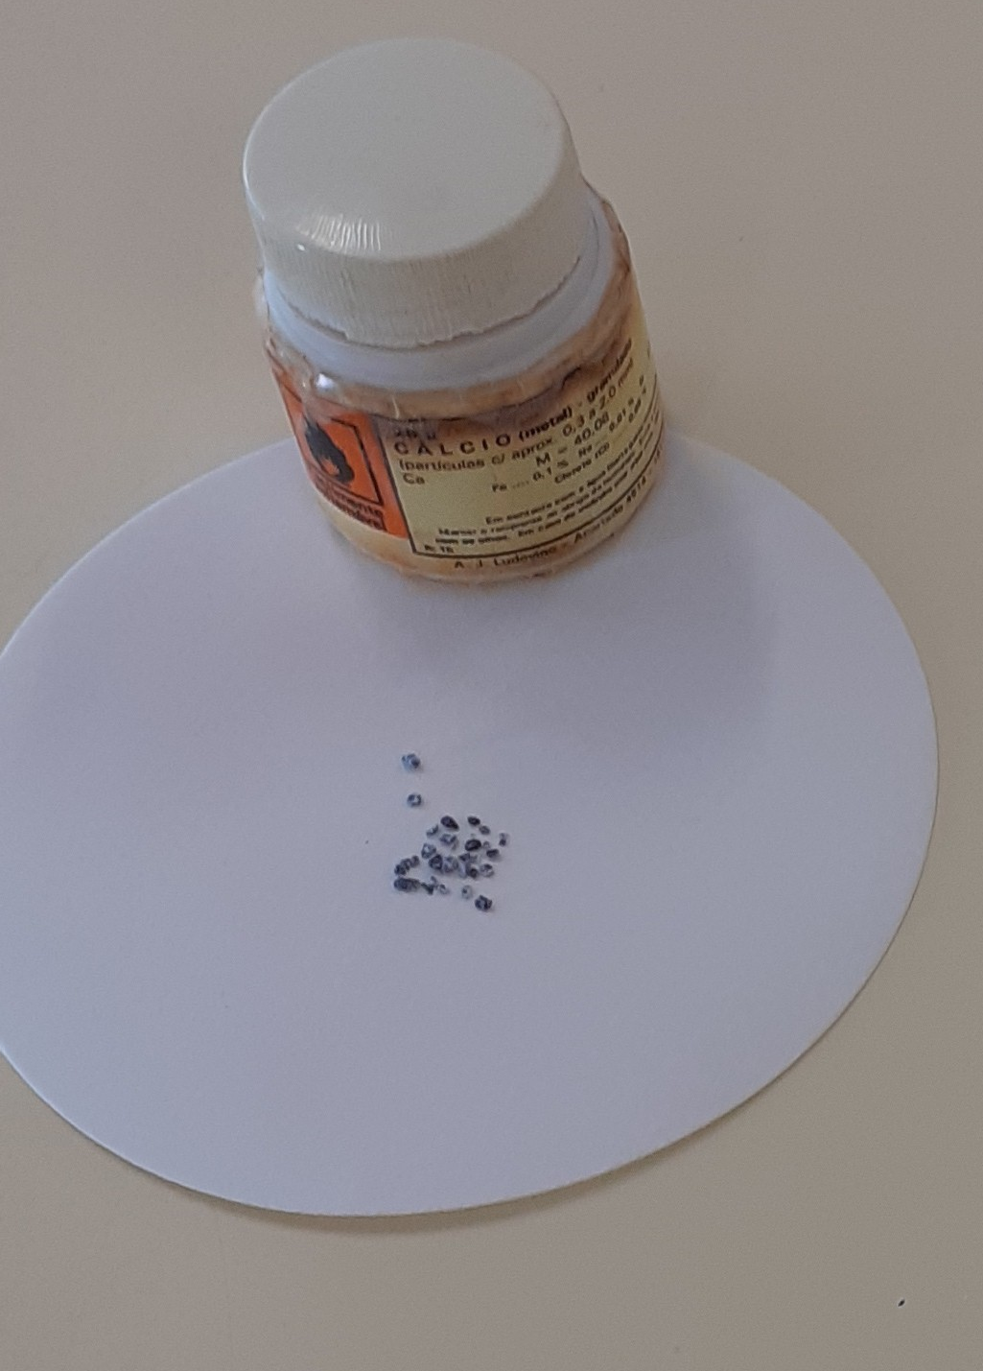

Slide 12
Procedure
- We filled the petri box with water,
- With the help of a spatula we put a little lithium in the water;
- We added a few drops of phenolphthalein at the end of the reaction.
- We recorded the observations.
- We carried out this procedure with the other substances (sodium, magnesium, and calcium)
- During the reaction of calcium with water, we placed a funnel facing downwards over the reaction;
- We approached a lit match at the exit of the funnel.
- We observed what happened.

Slide 13
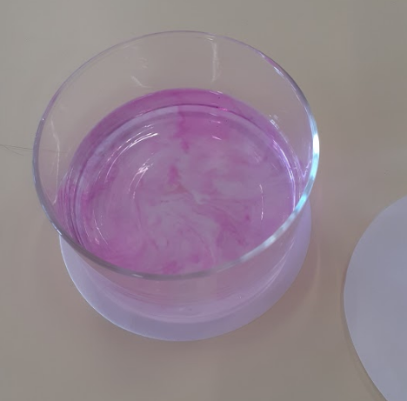
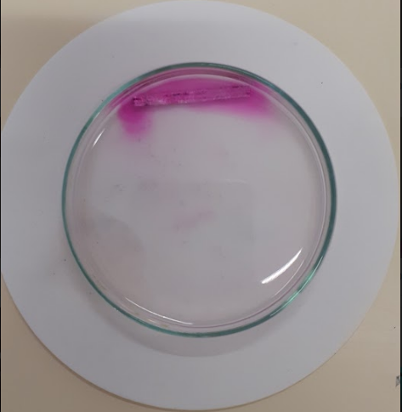
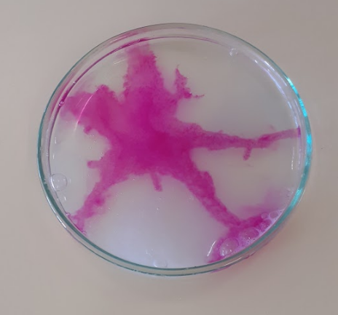
Observations
When lithium and sodium were placed in the water, they became a sphere that swirled on the surface of the water.
During the reaction, we observed the release of a gas.
The gas ignited when we approached a flame.
When phenolphthalein was added to each of the solutions, they acquired a pink color.
The reaction of magnesium with water took the longest.
The reaction of sodium with water was faster than the reaction of lithium.

Slide 14
Conclusions
We can conclude that during the reaction of these metals with water a hydroxide was formed, Because when we added phenolphthalein Its color changed from colorless to pink, which indicates the presence of a basic solution.
We also concluded that if the gas released was hydrogen, because when we approached the flame with the gas, it reacted violently by igniting itself. The flame test - proved the release of hydrogen.
The reaction of sodium with water was more violent than that of lithium with water. Therefore, we can conclude that the reactivity increases through the group since it is easier to yield 1 electron that is farther from the nucleus.
As the reaction of magnesium with water was slower than that of calcium, once again we can conclude that the reactivity increases throughout the group.
The reactions of the elements of the first group were more violent than those of the elements of the second group, so we conclude that Alkali Metals are more reactive than Alkaline Earth Metals.
Reactivity increases throughout the group and decreases over the period.

