Slide 1
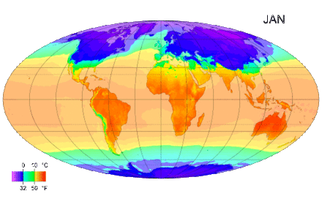
Convection currents

Slide 2
Introduction
Air circulation in the atmosphere
The Earth's atmosphere is a layer of air (a mixture of gases) that surrounds the planet.
The irregular warming of the Earth's surface by the Sun has implications for the climate.
In the intertropical zone, temperatures are high all year round, while in the polar regions the temperature is lower (usually negative).
The thermal equilibrium of planet Earth results from energy transfers in latitude.

Slide 3
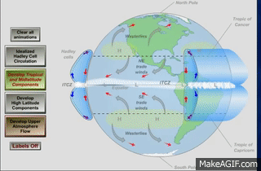
Introduction
The temperature of the atmosphere is higher over the Equator and lower at the Poles, this causes hot air at the equator which will rise.
As the mass of hot air moves to higher altitudes, it cools down and then the air becomes denser/heavier and begins to descend back to Earth, forming circulating cells.
This dynamic, associated with latitude variations, causes the wind.
Winds are a very important element in climate change. For example, in the Northern Hemisphere, the Southern wind brings up warm air from Mexico and the Caribbean to the North, while the Northern wind brings down the icy air of the Arctic region.

Slide 4
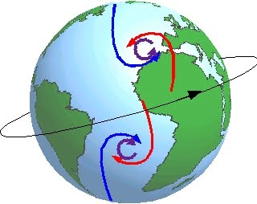
Introduction
Wind patterns between the Equator and the polar regions would show only one direction, North or South, if it wasn't for the Earth's rotational movement.
The Coriolis Effect, a result of the Earth's rotational movement, causes winds to divert.
Surface winds are diverted to the right in the Northern Hemisphere and to the left in the Southern Hemisphere.
The formation of this meteorological phenomena is related to the movement of air masses and differences in atmospheric pressure.
Weather phenomena, such as storms, hurricanes and tornadoes, are related to differences in atmospheric pressure, humidity and temperatures at certain times of the year.

Slide 5
Materials
5 Ice cubes
1 Big jar
Cold water
1 Little glass
Hot water
Spoon
Dye
Aluminum foil
Elastic
Pencil
Chronometer

Slide 6
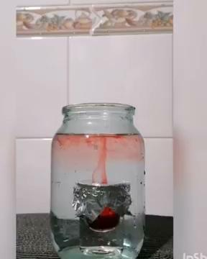

Slide 7
Procedure:
1. We placed the ice cubes in one of the jars and filled the bottle with cold water.
2. Filled the small glass with hot water and dye at its maximum capacity.
3. We covered the small glass with aluminum foil and fixed it with an elastic band.
4. We put the small glass inside the empty large bottle.
5. Removed the ice cubes from the other jar, and added the icy water, filling it up to 3/4.

Slide 8
Procedure:
6. We used the tip of the pencil to make a small hole in the aluminum.
7. We observed the contents of the jar for about 5 seconds.
8. We made a second hole in the aluminum.
9. We re-observed the contents of the bottle.
10. We continued to observe the contents of the vial every 5 minutes for approximately 30 minutes.

Slide 9
Observations
We observed the hot water rise and as it cooled down.
(We could observe this movement because we put dye in the water.)
Hot water and cold water never mixed.

Slide 10
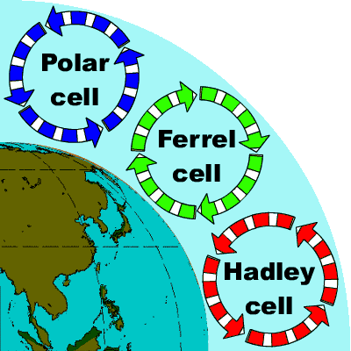
Conclusions
We can conclude that the less dense fluids (water or air) rise and the denser ones descend, not mixing, or mixing very slowly. So, a movement is created which we call the Convection Currents.

