Slide 1
Class 3^A Stringher
LILT race
9 april 2016
By Raffaele

Slide 2
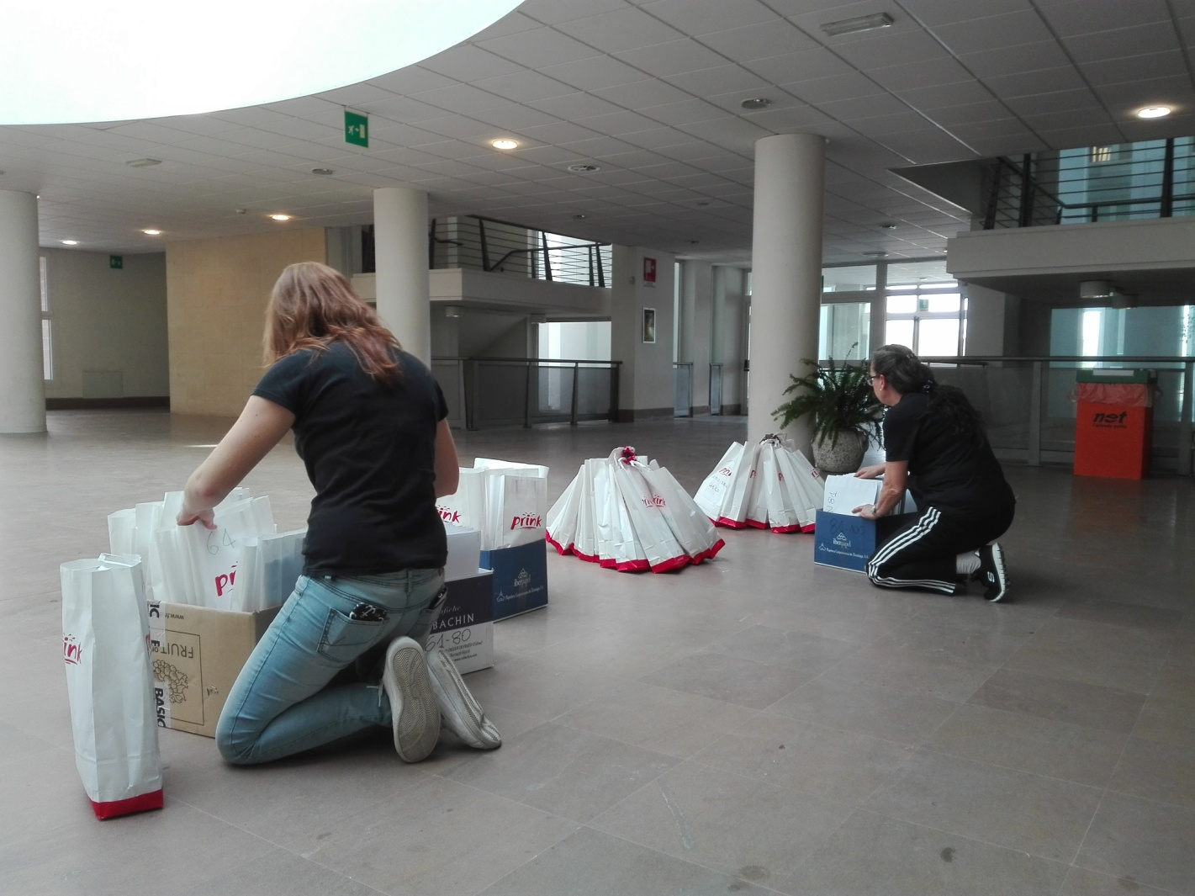
Preparing for the event at school

Slide 3
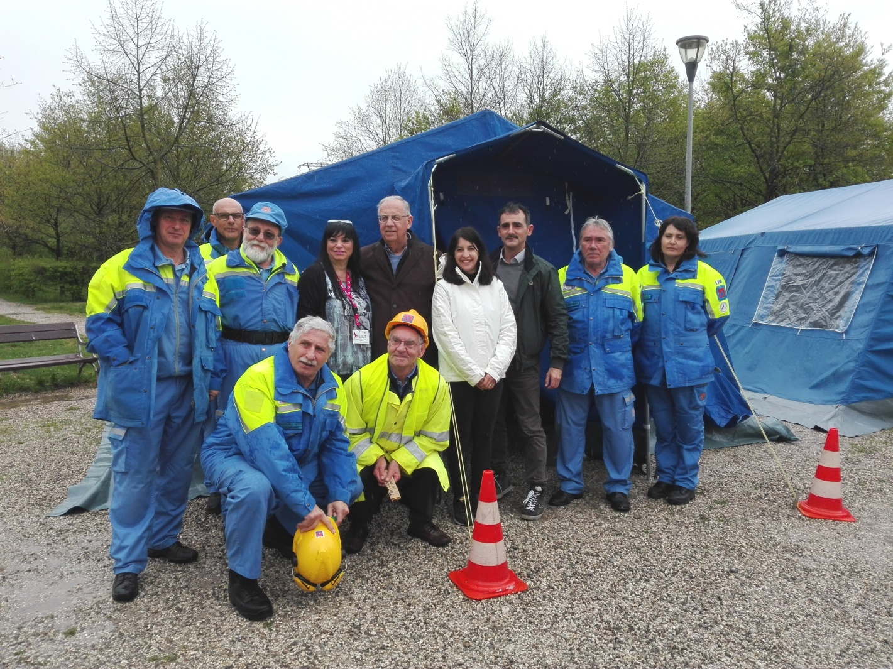
The Civil defense helped organizing the event

Slide 4
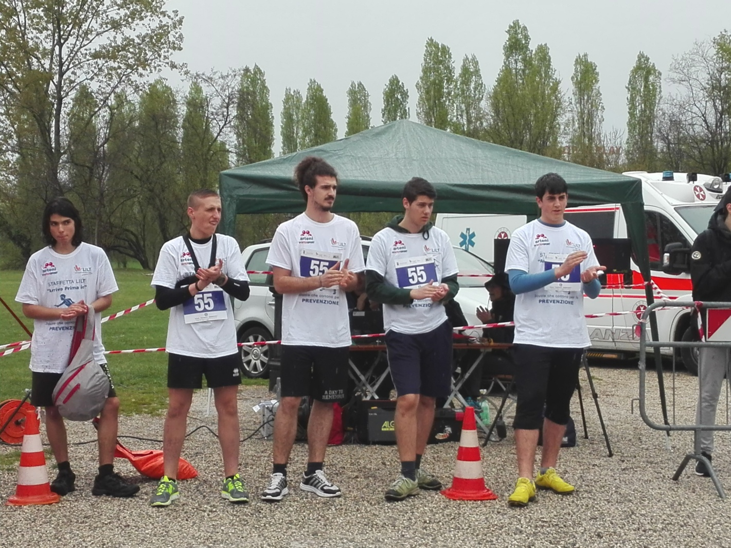
Before the departure

Slide 5
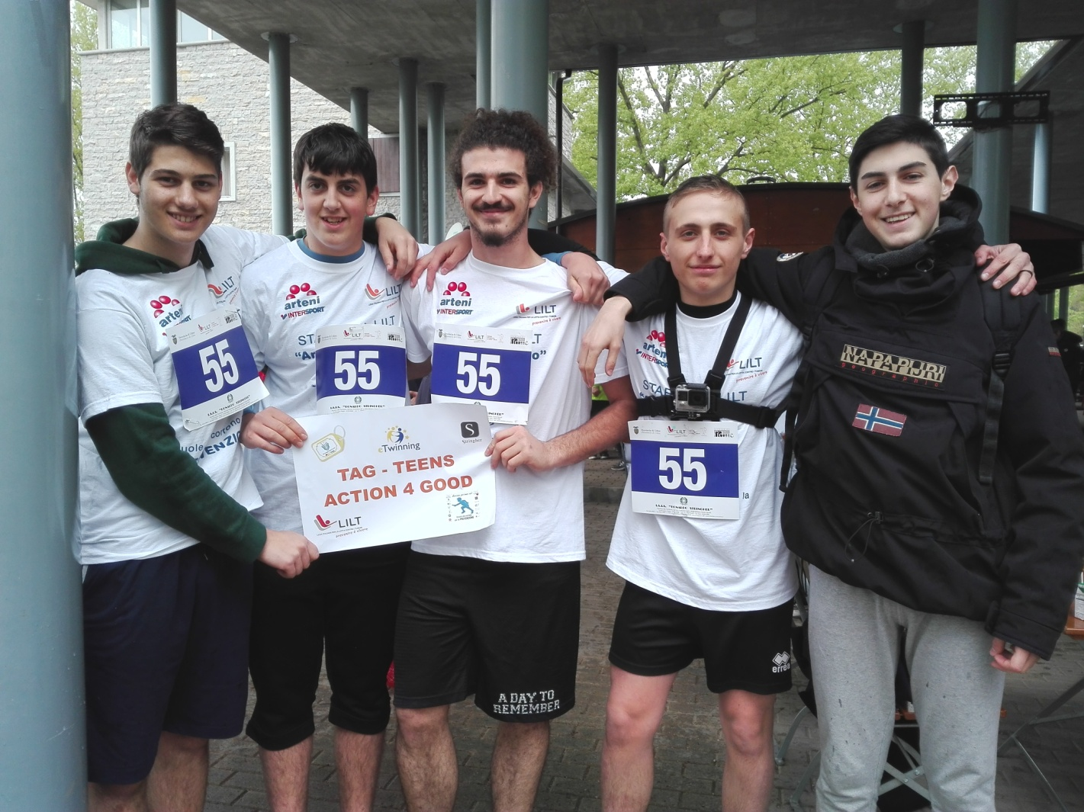
Our team!

Slide 6
The race! Watch the video!

Slide 7
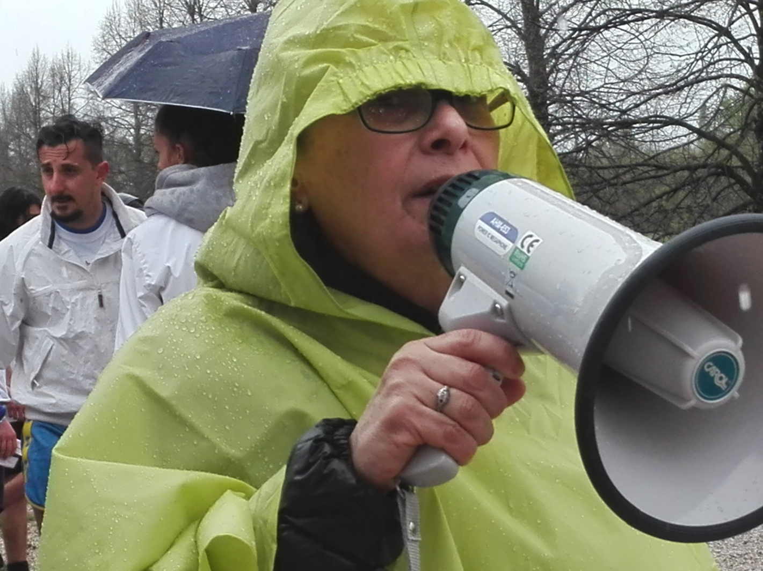
Our Teacher… the soul of LILT RACE

Slide 8
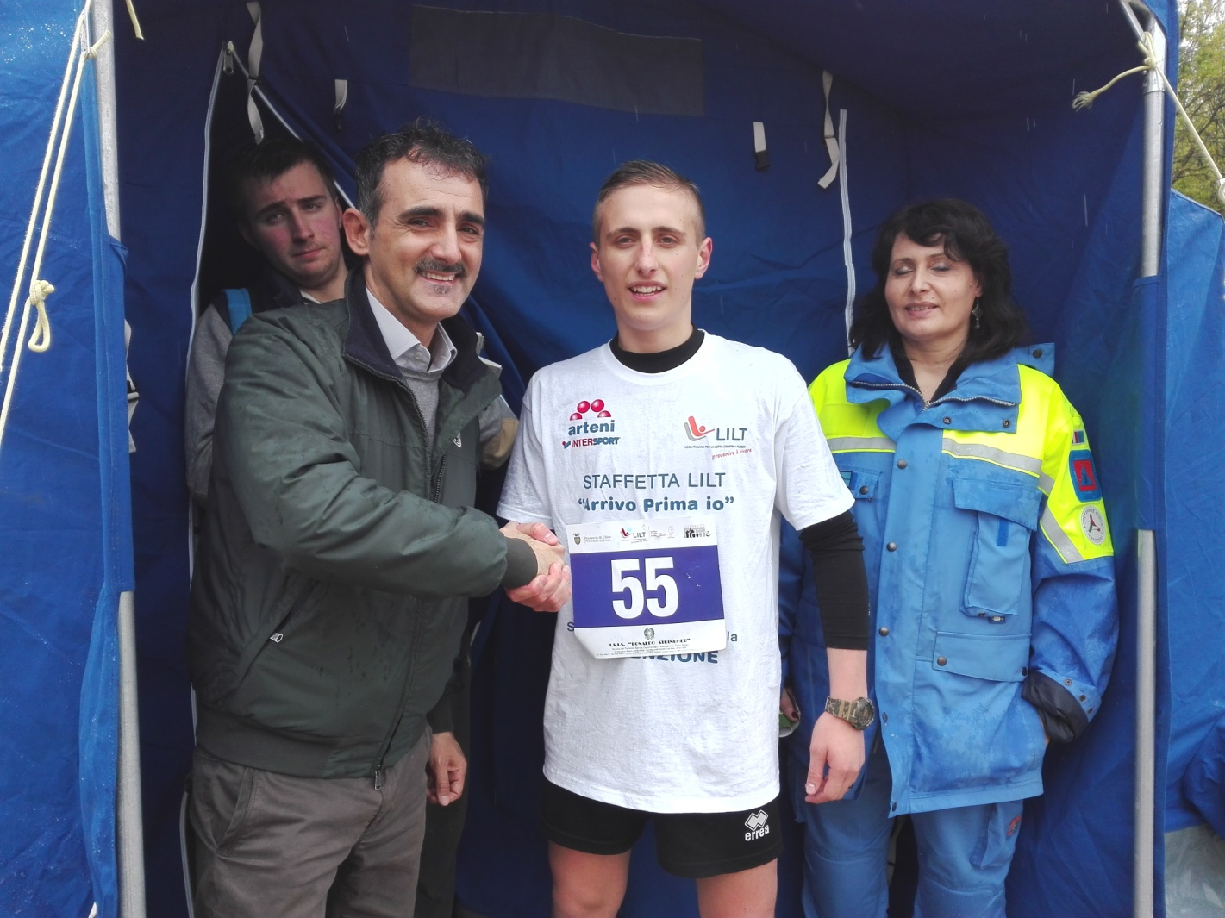
A representative of the city council congratulates us

