Slide 1
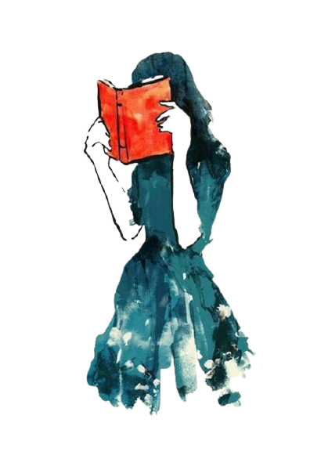
Deep reading

Slide 2
Obstacles
Strategies
Limited basic reading skills
(vocabulary, reading speed etc.)
Limited time and time management skills
Limited concentration
Limited amount of life experiences
Limited sense of meaning of the reading task
Few or no successes with deep reading

Slide 3
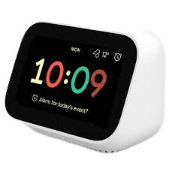
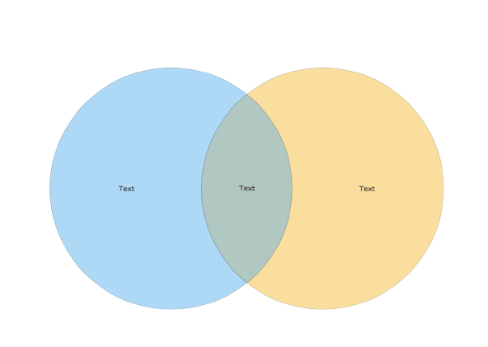
Limited basic reading skills
(vocabulary, reading speed etc.)
Strategies
Pre-reading
While-reading
Introduction to the text, brief abstract
Reading aloud + running commentary
Glossary provided by the teacher or made by the students
Graphic organizers (conflict, composition, character relations …)
Estimated reading time

Slide 4
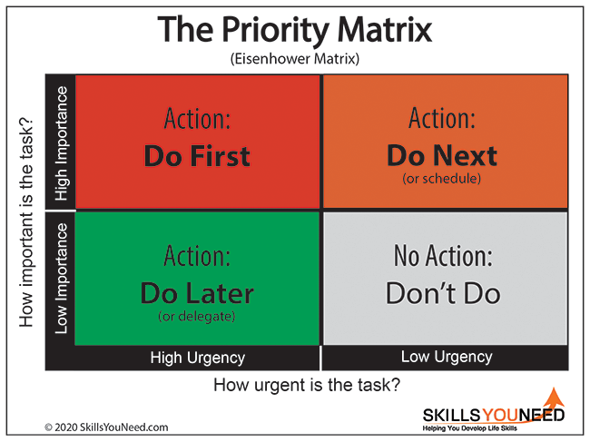
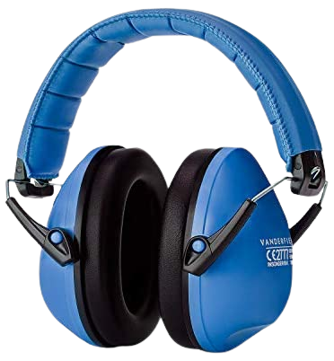
Limited time and time management skills + Limited ability to concentrate
Strategies
Pre-reading
While-reading
Introduction to time management
breaking down the task (eg. guiding questions)
”Reading session” (individually)
Reading aloud in class (common reading)
Management of distractions and disturbances
(virtual distractions, noise)
”Hoodie-reading”
noise cancelling headphones
”Aquarium talks”

Slide 5
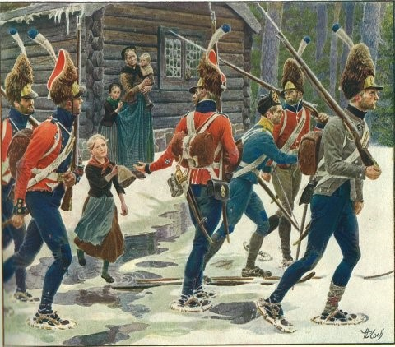
Limited amount of life experiences
Strategies
Pre-reading
While-reading
Calling on prior knowledge
Imagining worlds and persons
(the teacher’s suggestions create visual scenarios in the minds of the students )
Exploring paratext
Predicting

Slide 6
Limited sense of meaning of the reading task
Strategies
Pre-reading
While-reading
Elaboration of purpose
Phrasing ”I wonder”-questions
”Happy ambassadors” (senior students)
Visits by authors
Work sheets
(in taxonomical order)
Writing literature. Author workshops
Reading and discussing book reviews

Slide 7
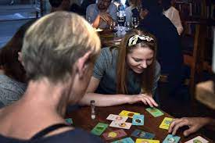
Few or no successes with deep reading
Strategies
Pre-reading
While-reading
Explaning ‘soft’ succes criteria
Reading games (”Literary cards”)
Comparing to deep movie experiences
”Casting”
”The hot chair”
Positive feedback on students’ efforts
Post-reading
Re-reading

Slide 8
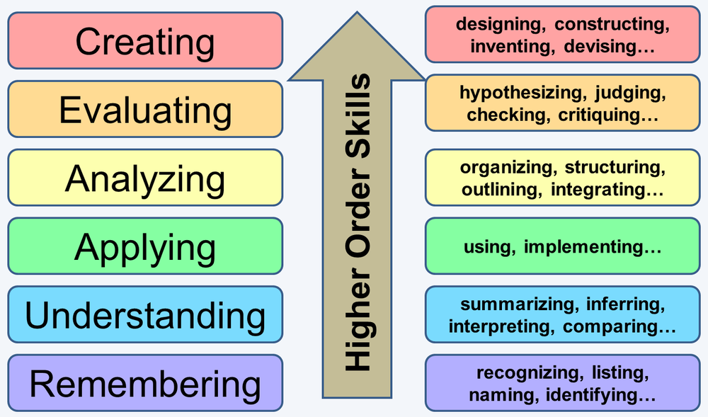
Bloom’s taxonomy

Slide 9
”Life long appreciation of literature”
Creating several
good reading experiences
Strategies for reducing
obstacles
”What is in it for me?”

Slide 10
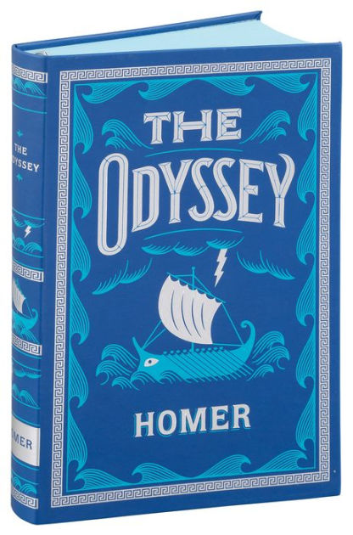
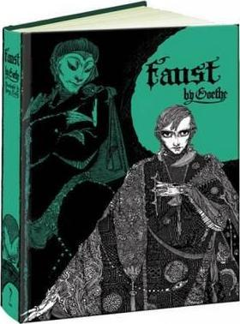
Literature circles in Eng A
A novel by Bernhard Schlink
Der Vorleser; translated work originally written in German

Slide 11
From toolbox to literature circle

Slide 12
Close reading and reflecting on literature

Slide 13
Final class(es): Reading circle

