Slide 1
BULGARIAN PUPPETRY WORKSHOP
DEVETO OSNOVNO UCHILISHTE “ PEYO YAVOROV”
BLAGOEVGRAD, BULGARIA
PROJECT 2018-1-BG01-KA229-048025

Slide 2
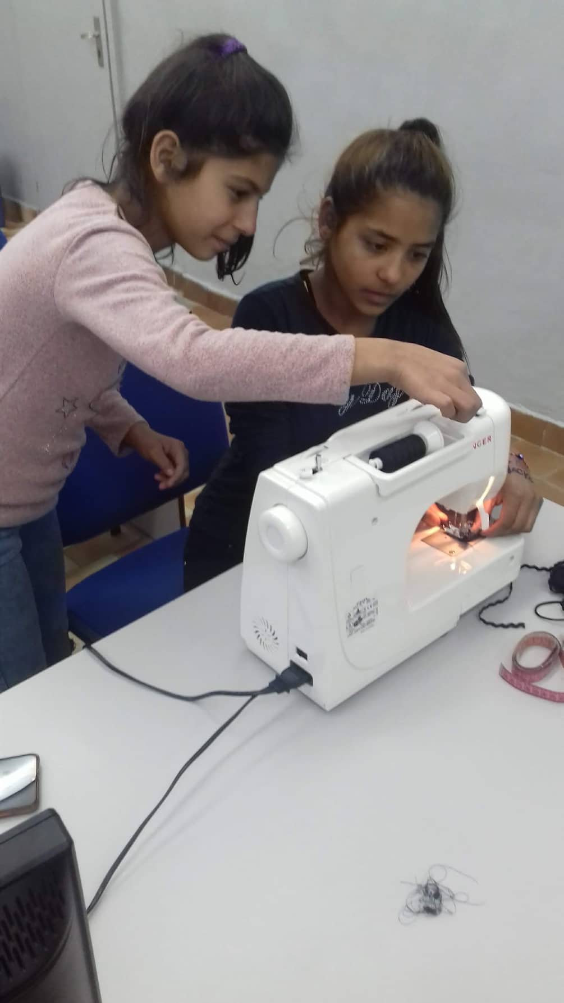
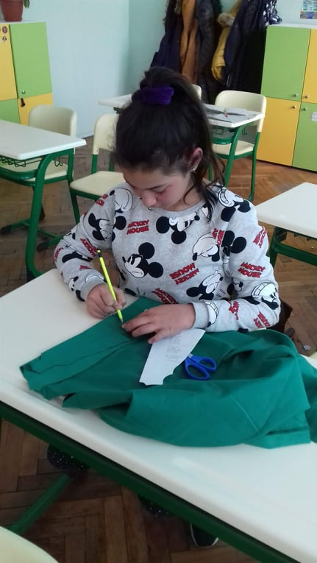
6TH AND 7TH GRADE PUPILS

Slide 3
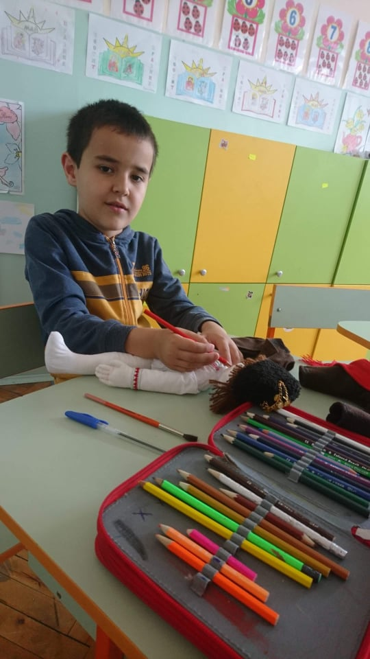
1ST GRADE PUPILS

Slide 4
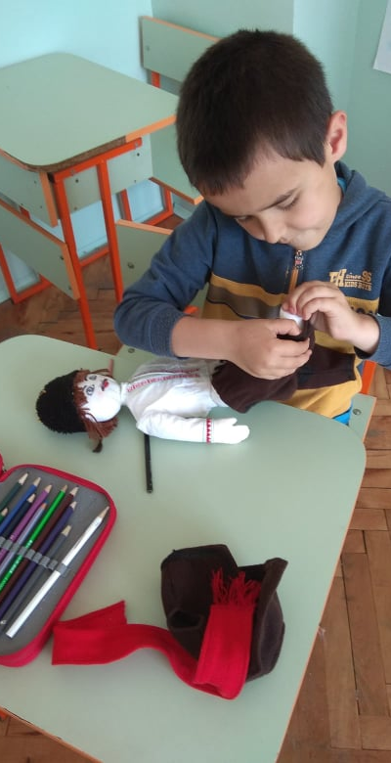
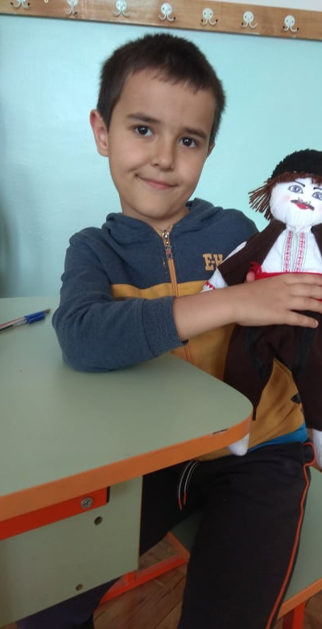

Slide 5
