Slide 1
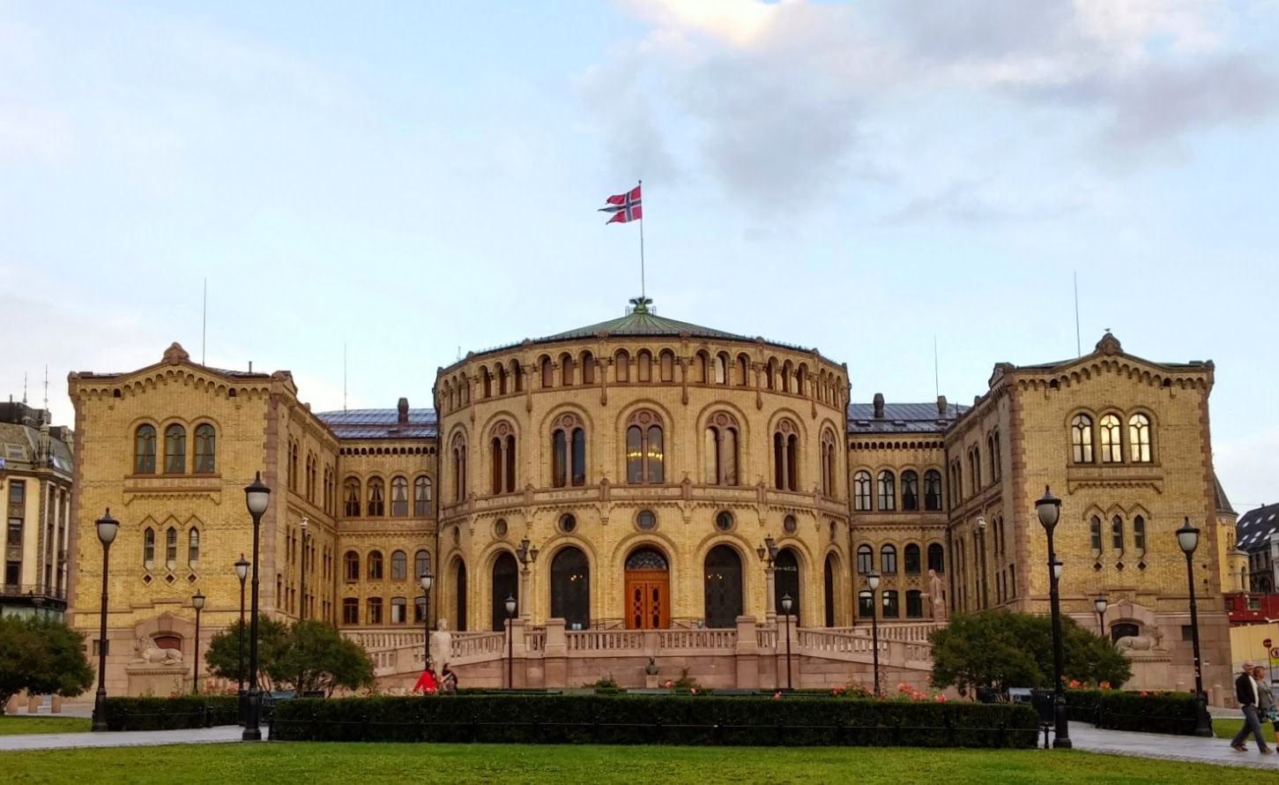
The Political Systems in Austria and Norway

Slide 2
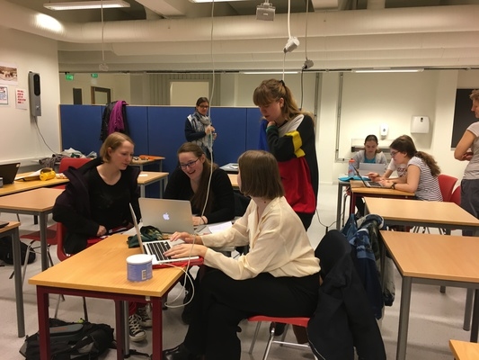
What we did
Explain the elective systems in Austria and Norway
Explain and compare the most popular parties in Austria and Norway
Survey
5 questions
28 people (in each country)
Age 15-50 (Austria) 15-20 (Norway)

Slide 3
Survey in Austria and Norway

Slide 4
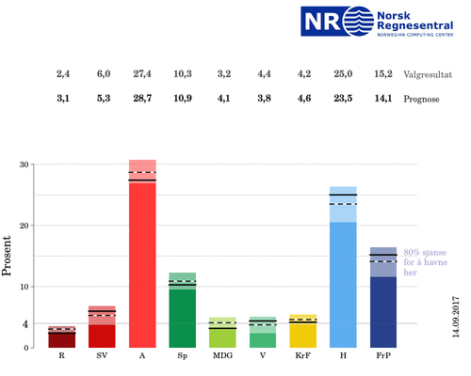
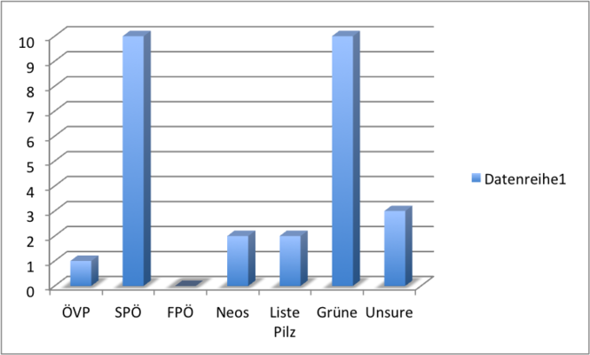
What would you vote?

Slide 5
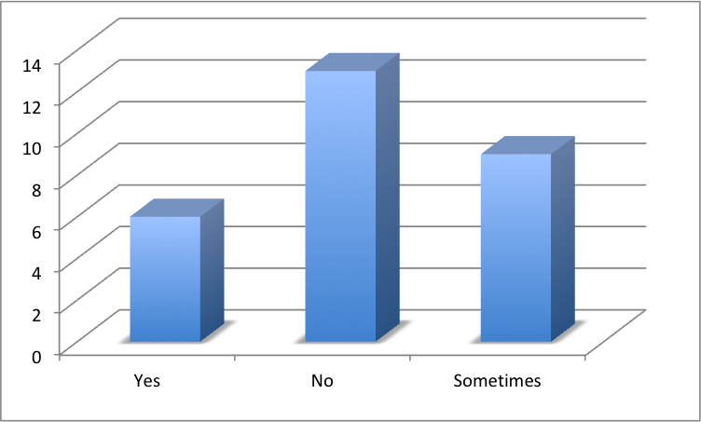
Do you check out news that concern politics?

Slide 6
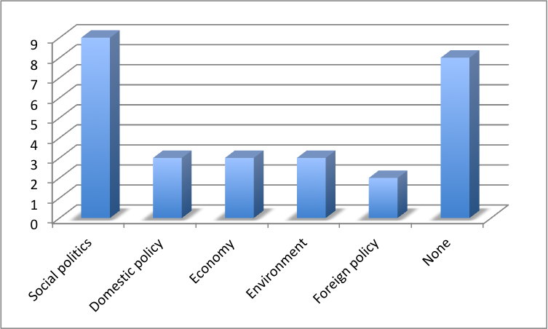
What political themes are you interrested in?

Slide 7
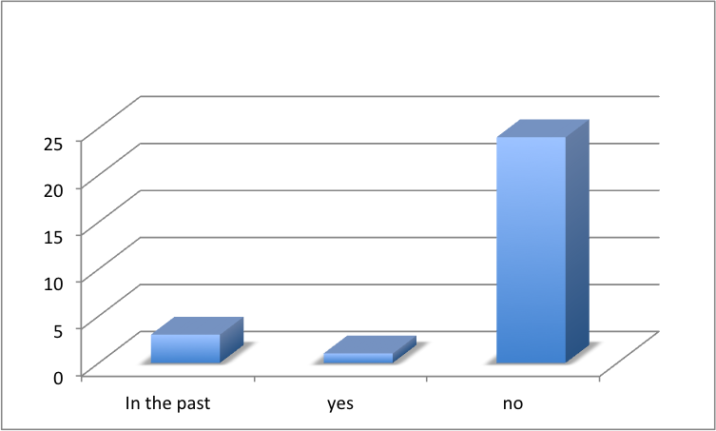
Are you part of a political organization?

Slide 8
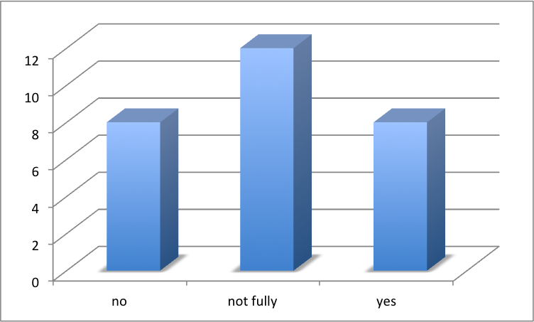
Are you happy with the political management of your country?

Slide 9
Thank you for your attention!

