Slide 1
Think Twice
eTwinning project 2019-2020
Country Presentation

Slide 2
Index
History -Zühtü Günaştı Anatolian High Shool
Geography –Zühtü Günaştı Anatolian High Shool
Popular Cities –Bingöl Karşıyaka Anatolian High School
Folk Dances – Bingöl Karşıyaka Anatolian High School
Famous Person – Bingöl Karşıyaka Anatolian High School
Art -Zühtü Günaştı Anatolian High Shool
Foods – Bingöl Karşıyaka Anatolian High School

Slide 3
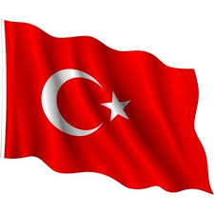
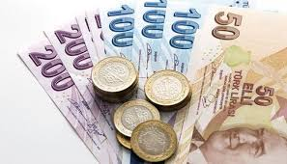
Official language is Turkish.
Currency is Turkish Lira.
Largest city is İstanbul.
Capital city is Ankara.

Slide 4
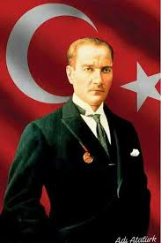
HISTORY
A Genious…
A Liberator…
A Founder…
A Man of Enlightment...
Mustafa Kemal Atatürk is the father of all Turks and founder of Turkish Republic and modern Turkey. He is the first leader who made a law for women right to be elected and voter in the parliament in 1934.

Slide 5
Historical Background and Culture
History in the land that is now Turkey dates back to 7500BC.
574 BC Cyrus of Persia conquers of Anatolia
127 BC Anatolia becomes the Roman provinces of Asia or Asia minor.
330 AD Constantine, the ruler of Byzantine Empire, founds New Rome to become Constantinople and İstanbul,
1243 Mongol Invasion
1288 The Ottoman Empire is founded
1453 Constantinople is conquered and becomes Istanbul

Slide 6
1520-1566 Golden Age of The Ottoman Empire.
1699 decline of The Ottoman Empire begins.
1914 Turkey allies with Germany during WW1 but stays neutral in WW11
Late 1910s/ early 1920s The Ottoman Empire falls.
1923 what is left of the Ottoman Empires becomes the Turkish Republic, great reform start taking places.
1940s democratic elections introduced.
1952 Turkey joined the North Atlantic Treaty Organization.

Slide 7
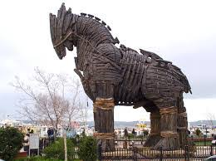
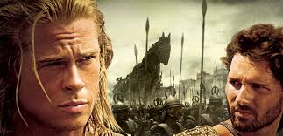
Çanakkale became witness two important battles in the history
One of them is mythological war of Troy

Slide 8
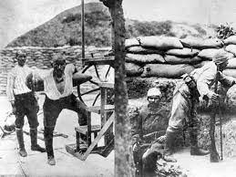
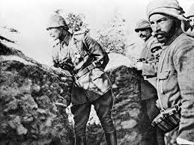
The other one of is the Battle of Çanakkale which takes places during World War 1 when Turkish Troops under the command of Mustafa Kemal Atatürk. Çanakkale has taken its place in the history. ‘Çanakkale; unpassable’

Slide 9
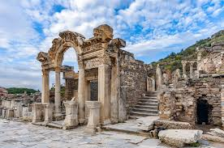
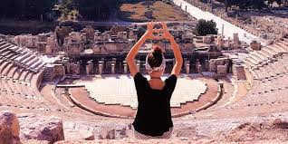
Library of Celsus, Selçuk built in 135AD

Slide 10
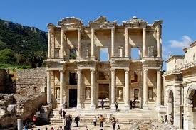
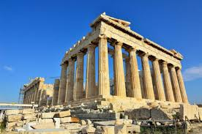
Artemis Temple is one of the seven wonders of the World in the town of Selçuk in İzmir.

Slide 11
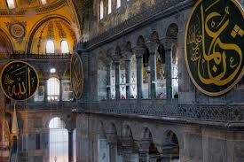
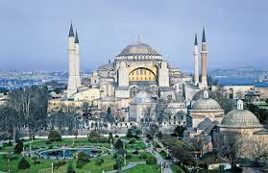
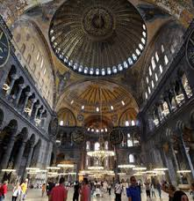
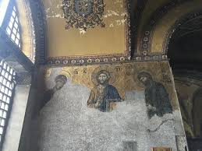
HAGIA SOPHIA

Slide 12
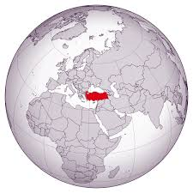
Geography
My country bridges two continents, which for over ten thousands years has been the home of the great cultures and the civilization of the world.

Slide 13
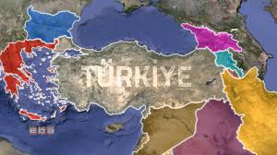
Bulgaria to the northwest
Greece to the west
Georgia to the northeast
Armenia, Azerbaijan and Iran to the east
Iraq, Syria to the southeast

Slide 14
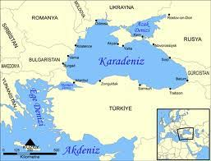
The Mediterranean Sea to the south
The Aegean Sea to the west
The Black Sea to the north

Slide 15
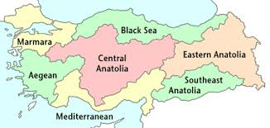
Geographical Regions
Turkey is divided into seven regions.

Slide 16
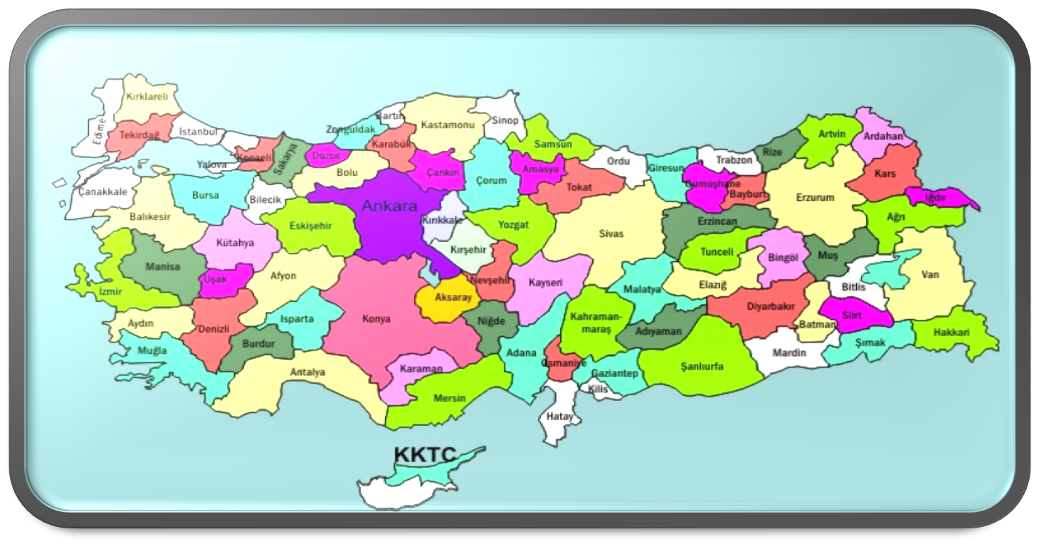
There are 81 cities in Turkey. Our school is in Mersin.

Slide 17
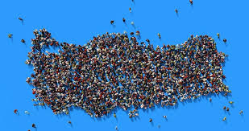
POPULATION
Our population is over 82 million.
Turkey has got mixed population
Turkish,Kurdish,Armanian,Bosnian,
Makedonian,Arabian and others
Last days, 3 million Syrians emigrated to Turkey

Slide 18
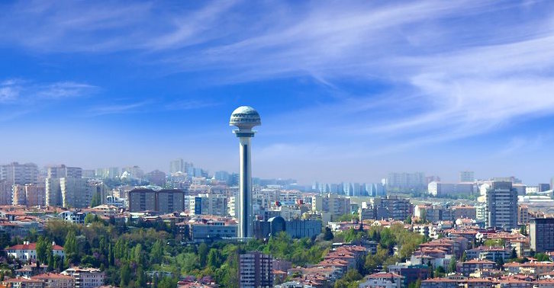
Popular Cities
ANKARA
Ankara is the capital city of Turkey.

Slide 19
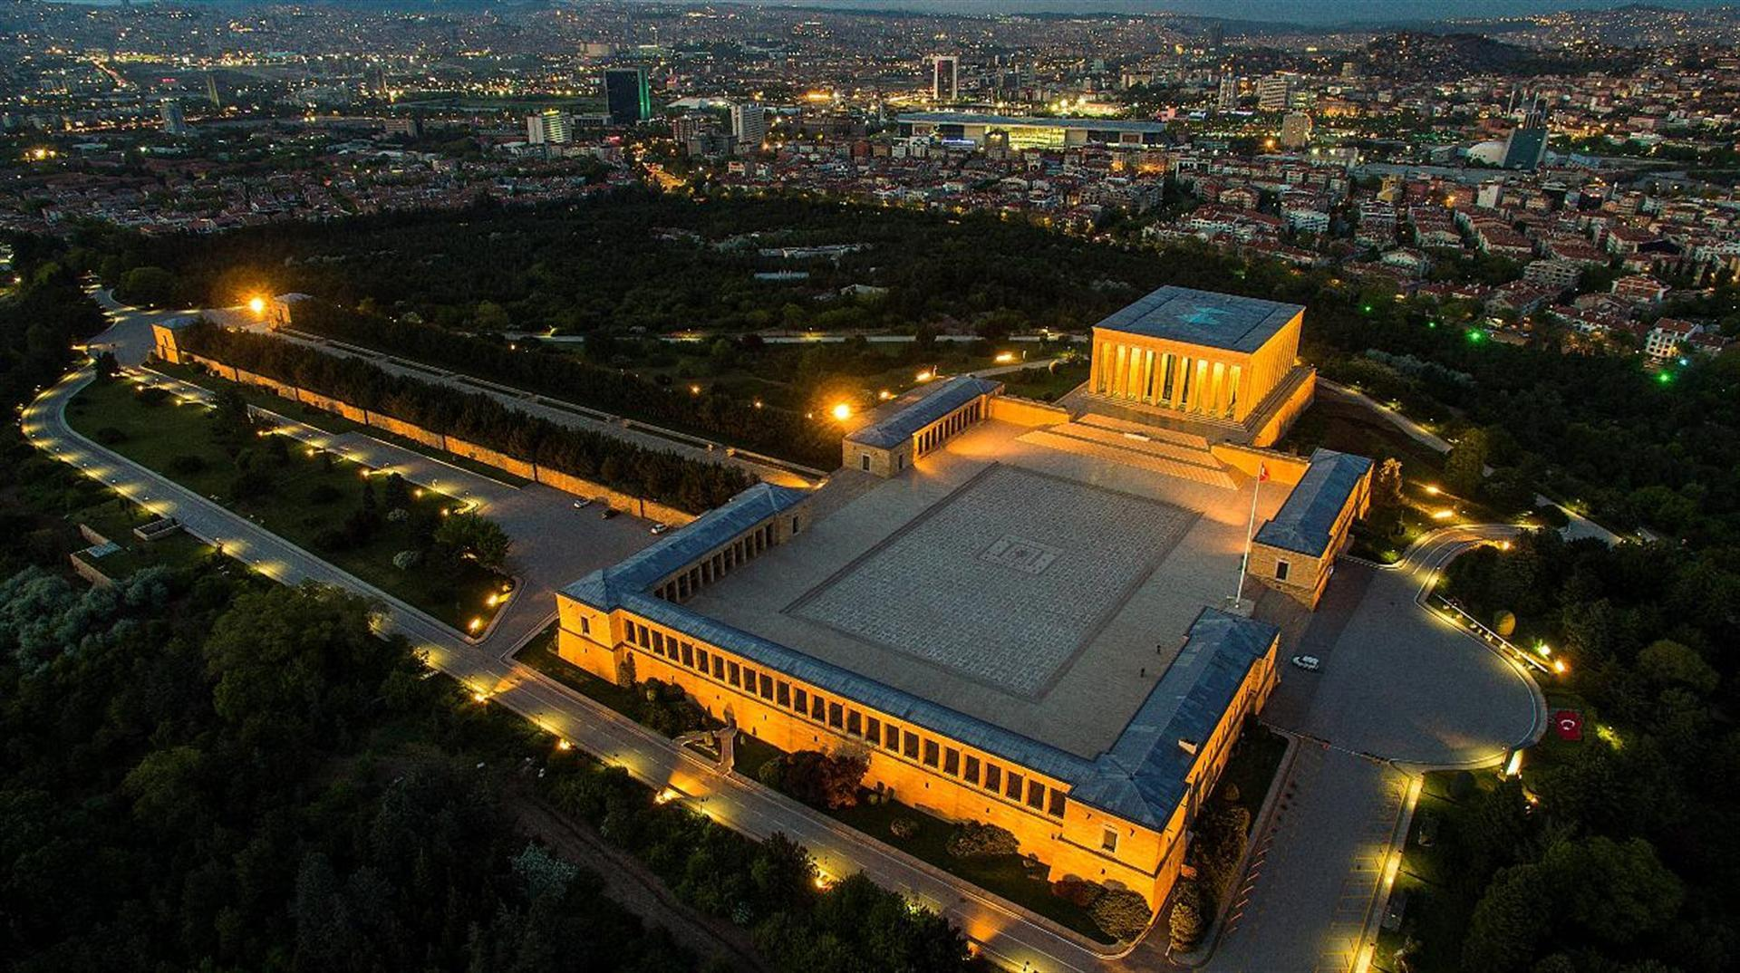
The greatest leader of Turkey Mustafa Kemal Atatürk’s tom “Anıtkabir” find in this city.

Slide 20
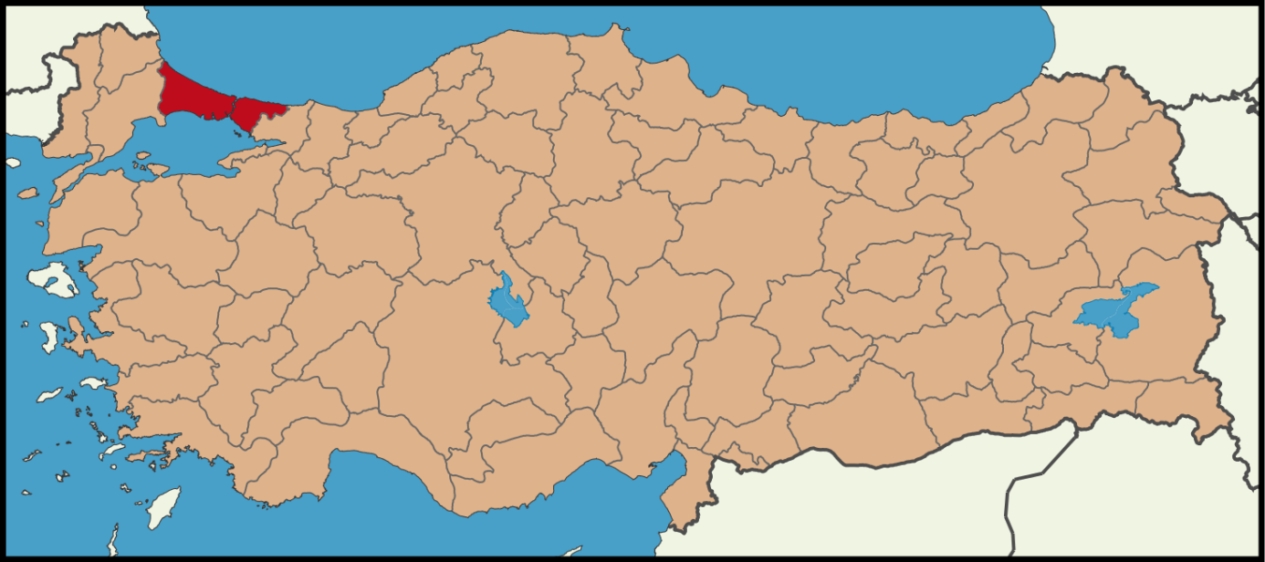
ISTANBUL
Istanbul is the only city in the world built on two continents Asia and other is Europe . For more than 1500 years Istanbul was capital of Roman, Byzanti­nee and Ottoman Empires. The museums, churches, palaces, grand mosques, bazaars and sites of natural beauty are countless in Istanbul.

Slide 21
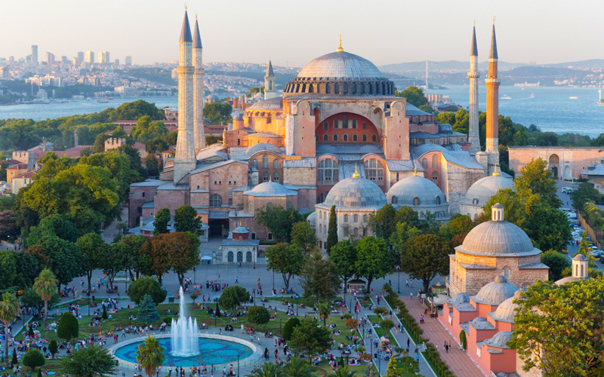
The most glorious architectural heritage is the Hagia Sophia which is referred to as the 8th Wonder of the World.

Slide 22
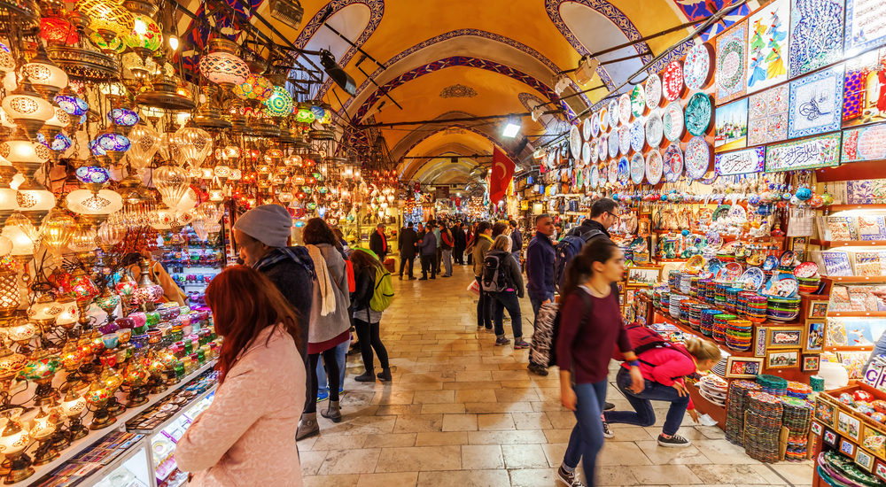
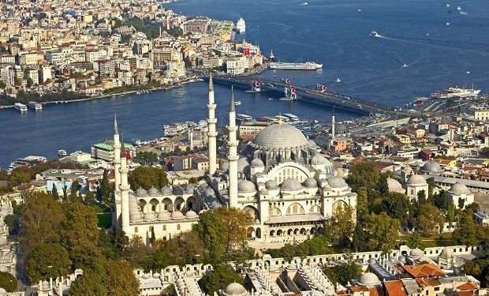
The Topkapı Palace is another important architectural heritage
Kapalı Çarşı (Grand Bazaar) is the most popular shopping center for the visitors
Sülaymaniye Mosque, a masterpiece of Sinan the Great Architect

Slide 23
NEVŞEHİR
Cappadocia (Nevşehir) is an open air museum full of unequal natural and cultural components

Slide 24
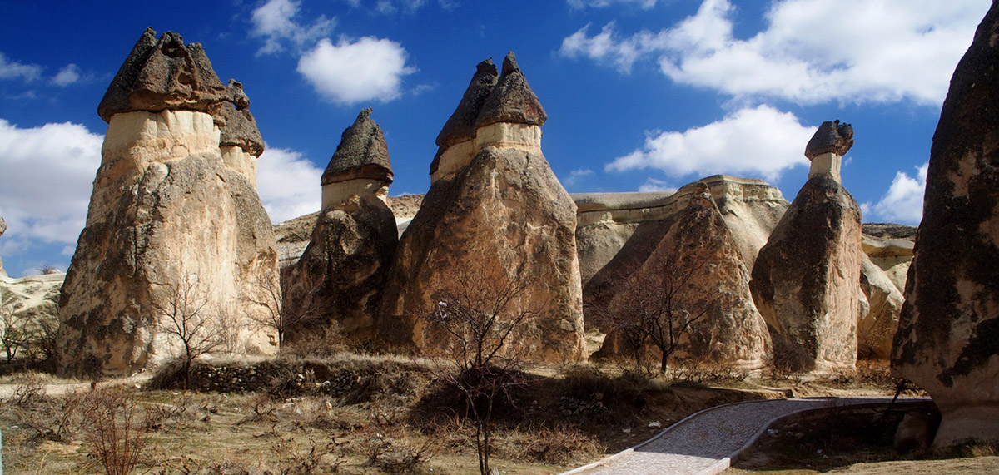
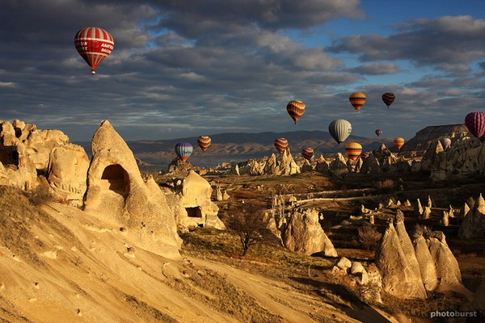
It is popu­lar with unique rock formation that they are known “fairy chimneys” in my country.
You can do hot air balooning activity.

Slide 25
ANTALYA
Antalya is a holiday paradise and today it is one of the world’s best loved tourist resorts

Slide 26
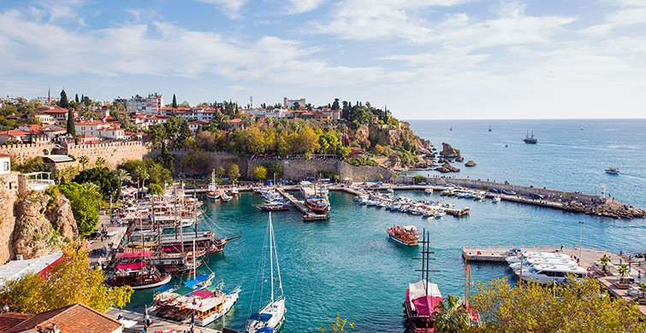
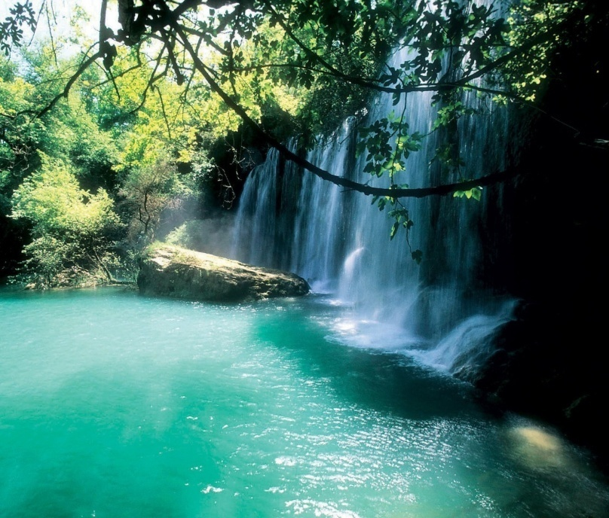
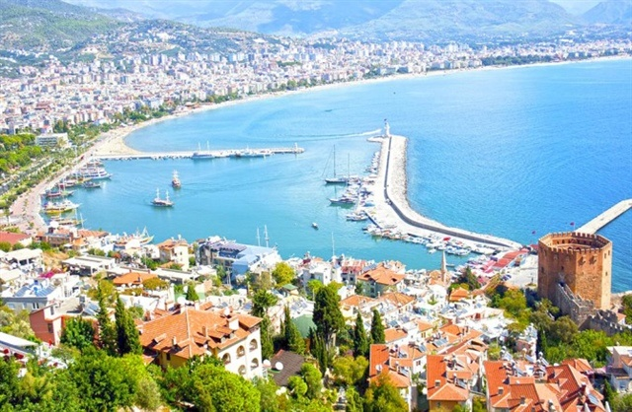

Slide 27
TURKISH FOLK DANCES
Turkey has a very ancient folk dance tradition, which varies from region to region, each dance being colourful, rhythmic, elegant and stylish. Some of the most famous dances; Bar, Halay, Zeybek, Horon, Kasik Oyunu. Turkey has a rich tradition of folk dancing with dances performed at all social occasions, from weddings and celebrations held for young men leaving for military service, to national and religious festivals, or local festivities.

Slide 28
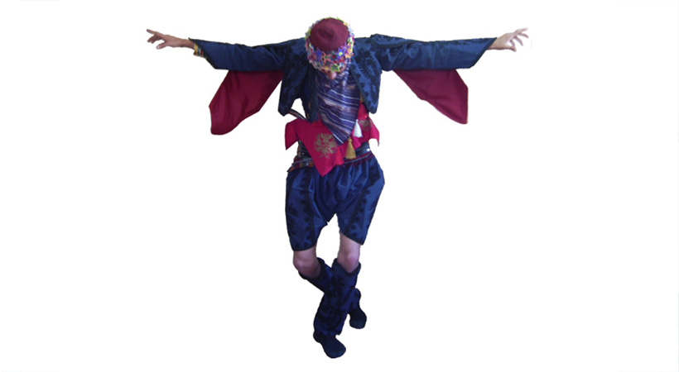
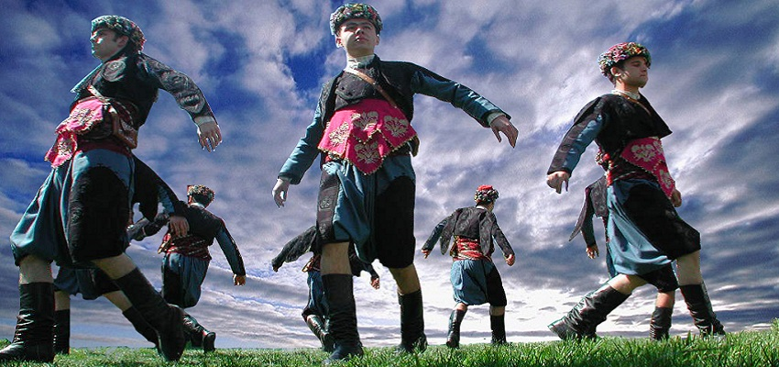
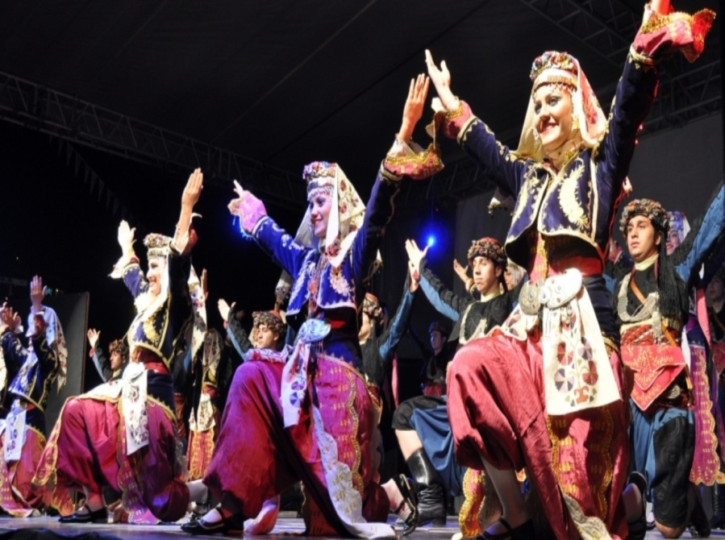
ZEYBEK
In this Aegean dance, colorfully dressed male dancers, called Efe, symbolize courage and heroism. Zeybek dance is formed, in general, of 9/8 measures and has a variety of tempos such as very slow, slow, fast and very fast. It is rendered by one person or two or by a group of people

Slide 29
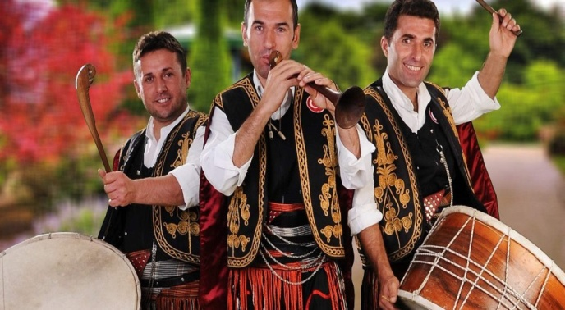
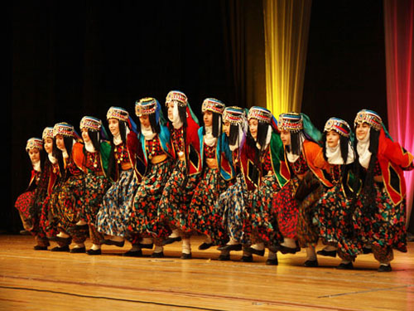
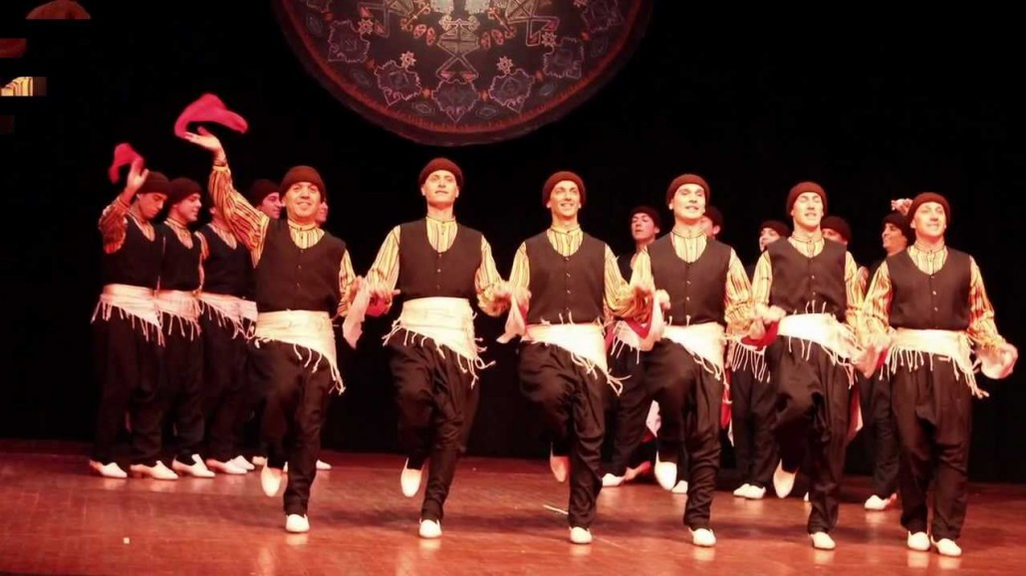
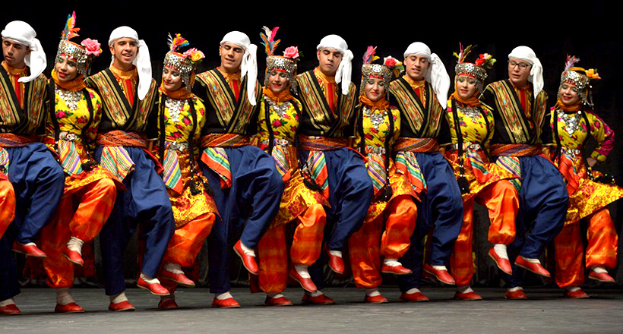
HALAY
Halay is a part of Turkish dance and is performed to a large extent in the Eastern, Southeastern and Central Anatolia and it is one of the most striking dance. It has a rich figure structure of simplicity is the symbol of creation and originality of the folk. You may experience all the measures and rhythmic elements of the Turkish folk music in the halay melodies.

Slide 30
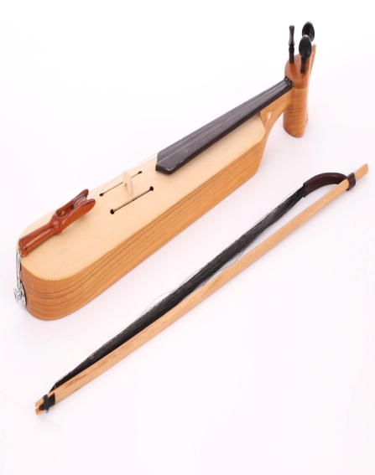
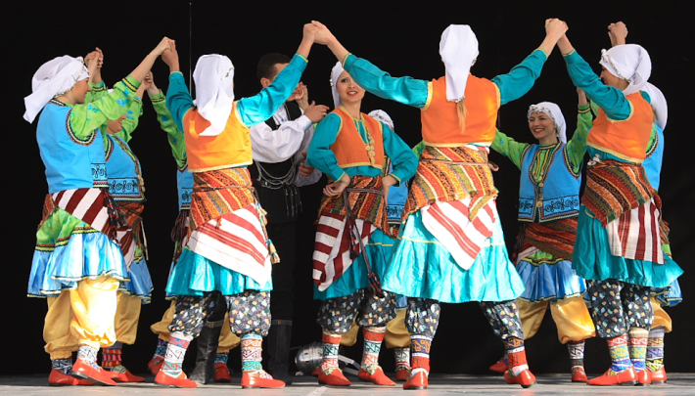
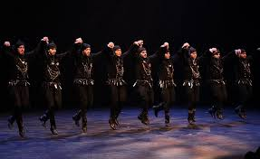
HORON
Horon appears very different from the folk dances in other parts of Turkey with its formation of tempo, rhythm and measure. This typical Black Sea dance is performed, in general, by groups and their characteristic measure is 7/16, dressed in black with silver trimmings. The dancers link arms and quiver to the vibrations of the kemence, a primitive type of violin

Slide 31
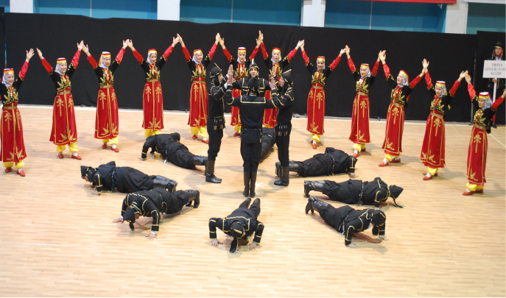
BAR
Bar is a form of folk dance from eastern Turkey. The dance is performed by groups in the open. Turkish folk music are applied with extremely different and interesting structures in this dance.

Slide 32
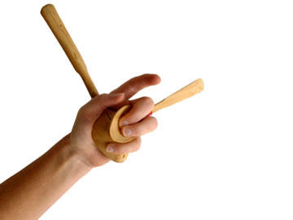
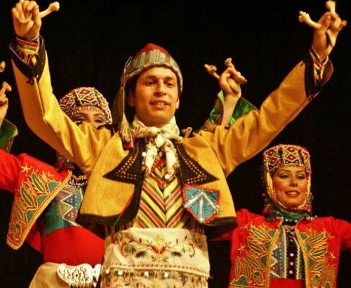
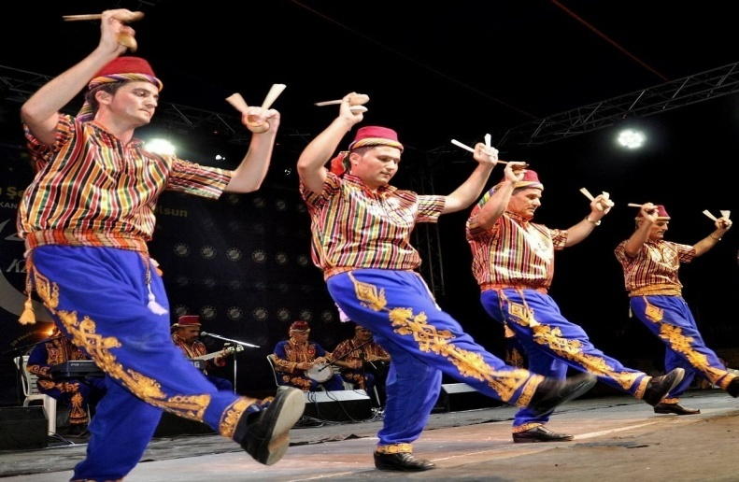
KASIK OYUNU
Kasik Oyunu is performed from Konya to Silifke and consists of gaily dressed male and female dancers clicking out the dance rhythm with a pair of wooden spoons in each hand.

Slide 33
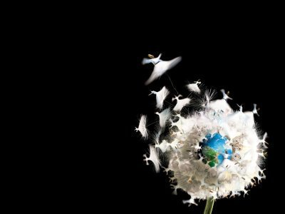
FAMOUS PEOPLE
MEVLANA CELALEDDIN RUMI (1207-1273)

Slide 34
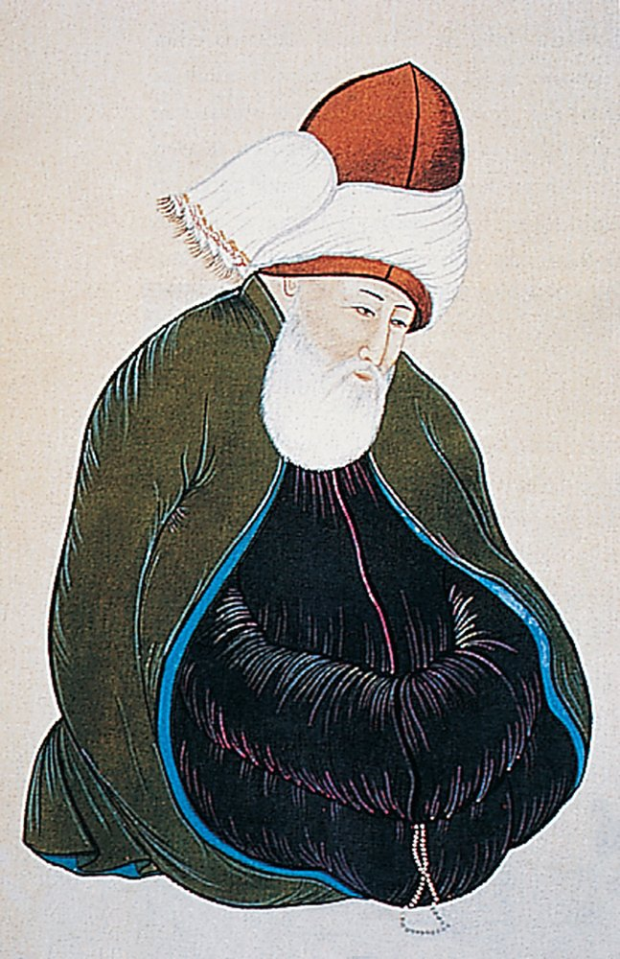
Mevlana Celaleddin Rumi was an Anatolian holy man who gave hope and inspiration to humanity. He is a 13th century Muslim saint and Anatolian mystic known throughout the world for his exquisite poems and words of wisdom, which have been translated into many languages.
He was born in 1207 in the city of Balkh, Horasan, present day in Afghanistan (or in the village of Wakhsh, present day in Tajikistan) and died in 1273 in Konya (Turkey). Rumi, as he is known in the west, is the best selling poet in USA. While he was studying Sufism he met Ahi Sems Tebrizi, and after this meeting his own ideas began to emerge. It is his poems about Sufism, however, for which he is chiefly remembered, respected and admired today.

Slide 35
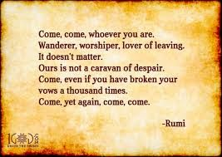
According to Mevlana, love is the only thing necessary to attain God. A plant or an animal may also love, but it is only man who has the capacity to love with his body, mind, thoughts and memory.
The most beautiful love, “Love of Truth,” begins when someone reaches this level of wisdom.
As we see, all mankind are brothers, and differences between religions do not square well with the divine presence.

Slide 36
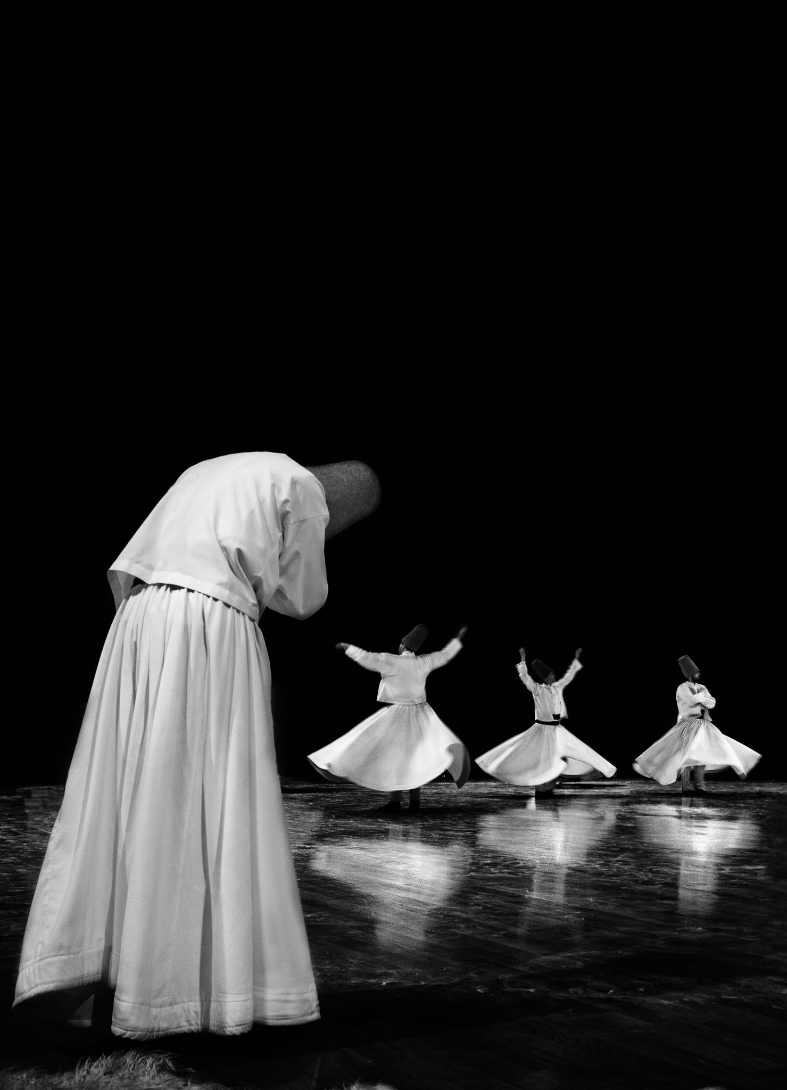

Followers of Mevlana (Mevlevi) spin around and around in a ritual called “sema.” This ritual symbolizes a world united in love and keeping step with the world’s universal rotation. The person do sema is called ‘semazen’. While one of their hands points to the sky, the other hand points to the ground meaning “Love from God spreads to the earth”. The spirit bursts forth from God and is immortal.

Slide 37


Nay is the chief instrument that used during the sema. The sound of the nay (a reed flute) tells of man’s longing to return to his initial source.
UNESCO Mevlana Year
The UNESCO (United Nations Educational, Scientific and Cultural Organization) marked 2007 as the "Mevlana Year" to celebrate 800th anniversary of the birth of Mevlana Celaleddin-i Belhi-Rumi. This decision was made because Rumi advocated tolerance, reason and access to knowledge through love. His mystical relationship with Islam produced masterpieces that have marked Islamic culture and religious beliefs beyond the borders of Turkey. His work and thought remain universally relevant today in our world.

Slide 38


Slide 39
ARTS
Ebru
Ebru is the art of painting on thickened water with tragacanth. Traditional Turkish Arts. The word br ebru köken is shown in Persian as the word br ebr gelen which means cloud. Although it is not known when and in which country Ebru art emerged, it is thought that this art is a decorative art unique to the eastern countries. Some Iranian sources say that it appeared in India.

Slide 40





Slide 41




Slide 42




FOODS
Baklava is not the most poopular desert in Turkey but also popular in the World. Also we have another popular sweets; sütlaç. kadayıf and the Turkish Delight. My country has a wide variety of cusine; mantı Turkish kebab, dolma , İçli köfte lahmacun pide döner iskender...
BAKLAVA
SÜTLAÇ
KADAYIF
TURKISH LOKUM

Slide 43








MANTI
KEBAP
DOLMA
İÇLİ KÖFTE
LAHMACUN
PİDE
DÖNER
İSKENDER

